Slide 1

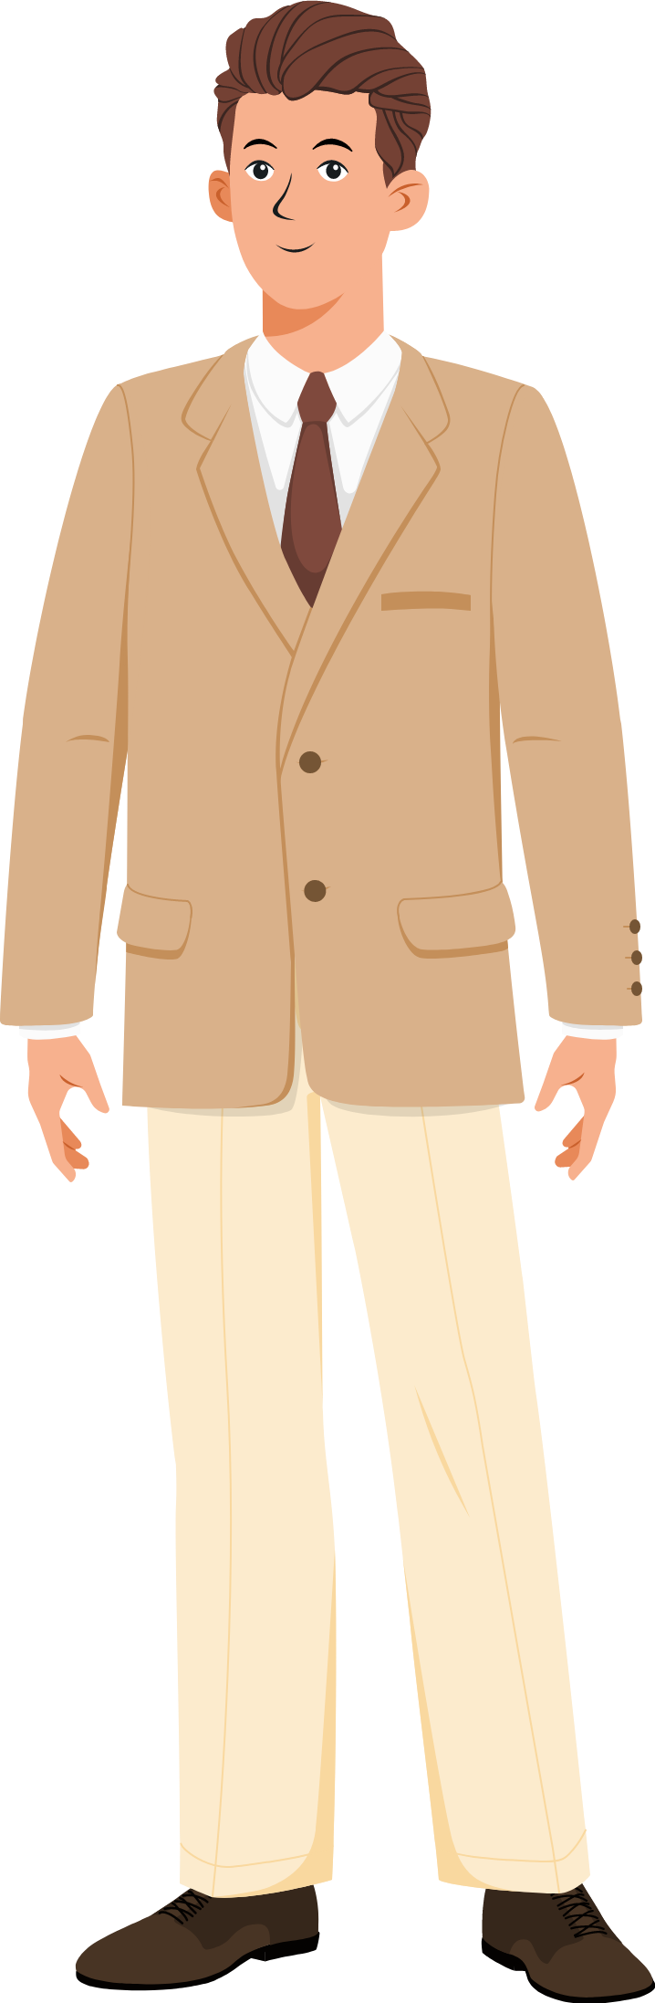
Conclusion

Slide 2
Start Game

Slide 3

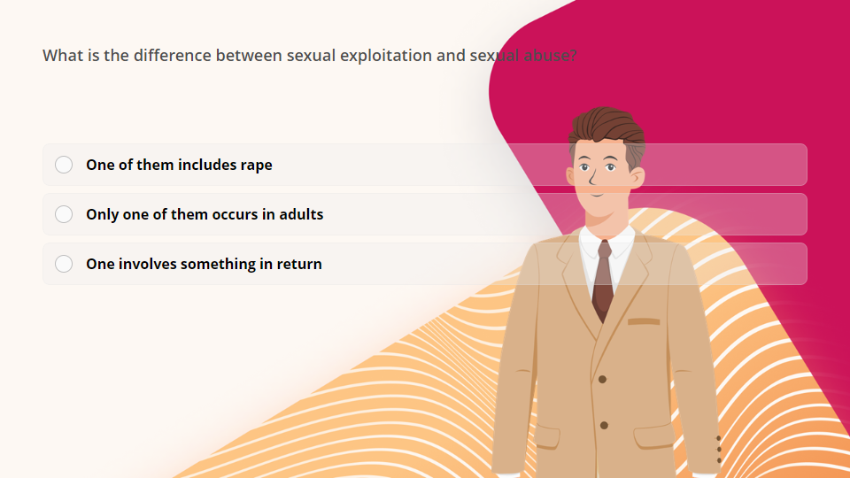
Quiz
Click the Quiz button to edit this object

Slide 4
Next Lesson

