Slide 1

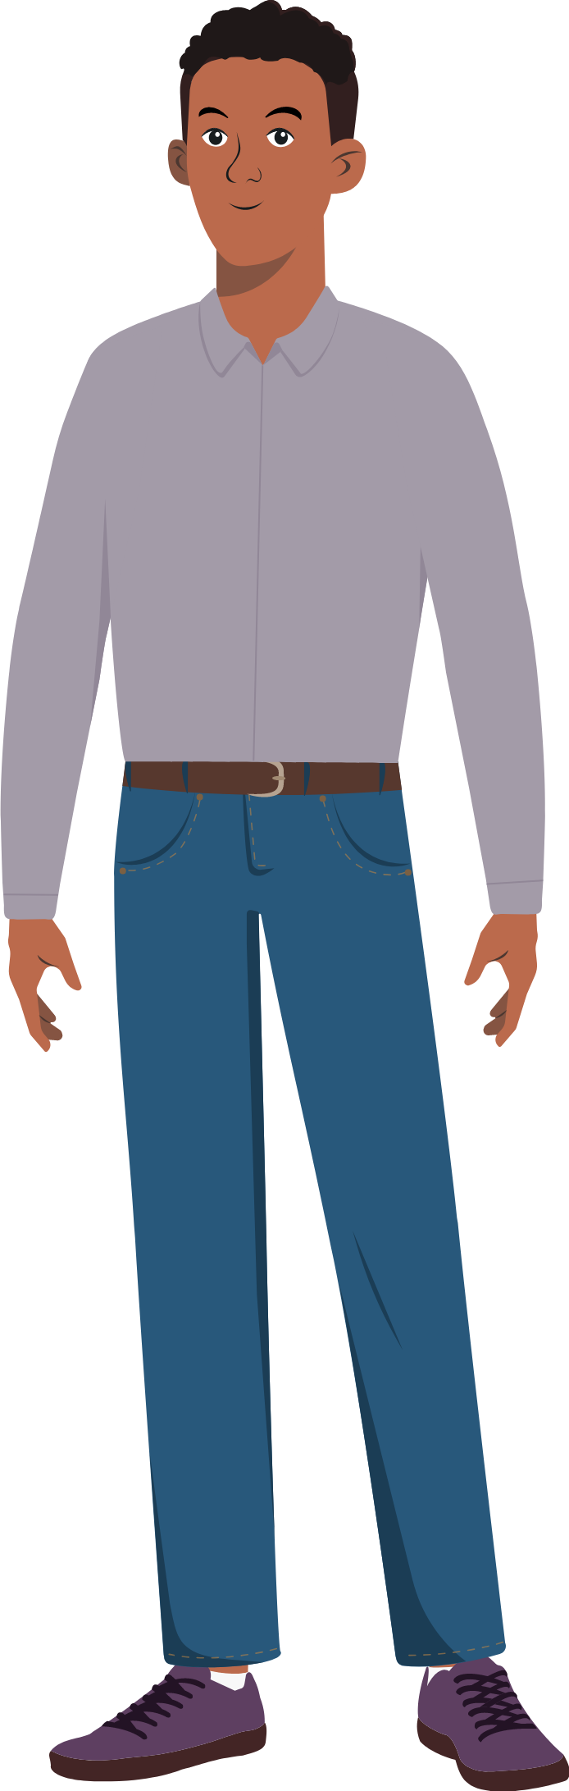
Hi! I’m Antoine. I’m here to help you get started.
Welcome to PSEA Course!

Slide 2
Since many now believe that they know PSEA, we start by a game where they show them that definitions are not as obvious as they think they are.

Slide 3
The terms we will be using in this session are very common and have been used interchangeably for years. However, in the policies, they are different. Thus, let’s see if you know them.

Slide 4
Sexual Harassment
Sexual Exploitation
Sexual Abuse
Sexual Gender Based Violence
Play

Slide 5

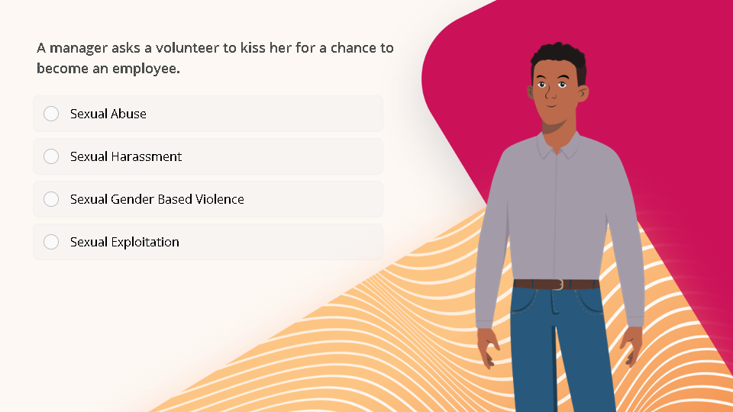
Quiz
Click the Quiz button to edit this object

Slide 6
Next Lesson

