Slide 1


Dealing with Disclosure
The dos and don’ts of dealing with disclosure

Slide 2

Here are some major information you should know if someone approached you to complaint about a misconduct:
Treat the survivor, or complainant, if different, with dignity and respect
Make him/her as comfortable as possible; always believe the survivor
If the survivor has not given consent to report the incident, inform him/her that there is nevertheless the obligation to report because the incident involves an aid worker.

Slide 3
How to collect the information:
Start by listening to the complainant
What you need are answers on: What, Where, When, and Who.
Do not ask why, this puts blame on the victim.
Do not investigate to see if the complaint is correct.

Slide 4
If the complainant is a child:
Talk with the child in the company of a trusted adult
Be comforting and supportive
Reassure the child that it is not their fault;
Do no harm: be careful not to traumatize the child further
Help them feel safe;
Information must be presented to them in ways and language that they understand and respect children’s opinions, beliefs and thoughts.

Slide 5
Before the complainant leaves, make sure he/she does not need any form of support. These mainly include but are not limited to: Basic assistance, safety and protection, health care, psychological support, and legal assistance. These are provided based on the need. You should not wait for the investigation to refer. You refer immediately.

Slide 6
Before the complainant leaves, make sure he/she does not need any form of support. These mainly include but are not limited to: Basic assistance, safety and protection, health care, psychological support, and legal assistance. These are provided based on the need. You should not wait for the investigation to refer. You refer immediately.

Slide 7
Select Correct sentence
Play

Slide 8

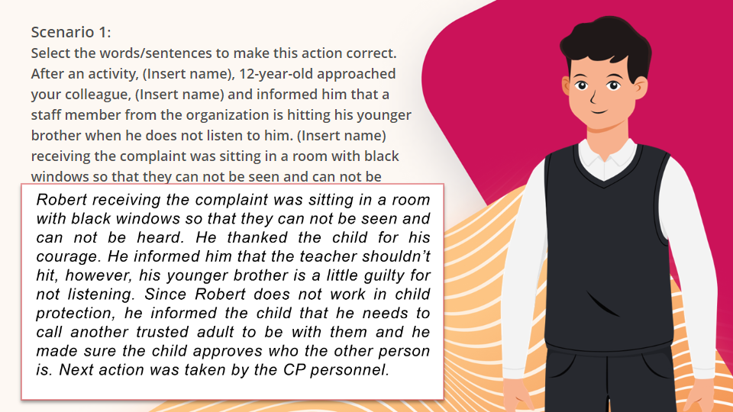
Quiz
Click the Quiz button to edit this object

Slide 9
Next Lesson

