Slide 1

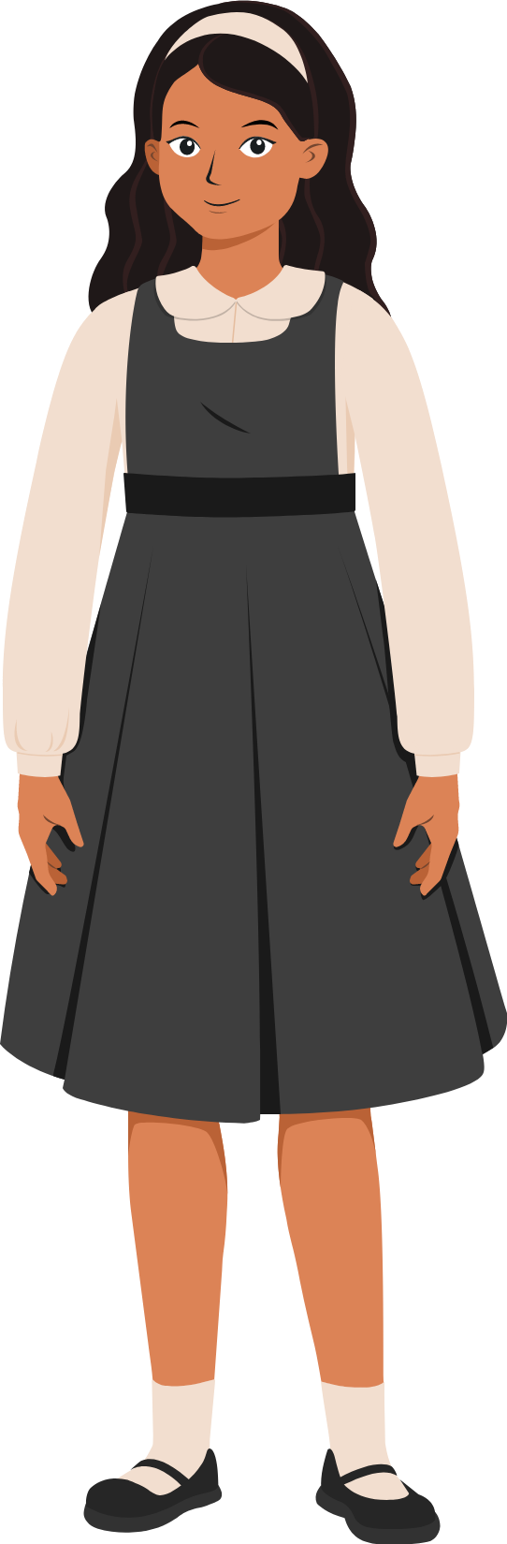
Quiz

Slide 2
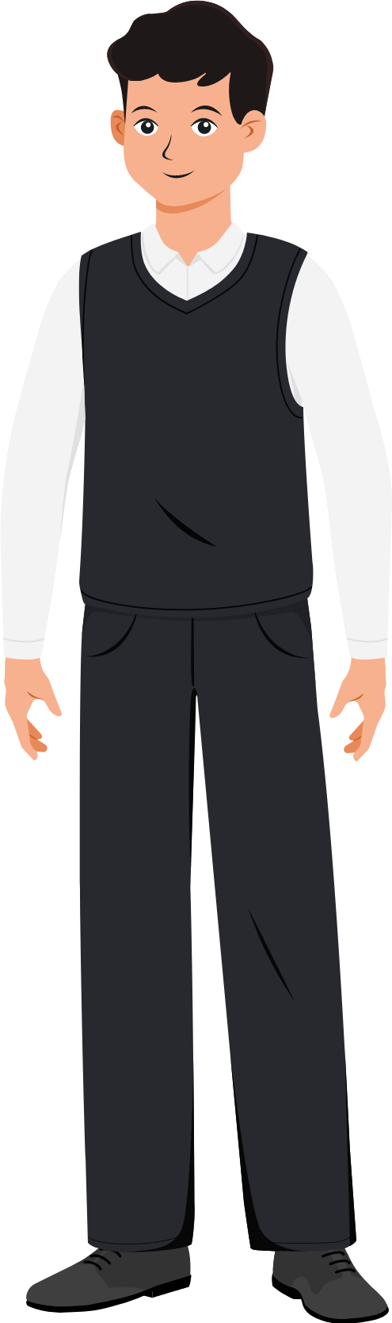

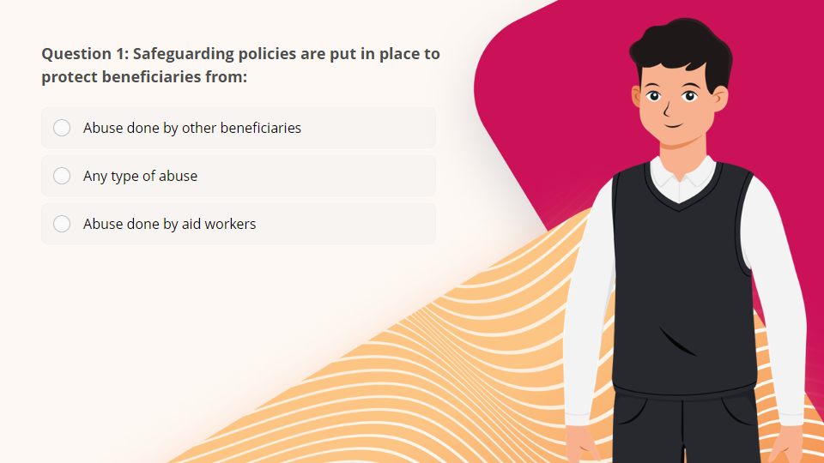
Quiz
Click the Quiz button to edit this object

Slide 3
Get Certificate

