Slide 1


Reporting Mechanism
How to report?

Slide 2

Reporting mechanisms at NABAD:
1- For staff:
A. Focal points:
- Mohamad Hawi reachable at @mohamad.hawi@nabadassociation.org
- Hussein Shouman reachable at @hussein.shouman@nabadassociation.org
- Naji Rifai reachable at @naji.rifai@nabadassociation.org
B. Anonymous reporting mechanism:
https://ee-eu.kobotoolbox.org/x/aidAFQvS

Slide 3
For beneficiaries:
Helpline: Takallam:
+961 79 111 538

Slide 4
Before proceeding, it is very important to understand the difference between reporting and referral.
Reporting: Informing the organization when a misconduct is done by an aid worker.
Note: We report with or without the details of the survivor based on his/her preferences.

Slide 5

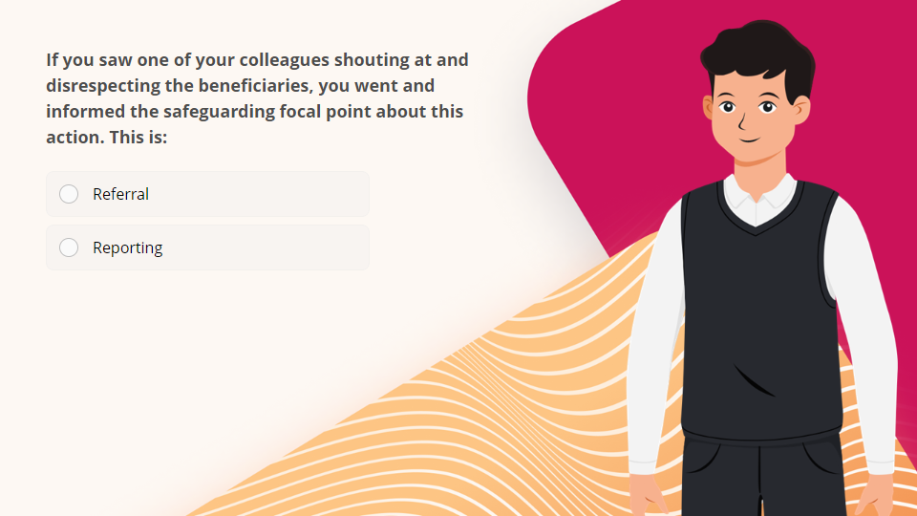
Quiz
Click the Quiz button to edit this object

Slide 6
Next Lesson

