Slide 1

C/C++ and Java Installation
For 2017 FRC Teams
Mike Anderson
(robot_maker12@verizon.net)
Herndon High School
FRC Team #116

Slide 2
What We’ll Talk About
Goals
The development environment
Talking to the RoboRIO
Making it move
Resources
Summary

Slide 3
Goals
The goal of this presentation is to help you understand how to prepare your development environment for use with C/C++ and Java
We clearly can’t explain all of the aspects because we have limited time
  But, you should leave here with a better understanding of the process
We will be talking about the set up rather than the languages themselves
  The WPILib is equivalent between the environments

Slide 4
Why C/C++?
C/C++ is a standard in embedded systems programming for over 30 years
  It’s still the most predominant language in embedded Linux, the IoT and the real-time operating system (RTOS) world
    This gives your team valuable real-world experience
It’s compiled to native machine code
  No virtual machine interpreters
    No pausing due to garbage collection
  It’s fast
It’s the native language of the RoboRIO’s Linux-based operating system
  The environment is written in C and Assembler
  You get easy, direct access to the underlying O/S
C++ is object oriented
  Full support from WPILib

Slide 5
Why Not C/C++?
C/C++ is compiled
  This adds complexity to the build
C/C++ is textual
  There are no cutesy GUIs with lots of obscure symbols and squiggly lines ☺
There is no VM to catch your mistakes
  The syntax is similar to Java
    Java was derived from C++
    Java VM is written in C/C++
C/C++ has pointers
  Objects can be referenced in many different ways
  This concept can be troublesome for some developers

Slide 6
Why Java?
Java has wide support in the industry
  Object-oriented approach with lots of reference material
Java is the language used on the AP exams
  Used in many computer science classes
Java is a byte-code interpreted language
  The use of the Virtual Machine (VM) allows for many dynamic language features
The VM will help catch some common memory mistakes
The version of Java used on the RoboRIO is version 8 from Oracle
WPILib is actually written in Java and then translated to C++

Slide 7
Why Not Java?
Java is interpreted
  Performance is lower than C/C++
Java is also textual like C++
  But, Java can be written using either imperative or declarative programming styles
The version of Java on the RoboRIO is not optimized for use in control systems
  The version is actually targeted at business applications
Garbage collection will cause the robot to hesitate during the mark and sweep cycle
  For the duration of the match, this should not be a problem

Slide 8
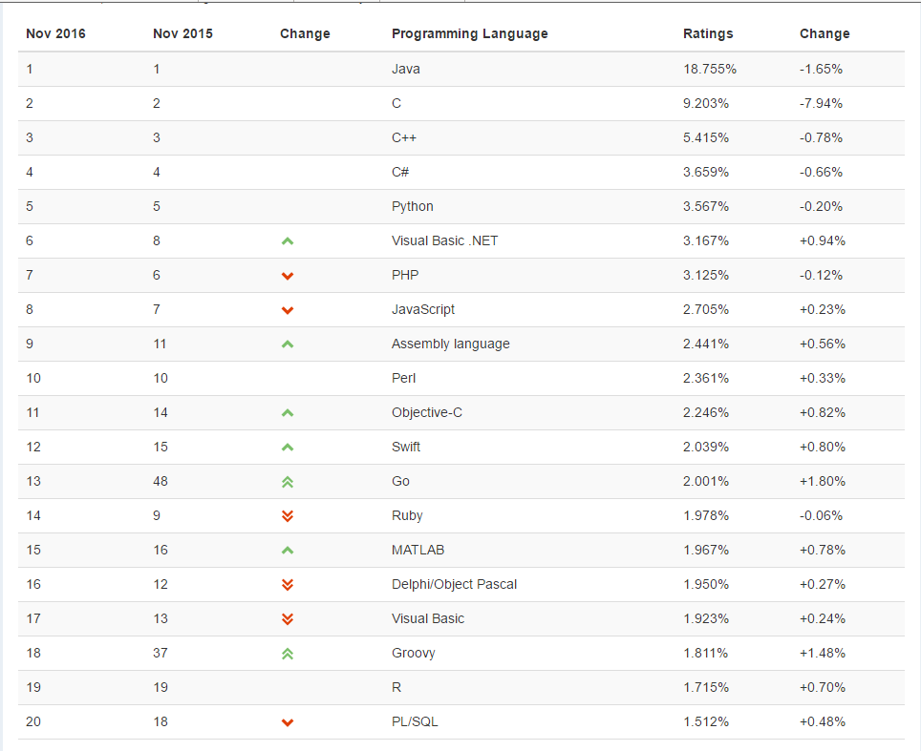
Top 20 Languages – Nov 2016
LabVIEW was #34 on this list

Slide 9
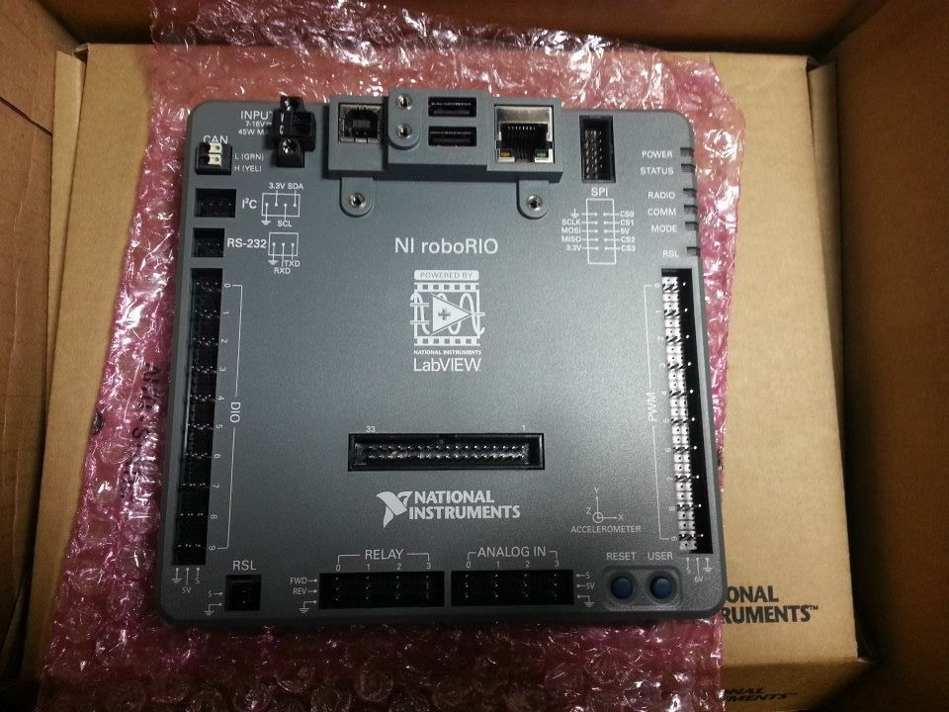
Getting Your RoboRIO Ready
Before you can start
development, you’ll need
to make sure that your
RoboRIO has the proper
operating system
image on it
  This is accomplished
  using the RoboRIO imaging
  tool or it can be done through LabVIEW
Java developers will need to deploy the Java 8 JDK to the RoboRIO
  There will be special instructions for this from FIRST

Slide 10
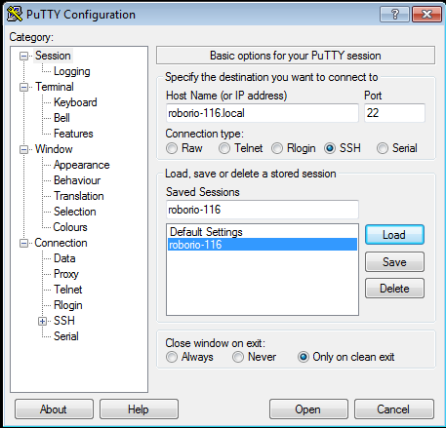
Some Useful Info…
The RoboRIO runs Linux
  SSH server is available
    Use Putty on Windows to get
    to SSH shell
  File transfers from IDE use
  SFTP
Addressing is via mDNS
  roborio-<team #>-FRC.local
The web server requires Microsoft Silverlight plug-in
Do not delete “admin” account
  All program transfers require it

Slide 11
The Development Environment
The FIRST-supported platform for C/C++ and Java is the Eclipse IDE tool
  The beta teams are using the Neon release
  The compiler is the open-source GNU 4.9 compiler
    Supports C++11 extensions
The C compiler is actually a cross-compiler
  We are building on an x86 for an ARM-based system
    Again, this is a standard approach for commercial, embedded development
There is also a way to install the Java bytecode compiler for Eclipse after you install the FRC plugins
  RoboRIO runs Java bytecode in the Oracle JVM
  Compiler on development platform produces the bytecode

Slide 12
Development Environment #2
During the beta, FIRST is only supporting Windows
  However, libraries and compilers are available for OS/X and Linux
The beta supports Windows 10
  You can still run it in a virtual machine
    For all you Mac OS/X and Linux fans
64-bit Windows is supported
The Java 8 JDK needs to be installed on your platform regardless of whether you use Java or C/C++
  Make sure you install the JDK and not just the JRE
  http://java.com

Slide 13

The Eclipse Neon IDE
To get started, first install
Oracle Java 8 JDK on the
Windows host
  Either 32- or 64-bit
  depending on your host
Next, go to Eclipse.org and
download the Eclipse IDE for C/C++ developers
  32- or 64-bit version to match your Java install
  Works for both C/C++ and Java development
Once installed, you’ll connect to FIRST to download the plug-ins for development
  This may change for kick-off

Slide 14
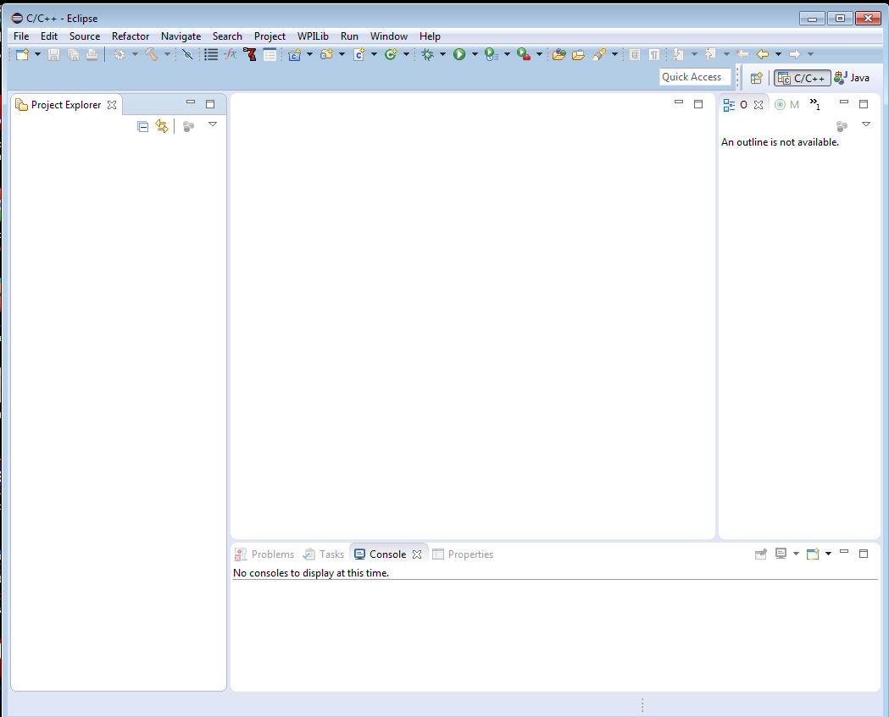
Installed Eclipse

Slide 15
Install FRC 2017 Update Suite
First, make sure you remove any old LabVIEW or driver station code
Run the update suite installer
  This will install the RoboRIO imaging tool and the latest firmware release
  Installs the latest driver station and smartDashboard
The 2017 Driver Station doesn’t look that different from the 2016 version
  So far…

Slide 16
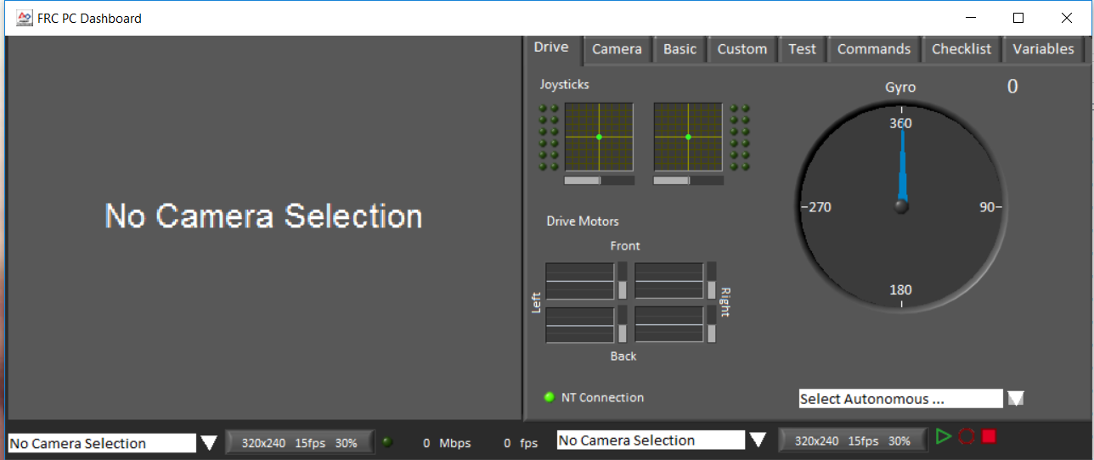
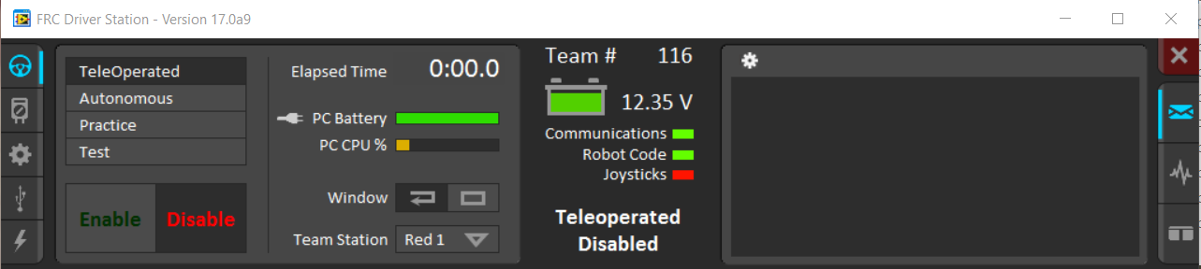
2017 Driver Station

Slide 17
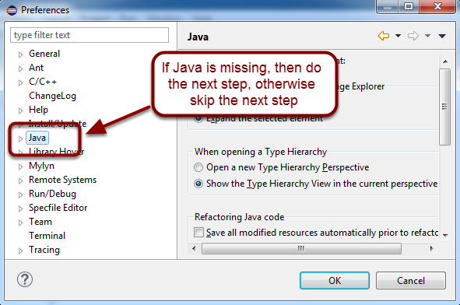
Checking for Java
If you’re working with Java, you’ll need to verify that the Java tools are installed
Normally, you won't have to go beyond this step if you installed the Oracle Java on your development station correctly

Slide 18
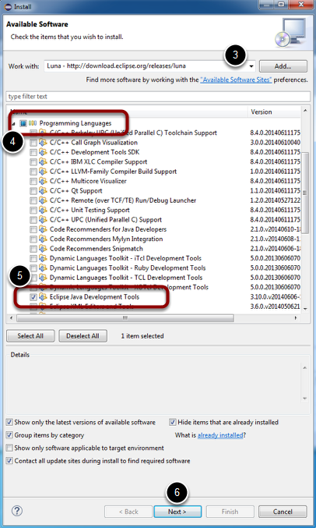
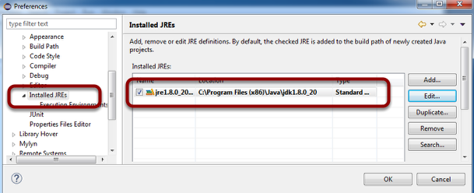
Find the Java Development Tools
If for some reason, Java
doesn’t show up in the
previous tab, you’ll need to
install the Java tools
Then, you’ll set up the JDK
in the preferences tab

Slide 19
Install the Third-Party Libraries
FIRST has unbundled the libraries for motor controllers like the CTRE Talon SRX
  This includes anything that has any special capabilities like the Rev Robotics SPARK as well
You’ll need to contact the manufacturer to get the instructions for integrating their product into the Eclipse environment
  Typically an installer for Windows
    OS/X and Linux will have to piece it together
You’ll need to add the libraries and header files to the search path of your project

Slide 20
Now, Java Should Work (on the Host)
Once you’ve verified that the Java tools and JDK are visible to Eclipse you should be able to use the new->project option to select and create a new Java-based robot project
This process looks almost identical to the steps for C/C++
  For the sake of time we’ll show the C++ steps, but the Java steps are similar

Slide 21
Java on the RoboRIO
Java does not come installed on the RoboRIO
  Issues with the license from Oracle
You need to have your host connected to both the RoboRIO and the Internet
cd to C:\Users\<username>\wpilib\tools and run java-installer.jar
Follow the prompts, accept the license and let the system install Java to the RoboRIO
  Repeat for each RoboRIO

Slide 22
Creating A Project
Eclipse collects all of the files related to building a piece of code into a subdirectory called a project folder
  It’s normally stored in your C:\user account
    You can put the project elsewhere when you open Eclipse
You can also import and export projects
  This allows you to create a .zip of the project for archival purposes
To create a new project use:
  File->New->Project and select WPILib Project

Slide 23
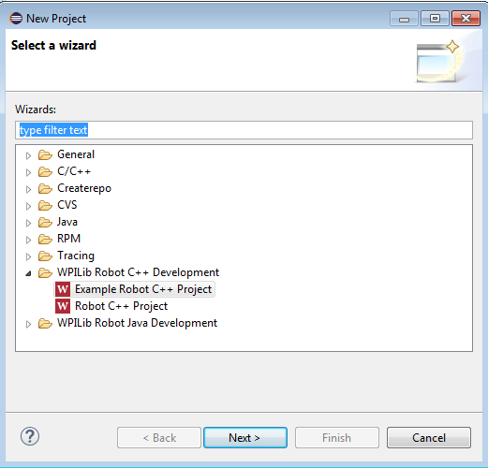
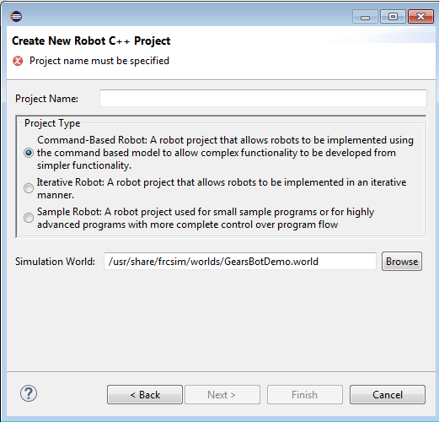
New Project -- Simple Robot

Slide 24
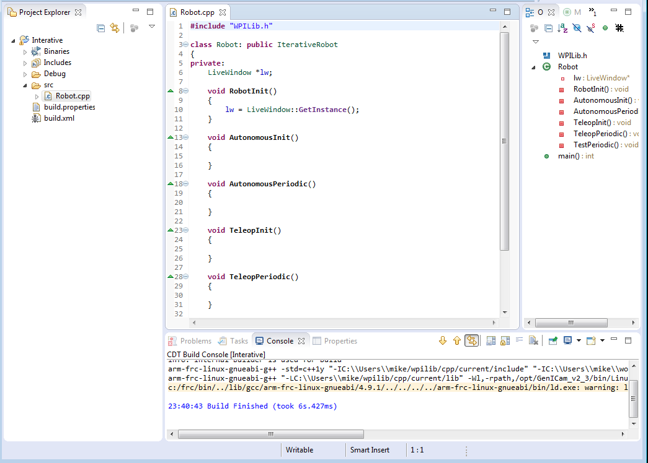
New Project Result

Slide 25
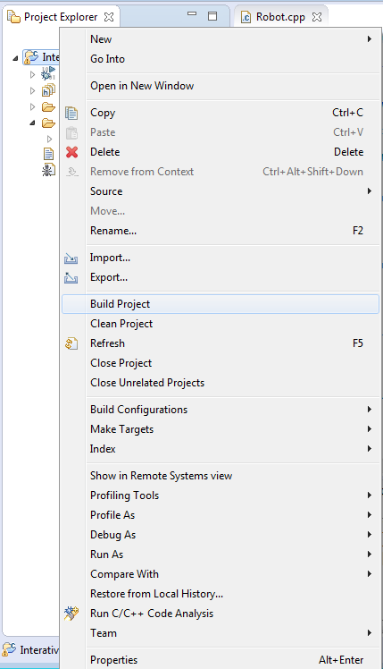
Build the Project
Eclipse will default to building
the project automatically
However, you can clean and
build the project manually
Use the Project menu to
configure the auto-build
feature

Slide 26
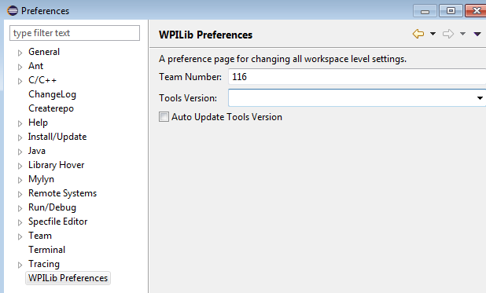
Set Team # in Preferences

Slide 27
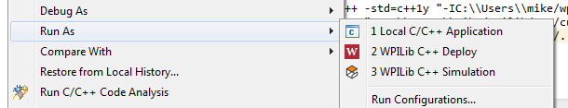
Deploying to the Target
When the code is built, you
can select Run As->WPILib C++ Deploy
This will open an SFTP connection to the RoboRIO (as “admin”) and copy the application to the file system
The application will then start running
  Waiting for the driver station

Slide 28
Debugging Code
The project is usually automatically created with debugging enabled
Select Debug As->WPILib C++ Deploy
The Eclipse will automatically switch to the Debug perspective
You can then set breakpoints
Once the driver station enables the application, your debug session will begin

Slide 29
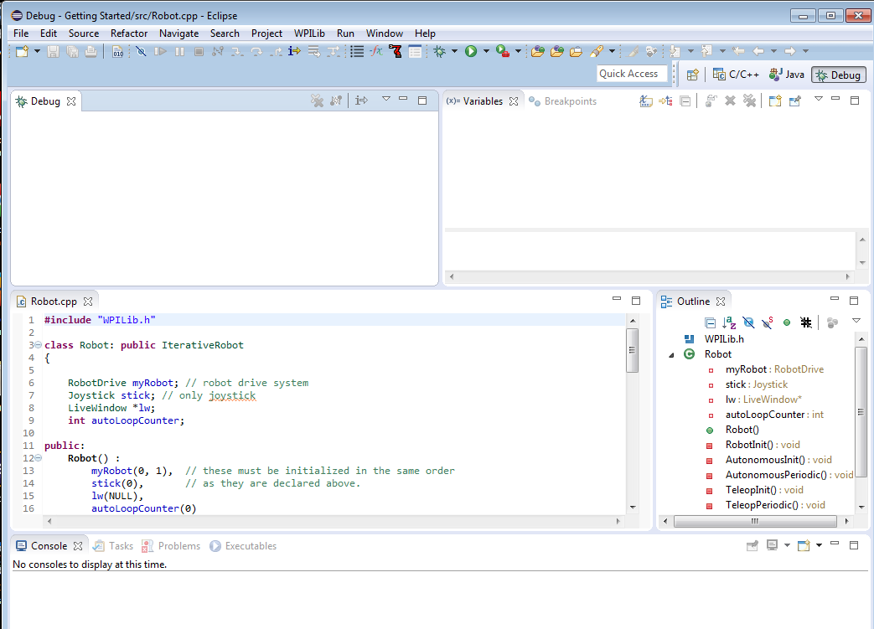
The Eclipse Debug Perspective

Slide 30
Resources
Chief Delphi
  http://www.chiefdelphi.com
FIRST forums
  http://forums.usfirst.org
NI Community Forums
  http://ni.com/FIRST
WPI / FIRST NSF Community site (ThinkTank)
These sites are monitored members of:
  WPI
  NI
  FIRST
All source code available for team<->team assistance
Phone support through NI
  866-511-6285 (1PM-7PM CST, M-F) ?

Slide 31
Summary
C/C++ can be very challenging to new developers
  C/C++ is similar enough to Java that Java developers can adapt to it quickly
    However, pointers will require some explaining
  Performance and fine-grain control are the biggest advantages to using C/C++
Java has a lot of support within the FIRST community and many school systems
  Being on the AP CS exam encourages schools to teach it
  Java is also used in the new FTC development environment
    Although the Java VM is slightly different for Android
WPILib class libraries have equivalent capability between C++ and Java versions
Java and C++ are syntactically very similar
  You could start with one and then switch without too much trouble

