Slide 1

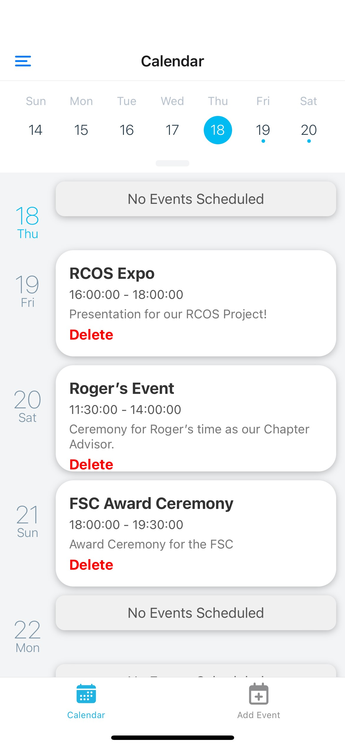
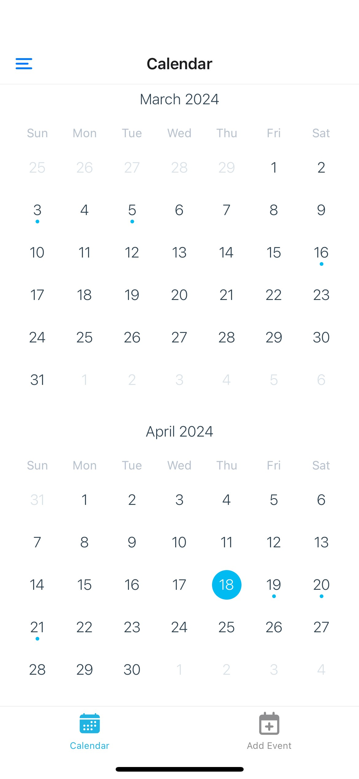
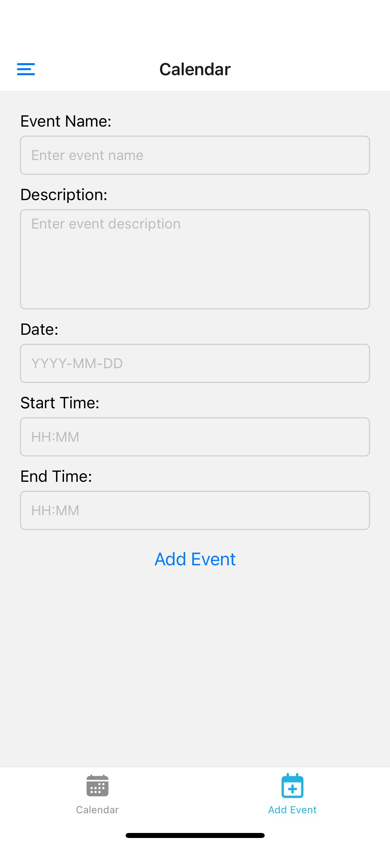
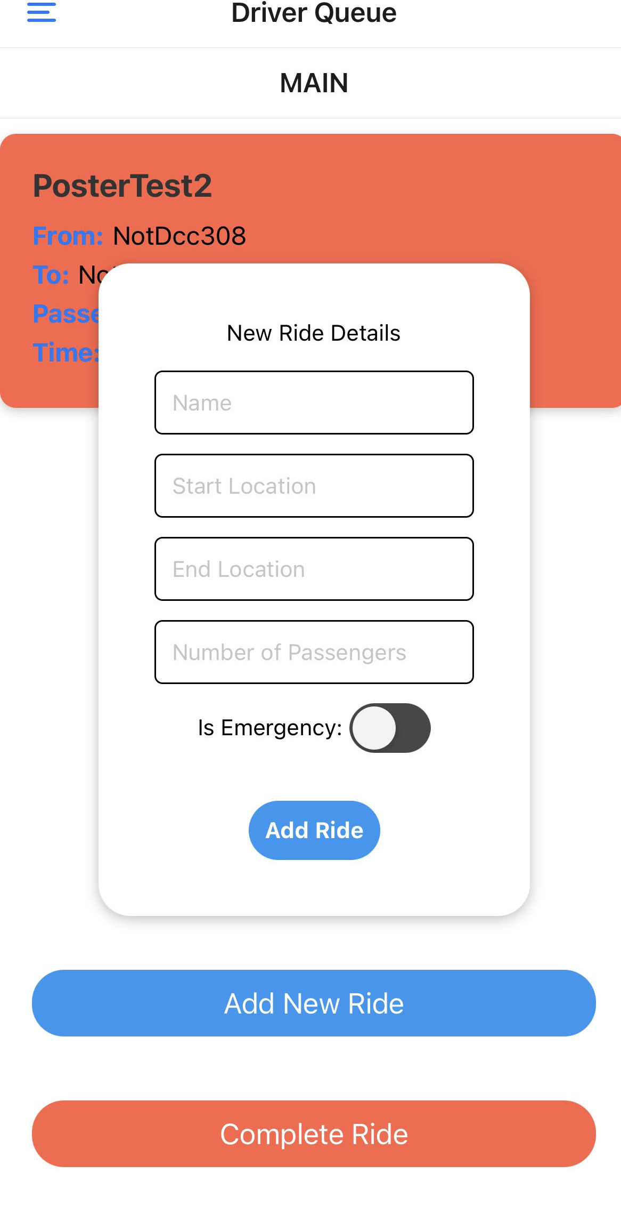
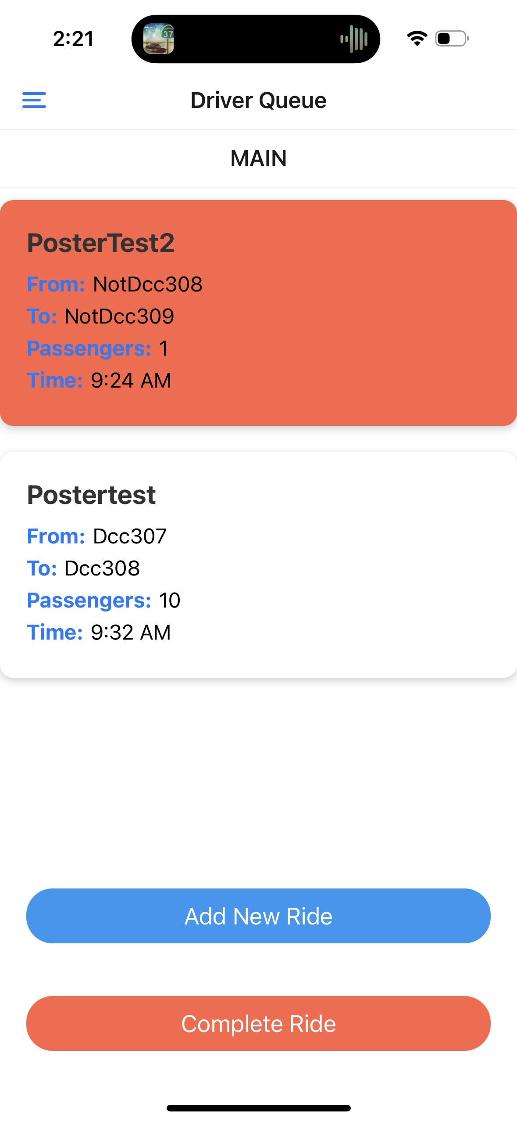



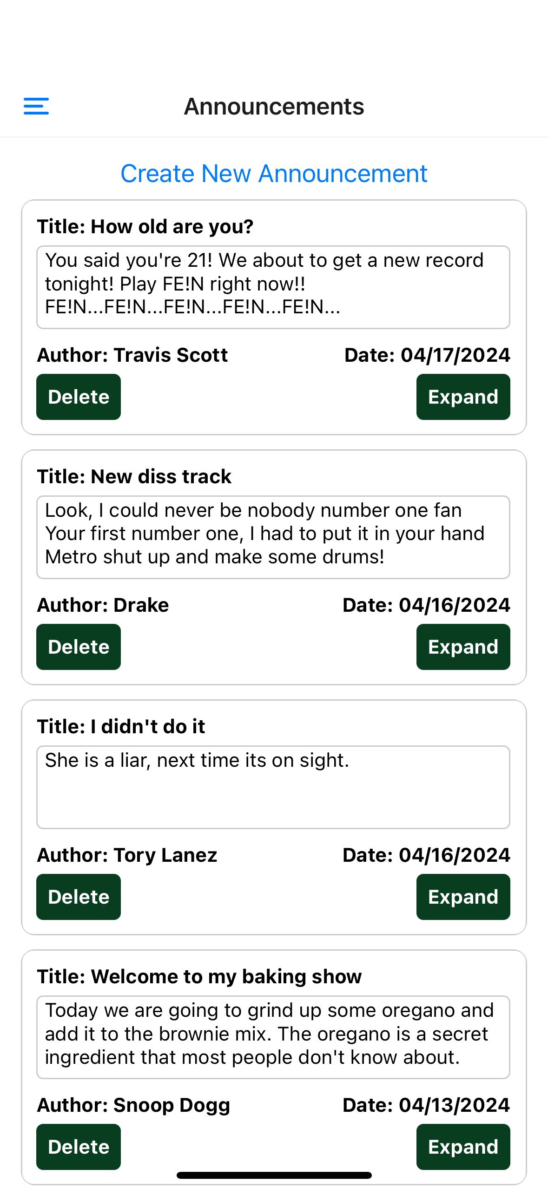
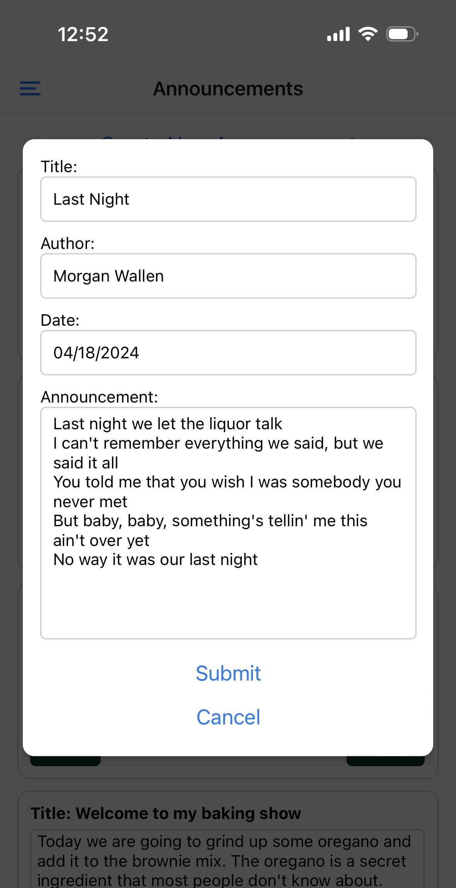
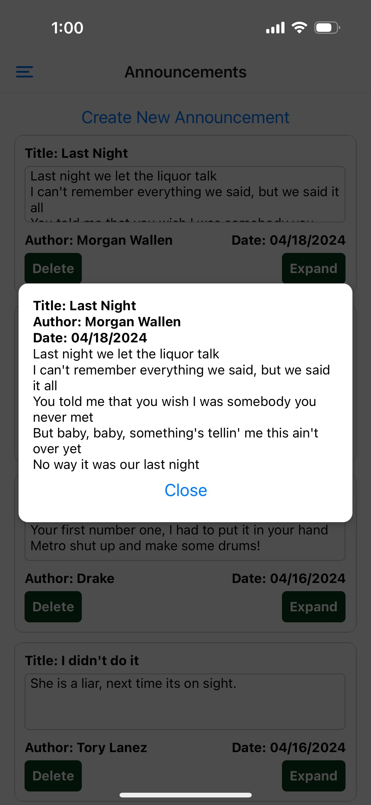

LambdaHub
Nevin Joshy, Jason Greenberg, Adriano Andrade
RCOS Project for Lambda Chi Alpha Fraternity
Introduction
Calendar Page Results
Driver Page Results
Conclusions
The Lambda Chi Alpha fraternity currently uses many different applications including, but not limited to Messenger, Gmail, Phone Messaging, and Google Calendar to organize its affairs. This includes releasing Google forms, announcements, upcoming events, and general communication, all split into different apps, mixed with personal communications as well. With LambdaHub, we aim to consolidate these platforms into one, streamlined and easy-to-use environment that will reduce confusion and vastly improve communication within the fraternity. The officers of the fraternity will be granted admin access to the app, giving them the access to add personalized announcements, and calendar events, and grant privileges to other members within the app.
The initial calendar configuration was derived from Wix's open source react native library, which had some calendar UIs to choose from
We built upon the scrollable calendar feature by embedding into the top of the screen, in a place where it can be conveniently accessed. It features marked dates so users know which days have an event.
The remainder of the screen is an agenda-style event layout, where each event over the next week is displayed, and the user can scroll down to see further dates.
The add event tab allows convenient area for users to add an event to the calendar, with in-text-box instructions to make the user experience easier.
The initial vision for the driver page was to have a queue of rides that users create and that are managed by a superuser.
When the user click the "Create Ride" button a modal pops up that has multiple character fields for them to input their information into.
In the "Create Ride" modal there is a check field that the user can click if their ride is an emergency. When an emergency ride is created it will be displayed as red.
Lastly, the "Complete Ride" pops off the oldest ride in the list, this can be changed later to be a swiping feature instead so that you can choose which ride to complete.
Each of these requests take the custom primary key "identifier" that each ride object has. The list is sorted by this identifier and allows for easy access.
Our LambdaHub app proved to fulfill many of our initial goals, namely implementing a fully functional Calendar, Announcements, and Driver Queue Screen
Our Calendar page still requires editing functionality for events, and needs some bug fixes, like refreshing events after addition and deletion. It also needs to sort events on the same day by time.
Our Announcement page still needs an attractive UI, and further linking with our Django backend for delete requests
Our Driver page needs functionality to press and join a ride with a fixed number of people, as well and further UI enhancements
All of our pages need separate admin user experience, as we want the normal user experience to be view only. Our largest next step for our project would be to implement these admin/user pages, and with that the ability to create an account and store users in the database.
Even further in the future, we would like to organize events and announcements made by each chapter officer(President, Vice President, Philanthropy Chair, etc.) to be organized separately.
Finally, our app needs to be published to a server so that our app can be used by the members of the Lambda Chi Alpha fraternity.
Objective / Goals
Building the app from scratch, we plan to implement some foundational key features, including an Announcement Page, Driver Queue Page, and Calendar Page.
Each page within the app will have a User Interface which will allow the user to enter and receive information.
Each page within the app will have a Backend for storage and retrieval of data.
The three pages will be fully functional and will allow for further implementations of other pages.
Calendar Landing Screen
Scrollable Calendar with Marked Dates
Add Event Screen
Methods & Materials
Materials:
•React Native
•Django
•SQLite
We picked React Native, because we wanted our app to work across all platforms. React Native also allows to see your updates in real time.
We picked Django because it is very versatile and because of its intuitive admin interface that allows the user to interact with the objects that are created.
Lastly, we picked SQLite because SQLite requires very minimal configuration and setup before use. SQLite is also incredibly easy to use.
Methods:
Since we all practically had zero knowledge on how to use these frameworks, we had to spend a lot of time doing research. We spent a good amount of time watching YouTube videos that explain how to use these frameworks and we also had to spend a lot of time looking specific syntax and logic questions up online,
Acknowledgements
We would like to thank the RCOS staff, especially those that were in Sage 3101 and offered us support when we ran into our (numerous) problems. Furthermore, the workshops on web development and server-side programming hosted by the mentors were incredibly helpful in building our app from scratch to where it is now.
Announcements Page Results
The goal of the Announcements Page was to allow anyone to display messages related to upcoming events, mandatory meetings, updates within the fraternity, etc.
The page when opened, displays all the messages that have been created in the past, each in their own announcement box. Currently, the screen is using a dummy data file for inputs.
Also on the page is a button “Create New Announcement” which upon clicking opens a modal. The modal has bars which allow the user to enter information for “Title”, “Author”, “Date” (prefilled), and “Announcement”.
Within each announcement box are two buttons, “Delete” and “Expand”. The “Delete” button removes the selected message from the screen, however the message will still be stored in the backend. The “Expand” button opens a modal which shows all the data of the message. The container for the announcement is scrollable, but the “Expand” button allows for easier viewing.
Announcements Page
Create Announcement Modal
Expand Announcement Modal
Check out our Repositories!

