Slide 1

Apache Spark

Slide 2
Agenda
Distributed processing
What is spark and why
Difference between spark and map-reduce
Spark Architecture
RDD
Transformation and Action in RDD with example
Spark Deployment
Spark-SQL
Spark-Mllib

Slide 3
Distributed processing
Definition : Distributed processing is a phrase used to refer to a variety of computer systems
that use more than one computer (or processor) to run an application.
This includes parallel processing in which a single computer uses more than
one CPU to execute programs.
Advantages :
Lower Cost
Reliable
Improved Performance and Reduced Processing Time
Flexible

Slide 4
Difference between distributed processing and Parallel processing
Distributed Processing | Parallel processing
Loosely Coupled systems | tightly coupled systems.
processors do not share memory and each processor has its own local memory | single system wide primary memory shared by all the processors
processors of distributed operating systems can be placed far away from each other | not the case with parallel processing systems
larger no. of processors | no. of processors that can be usefully deployed is very small
synchronization algorithms are used | Globle clock is used for controlling
unpredictable communication delays between processors | processors in the parallel processing system share over an interconnection network

Slide 5
Spark Goals
Extend the MapReduce model to better support two common classes of analytics apps:
Iterative algorithms (machine learning, graph)
Interactive data mining
Enhance programmability:
Integrate into Scala programming language
Allow interactive use from Scala interpreter
Notes:
5

Slide 6
Apache Spark
Apache Spark™ is a fast and general engine for
large-scale data processing.
Fast and general engine for big data processing with
libraries for SQL, streaming, advanced analytics.
Most active open source project in big data.
Speed : Run programs up to 100x faster than
Hadoop MapReduce in memory, or 10x faster on disk.
Ease of Use : Write applications quickly in Java, Scala, Python, R.
Generality : Combine SQL, streaming, and complex analytics.
Runs Everywhere : Spark runs on Hadoop, Mesos, standalone, or in
the cloud. It can access diverse data sources including HDFS,
Cassandra,HBase, and S3

Slide 7
Difference between spark and Map-reduce
Performance
Ease of Use
Cost
Compatibility
Data Processing
Failure Tolerance
Security
Notes:
https://www.xplenty.com/blog/2014/11/apache-spark-vs-hadoop-mapreduce/

Slide 8
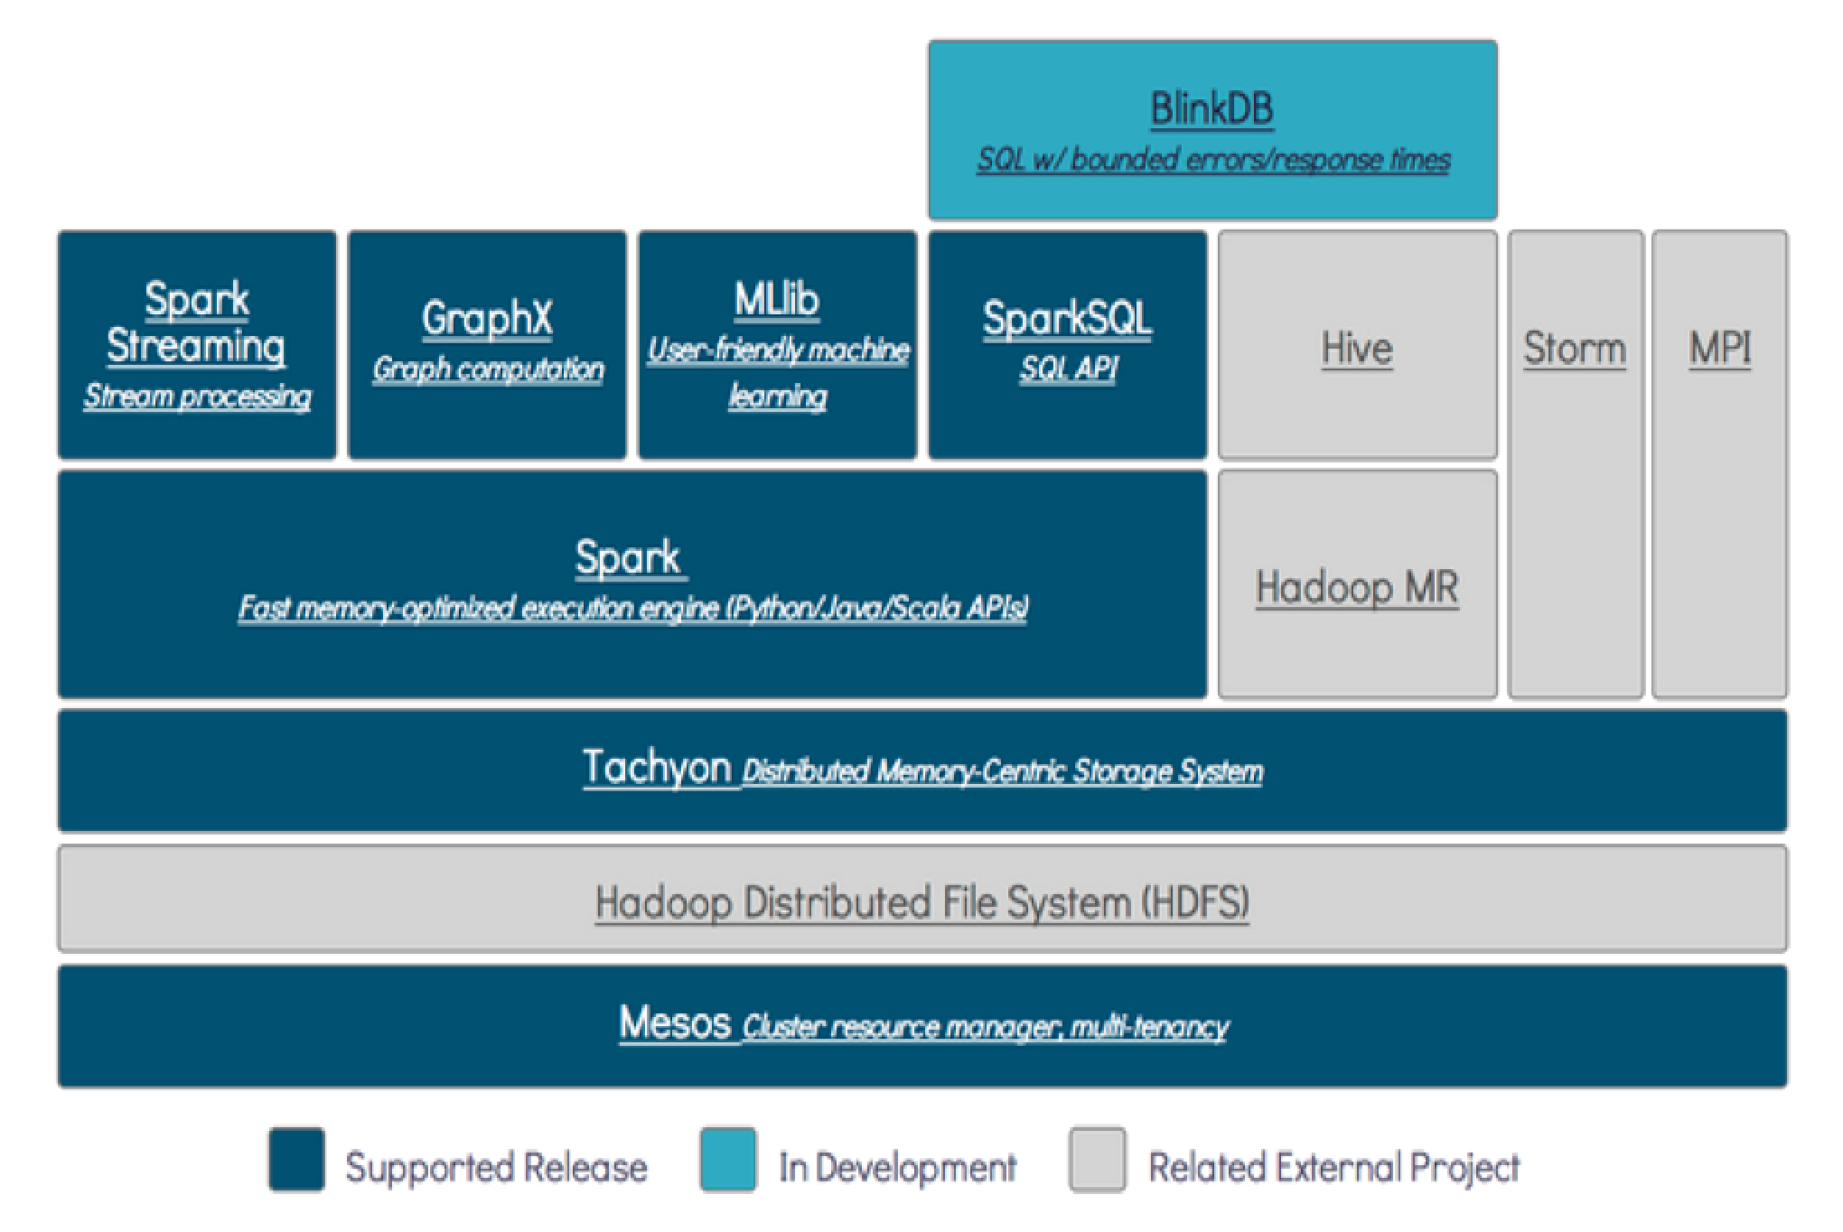
Spark Architecture

Slide 9
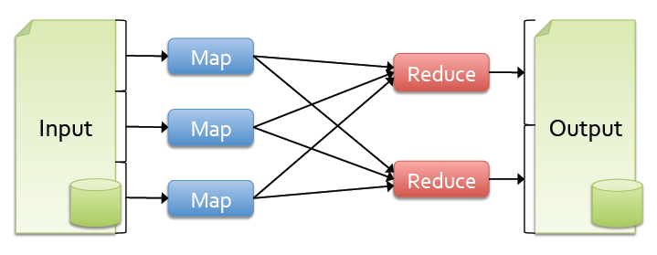
Background
Most current cluster programming models are based on directed acyclic data flow from stable storage to stable storage
Benefits of data flow: runtime can decide where to run tasks and can automatically recover from failures

Slide 10
Solution: Resilient Distributed Datasets (RDDs)
Allow apps to keep working sets in memory for efficient reuse
Retain the attractive properties of MapReduce
Fault tolerance, data locality, scalability
Support a wide range of application

Slide 11
RDD (Resilient Distributed DataSet)
RDD :
Collection of data having following properties
Immutable
Lazy evaluated
Cacheable
Type inferred

Slide 12
Immutable
Once created can not change
(like string in java)
Big-data block is immutable
Advantages :
Can caching data
Parallelize

Slide 13
Problem with immutability
Multiple copy of data
Space Complexity
Multiple passes over data
Decrease the performance

Slide 14
Lazy Evaluation in spark
Lazy evaluation
Defers from evaluation
Difference between execution and evaluation
No problem of the performance

Slide 15
Laziness and immutable
Lazy only if the underneath data is immutable
You cannot combine transformation if transformation has
side effect
So combining laziness and immutability – get better
performance
Multiple transformation of same data – gives same
result every time

Slide 16
Type Inference
Type inference is part of complier to determining
the type by value
As all transformation are side effect free ,
we can determine the type by operation.
Each transformation have return type

Slide 17
Caching
Immutable data allows you to cache data for long time
Lazy transformation allows to recreate data on failure
Transformation can be saved also
Caching data improves execution engine performance

Slide 18
Spark RDD Overview
Immutable collections of objects spread across a cluster
Built through parallel transformations (map, filter, etc)
Automatically rebuilt on failure
Controllable persistence (e.g. caching in RAM) for reuse
Shared variables that can be used in parallel operations

Slide 19
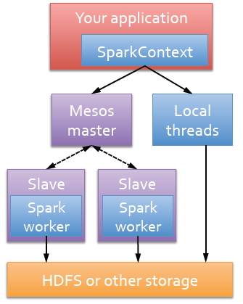
Run Spark
Spark runs as a library in your program
(1 instance per app)
Runs tasks locally or on Mesos
new SparkContext ( masterUrl, jobname, [sparkhome], [jars] )
MASTER=local[n] ./spark-shell
MASTER=HOST:PORT ./spark-shell

Slide 20
RDD Abstraction
An RDD is a read-only , partitioned collection of records
Can only be created by :
(1) Data in stable storage
(2) Other RDDs (transformation , lineage)
An RDD has enough information about how it was derived from other datasets(its lineage)
Users can control two aspects of RDDs:
1) Persistence (in RAM, reuse)
2) Partitioning (hash, range, [<k, v>])
Notes:
RDD可以根据关键字指定分区顺序，
目前支持hash分区和range分区。用户可以使用同一种hash来将两个RDD进行分区，这样便于以后的join操作。
RDD是静态类型对象，当然你也可以像定义其他对象一样来定义RDD，如RDD[Int]
20

Slide 21
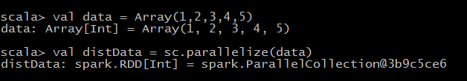
RDD Types: parallelized collections
By calling SparkContext’s parallelize method on an existing Scala collection (a Seq obj)
Once created, the distributed dataset can be operated on in parallel
Notes:
21

Slide 22
RDD Types: Hadoop Datasets
Spark supports text files, SequenceFiles, and any other Hadoop inputFormat
val distFiles = sc.textFile(URI)
Other Hadoop inputFormat
val distFile = sc.hadoopRDD(URI)
Local path or hdfs://, s3n://, kfs://

Slide 23
RDD Operations
Transformations
create a new dataset from an existing one
Actions
Return a value to the driver program
Transformations are lazy, they don’t compute right away. Just remember the transformations applied to datasets(lineage). Only compute when an action require.

Slide 24
Transformations
Transformations | Meaning
map(func) | Return a new distributed dataset formed by passing each element of the source through a function func
flatMap(func) | Return a new datasets formed by selecting those elements of the source on which func returns true
union(otherDateset) | Return a new dataset that contains the union of the elements in the source dataset and the argument
… | …

Slide 25
Actions
Actions | Meaning
reduce(func) | Aggregate the elements of the dataset using a function func
collect() | Return all the elements of the dataset as an array at the driver program
count() | Return the number of elements in dataset
first() | Return the first element of the dataset
saveAsTextFile(path) ….. | Write the elements of the dataset as text file (or set of text file) in a given dir in the local file system, HDFS or any other Hadoop-supported file system ……

Slide 26
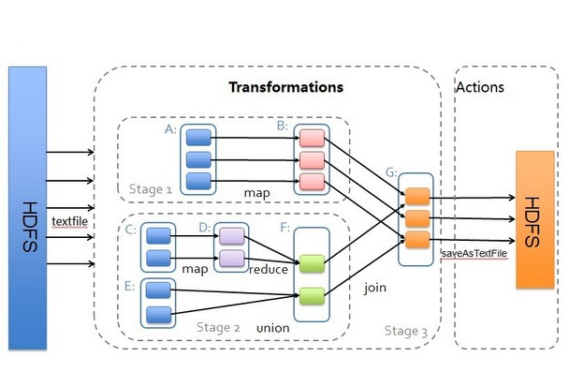
Transformations & Actions

Slide 27
Representing RDDs
Challenge: choosing a representation for RDDs that can track lineage across transformations
Each RDD include:
1) A set of partitions(atomic pieces of datasets)
2) A set of dependencies on parent RDDs
3) A function for computing the dataset based
its parents
4) Metadata about its partitioning scheme
5) Data placement

Slide 28
Interface used to represent RDDs
Operation | Meaning
partitons() | Return s list of partition objects
preferredLocations(p) | List nodes where partition p can be accessed faster due to data locality
dependencies() | Return a list of dependencies
iterator(p, parenetIters) | Compute the elements of partition p given iterators for its parent partitions
partitioner() | Return metadata specifying whether the RDD is hash/range partitioned
Notes:
设计接口的一个关键问题就是，如何表示RDD之间的依赖。我们发现RDD之间的依赖关系可以分为两类，即：（1）窄依赖（narrow dependencies）：子RDD的每个分区依赖于常数个父分区（即与数据规模无关）；（2）宽依赖（wide dependencies）：子RDD的每个分区依赖于所有父RDD分区。例如，map产生窄依赖，而join则是宽依赖（除非父RDD被哈希分区）。
28

Slide 29
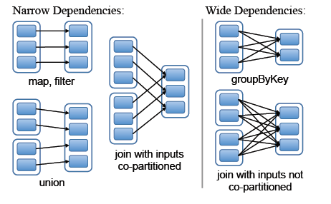
RDD Dependencies
Each box is an RDD, with partitions shown as shaded rectangles
Notes:
窄依赖允许一个集群节点以流水线的方式计算所以父分区。
宽依赖类似于MR的shuffle过程。
29

Slide 30
Spark Deployment
Local multicore: just a library in your program
EC2: scripts for launching a Spark cluster
Private cluster: Mesos, YARN, Standalone Mode

Slide 31

Spark Standalone

Slide 32
Spark yarn Deployment Mode
Cluster Deployment Mode
Client Deployment Mode
Mode | YARN Client Mode | YARN Cluster Mode
Driver runs in | Client | ApplicationMaster
Requests resources | ApplicationMaster | ApplicationMaster
Starts executor processes | YARN NodeManager | YARN NodeManager
Persistent services | YARN ResourceManager and NodeManagers | YARN ResourceManager and NodeManagers
Supports Spark Shell | Yes | No

Slide 33
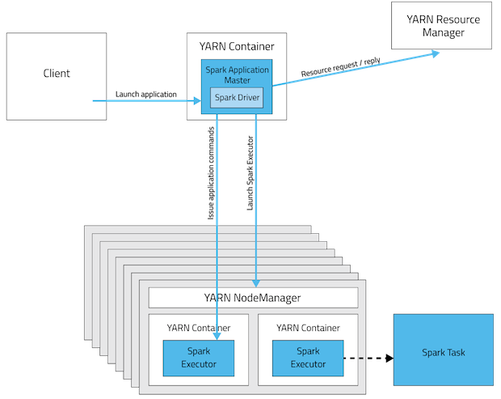
Cluster Deployment Mode

Slide 34
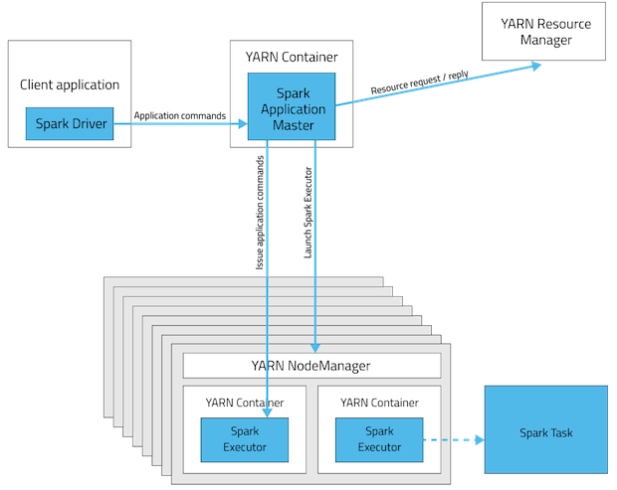
Client Deployment Mode

Slide 35
Command for Spark Yarn client mode
./bin/spark-submit --class org.apache.spark.examples.SparkPi \
--master yarn \
--deploy-mode client\
--driver-memory 4g \
--executor-memory 2g \
--executor-cores 1 \
--queue thequeue \
lib/spark-examples*.jar \ 10

Slide 36
Command for Spark Yarn Cluster mode
./bin/spark-submit --class org.apache.spark.examples.SparkPi \
--master yarn \
--deploy-mode cluster\
--driver-memory 4g \
--executor-memory 2g \
--executor-cores 1 \
--queue thequeue \
lib/spark-examples*.jar \ 10

Slide 37
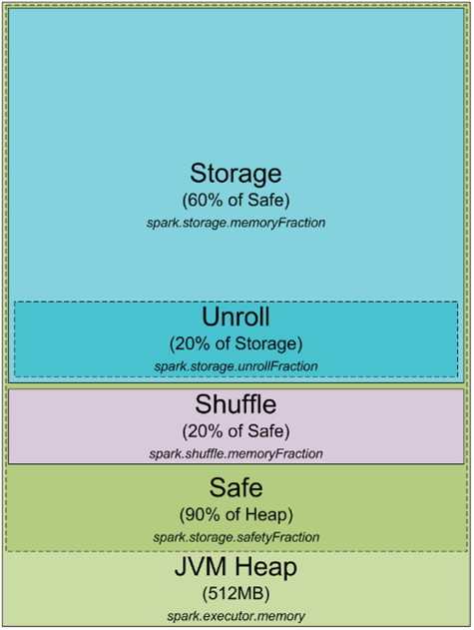
Spark memory model

Slide 38
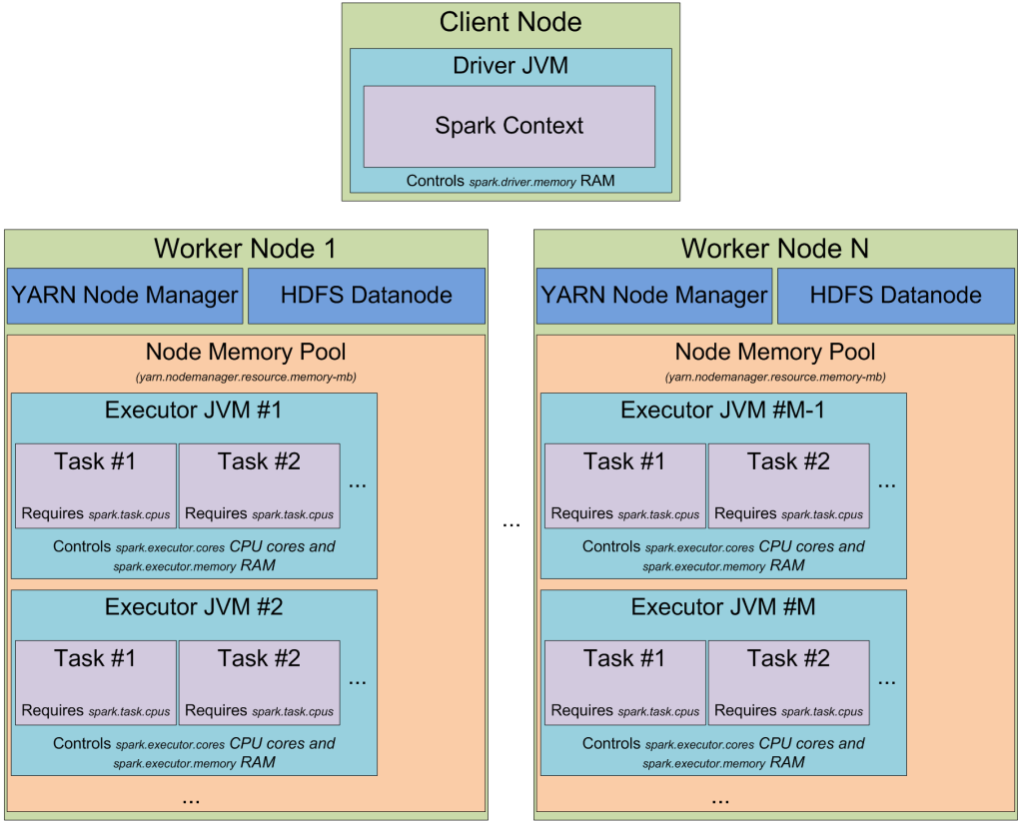

Slide 39
Spark Word Count Example
1) Create the spark context :
SparkConf conf = new SparkConf().setAppName("org.sparkexample.WordCount").
setMaster("local");
JavaSparkContext sparkJSC= new JavaSparkContext(conf);
2) Read the file to create the RDD
JavaRDD<String> lines = sparkJSC.read().text(args[0]).javaRDD();
3)Tokenize the lines into word
JavaRDD<String> words = lines.flatMap(new FlatMapFunction<String, String>() {
@Override
public Iterator<String> call(String s) {
return Arrays.asList(SPACE.split(s)).iterator();
}
});

Slide 40
Continue Spark word count program
4) Create the pair for each word
JavaPairRDD<String, Integer> ones = words.mapToPair(
new PairFunction<String, String, Integer>() {
@Override
public Tuple2<String, Integer> call(String s) {
return new Tuple2<>(s, 1);
}
});
5) Reduce by key(reduce phase)
JavaPairRDD<String, Integer> counts = ones.reduceByKey(
new Function2<Integer, Integer, Integer>() {
@Override
public Integer call(Integer i1, Integer i2) {
return i1 + i2;
}
});

Slide 41
Continue Spark word count program
6) Get the result
List<Tuple2<String, Integer>> output = counts.collect();
for (Tuple2<?,?> tuple : output) {
System.out.println(tuple._1() + ": " + tuple._2());
}
7) Stop the spark context
sparkJSC.stop();

Slide 42
Shared Variable in Spark
Accumulator : Write only no read on worker(like counters)
Broadcast variable : Read only no write on worker
Use of Accumulator and Broadcast

Slide 43
Broadcast variable
Broadcast variables are:
Immutable
Distributed to the cluster
Fit in memory

Slide 44
Introduce to Spark SQL

Slide 45
Challenges and Solutions
Challenges
Solutions
Perform ETL to and from various
(semi- or unstructured) data
sources
Perform advanced analytics
(e.g. machine learning, graph
processing) that are hard to
express in relational systems.
A DataFrame API that can perform
relational operations on both external data
sources and Spark’s built-in RDDs.
A highly extensible optimizer, Catalyst, that
uses features of Scala to add composable
rule, control code gen., and define extensions.

Slide 46
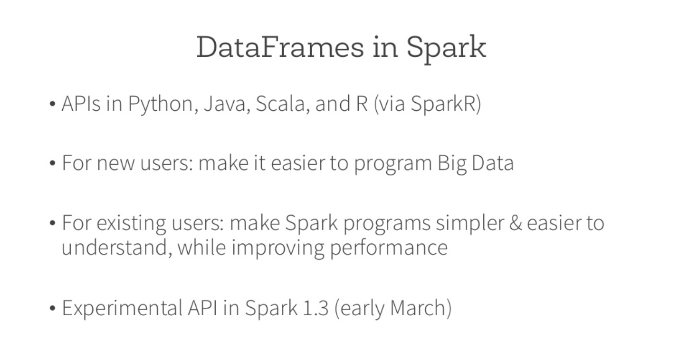

Slide 47
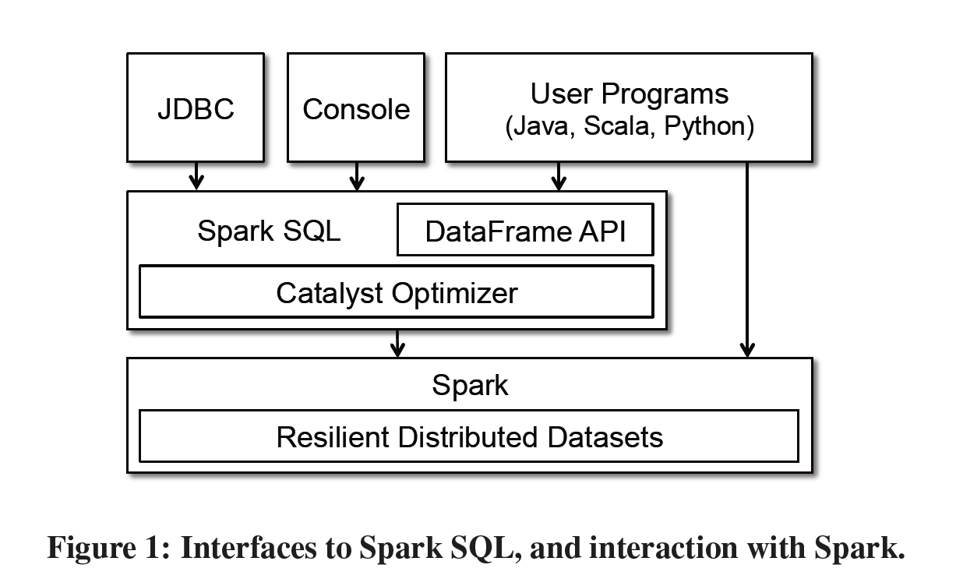
Programming Interface

Slide 48

Declarative BigData Processing
SQL
Let Developers Create and Run Spark Programs Faster:
Write less code
Read less data
Let the optimizer do the hard work

Slide 49
Advantages over Relational Query Languages
Holistic optimization across functions composed in different languages.
Control structures (e.g. if, for)
Logical plan analyzed eagerly → identify code errors associated with data schema issues on the fly.

Slide 50
Data Model
Nested data model
Supports both primitive SQL types (boolean, integer, double, decimal, string, data, timestamp) and complex types (Structs, arrays, maps, and unions); also user defined types.
First class support for complex data types

Slide 51
Querying Native Datasets
Infer column names and types directly from data objects (via reflection in Java and Scala and data sampling in Python, which is dynamically typed)
Native objects accessed in-place to avoid expensive data format transformation.
Benefits:
Run relational operations on existing Spark programs.
Combine RDDs with external structured data
Columnar storage with hot columns cached in memory

Slide 52
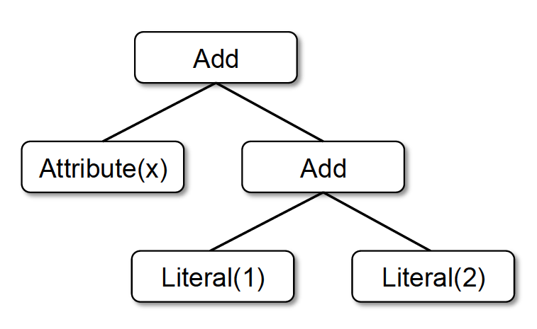
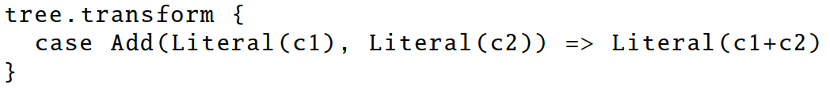
Catalyst
Add
Attribute(x)
Literal(3)
x + (1 + 2)
x + 3
Notes:
Done in Scala because functional programming languages naturally support compiler functions.

Slide 53
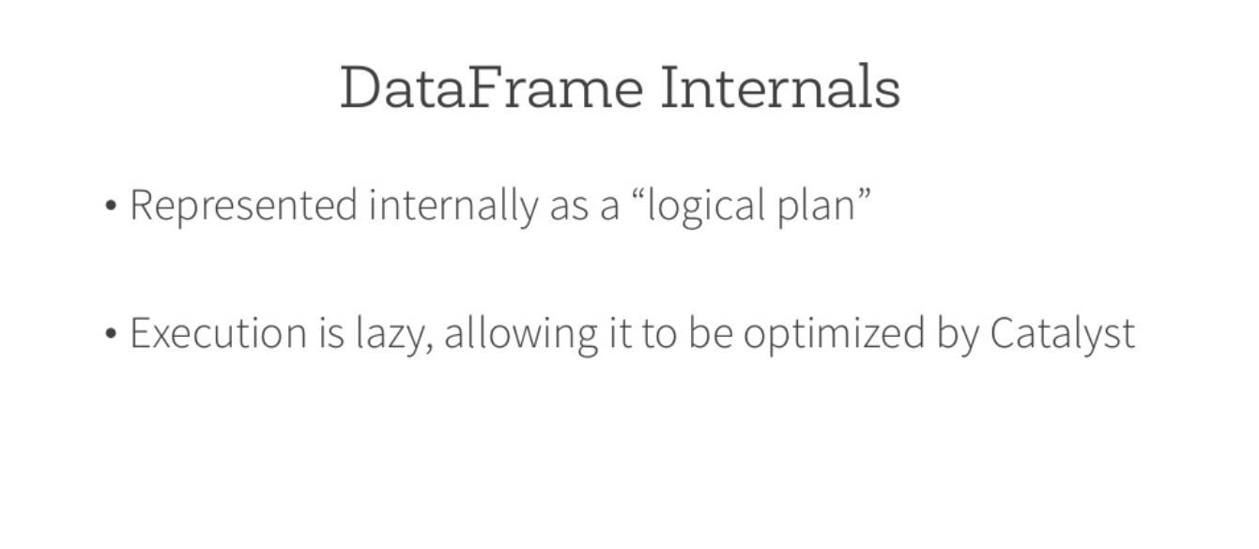

Slide 54
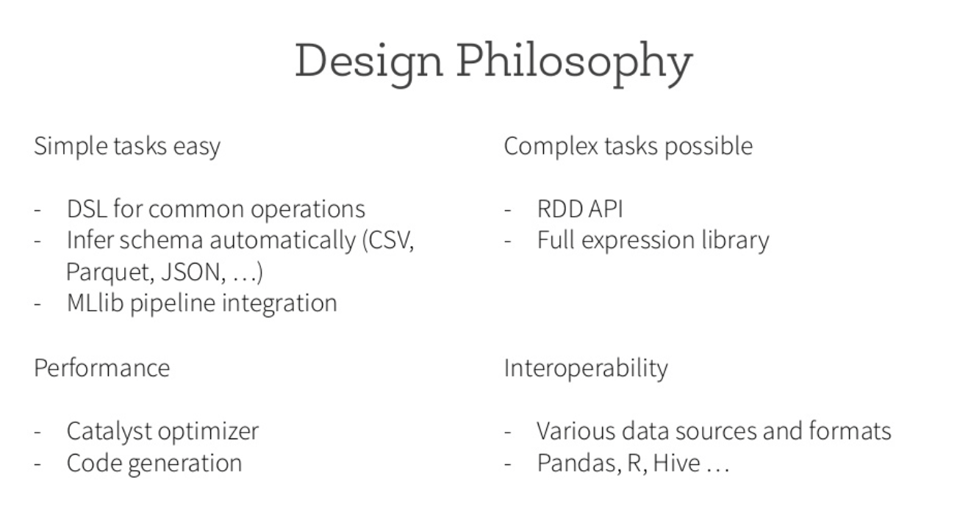
Notes:
Domain Specific Language :DSL

Slide 55
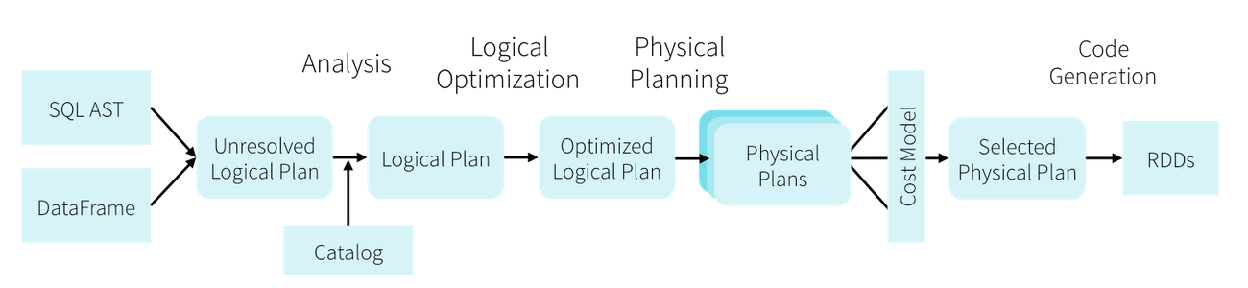
Optimization

Slide 56
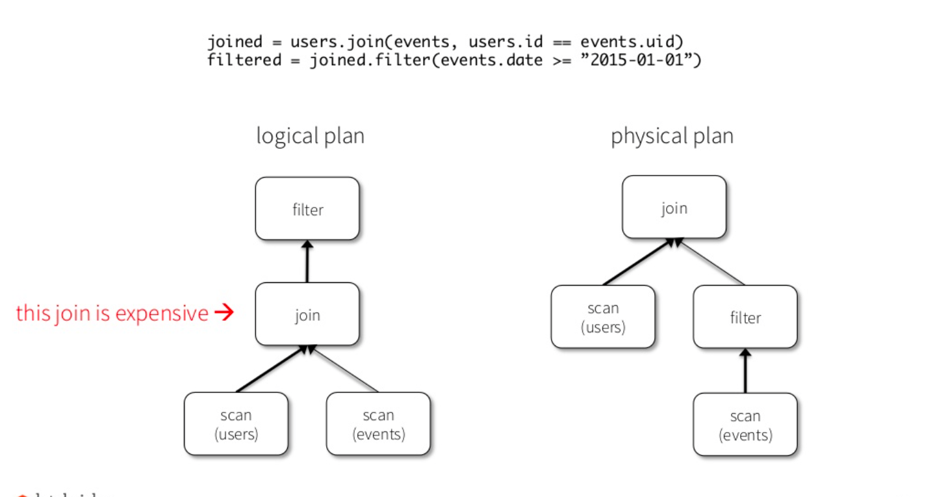

Slide 57
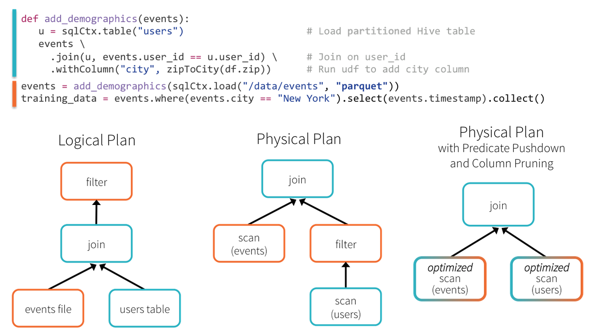

Slide 58
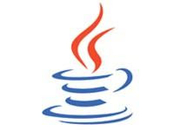





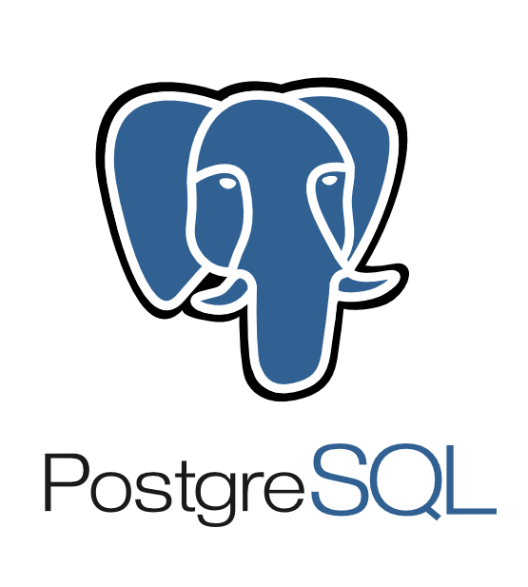









Extensible Input & Output
Spark’s Data Source API allows optimizations
like column pruning and filter pushdown into custom data sources.
Built-In
External
{ JSON }
JDBC
and more…

Slide 59
Spark MLlib
MLlib is a Spark subproject
providing machine learning primitives:
• initial contribution from AMPLab, UC Berkeley
• shipped with Spark since version 0.8
• 33 contributors

Slide 60
What is MLlib
Algorithms:
• classification: logistic regression, linear support
vector machine (SVM), naive Bayes
regression: generalized linear regression (GLM)
collaborative filtering: alternating least squares (ALS)
clustering: k-means
decomposition: singular value decomposition (SVD),
principal component analysis (PCA)

Slide 61
Scikit-learn?
Algorithms:
classification: SVM, nearest neighbors, random forest
regression: support vector regression (SVR),
ridge regression, Lasso, logistic regression,
clustering: k-means, spectral clustering,
decomposition: PCA, non-negative matrix factorization (NMF),
independent component analysis (ICA)

Slide 62
k-means (scala)
// Load and parse the data.
val data = sc.textFile("kmeans_data.txt")
val parsedData = data.map(_.split(‘ ').map(_.toDouble)).cache()
// Cluster the data into two classes using KMeans.
val clusters = KMeans.train(parsedData, 2, numIterations = 20)
// Compute the sum of squared errors.
val cost = clusters.computeCost(parsedData)
println("Sum of squared errors = " + cost)

Slide 63
Spark Mllib advantages
Scalability
Performance
User-friendly APIs
Integration with Spark and its other components

Slide 64
Thank You

