Slide 1
Programų sistemų testavimas ir konfigūracijos valdymas (PSTV7134)
Andrius Adamonis
http://www.mif.vu.lt/~adamonis/tikv
Tema02 – Test levels, methods and tools
2016/2017 m.m. rudens semestras

Slide 2
Warm-up

Slide 3
Which statements are correct when talking about V-model?
A. Consists of the same steps as Waterfall model
B. It is cyclical lifecycle model
C. It allows to deliver a working version of a software as early as possible
D. It allows to start test planning as early as possible
Notes:
D

Slide 4
Which statements are correct when talking about an iterative method?
A. Final specifications are used from the very beginning (of the project)
B. Users are involved into testing throughout whole implementation project
C. Changes in the software shall not be formally described
D. It is not suitable to develop web based systems
Notes:
B

Slide 5
Which cases list activities in the right order?
A. Unit testing, system testing, acceptance testing, maintenance testing
B. System testing, unit testing, acceptance testing, maintenance testing
C. Acceptance testing, system testing, maintenance testing, unit testing
D. Unit testing, maintenance testing, system testing, acceptance testing
Notes:
A

Slide 6
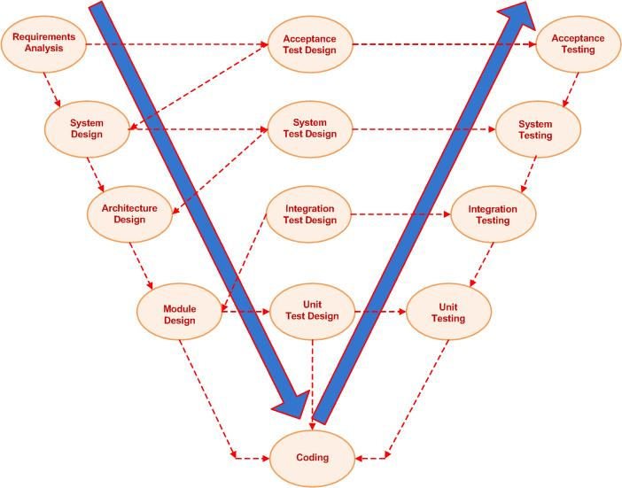
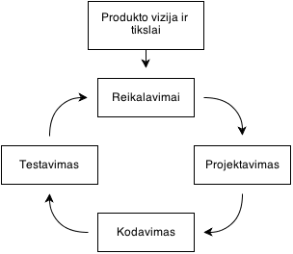
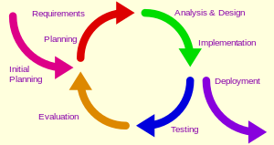
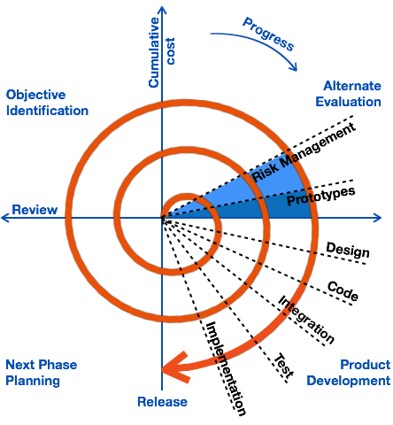
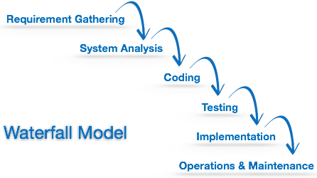
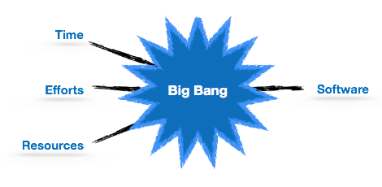
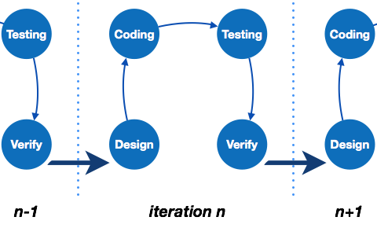
Software development lifecycle models
Sequential Iterative

Slide 7
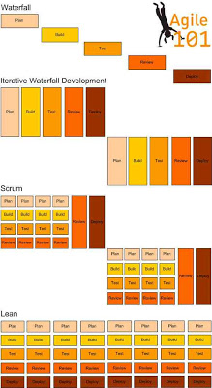
Software development lifecycle models

Slide 8
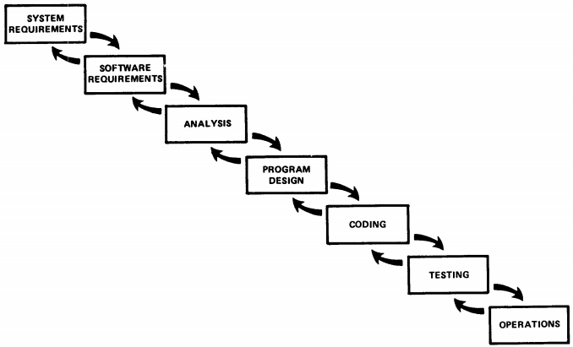
Sequential SDLC - Waterfall

Slide 9
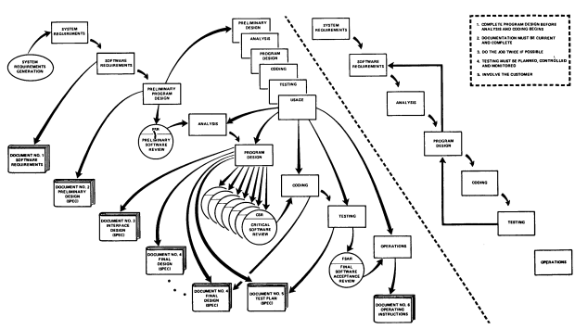
Sequential SDLC - Waterfall

Slide 10
Test levels in V-model

Slide 11
Test levels
Test object
Unit
Composite of units
System
Integration of systems
Relationship to V-model
Requirements
Acceptance testing
System spec
System testing
Technical spec
Integration testing
Unit design
Unit testing
Development

Slide 12
Unit testing
Unit:
Procedure, function, method, class, ...
Executed by developers
Does unit implement specification?
Is all code of the unit can be executed?
Defects are not logged – immediately fixed
Notes:
12

Slide 13
Benefits of unit testing
Easy to make changes in the code – if unit tests pass, then nothing's broken
Integration testing is easier
Tests – documentation of the system
Textual documentation might be easier to comprehend, but tends to become outdated
Test-driven development – unit tests instead of detailed design
Notes:
13

Slide 14
Unit testing
In ideal case – units are not interraleted
In reality – objects call methods of other objects:
Mock objects are needed (imituojantys objektai)
Method stubs are needed (fiktyvūs metodai)
Drivers, test harnesses are needed (fiktyvūs kvietėjai)

Slide 15
Mock object
Our actual code
Mock object for test case to test alarm
Example:
Time = GetCurrentTime();
if (Time >= ’07:00’) {
AlarmRing(“Get up!”);
}
GetCurrentTime() {
return 07:00
}

Slide 16
Stubs
Test harness to execute actual code
Our actual code
Example, object to be tested requires an object that would call its methods:
AlarmClock ac = new AlarmClock();
ac.AlarmRing(“Morning!”);
class AlarmClock() {
...
AlarmRing(string Text) {
Beep(10);
Print(Text);
}
}

Slide 17
Mock objects
Important to separate:
Interface from implementation
One system from another
If unit calls database:
Abstract db interface shall be created
Implementation of this interface shall be created – mock objec
Unit test shall avoid using db, mock object shall be used instead
Notes:
17

Slide 18
Unit testing
Unit testing according to purists
Automated unit testing:
xUnit
Cucumber?
Test generators?
Notes:
18

Slide 19
Integration testing
Units are integrated
Integration strategies:
big-bang integration
Bottom to top integration
Top to bottom integration

Slide 20
Big bang integration
All modules are integration at once
Separate integrations are not tested, only the system as a whole
Difficult to isolate defects
Bad choice ☺

Slide 21
Top to bottom integration
1
2
3
4
5
6
7
System is integrated in stages: first of all units that invoke another units
Testing is started from "the surface"
Stub units are required (fiktyvūs moduliai)
Notes:
Integravimo tvarka būtų: 1,2 ; 1,3 ; 2,4 ; 2,5 ; 3,6; 3,7. Testuojant modulių 1,2 integraciją, moduliai 4 ir 5 dar gali būti nesuintegruoti. Tada vietoje jų reikės imituojančių modulių.
21

Slide 22
Bottom to top integration
1
2
3
4
5
6
7
System is integrated in stages: first of all units that are not invoked by any other unit
Testing is started from "the bottom"
Drivers are used (fiktyvūs kvietėjai)
Notes:
22

Slide 23
System testing
It is not enough to test mutual integration of separate units
All integrated system is tested:
Functionality against functional spec
Non-functional testing
Environment – as close as possible to a production environment
Executed by an independent test team

Slide 24
Systems integration testing
Integration of seperate systems is tested, for example:
Integration of banking system with ATM
If systems are being developed by different teams:
What team is responsible for SIT?
Integrations:
Webservices, Message Queuing, Batch files, ...
Notes:
Šie pavyzdžiai atspindi, kokie gali būti integracijos tipai – online/sinchroninis bei asinchroninis
24

Slide 25
System integration testing
Things being tested:
Integrity of the systems (does not break when connected)
Connectivity (data is being transferred from one to another)
Integrity of data (data is integral in all systems)
Integrity of data at particular time
Integrity of data formats (when data is transferred, no discrepancies in formats)

Slide 26
Non-functional testing
What properties of the systems we want to test:
Suitability of the system (installability, maintainability)
Usability
Performance (speed, load tolerance)
Security
Error tolerance
Recoverability
Notes:
Tikslai ateina ne iš dangaus, o įvertinus projekto ir produkto rizikas.
26

Slide 27
System suitability testing
Suitability? – TODO
Is it suitable to automate planned tasks?
Suitable for real users?
Improves work processes?
Testing can be undertaken according to use-cases
Notes:
27

Slide 28
Usability testing
Usability
Comfortable?
Clear and simple?
Accesible? (suitabe for disabled)
Special testing methods:
Observation of users
Review against checklists of best practices
Usability standards
Notes:
Galima daryti apklausas, bet stebėjimas efektyviau
28

Slide 29
Performance testing
How effective:
When under expected load
When under extreme load
Is reaction time suitable?
Aren't there defects when under load?
After load decreases, whether system falls back into normal mode of operation?
Special tools are needed

Slide 30
Security testing
Properties tested:
Confidentiality
Data integrity
Authentification
Authorization
Non-repudiation
Penetration testing
Special tools and knowledge required
Notes:
30

Slide 31
Error-tolerance testing
Errors:
Incorrect data entered
No acces to servers (db, etc)
Lack of resources (timeouts, deadlocks, etc)
...
How errors are displayed to a user
Messages are clear
Work can be continued
Notes:
31

Slide 32
Deployment testing
Is it possible to deploy?
Can be deployed to non-standard location?
All necessary steps required?
What if system is already deployed?
What about uninstall?
For complex systems:
Installation documentation
Notes:
32

Slide 33
Acceptance testing

Slide 34
Smoke testing (bazinis testavimas)
In manuacturing – object tested is filled-in with smoke and extruding smoke signals about cracks – quick check whether it is worth to continue testing
In software development – set of core tests is executed in order to evaluate whether full test suite shall be executed
IOW, whether system passes the most basic test scenarious

Slide 35
Smoke testing
Often:
Used for regression testing
Automated
Executed immediately after system build

Slide 36
Retesting and regression testing
Retesting – execution of test cases that failed previous test round in order to confirm that defects have been fixed
Regression testing – repeated execution of test suite in order to confim that there are no new defects in the software parts that were not changed after previous testing and bugfixing round
Notes:
Pakeitimai ARBA pataisymai
36

Slide 37
Alfa and beta testing
Alfa testing – potential users test software in development environment
Beta testing – potential users test software in their own production environment; defect reporting system is needed
Usually used for products (COTS – commercial of the shelf – software)
There might be several iterations (RC, RC2, ...)

Slide 38
Operation readiness testing
Beta testing is more suitable for products
For large software projects operational readiness testing is more relevant
E.g., replacement of a banking system
IOW – system rollout (launch) rehearsal
All data has been transferred?
All system processes are running?
Is operations team ready to execute software and able to solve issues if there are any?

Slide 39
Maintenance testing
After system is launched maintenance starts
Changes come from:
New functionality is required
System is being upgraded into new environment/infrastructure
Data is migrated to a new system (data migration/archival)
Defects found

Slide 40
Maintenance testing
After changes:
Retesting
Regression testing (preceeded by analysis of effect of change)
Possible issues when analysing effect of changes:
Outdated specifications
Changes in the project team

