Slide 1
Software Engineering and Testing configuration management (PSTV7134)
Andrius Adamonis
http://www.mif.vu.lt/~adamonis/tikv
Tema03 - Test design
2016/2017 mm. fall semester
Notes:
The test development process (K3)
Differentiate between a test design specification, test case specification and test procedure specification. (K2)
Compare the terms test condition, test case and test procedure. (K2)
Evaluate the quality of test cases in terms of clear traceability to the requirements and expected results. (K2)
Translate test cases into a well-structured test procedure specification at a level of detail relevant to the knowledge of the testers.
Categories of test design techniques (K2)
Recall reasons that both specification-based (black-box) and structure-based (white-box) approaches to test case design are useful, and list the common techniques for each. (K1)
Explain the characteristics and differences between specification-based testing, structure-based testing and experience-based testing.
Specification-based or black-box techniques (K3)
Write test cases from given software models using equivalence partitioning, boundary value analysis, decision tables and state transition diagrams/tables.
Explain the main purpose of each of the four techniques, what level and type of testing could use the technique, and how coverage may be measured. (K2)
Explain the concept of use case testing and its benefits. (K2)
Structure-based or white-box techniques (K4)
Describe the concept and importance of code coverage. (K2)
Explain the concepts of statement and decision coverage, and understand that these concepts can also be used at other test levels than component testing (e.g. on business procedures at system level). (K2)
Write test cases from given control flows using statement and decision test design techniques. (K3)
Assess statement and decision coverage for completeness with respect to defined exit criteria.
Experience-based techniques (K2)
Recall reasons for writing test cases based on intuition, experience and knowledge about common defects. (K1)
Compare experience-based techniques with specification-based testing techniques.
Choosing test techniques (K2)
Classify test design techniques according to their fitness to a given context, for the test basis, respective models and software characteristics.

Slide 2
Warm-up

Slide 3
Which of the volgende define the expected result of a test?
A. Test case (test)
B. Test procedure (Test procedure)
C. Test execution Schedule (testing The timetable)
D. Test condition (Test condition)
Notes:
A

Slide 4
Which of the volgende are most Characteristic of structure-based testing?
A. information about how the software is constructed is used to DERIVE test cases.
B. Statement coverage and / or Decision Coverage Can Be Measured for Existing test cases.
C. The knowledge and experience of people are used to DERIVE test cases.
D. Test cases are derived from a model or specification of the system.
Notes:
A ir B

Slide 5
Case study
A system is designed to accept values ​​of examination marks as Follows:
Fail 0-39 inclusive
Pass 40-59 inclusive
Merit 60-79 inclusive
Distinction 80-100 inclusive
In volgende Which of the sets of values ​​are all values ​​in Different equivalence partitions?
A. 25, 40, 60, 75
B. 0, 45, 79, 87
C. 35, 40, 59, 69
D. 25, 39, 60, 81
Notes:
B

Slide 6
Terminology

Slide 7
The design of Tests:
Identify Test conditions.
Specify test cases.
Specify continue the procedure.

Slide 8
A test condition (Test condition)
A test condition - an item or event of a component or system That Could be verified by one or more test cases, eg a function, transaction, feature, quality attribute, or structural element.
In other words, a test condition is some Characteristic of our software That we can check with a test or a set of tests.

Slide 9
Test case (test)
A test case - a set of input values, execution Preconditions, expected results and execution postconditions, Developed for a Particular Objective or test condition, Such as to exercise a Particular program path or to verify compliance with a Specific Requirement.
In other words, a test case: the system gets to some starting point for the test (Execution Preconditions) then Applies a set of input values ​​That ShouldACHIEVE a Outcome given (expected result), and leaves the system at some end point (Execution postcondition).

Slide 10
Test procedure (Test procedure)
A test procedure specification - a sequence of actions for the execution of a test.
A test procedure todėl Identify all the Necessary actions in sequence the Execute a test. Test procedure SPECIFICATIONS are OFTEN CALLED testscripts.

Slide 11
Test design steps
dECID In a test condition, Which would typically be a small section of The Specification for our software under test;
design That case a test will verify the test condition;
write a test procedure to execute the test, ie get it into the right starting state, The input values, and check the Outcome.
To test a whole system we write a test execution schedule, Which puts all the individual pursuing the procedure in the right SEQUENCE and sets up the system so That They Can Be Run.

Slide 12
Test development steps
Identify the test conditions
that is, select the conditions that you need to check the software
Specify tests (test cases)
which will be tested in the test conditions
Specify test procedures
specifying how to meet the test, that is, as the original tested object initialized state, enter values ​​and test results
Just to test the system, you need to develop a testing schedule down the system by testing and testing procedures

Slide 13
example
Requirements:
1.2.3 The input screen Shall have three fields:
a title field with a drop-down selector;
a That surname field can accept up to 20 alphabetic characters and The hyphen (-) character;
a Which first name field can accept up to 20 alphabetic characters.
All Shall alphabetic characters without a case Insensitive. All fields mustwithout Completed. The date is validated When the Enter key is pressed. If the dateis Valid the system moves on to the job input screen; if not, an error messageis displayed.

Slide 14
example
Test condition (one of many):
Thy surname field can accept up to 20 alphabetic characters and the hyphen (-) CHARACTER
Test cases:
Mr. Brian Hambling
Ms Angelina Samaroo
Ms. Compo Simmonite
Mr. Hyde-White Wilfred
Mr. R Thangamani
Mr. Geoff Thompson1
Mr. Morgan Peter
Mr Williams Pete'
Mr. Ratnasabapathy SuperDuperVeryLongName

Slide 15
example
Test script:
Test precondition:
navigate the system to the APPROPRIATE input screen, select a title, Tab to the surname field,
Input values:
enter a of value,
TAB the The first house field and enter a of value, then press the Enter key.
Expected results:
The system Should the trial move on to the job input screen (if we input the date was valid),
Another test case, expected result:
display an error message (if the input was not valid date).

Slide 16
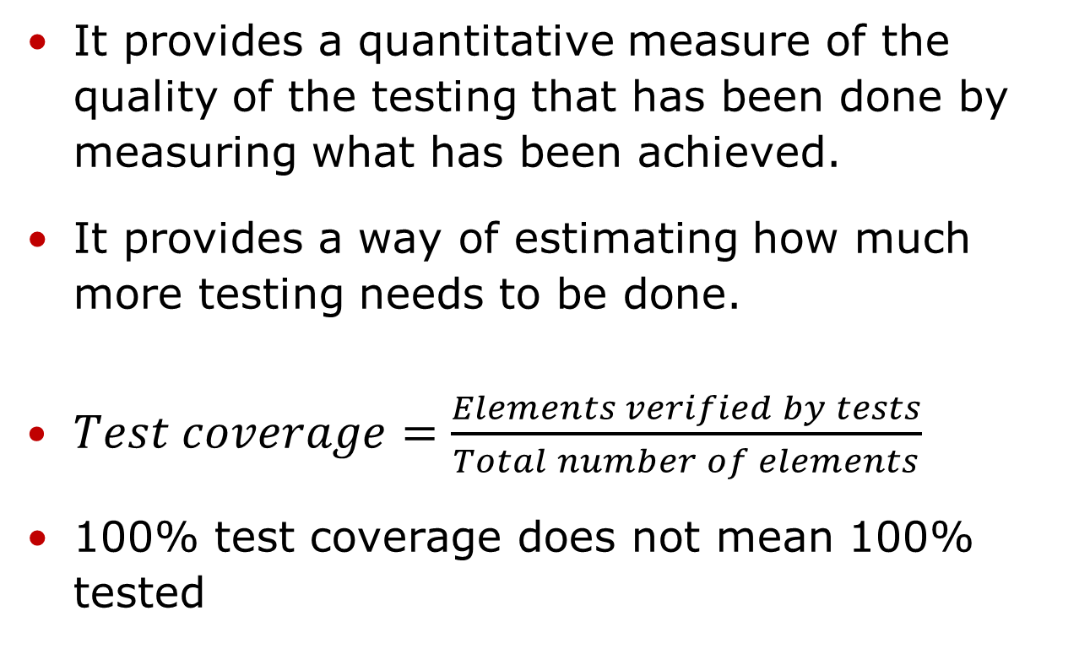
Test coverage
It provides a quantitative measure of the quality of the testing That has been done by measuring what has been Achieved.
It provides a way of Estimating how much more testing needs to be done.
100% test coverage does not mean 100% tested

Slide 17
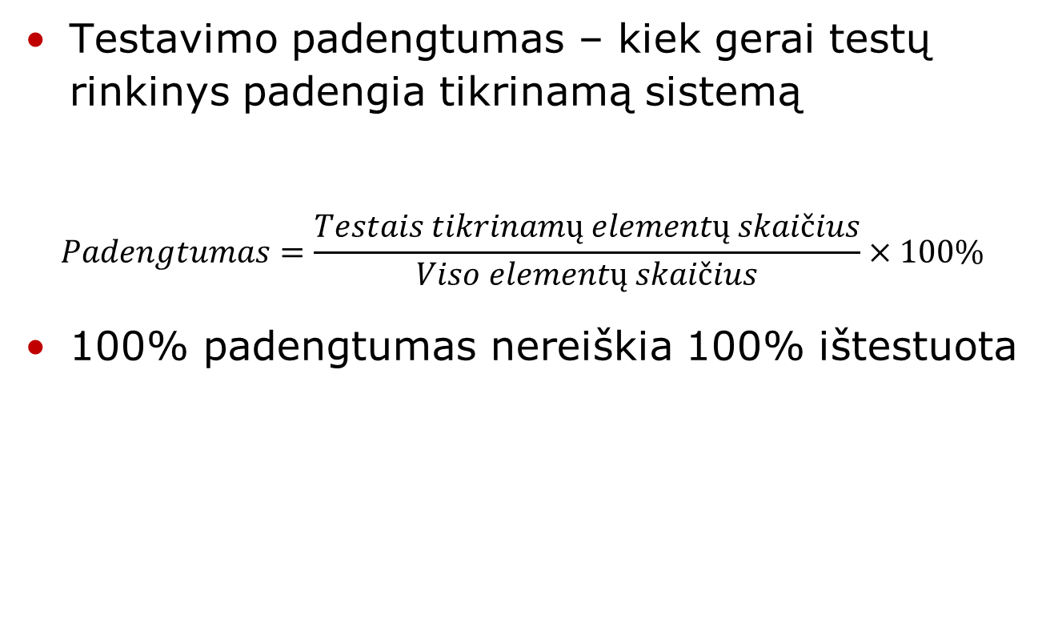
Test padengtumas

Slide 18
Test coverage
Benefits:
Forces the Develop Additional tests in Order the ACHIEVE Planned test coverage
helps the Identify code areas not covered by tests
Indirectly characterizes Quality
limitations:
Metrics is applicable only the code already Developed
If code is Discovery/not yet Developed, then structural testing techniques does not help the Identify Such areas

Slide 19
Smart tester

Slide 20
Smart tester
Goal of the smart tester is to understand the functionality, input / output domain, and the environment of use for the code being tested.
For Certain types of testing, the tester must also understand in detail how the code is constructed.
Finally, a smart tester needs tand use knowledge of the types of Defects That are commonly Injected During development or maintenance of this type of software.

Slide 21
Smart tester
using this information, the smart tester must then Intelligently select a subset of test inputs as well as combinations of test inputs That she believe have the greatest possibility of Revealing Defects within the conditions and Constraints Placed on the testing process.

Slide 22
Effective test
A smart tester who wants to Maximize use of time and resources knows That she needs to Develop what we will call Effective test Case for execution based testing.
Effective test case we mean one that has a Revealing good possibility of a defect, and
more efficient use of Organizational resources,
a higher probability test for reuse,
cadherence to loser Testing and Project Schedules and budget, and,
the possibility for delivery of a higher-quality software product.

Slide 23
Test design techniques

Slide 24
Categories
Those based on deriving test cases Directly from a specification or a model of a The proposed system or system, known as specification-based or black-box techniques.
Those based on deriving test cases Directly from the structure of a component or system, known as structure-based, structural or white-box techniques.
Those based on deriving test cases from the tester's experience of Similar Systems and General experience of testing, known as experience-based techniques.

Slide 25
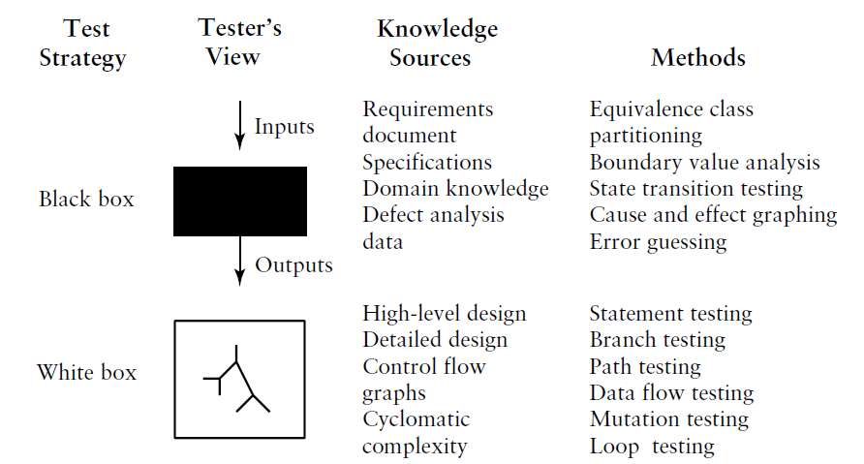
Major test techniques

Slide 26
Experience based test design techniques
Intuitive (BB)
Ad-hoc - testing without Any plan
Error guessing - Error guessing is a very simple technique that takes advantage of a tester's Skill, Intuition and experience with Similar applications to Identify special tests
Exploratory testing - Exploratory testing is a technique That combines the experience of testers with a structured approach to testing SPECIFICATIONS Where proceedings are missing or inadequate and Where there is severe time Pressure.

Slide 27
testing technology
Based on the properties of input data (BB):
Equivalent data class
Pairwise
marginal
Random data

Slide 28
Equivalence class
Enter new Widget Identifier:
Should a widget identifier consists of 3-15 alphanumeric Which characters of the first two letters must without
What are the equivalence classes?
What limit values ​​parinktume?
Make test Date of the table.
Notes:
Knygoje „Practical software testing“ 74 lapas (pdf – 96)

Slide 29
Pairwise Testing
When the test has a lot of input parameters and expensive to test all the combinations
Formed in each of two / three main parameters of the table in accordance with test results to determine the test cases persists

Slide 30
marginal
The relevant inputs limit values ​​and tests concluded that the tested combination of values ​​Each strip
Immunity test values ​​are selected and the permitted limits Bound

Slide 31
Random data
Input data is generated completely at random
OK automated

Slide 32
testing technology
Code-based analysis (WB):
The control sequences (control-flow)
as a management form the sentences of all possible execution paths of the program
data flow
Control sequences annotated variable value information to determine how variables are initialized and changed

Slide 33
testing technology
Error analysis is based on (BB / WB)
Error guessing
mutation testing
when the program is mutated in small syntactic changes and verify that the test found that the mutation caused by an error (in some cases, can be seen as a set of tests to conclude that "kills" all mutants)

Slide 34
testing technology
Usage scenarios based (BB):
Operational profile
The aim is to create input the date of its distribution corresponds to the actual environmental data
User tracking heuristics
Tracks the actual use and is concluded by tests, focusing on the most common behavioral Paterno

Slide 35
testing technology
The model-based (WB):
Decision tables
Made up of a table setting out what the input leads to the execution of the programs and the results of tests concluded to be checked all the possible combinations
The finite state machine
Made up state diagrams and tests designed to be applied to all states and transitions between them
Formal specification
Workflow models

Slide 36
ISTQB Foundation Requires
equivalence Partitioning
Boundary value analysis
Decision table testing
State transition testing
Use case testing

Slide 37
Literature
Lee Copeland, A Practitioner's Guide to Software Test Design, Artech House, 2004. ISBN: 158053791x
Notes:
A_Practitioner's_Guide_to_Software_Test_Design.chm
Software Testing. An ISTQB-ISEB Foundation Guide.pdf

