Slide 1
Programų sistemų testavimas ir konfigūracijos valdymas (PSTV7134)
Andrius Adamonis
http://www.mif.vu.lt/~adamonis/tikv
Tema03 – Test design
2016/2017 m.m. rudens semestras
Notes:
The test development process (K3)
Differentiate between a test design specification, test case specification and test procedure specification. (K2)
Compare the terms test condition, test case and test procedure. (K2)
Evaluate the quality of test cases in terms of clear traceability to the requirements and expected results. (K2)
Translate test cases into a well-structured test procedure specification at a level of detail relevant to the knowledge of the testers.
Categories of test design techniques (K2)
Recall reasons that both specification-based (black-box) and structure-based (white-box) approaches to test case design are useful, and list the common techniques for each. (K1)
Explain the characteristics and differences between specification-based testing, structure-based testing and experience-based testing.
Specification-based or black-box techniques (K3)
Write test cases from given software models using equivalence partitioning, boundary value analysis, decision tables and state transition diagrams/tables.
Explain the main purpose of each of the four techniques, what level and type of testing could use the technique, and how coverage may be measured. (K2)
Explain the concept of use case testing and its benefits. (K2)
Structure-based or white-box techniques (K4)
Describe the concept and importance of code coverage. (K2)
Explain the concepts of statement and decision coverage, and understand that these concepts can also be used at other test levels than component testing (e.g. on business procedures at system level). (K2)
Write test cases from given control flows using statement and decision test design techniques. (K3)
Assess statement and decision coverage for completeness with respect to defined exit criteria.
Experience-based techniques (K2)
Recall reasons for writing test cases based on intuition, experience and knowledge about common defects. (K1)
Compare experience-based techniques with specification-based testing techniques.
Choosing test techniques (K2)
Classify test design techniques according to their fitness to a given context, for the test basis, respective models and software characteristics.

Slide 2
Warm-up

Slide 3
Which of the following defines the expected result of a test?
A. Test case (testas)
B. Test procedure (testavimo procedūra)
C. Test execution schedule (testavimo vykdymo tvarkaraštis)
D. Test condition (testo sąlyga)
Notes:
A

Slide 4
Which of the following are most characteristic of structure-based testing?
A. Information about how the software is constructed is used to derive test cases.
B. Statement coverage and/or decision coverage can be measured for existing test cases.
C. The knowledge and experience of people are used to derive test cases.
D. Test cases are derived from a model or specification of the system.
Notes:
A ir B

Slide 5
Case study
A system is designed to accept values of examination marks as follows:
Fail 0–39 inclusive
Pass 40–59 inclusive
Merit 60–79 inclusive
Distinction 80–100 inclusive
In which of the following sets of values are all values in different equivalence partitions?
A. 25, 40, 60, 75
B. 0, 45, 79, 87
C. 35, 40, 59, 69
D. 25, 39, 60, 81
Notes:
B

Slide 6
Terminology

Slide 7
The design of tests:
Identify test conditions.
Specify test cases.
Specify test procedures.

Slide 8
A test condition (testo sąlyga)
A test condition – an item or event of a component or system that could be verified by one or more test cases, e.g. a function, transaction, feature, quality attribute, or structural element.
In other words, a test condition is some characteristic of our software that we can check with a test or a set of tests.

Slide 9
Test case (testas)
A test case – a set of input values, execution preconditions, expected results and execution postconditions, developed for a particular objective or test condition, such as to exercise a particular program path or to verify compliance with a specific requirement.
In other words, a test case: gets the system to some starting point for the test (execution preconditions); then applies a set of input values that should achieve a given outcome (expected result), and leaves the system at some end point (execution postcondition).

Slide 10
Test procedure (testavimo procedūra)
A test procedure specification – a sequence of actions for the execution of a test.
A test procedure therefore identifies all the necessary actions in sequence to execute a test. Test procedure specifications are often called test scripts.

Slide 11
Test design steps
decide on a test condition, which would typically be a small section of the specification for our software under test;
design a test case that will verify the test condition;
write a test procedure to execute the test, i.e. get it into the right starting state, input the values, and check the outcome.
To test a whole system we write a test execution schedule, which puts all the individual test procedures in the right sequence and sets up the system so that they can be run.

Slide 12
Testų kūrimo žingsniai
Identifikuoti testavimo sąlygas,
tai yra, atrinkti sąlygas, kurias reikia patikrinti PĮ
Specifikuoti testus (testavimo atvejus),
kuriais bus patikrintos tos testavimo sąlygos
Specifikuoti testavimo procedūras,
aprašančias, kaip įvykdyti testus, tai yra, kaip inicializuoti pradinę testuojamo objekto būseną, įvesti reikšmes ir patikrinti gautus rezultatus
Visai sistemai ištestuoti, reikės parengti testų atlikimo tvarkaraštį, nustatantį sistemos parengimo testavimui ir testų atlikimo tvarką

Slide 13
Example
Requirements:
1.2.3 The input screen shall have three fields:
a title field with a drop-down selector;
a surname field that can accept up to 20 alphabetic characters and the hyphen (-) character;
a first name field which can accept up to 20 alphabetic characters.
All alphabetic characters shall be case insensitive. All fields must be completed. The data is validated when the Enter key is pressed. If the data is valid the system moves on to the job input screen; if not, an error message is displayed.

Slide 14
Example
Test condition (one of many):
The surname field can accept up to 20 alphabetic characters and the hyphen (-) character
Test cases:
Mr Hambling Brian
Ms Samaroo Angelina
Ms Simmonite Compo
Mr Hyde-White Wilfred
Mr R Thangamani
Mr Thompson1 Geoff
Mr “Morgan” Peter
Mr Williams ‘Pete’
Mr Ratnasabapathy SuperDuperVeryLongName

Slide 15
Example
Test script:
Test precondition:
navigate the system to the appropriate input screen, select a title, tab to the surname field,
Input values:
enter a value,
tab to the first name field and enter a value, then press the Enter key.
Expected result:
The system should either move on to the job input screen (if the data we input was valid),
Another test case, expected result:
display an error message (if the input data was not valid).

Slide 16
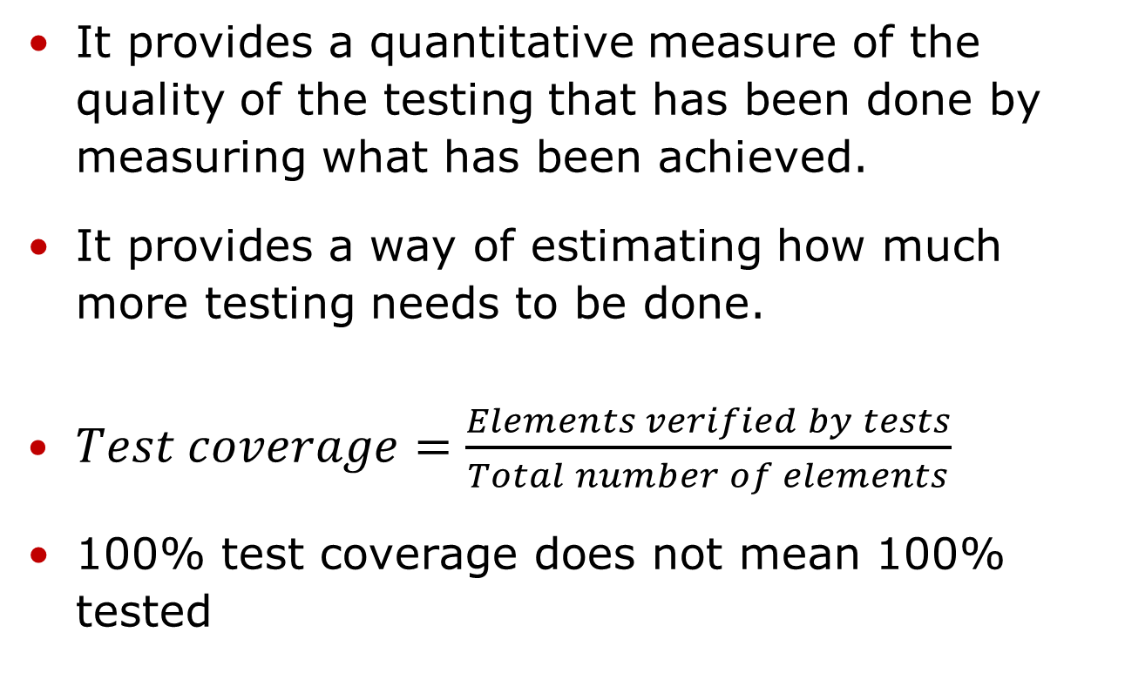
Test coverage
It provides a quantitative measure of the quality of the testing that has been done by measuring what has been achieved.
It provides a way of estimating how much more testing needs to be done.
$Test coverage=\frac{Elements verified by tests}{Total number of elements}$
100% test coverage does not mean 100% tested

Slide 17
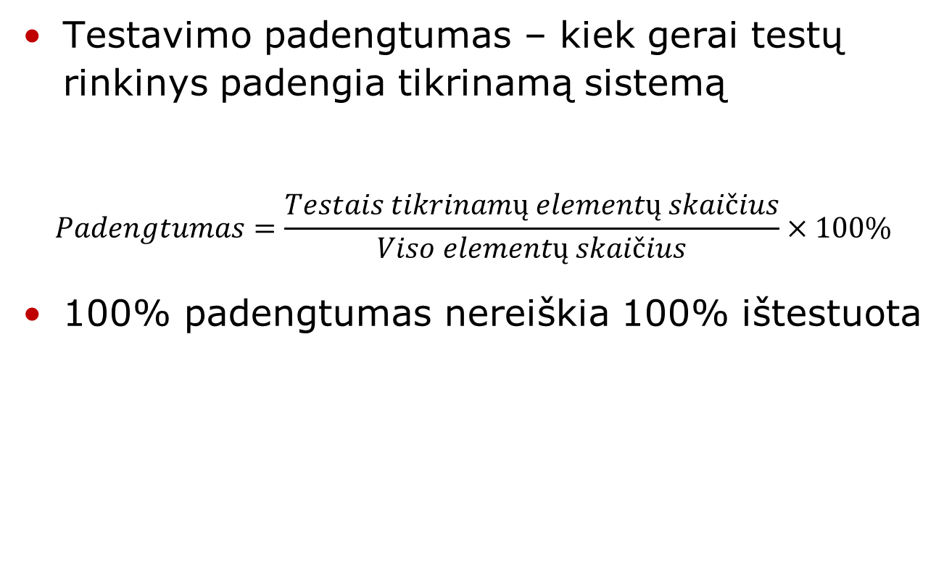
Testavimo padengtumas

Slide 18
Test coverage
Benefits:
Forces to develop additional tests in order to achieve planned test coverage
Helps to identify code areas not covered by tests
Indirectly characterizes quality
Limitations:
Metrics is applicable only to code already developed
If code is missing/not yet developed, then structural testing techniques does not help to identify such areas

Slide 19
Smart tester

Slide 20
Smart tester
goal of the smart tester is to understand the functionality, input/output domain, and the environment of use for the code being tested.
For certain types of testing, the tester must also understand in detail how the code is constructed.
Finally, a smart tester needs to use knowledge of the types of defects that are commonly injected during development or maintenance of this type of software.

Slide 21
Smart tester
Using this information, the smart tester must then intelligently select a subset of test inputs as well as combinations of test inputs that she believes have the greatest possibility of revealing defects within the conditions and constraints placed on the testing process.

Slide 22
Effective test
A smart tester who wants to maximize use of time and resources knows that she needs to develop what we will call effective test cases for execution-based testing.
effective test case we mean one that has a good possibility of revealing a defect, and
more efficient use of organizational resources,
a higher probability for test reuse,
closer adherence to testing and project schedules and budgets, and,
the possibility for delivery of a higher-quality software product.

Slide 23
Test design techniques

Slide 24
Categories
Those based on deriving test cases directly from a specification or a model of a system or proposed system, known as specification-based or black-box techniques.
Those based on deriving test cases directly from the structure of a component or system, known as structure-based, structural or white-box techniques.
Those based on deriving test cases from the tester’s experience of similar systems and general experience of testing, known as experience-based techniques.

Slide 25
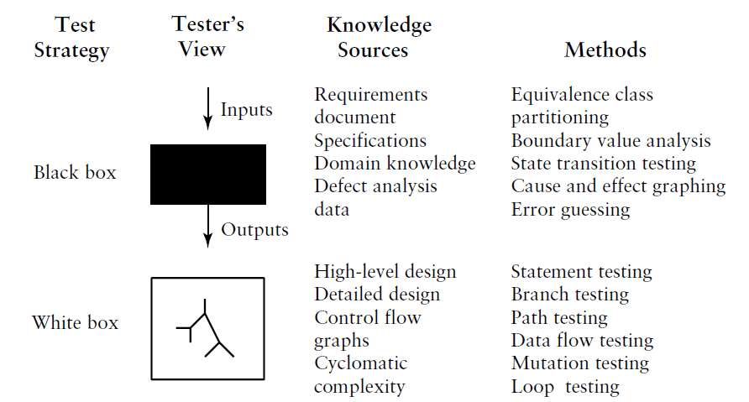
Major test techniques

Slide 26
Experience based test design techniques
Intuitive (BB):
Ad-hoc – testing without any plan
Error guessing - Error guessing is a very simple technique that takes advantage of a tester’s skill, intuition and experience with similar applications to identify special tests
Exploratory testing – Exploratory testing is a technique that combines the experience of testers with a structured approach to testing where specifications are either missing or inadequate and where there is severe time pressure.

Slide 27
Testavimo technikos
Įeities duomenų savybėmis pagrįstos (BB):
Ekvivalenčių duomenų klasės
Pairwise
Ribinių reikšmių
Atsitiktinių duomenų

Slide 28
Ekvivalentumo klasės
Enter new widget identifier:
a widget identifier should consist of 3–15 alphanumeric characters of which the first two must be letters
Kokios yra ekvivalentiškumo klasės?
Kokias ribines reikšmes parinktume?
Sudarykime test data lentelę.
Notes:
Knygoje „Practical software testing“ 74 lapas (pdf – 96)

Slide 29
Pairwise testing
Kai testas turi daug įeities parametrų ir jų visas kombinacijas ištestuoti brangu
Sudaromos kiekvienų dviejų/trijų parametrų kombinacijų lentelės ir pagal testų rezultatus galima nustatyti kurie atvejai nepraeina testo

Slide 30
Ribinių reikšmių
Nagrinėjamos ribinės įeities duomenų reikšmės ir testai sudaromi, kad būtų patikrintos reikšmių kombinacijos iš kiekvieno rėžio
Atsparumo testams reikšmės parenkamos ir už leidžiamų rėžių ribų

Slide 31
Atsitiktinių duomenų
Įeities duomenys generuojami visiškai atsitiktinai
Gerai automatizuojamas

Slide 32
Testavimo technikos
Kodo analize pagrįstos (WB):
Valdymo sekos (control-flow)
kaip valdymo sakiniai suformuoja visus galimus programos vykdymo kelius
Duomenų srautų
Valdymo sekos anotuojamos kintamųjų reikšmių informacija, siekiant nustatyti kaip kintamieji inicializuojami ir keičiami

Slide 33
Testavimo technikos
Klaidų analize pagrįstos (BB/WB):
Klaidų spėliojimo
Mutacijų testavimas
kai programa mutuojama mažais sintaksiniais pakeitimais ir tikrinama, ar testas surado tos mutacijos sukeltą klaidą (atskiru atveju, gali būti nagrinėjama, kaip sudaryti testų aibę, kuri „nužudo“ visus mutantus)

Slide 34
Testavimo technikos
Naudojimo scenarijais pagrįstos (BB):
Operacinis profilis
Siekiama sudaryti input data, savo pasiskirstymu atitinkantį realios aplinkos duomenis
Naudotojo stebėjimo euristikos
Stebimas realus naudojimas ir pagal tai sudaromi testai, fokusuojantis į dažniausiai pasitaikančius elgesio paternus

Slide 35
Testavimo technikos
Modeliu pagrįstos (WB):
Sprendimų lentelės
Sudaromos lentelės, nustatančios kokie inputai veda prie kurių programų vykdymo rezultatų ir testai sudaromi, kad būtų patikrinamos visos galimos kombinacijos
Baigtinių būsenų mašina
Sudaromos būsenų diagramos ir testai parenkami, kad būtų patikrinamos visos būsenos ir perėjimai tarp jų
Formali specifikacija
Darbų sekų modeliai

Slide 36
ISTQB Foundation requires
Equivalence partitioning
Boundary value analysis
Decision table testing
State transition testing
Use case testing

Slide 37
Literature
Lee Copeland, A Practitioner's Guide to Software Test Design, Artech House, 2004. ISBN:158053791x
Notes:
A_Practitioner's_Guide_to_Software_Test_Design.chm
Software Testing. An ISTQB-ISEB Foundation Guide.pdf

