Slide 1
Neural Networks Demystified
A Prologue to Neural Networks

Slide 2
Myserium
“Any sufficiently advanced technology is indistinguishable from magic.”
  – Arthur C. Clarke
“In the 1980s, Minsky and Good had shown how neural networks could be generated automatically - self replicated - in accordance with any arbitrary learning program. Artificial brains could be grown by a process strikingly analogous to the development of a human brain. In any given case, the precise details would never be known, and even if they were, they would be millions of times too complex for human understanding. Whatever way it worked, the final result was a machine intelligence that could reproduce - some philosophers still preferred to use the word "mimic" - most of the activities of the human brain - and with far greater speed and reliability. It was extremely expensive, and only a few units of the HAL9000 series had yet been built...”
  – 2001: A Space Odyssey

Slide 3
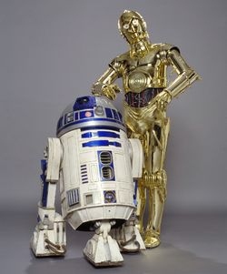


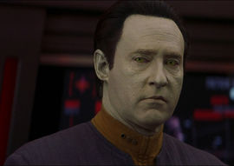
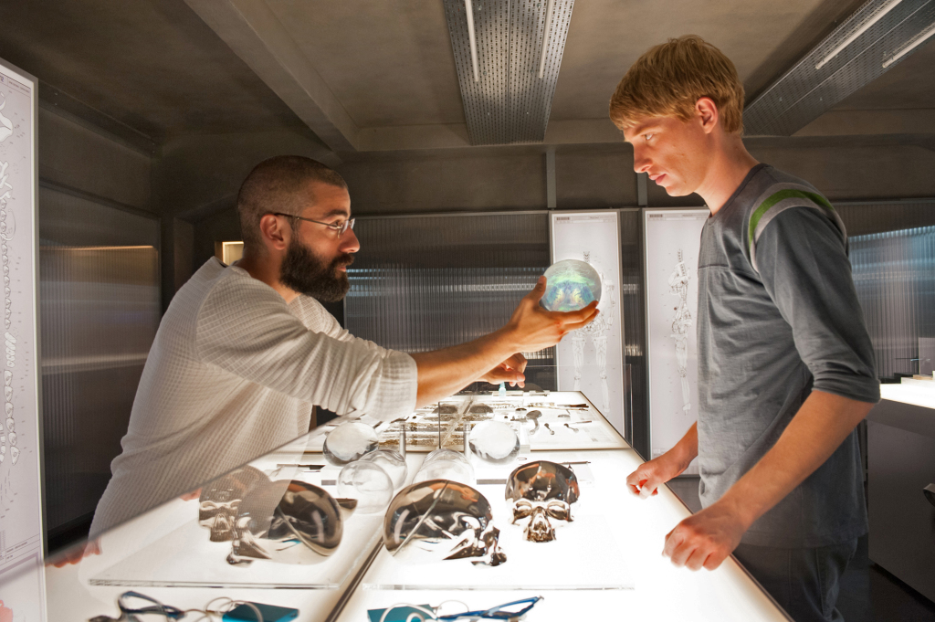
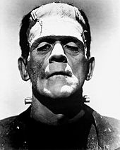
Notes:
http://2001.wikia.com/wiki/HAL_9000
http://starwars.wikia.com/wiki/Droid
http://www.davisenterprise.com/files/2015/04/Ex-MachinaW-1024x681.jpg
http://memory-alpha.wikia.com/wiki/Data
https://commons.wikimedia.org/wiki/File:Frankenstein%27s_monster_(Boris_Karloff).jpg
https://i.ytimg.com/vi/nQ7XUCBcAQg/maxresdefault.jpg

Slide 4
A few philosophical points …

Slide 5
Turing Test
Posed by Alan Turing
A judge is performing a blind interrogation of two individuals and cannot see which is a human and which is a computer
The computer passes the Turing test if the judge cannot determine which is the human and which is the computer
----------------------------------------------------------------------------------------------------------------
Can machines think? Do submarines swim? (Noam Chomsky) Is the Turing Test really sufficient to determine whether a machine is thinking like a human?

Slide 6
John Searle's Chinese Room
A person sits in room and receives Chinese texts via a mail slot.
This person doesn't know Chinese.
Based on instructions written in English, the person determines how to respond with the appropriate pictograms, writes a message, and returns an output via a second mail slot.
------------------------------------------------------------------------------------------------------------
Does a computer program (such a decision tree or neural network) really understand the symbols it manipulates? Does it matter whether it does or not if something practical can still be accomplished?
Is A.I. no more than unconscious processing?

Slide 7
What is Consciousness?
Consciousness is the Subjective Quality of Experience (Qualia)
Thomas Nagel's “What It's Like to Be a Bat”
  Bats have consciousness like humans but use echolocation to get around.
  Objective explanation without the subjective perspective cannot explain consciousness.
  Subjective perspective cannot be explained solely by objective terms.
David Chalmers
  Hard Problem of Consciousness: Explaining how and why we have qualia.
  Other problems of the mind can be, at least in theory, explained by science: attention, desire, perception, language processing, etc.

Slide 8
Frank Jackson's Knowledge Argument
Mary and The Black & White Room
Mary is a scientist in the field of color perception.
She knows all about the physics of light, the eye, and the visual pathways in the brain.
She has been living her whole life without color; the room and everything inside is black, white, or gray. No greens, no blues, no reds.
One day she steps outside the room and sees a blue sky, a red rose, and green grass.
By just seeing color for herself, Mary gains knowledge and learns something: what it feels like to see color. (Qualia)
-------------------------------------------------------------------------------------------------------------
Does a computer, an executing algorithm, or a neural network have a subjective quality of experience? How would we even know?

Slide 9
Ned Block's China Brain
  Imagine a billion people each have two-way radios (entire population of China)
  A person receives signals from others
    Some signals encourage a response
    Other signals discourage a response
    Based on the average kind of signal received, this individual decides to either send out a signal or not.
  -----------------------------------------------------------------------------------------------------------
  This network of people with radios could do some useful calculations but … is it conscious? Could we ever make it conscious? Would increasing the number of connections or types of connections cause consciousness to emerge?

Slide 10
Simulation vs Reality
Weather simulations are helpful predicting the weather forecasts, but does simulating a rain storm literally cause rain to form inside the computer?
Model is an abstraction of relevant features of some phenomenon
Model is an approximation at best
Simulation perform calculations based on a particular model to determine how measurable features will respond under given conditions
“All models are wrong; some are just more useful than others.” --unknown

Slide 11
Consciousness is overrated
Most of what the brain does is unconsciousness
  Breathing
  Typing words
  Walking
  Many “pre-programmed” decisions
  “autopilot”
  Libet experiment …
Most complex systems are not conscious
  Liver cells
  Heart – excitable cells
  Enteric nervous system
  Economies and societies
Just want to a machine to get stuff done …
  Automate the decision process
  Find patterns
  Classify data

Slide 12
A little neuroscience …
Notes:
The goal of computational neuroscience is use mathematical models, including neural networks, to help understand neurons and brains and behavior.

Slide 13
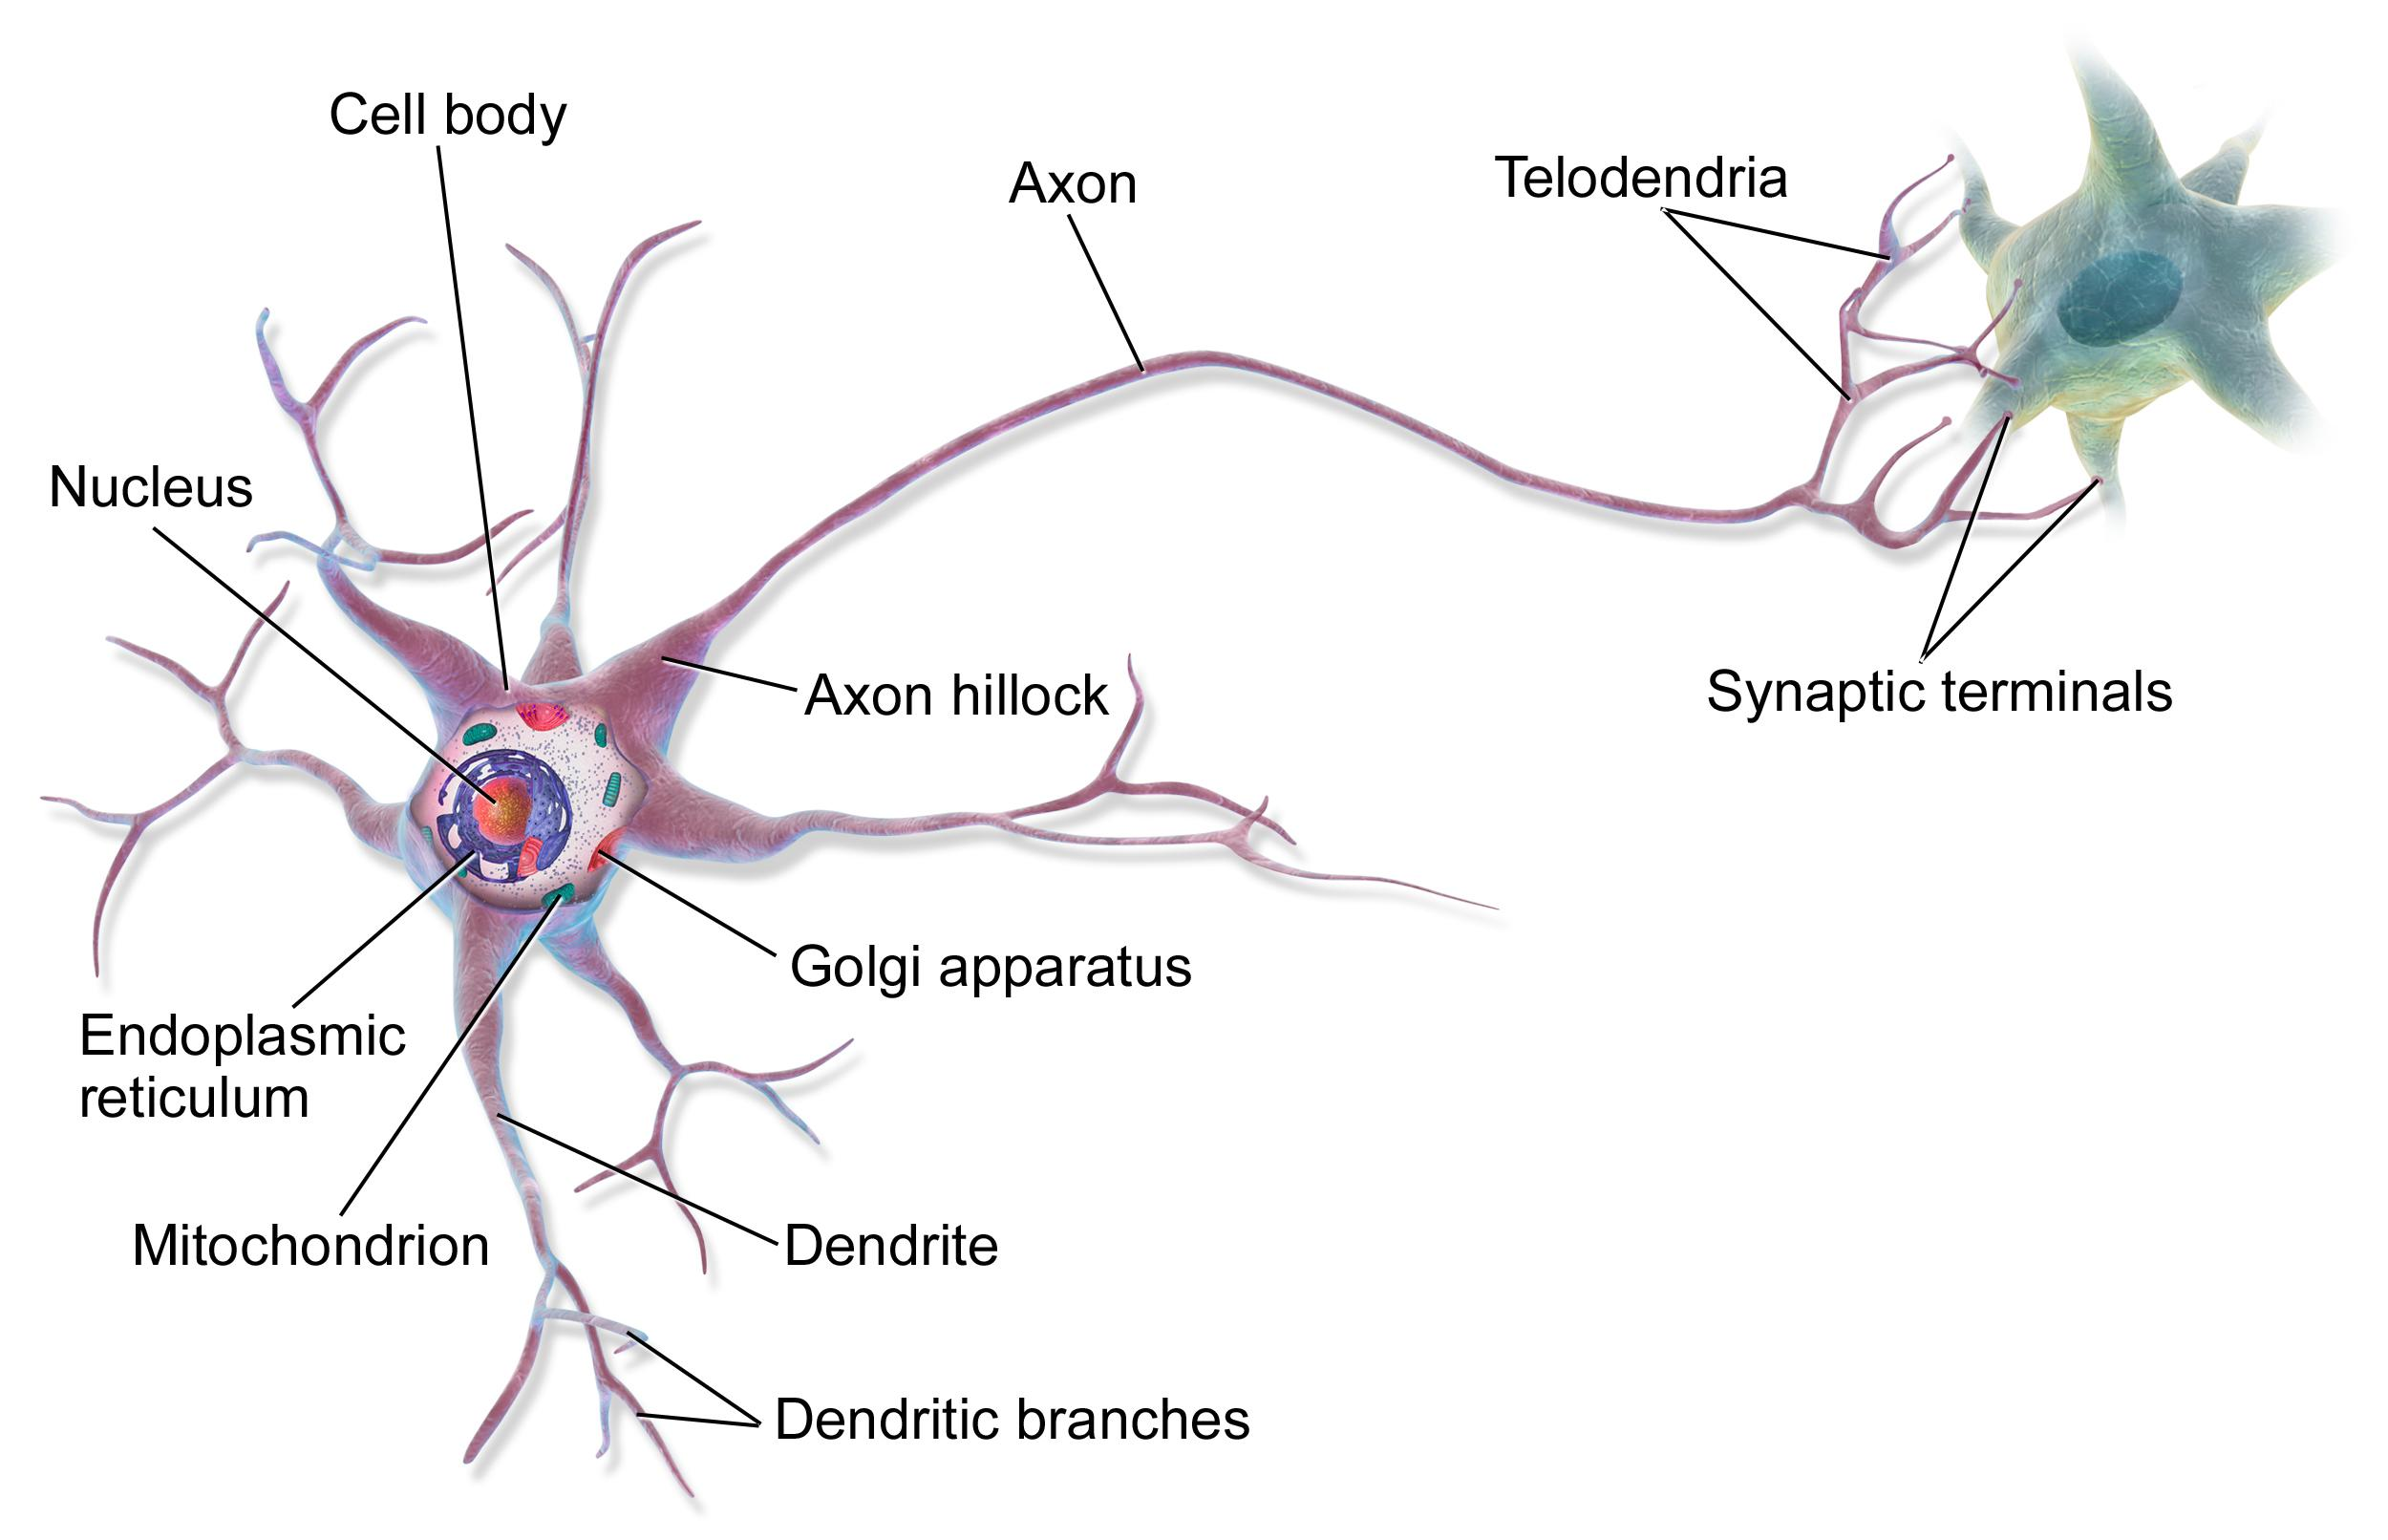
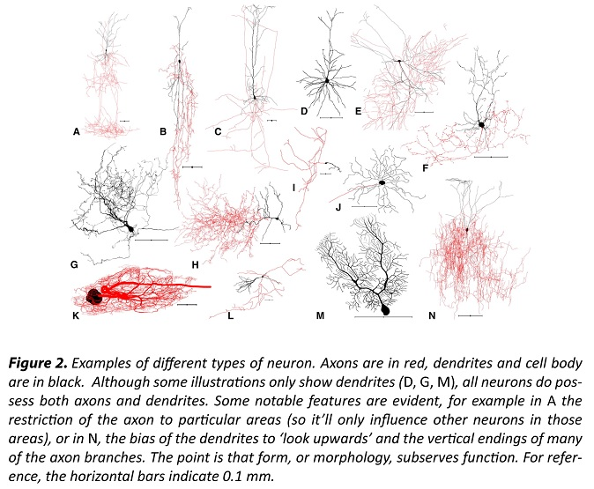
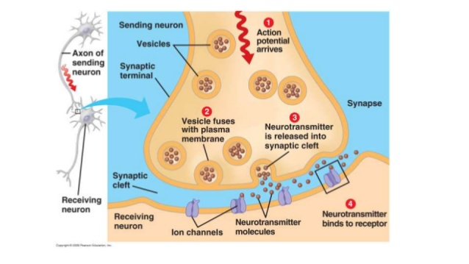
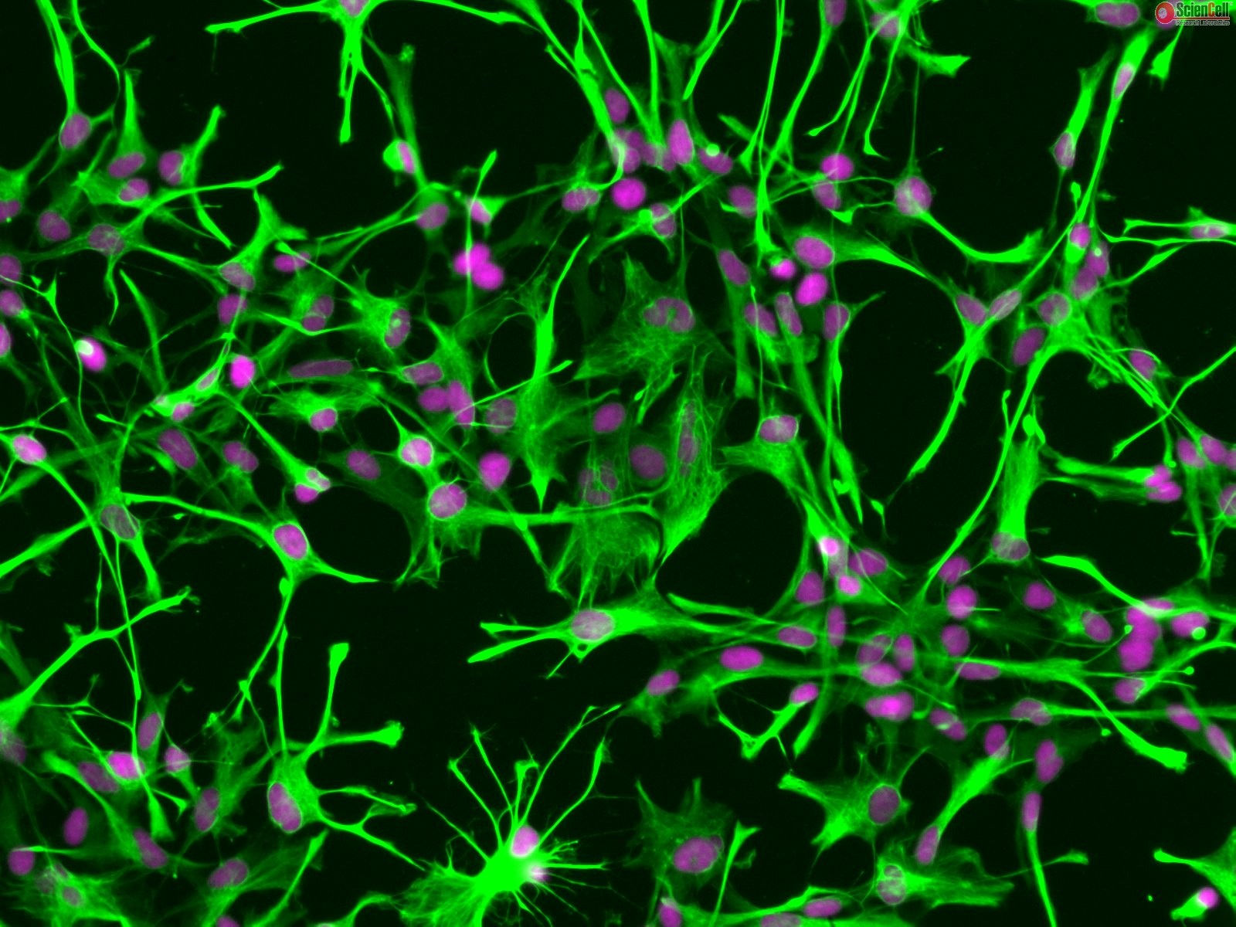
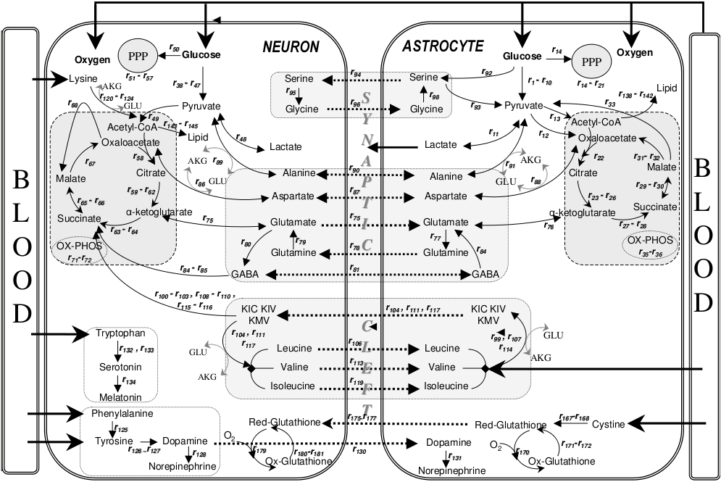
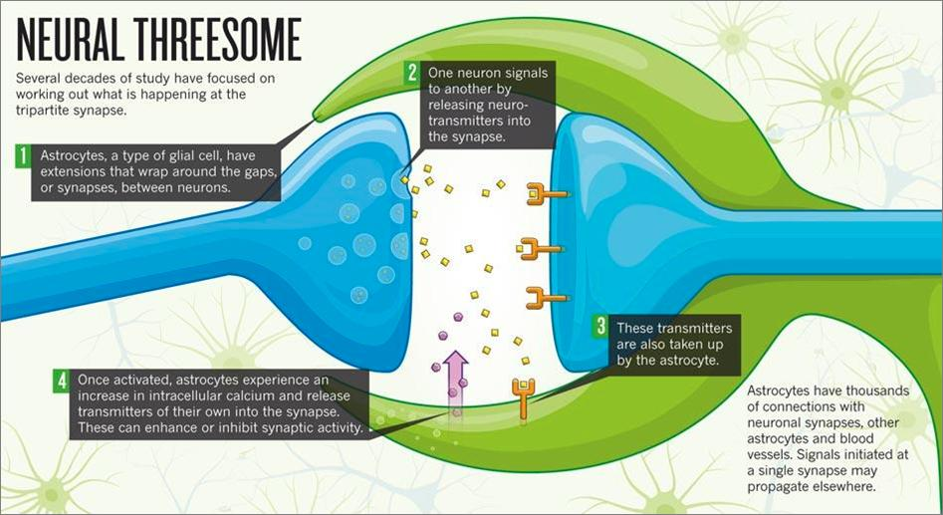
Biological Neurons
Notes:
Neurons are Living cells
Dendrites, soma, axon – https://en.wikipedia.org/wiki/Neuron
Astrocytes – By Prepared by User:OldakQuill from diagram in journal article (see source). Authors of article: Tunahan Cakir, Selma Alsan, Hale Saybasili, Ata Akin, Kutlu Ulgen - Cakir, Tunahan; Selma Alsan, Hale Saybasili, Ata Akin, Kutlu Ulgen (2007). "Reconstruction and flux analysis of coupling between metabolic pathways of astrocytes and neurons: application to cerebral hypoxia". Theoretical Biology and Medical Modelling 4 (1): 48. DOI:10.1186/1742-4682-4-48. ISSN 1742-4682. Retrieved on 2007-12-17., CC BY 2.0, https://commons.wikimedia.org/w/index.php?curid=3241290
http://www.sciencellonline.com/products-services/primary-cells/human-astrocytes.html
http://www.qbi.uq.edu.au/brain-facts/neuroscience-basics-action-potentials-and-synapses
https://wiki.brown.edu/confluence/display/BN0193S04/Astrocytes--Calcium+Signaling,+Gliotransmission,+and+Synaptic+Plasticity
http://www.slideshare.net/jamiehworkman/nervous-system-3-32538833

Slide 14
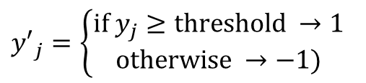
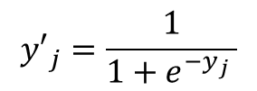
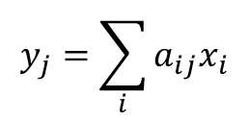

Artificial Neurons
Threshold or Squashing Function
Integrate Inputs
Σ
Notes:
Doesn't include neurotransmitters (although their effects might be captured by weights of inputs)
Nothing is modeled about what happens inside the cell.
Concentrates on the membrane potential and whether an action potential is triggered.

Slide 15
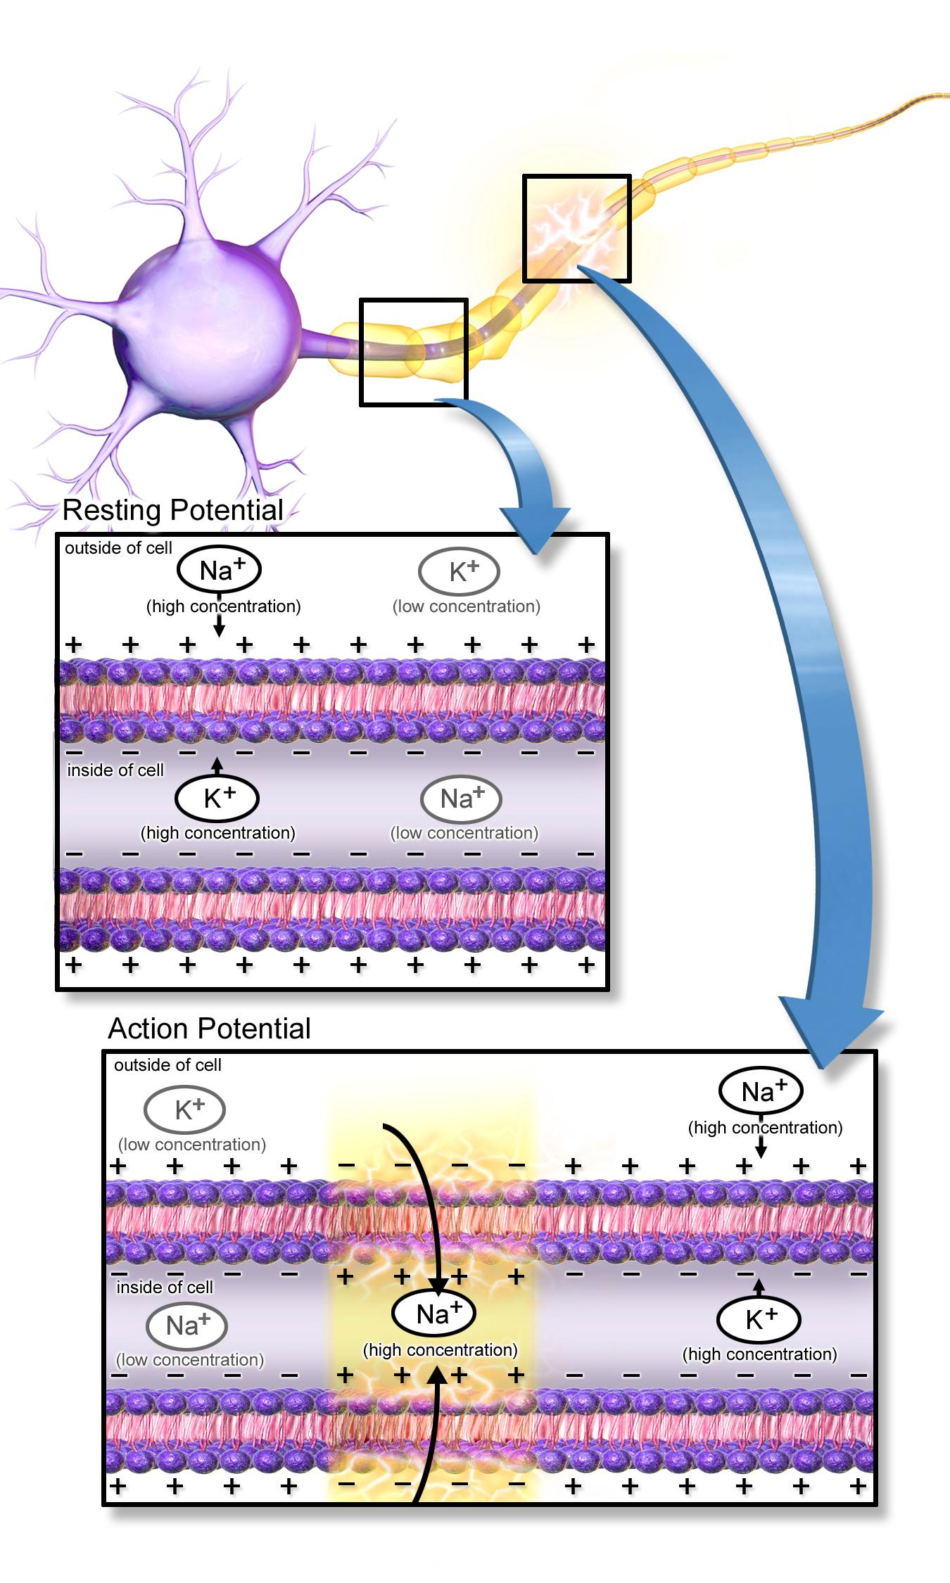
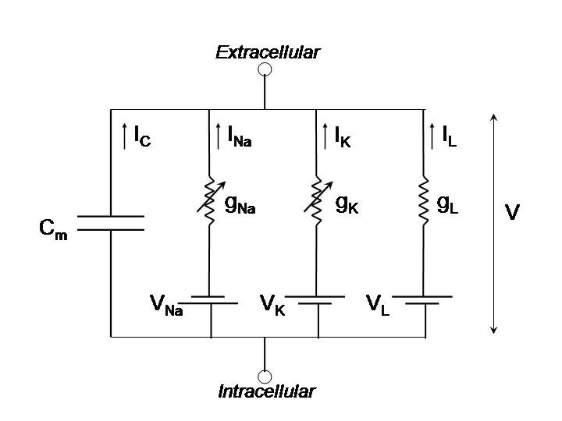
Hodgkin – Huxley Models
Notes:
Diagram of membrane, voltage gates, ions
By BruceBlaus. When using this image in external sources it can be cited as:Blausen.com staff. "Blausen gallery 2014". Wikiversity Journal of Medicine. DOI:10.15347/wjm/2014.010. ISSN 20018762. - Own work, CC BY 3.0, https://commons.wikimedia.org/w/index.php?curid=29452220
An action potential is a traveling disturbance in membrane potential, i.e. the voltage across the bi-lipid cell membrane of the neuron. The Hodgkin-Huxley equations are a mathematical model that describes the dynamics of membrane potential and the concentration of ions responsible for the membrane potential. Proteins embedded in the surface of the cell membrane, known as ion channels, allow the flow of ions across the membrane. Many of the relevant ion channels are voltage sensitive and change their shape (conformation) depending upon the membrane potential. Thus, as the membrane potential changes, these ion channels open up allowing specific ions (such as calcium, sodium, potassium) to flow or close off.
https://thephysicsdomain.files.wordpress.com/2013/03/hodgkin-huxley.png
Neurotransmitters

Slide 16
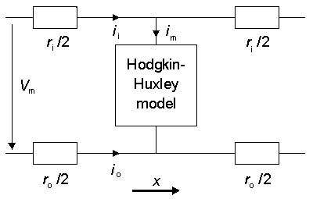
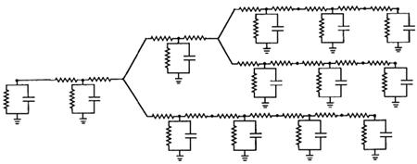
Cable Theory
Notes:
Hodgkin-Huxley equations are lumped capacitance – membrane is at the same potential everywhere.
Approximation is good for a small region or a soma but not so representative of a long axon.
Cable theory – use a mathematical model similar to that used for electrical transmission lines.
Membrane potential varies along the length of the axon as a traveling distrubance.
Show photo of circuit.
http://www.bem.fi/book/04/04.htm
http://www.brains-minds-media.org/archive/218

Slide 17
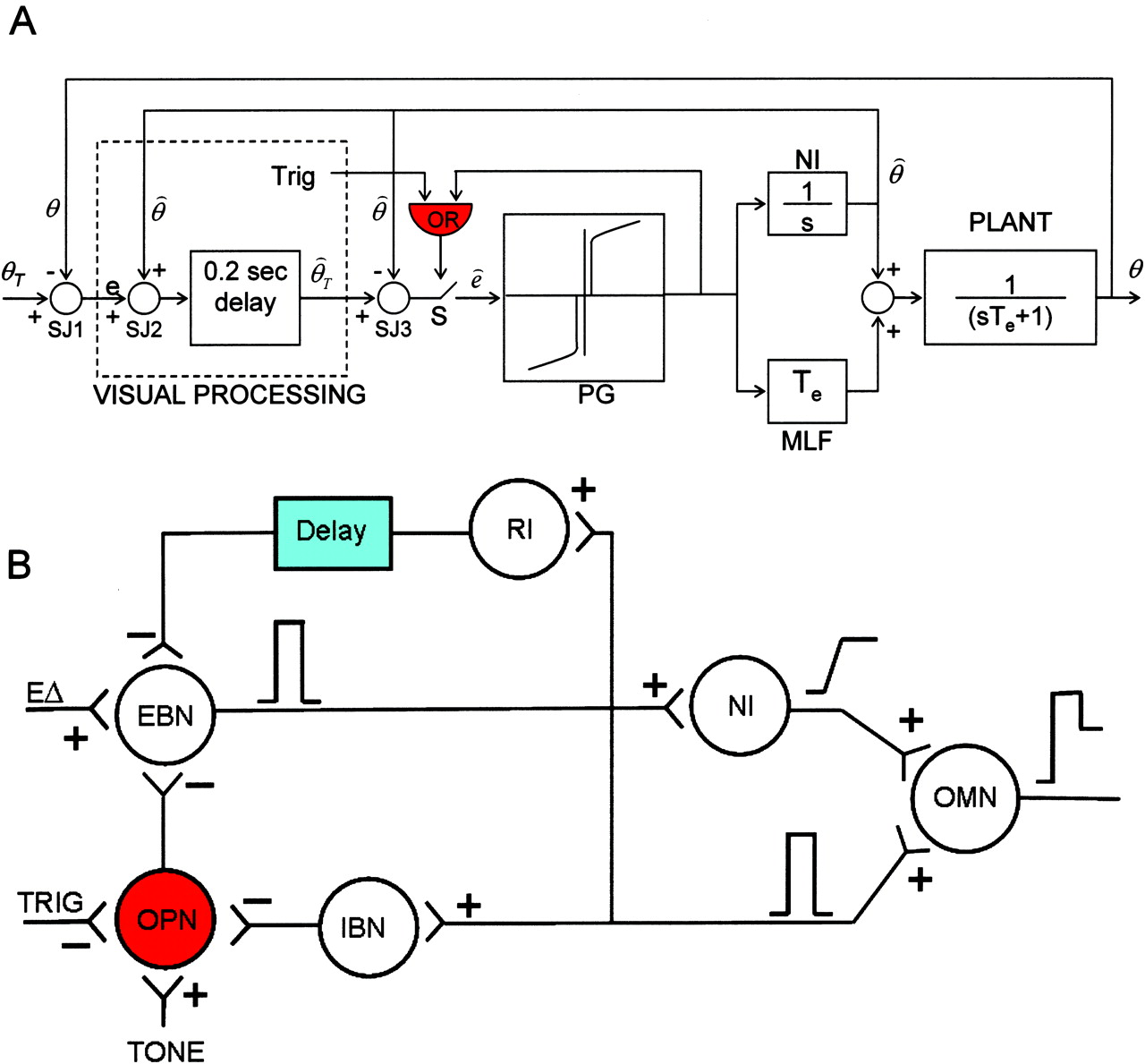
Control Theory
Experimental work by David Robinson on the Vestibular-Ocular Motor Reflex mathematically modeled with control theory.
Translated to a neural network model to understand how the brain might process signals
Notes:
Use control theory to build up mathematical model of a behavior or neurological response
Determine how neurons would realize that mathematical model
Ultimate goal is explaining how the brain performs
http://brain.oxfordjournals.org/content/130/1/10

Slide 18
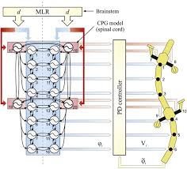
Central Pattern Generators
Notes:
Central Pattern Generators related to coordinated, rhythmic behaviors, such as animal locomotion
Photo of network of three nodes.
Each node spontaneously integrates voltage towards a threshold
When the voltage reaches the neuron's threshold the voltage resets and neuron fires.
The firing neuron inhibits the neuron on which it impinges.
https://www.cs.cmu.edu/~hgeyer/Teaching/R16-899B/Papers/Ijspeert08NeuralNEtworks.pdf

Slide 19
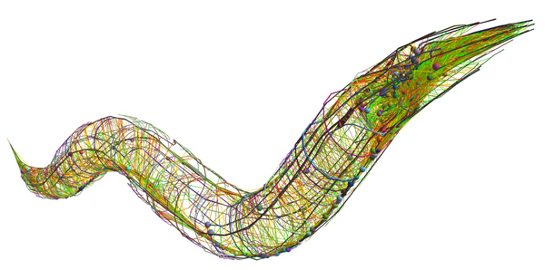
C. Elegans
Notes:
Real neurons are complicated living cells.
Models approximate what we measure.
Modeling C. elegans …. mapped all the neurons and connections … models still don't capture everything
http://www.scientificamerican.com/article/c-elegans-connectome/

Slide 20
A little engineering …
Notes:
If trying to automate reason is successful at playing chess but not in everyday reasoning humans perform, perhaps having computers mimicking how brains compute would result in computers capable of thinking more like humans.

Slide 21
What is Artificial Intelligence (A.I.)?
Strong A.I. - achieving general human-like intelligence in machines
Weak A.I. - non-sentient, intelligence with narrow focus
Automated Reasoning
  codifying what we know with rules
  expert systems, theorem proving
Biologically-inspired, computational paradigm to solve useful problems
  Artificial Neural Networks (Connectionism), Genetic Algorithms
  finding relationships we don't explicitly know in data
  recognizing patterns we might implicitly know in data

Slide 22
Brief History of A.I.
(Related to Neural Networks)
Warren McCulloch and Walter Pitts (1943) “A Logical Calculus of the Ideas Immanent in Nervous Activity”
Frank Rosenblatt – Mark I Perceptron (1958) – hardware-based, feed-forward, neural network capable of classifying visual patterns.
Marvin Minsky and Seymour Papert (1969) heavily criticized ANN which stifled funding
A.I. Winter (1970's and 1980's) – research didn't live up to hype, so funding dried up.
Connectionism (late 1980's) – reemergence of AI under a different name
Computational intelligence (1990's) – neural networks, fuzzy logic, genetic algorithms
Machine Learning (2000's and beyond) – computational methods based on statistical analysis of data
Computational paradigm to solve useful problems
  Abstractions not biological
  Another tool in the toolbox
Notes:
http://www.cse.chalmers.se/~coquand/AUTOMATA/mcp.pdf

Slide 23
Feed-forward Neural Network no feedback connections
x₁
y₁
y'₁
x₂
z₁
z'₁
y₂
y'₂
A
B
x₃
z₂
z'₂
y₃
y'₃
x₄
z₃
z'₃
y₄
yj = ∑aij*xi
y'j = fNL(yj)
zk = ∑bjk*y'j
z'k = fNL(zk)
y'₄
x₅
Notes:
Nodes
Inputs, activation function, output
Weights
Layers
Architecture

Slide 24
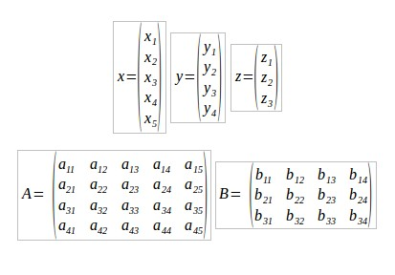

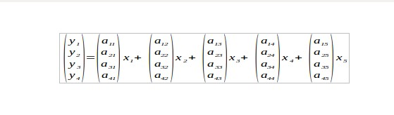
It's all Linear Algebra nowadays!
y = Ax
y' = fNL(y)
z = By'
z' = fNL(z)
Notes:
A basis is a set of linearly independent vectors which span the vector space. In other words, a linear combination of vectors from the set (a column array of numbers is a vector in this context) can uniquely represent any vector in the space. Also no vector in the set can be represented by a linear combination of the other vectors in that set (uniqueness).
y = Ax
The connections between this layer and that layer can be expressed by this matrix equation.
Y is a linear combination of the columns of A, with the elements of x as the coefficients
A is a set of basis vectors
Finding weights is finding the unknown basis vectors which map the input Y to the output X

Slide 25
Example Code in Elixir
ElixirDaze 2016 - Learn Elixir: Building a Neural Network from Scratch by Karmen Blake
Example of a feedforward neural network in Elixir
https://youtu.be/YE0h9DURSOo?t=18m59
Links to his github
  https://github.com/kblake/neural_network_elixir
  https://github.com/kblake/neural-net-elixir-v1
00:00-12:00 brief introduction to a feedforward neural network
12:00-15:00 his initial approach
15:00-19:00 his difficulties (bad code smell)
19:00-23:00 his refactored approach (cleaner code)
23:00-24:45 discussion on data transformations
24:45-29:20 training neural networks
29:25-end misc. comments
31:45-github links

Slide 26
Learning Algorithms
Need an objective function (measure of the difference between the output of the neural network and the training data) also called a fitness function.
Goal is to adjust weights to obtain optimal performance as measured by the objective function.
Learning (training) is Iterative process
  Run neural network with the training data
  Get a measure of the neural network's fitness using the objective function
  Adjust the weights as per the learning algorithm (which depends upon the value of the objective function for this iteration.)
  Repeat until the measure is optimal (not necessarily minimal because overfitting may cause the neural network to be less able to generalize.)
Back propagation is a common algorithm, but almost any optimization scheme might work.
Notes:
Learning algorithms
Objective / fitness function
Data for training and validation

Slide 27
Tips
Collected data might require preprocessing such as feature extraction of transformations
  Height or width of sampled waveform
  FFT
  Enumerated color or shading
Each input should be about the same magnitude.
  Having huge differences might cause numerical problems with matrix calculations
  Normalizing input values might help
  Using logarithms might help
Some of the data should be used for training and the rest for validation

Slide 28
Other Related Topics …
Statistical Pattern Recognition
  Template matching
  K-means clustering
  Principle Component Analysis
Support Vector Machines
Machine Learning

Slide 29
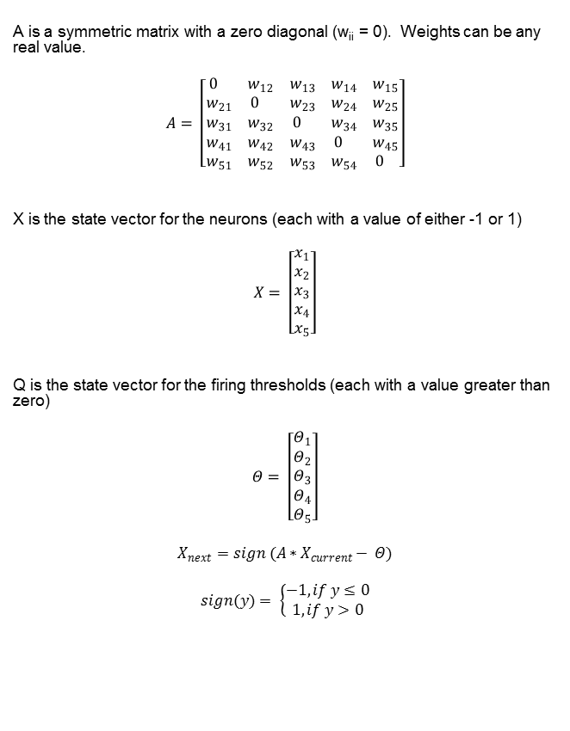
Hopfield Network
x₁
x₅
A
x₂
x₄
x₃
Notes:
All nodes fully interconnected
Dynamical system
Pattern recognition
Might be more difficult to implement – order to update – possibly random
Hebbian learning – unsupervised learning
Example in Elixir

Slide 30
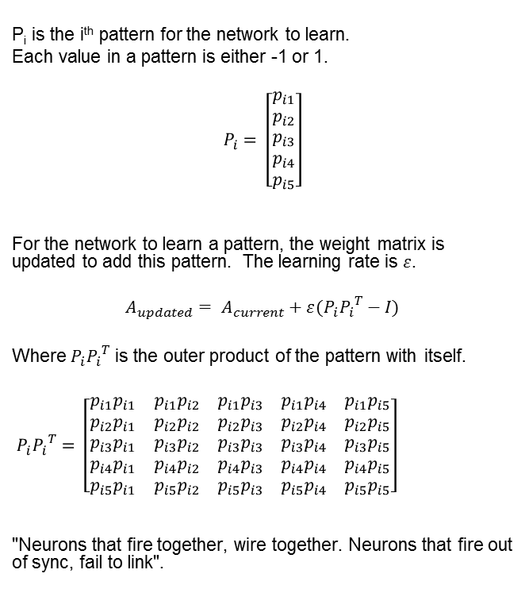
Hebbian Learning
x₁
x₅
A
x₂
x₄
x₃

Slide 31
Neurons in Elixir
Could just perform matrix calculations, but …
A neuron could be a process
Process may have internal states and associated activity in response to inputs

Slide 32
A return to consciousness …

Slide 33
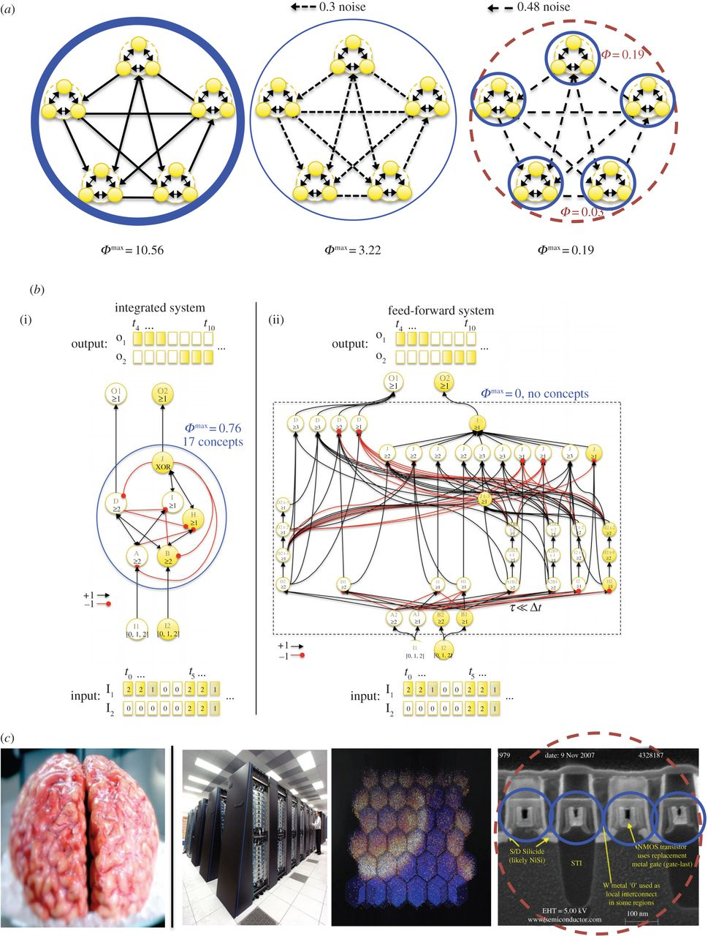
Integrated Information Theory
Giulio Tononi
Phi – measure of integrated information
More interconnected, the higher the Phi
Correlation to level of consciousness
Christof Koch
One cannot tell from the functional behavior (relationship between the input and the output) if a system has consciousness
Functionally equivalent networks with different architectures can have different phi values!
Neural Correlates of Consciousness
  Sub-components have internal states
  Network has feedback
Notes:
http://rstb.royalsocietypublishing.org/content/370/1668/20140167

Slide 34
Thank You!

Slide 35
Backup Slides

Slide 36
For Further Reading
Thomas Nagel, “What it's like to be a bat”
Christof Koch, Consciousness: Confession of a Romantic Reductionist
Giulio Tononi, Phi: A Voyage from the Brain to the Soul
David Chalmers, The Conscious Mind
Marvin Minsky, Society of Mind
Hubert Dreyfus, What Computers Can't Do
Russ Eberhart and James Kennedy, Swarm Intelligence
Computational Intelligence
Machine Intelligence

Slide 37
AI in Film
Ex Machina
Her
2001: A Space Odyssey
Blade Runner
Ghost in the Shell
A.I.
I, Robot
Star Wars
Star Trek

