Slide 1
UNIT 3 - Sprint 2 - Module 1
Web Application Development with Flask
Prof. Aleksandra Singer

Slide 2
Useful Links
Github Repo to FORK!
Flask Documentation
Flask + Database tutorial
Any API:
Github Public API repo:
Twitoff:
Heroku:
Basilica:
PFA/PMML:
https://github.com/LambdaSchool/DS-Unit-3-Sprint-3-Productization-and-Cloud
https://flask.palletsprojects.com/en/1.1.x/quickstart/
https://flask-sqlalchemy.palletsprojects.com/en/2.x/quickstart/#a-minimal-application
https://any-api.com
https://github.com/public-apis/public-apis
http://twitoff.herokuapp.com/
https://www.heroku.com/
https://www.basilica.ai/
https://medium.com/@avloss/machine-learning-in-production-41ccf9e2fc94

Slide 3
Objectives:
Distinguish between front end, back end, database, and which tasks are appropriate for which
Create a simple Python web application that exposes an API to URL endpoints

Slide 4
Learning Terms
Front end?
Back end?
Database?
Server?

Slide 5
Server vs Database
The Main Difference Between a Server and Database
Related information is collected, stored, and maintained in a Database and is primarily the data repository.
A Server is a hardware unit managing multiple or specific functions for a network and connected clients.
source: http://www.differencebetween.net/technology/difference-between-a-server-and-database/

Slide 6
Front End Vs Back End Development
Front-end developers work on what the user can see while back-end developers build the infrastructure that supports it. The term “front-end” refers to the user interface, while “back-end” means the server, application and database that work behind the scenes to deliver information to the user.
The user enters a request through the interface.
It’s then verified and communicated to the server, which pulls the necessary data from the database and sends it back to the user.
source: https://conceptainc.com/blog/difference-front-end-back-end-development/

Slide 7
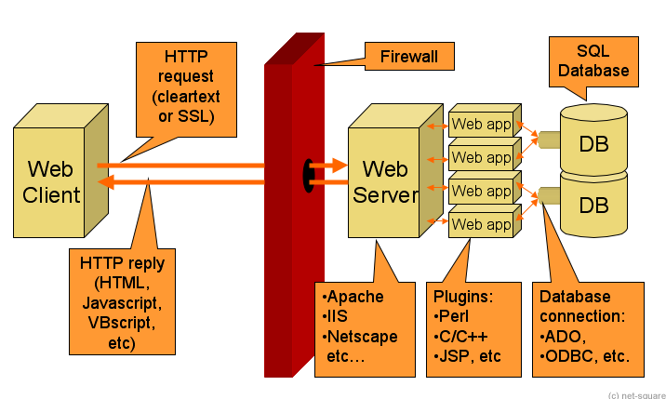

Slide 8
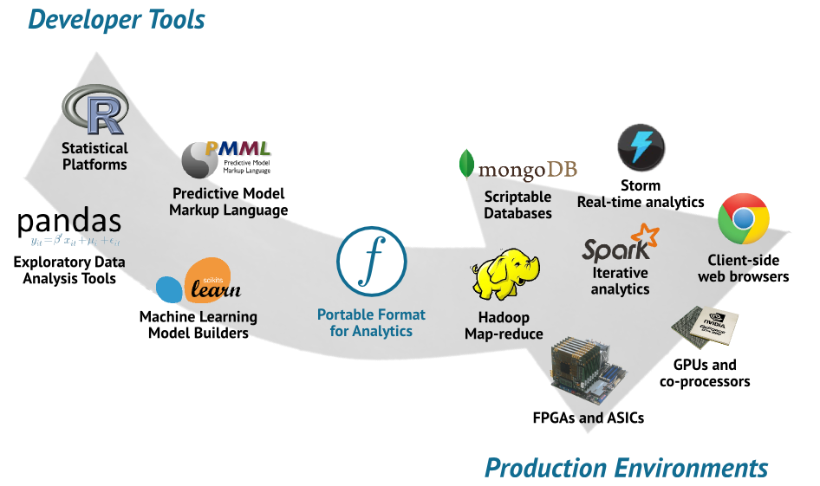

Slide 9
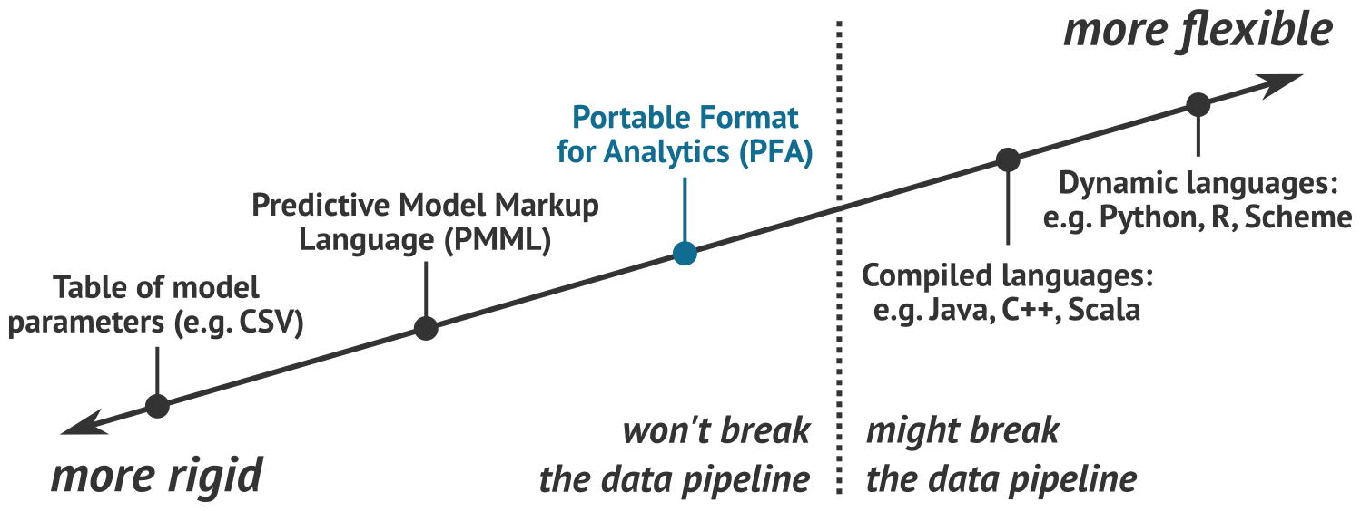

Slide 10
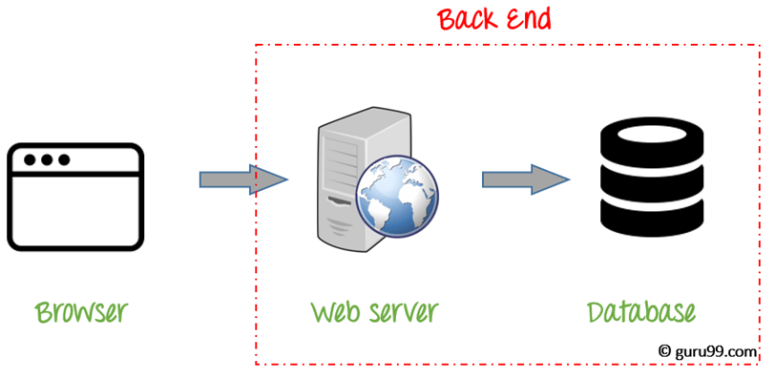

Slide 11
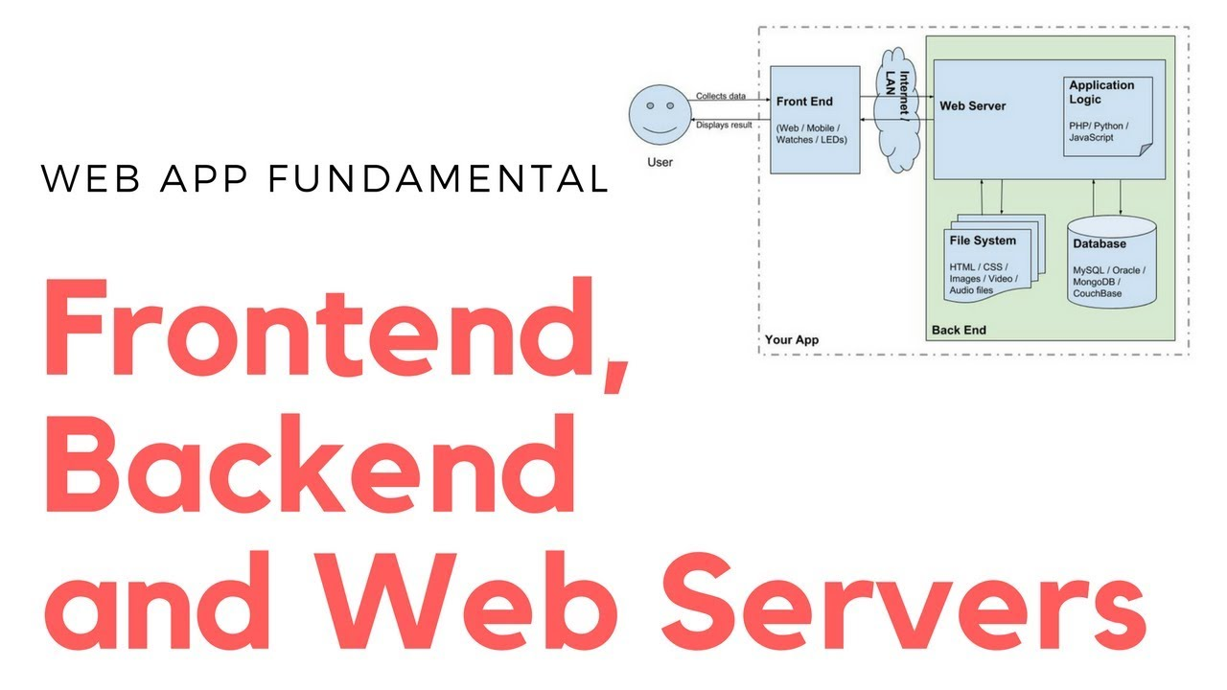

Slide 12
Virtual Environment for This Project
[packages]
flask = "*" (pipenv install Flask with a capital letter F)
jinja2 = "*"
basilica = "*"
tweepy = "*"
redis = "*"
psycopg2 = "*"
flask-sqlalchemy = "*"
gunicorn = "*"
scikit-learn = "*"
python-dotenv = "*"
python-decouple = "*"

Slide 13
Twitoff App
A fun web application for comparing and predicting tweets Check out the deployed version at:
http://twitoff.herokuapp.com/
or https://alekslovesdata-twitoff-ds7.herokuapp.com/

Slide 14
Objectives:
Distinguish between front end, back end, database, and which tasks are appropriate for which
Create a simple Python web application that exposes an API to URL endpoints

