Slide 1
Genuine Joe Analysis
By: Samuel Hepner

Slide 2
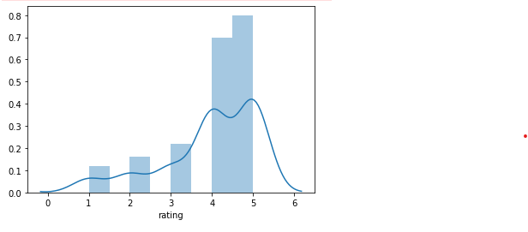

Yelp rating
Overall great!

Slide 3
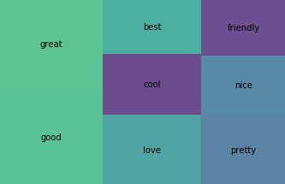

What are you doing well?
People, overall, agree that you are great café but they also agree that you have friendly staff. They also think the café is pretty and stylish.

Slide 4

Your competition
I selected the reviews that talk about all other coffee shops (not yours). I did the same analysis and I found that the avg. rating was higher but that doesn’t mean your competition is doing. It means that there were a lot more reviews so the bad coffee shops ratings didn’t affect the other coffee shops’ rating.

Slide 5
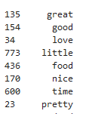
The competition’s yelp reviews
I found the top 8 words found in the competition’s Yelp reviews:
There are a lot of similarities between your coffee shop’s reviews.
However, there are two words here that are on your list:
‘Little’ and ‘time’
‘Little’ could be associated with little space or little portions. It could also be associated with a the fact that many people had little to say.
‘Time’ could mean it took a while to receive their order or they spent a long time there.

