Slide 1
Genuine Joe Analysis
By: Samuel Hepner

Slide 2
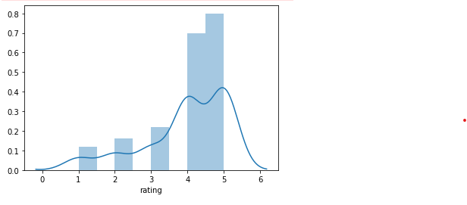
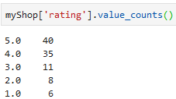
Yelp rating
Overall great!

Slide 3


What are you doing well?
People, overall, agree that you are great café but they also agree that you have friendly staff. They also think the café is pretty and stylish.

