Slide 1
Re:Public
A democracy assistant.

Slide 2
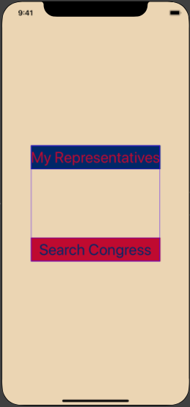
Home View
While this is probably the most unassuming screen in the application. It’s doing the most work. As this view loads, is begins a series of events. Loading first our “Voter” Object. Once that’s done, voter grabs location via CoreLocation. Once it’s determined what state the user lives in, it’s off to the races.
The system is able to bootstrap itself with a complete set of data from anywhere in the U.S. for every congressman of a state. Sounds like it takes multiple requests and a lot of sorting, seitching and background, logic, doesn’t it? In a couple of slides we’ll get to how that works.

Slide 3
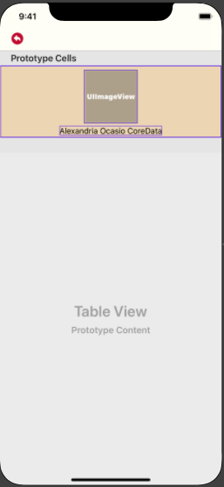
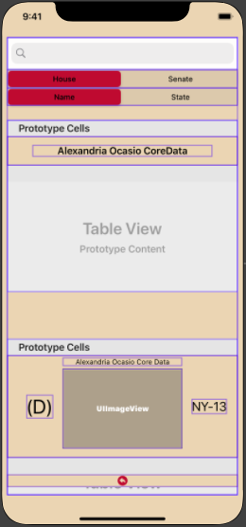
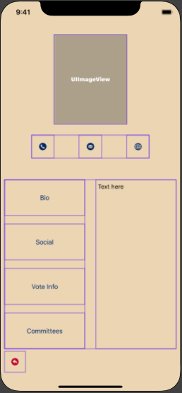
Features
In addition to the automatically populated tableview containing a user’s reps, there’s a full featured search that will allow users to search by name or by state for either chamber of congress.
We can get from either of these views to a detail view which shows off just a little of the breadth of data our API is providing us. This screen will allow you one-touch information access as well as direct contact via phone, email, and HTTP. All at one tap.

Slide 4
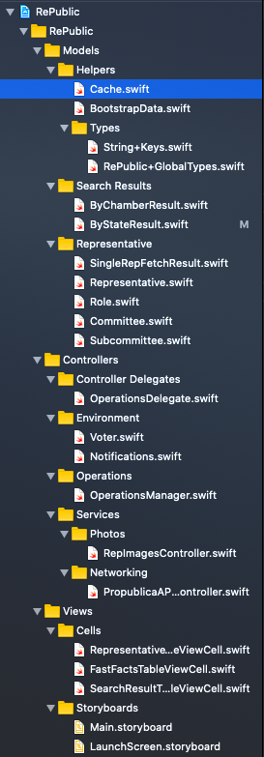
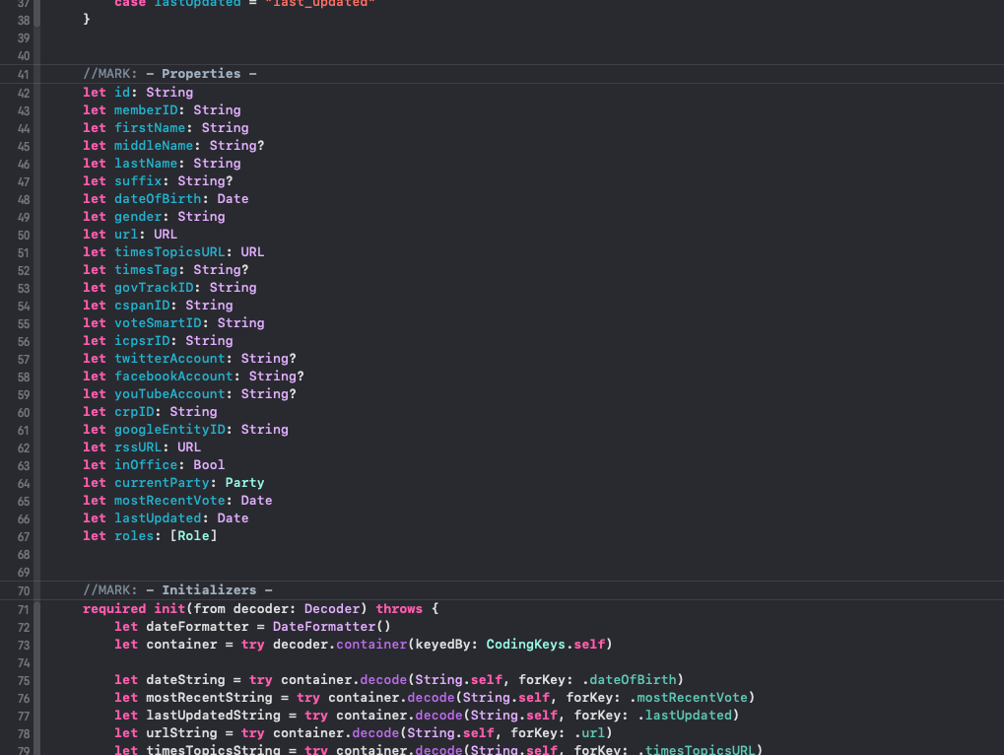
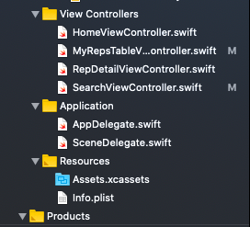
Under the Hood
This, as you can see is a monster of an app underneath. I designed it to be robust and make adding more features later as easy as justa couple of lines of code. I did this by extending the model out to it’s limits and making sure there was organized access to data without skimping on the more obscure or wonky data points that seem less obvious for features now.

Slide 5
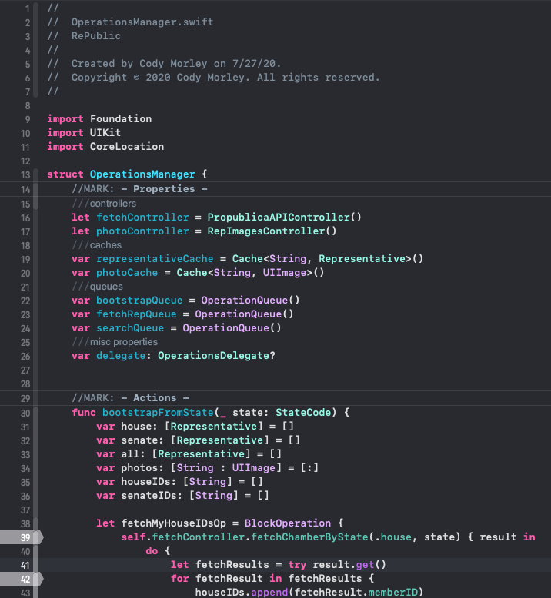
Concurrency
Concurrency was always going to be this app’s biggest issue. Lots of fetches, lots of sorting lots of coercing sysm control enums back and for to their natural string types… sounds like an asyncronus nightmare. And it would be….
Except for the Operations Manager. At 500 lines of code this is easily the largest file in the app. It runs 3 Queues of asynchronous tasks and manages 2 separate caches. It’s also soley responsible for changing any data on the Voter object and thus through the app via it’s delegation pattern. Like every app there were errors with this one. But none of them had to do with multithreading!

