Slide 1

University of Rwanda
College of Science and Technology
D_C^q X(t)=F(t,X(t))
R0 = beta_eff/(tau_eff+delta+mu) x [1+eta tau_eff/(rho_eff+mu)]
A Fractional-Order Compartmental Model
of HIV Transmission
with Social Behaviour Interventions
Fractional SITA dynamics and dashboard simulation
NDACYAYISABA Lambert
Supervisor: Dr. MUHIRWA Jean Pierre
Kigali, Rwanda
Presentation content follows the submitted final-year project report

Slide 2
Background / Motivation
Rwanda-aware public-health motivation
Context: HIV in Rwanda
HIV transmission is shaped by biology, treatment access, and social behaviour.
Awareness, safer behaviour, testing, treatment-seeking, and adherence can change long-term outcomes.
In Rwanda, prevention and adherence support remain important alongside treatment progress.
Mechanism: Behaviour
Method: Fractional memory
Output: Simulation evidence
Why mathematics?
A model gives a controlled way to compare intervention strategies and understand possible long-term behaviour.

Slide 3
Problem Statement + Literature Gap
Limitations in ordinary modelling
Literature gap
Ordinary models usually depend only on the present state.
HIV-related behaviour may depend on past awareness, stigma, testing history, and adherence.
Social behaviour is often simplified into fixed rates.
Classical HIV models use ODE compartments such as SICA/SITA.
Fractional models use Caputo derivatives for memory effects.
Few works combine fractional HIV dynamics, behaviour controls, and an interactive dashboard.
Research focus: a fractional-order SITA model that connects memory effects, social behaviour interventions, numerical simulation, and dashboard exploration.

Slide 4
Objectives
Main objective
To formulate, analyse, and computationally simulate a fractional-order SITA model of HIV transmission incorporating social behaviour interventions.
1. Model formulation
2. Model analysis
Specific objectives
Formulate a fractional-order SITA HIV model using the Caputo derivative and social behaviour interventions.
Analyse positivity, boundedness, disease-free equilibrium, R0, and fractional stability.
Implement simulations and a Python dashboard to study memory effects, interventions, sensitivity, and epidemic trajectories.
3. Simulation dashboard

Slide 5
Model Diagram: SITA
effective transmission
testing and treatment
S(t)
Susceptible
I(t)
Infected
T(t)
Treated
A(t)
AIDS stage
reduced progression
State variables
S susceptible, I infected, T treated, A AIDS-stage population.
Controls
u1 awareness, u2 safer behaviour, u3 testing, u4 adherence.

Slide 6
Fractional-Order SITA Model
Objective 1: model formulation
Meaning of interventions
D_C^q X(t) = F(t, X(t)), 0 < q <= 1
u1 and u2
Reduce effective transmission through awareness and safer behaviour.
lambda(t) = beta_eff(I + eta T)/N
D_C^q S = Lambda - lambda(t)S - mu S
D_C^q I = lambda(t)S - (tau_eff + delta + mu)I
D_C^q T = tau_eff I - (rho_eff + mu)T
D_C^q A = delta I + rho_eff T - (d + mu)A
u3
Increases testing/treatment movement from infected to treated.
u4
Reduces progression from treatment to AIDS stage through adherence support.
Intervention-adjusted rates
beta_eff = beta0(1-u1)(1-u2)
tau_eff = tau(1+u3)
rho_eff = rho(1-u4)
q
q=1 is ordinary; q<1 means previous states influence the present trajectory.

Slide 7
Objective 2: Mathematical Analysis Evidence
Positivity proof
Disease-free equilibrium and threshold
S=0: D_C^q S = Lambda >= 0; I=0: D_C^q I = lambda(t)S >= 0
T=0: D_C^q T = tau_eff I >= 0; A=0: D_C^q A = delta I + rho_eff T >= 0
E0 = (Lambda/mu, 0, 0, 0), R0 = rho(FV^-1)
F contains new infections; V contains transition/removal terms.
Therefore the vector field points inward on the boundary, so R_+^4 is positively invariant.
Fractional stability condition
|arg(lambda_i)| > q*pi/2 for every eigenvalue lambda_i.
When R0 < 1 and this condition holds, E0 is locally asymptotically stable.
Boundedness proof
N = S + I + T + A
D_C^q N = Lambda - mu N - dA <= Lambda - mu N
By fractional comparison, limsup N(t) <= Lambda/mu.
Defense line
Objective 2 is fulfilled by positivity, boundedness, DFE/R0 threshold analysis, and fractional stability.

Slide 8
Numerical Scheme + Implementation
Numerical idea
Inputs
parameters, initial conditions, q, controls
Time interval is divided into discrete steps.
A predictor estimates the next state.
A corrector updates the state using fractional-memory weights.
The same engine is used for baseline, memory, intervention, and sensitivity experiments.
Solver
fractional ABM-type numerical method
Outputs
trajectories, R0, scenarios, sensitivity
Presentation
moving graphs during the live demo
Dashboard access for the live demo
Hosted: https://hiv-model.onrender.com/dashboard
Local backup: http://127.0.0.1:5000/dashboard

Slide 9
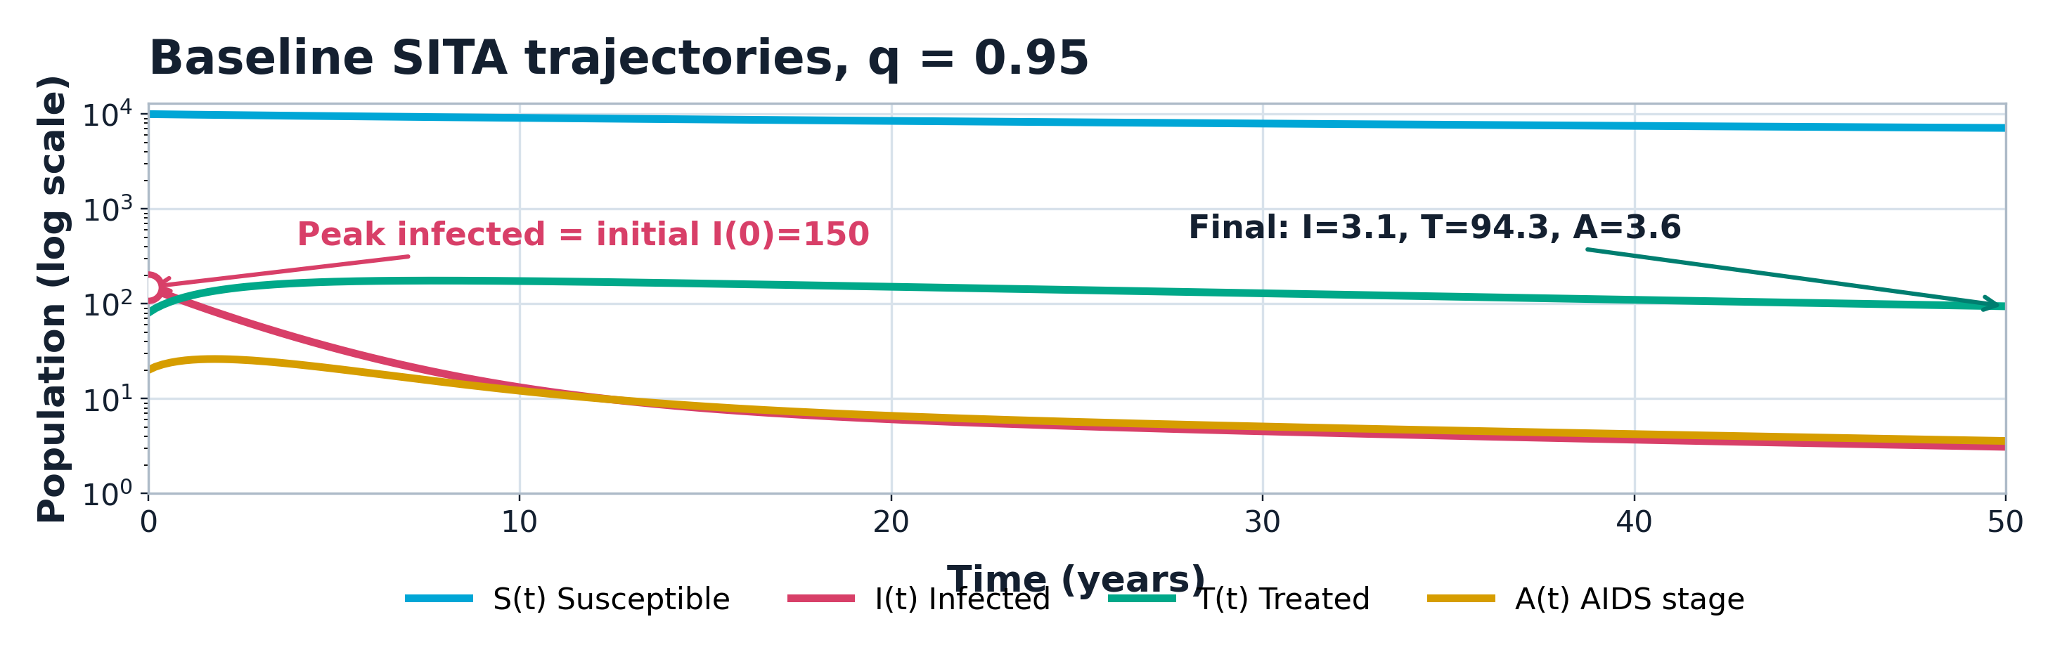
Baseline Simulation Result
▶ R0 = 0.430 < 1. The infected class starts at I(0)=150 and declines to I=3.1; treatment remains visible at T=94.3. Source: submitted report, Chapter 6 baseline simulation.

Slide 10
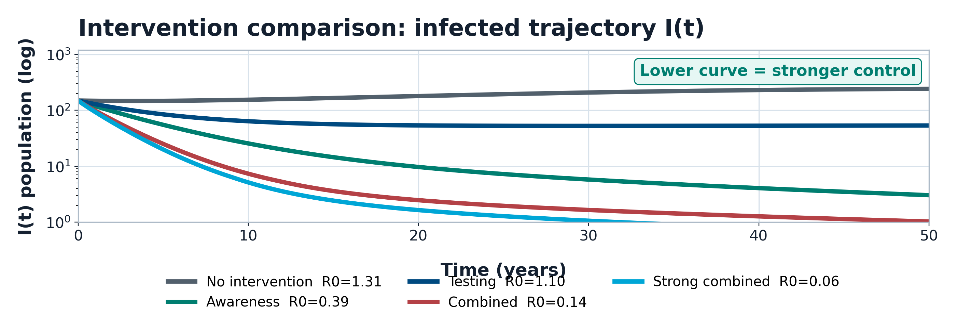
Simulation Results: Intervention Comparison
▶ Lower curves mean fewer infected individuals. Combined strategies act on transmission, treatment movement, and AIDS progression together. Source: submitted report, Chapter 6 intervention comparison.

Slide 11
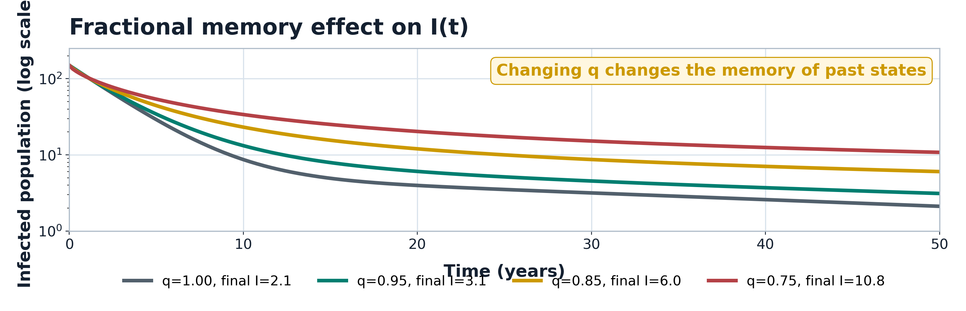
Simulation Results: Fractional Memory
▶ q = 1 is the ordinary model; q < 1 introduces memory. The curve separation shows the computational effect of fractional memory. Source: submitted report, Chapter 6 memory comparison.

Slide 12
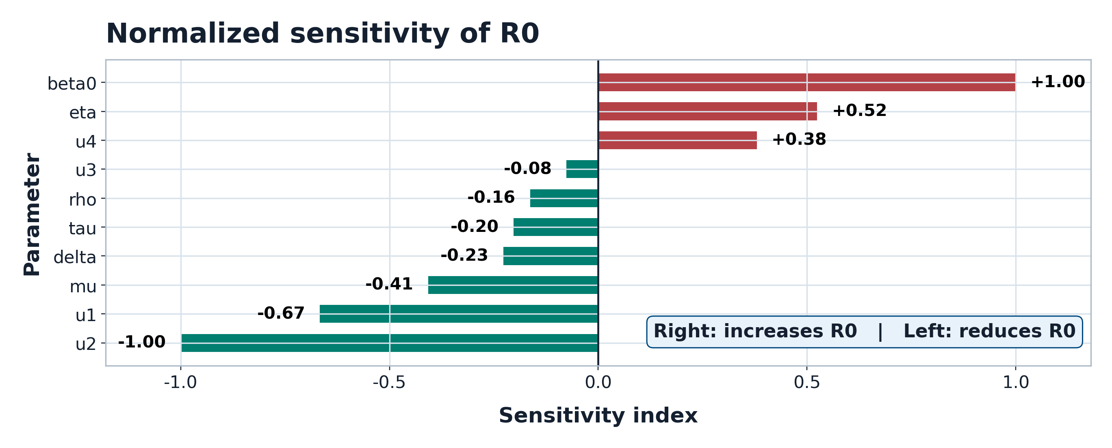
Dashboard and Sensitivity Evidence
▶ Sensitivity index: U_p^R0=(partial R0/partial p)(p/R0). Positive bars increase R0; negative bars reduce R0. Source: submitted report, Chapter 6 sensitivity analysis.

Slide 13
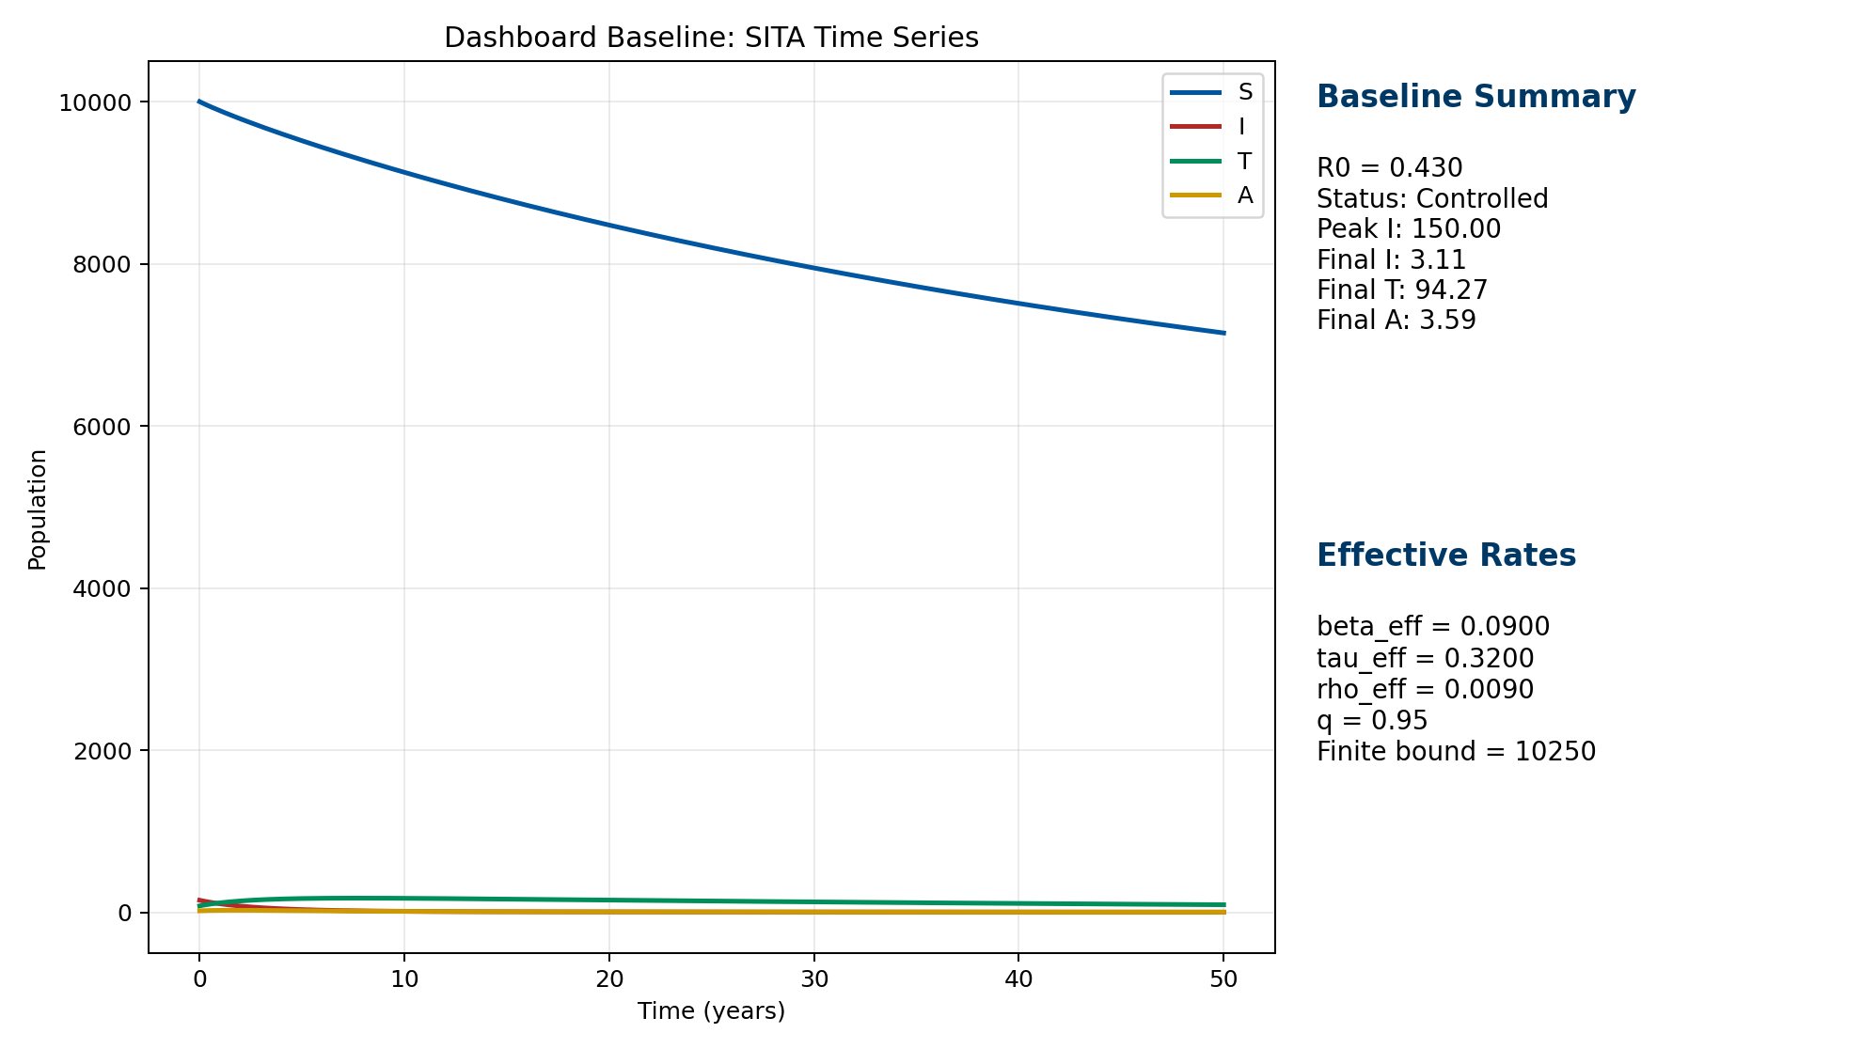
Live Dashboard Demonstration
Open during the defense
Dashboard link
https://hiv-model.onrender.com/
Run the baseline simulation.
Show the final state summary and interpretation.
Compare no intervention with combined intervention.
Change q to show the fractional memory effect.

Slide 14
Conclusion + Recommendations
Conclusion
Recommendations
The SITA HIV model was extended using fractional memory.
Behavioural interventions were represented through effective rates.
Numerical simulations support combined intervention strategies.
Calibrate parameters with Rwanda-specific data.
Extend the model using age, gender, or stochastic structure.
Compare other fractional operators.
Improve the dashboard into an educational decision-support tool.
Final message: the work connects mathematical analysis, numerical simulation, and a working dashboard for communicating HIV intervention dynamics.

