Slide 1
CMPE 255 · DATA MINING · SPRING 2026
Predicting Student Dropout & Academic Success
A data-mining study of 4,424 university students
Lam Nguyen· 018229432
Tri Ngo· 015712749
San José State University
APRIL 2026
01/19
Notes:
SLIDE 1 — Title (Lam speaks, ~30 seconds)
Hi everyone, I'm Lam and this is Tri. Our project is about predicting whether university students will drop out, stay enrolled, or graduate — using data mining techniques on a dataset of about 4,400 students from a Portuguese university.
Over the next 12 minutes or so, we'll walk you through the data, what we found in our exploration, six different classification models we tested, some clustering and association rule mining, and what we'd actually recommend a university do with these results.
Let's start with why this matters.

Slide 2
01 · MOTIVATION
Why student dropout matters
32.1%
Dropout costs students years of investment and costs universities funding, reputation, and capacity. Early identification of at-risk students unlocks targeted academic advising before it's too late.
of students in our dataset dropped out before graduating
OUTCOME
COUNT
SHARE
Dropout
1,421
32.1%
Enrolled
794
17.9%
Graduate
2,209
49.9%
Total
4,424
100%
Source: UCI ML Repository, Dataset 697 (Realinho et al., 2021)
02/19
Notes:
SLIDE 2 — Motivation (Lam, ~40 seconds)
So dropout is expensive for everyone involved. Students lose years of tuition and time. Universities lose funding — a lot of state funding is tied to retention numbers — and they take a hit on rankings.
The big number on this slide: 32.1% of the students in our dataset dropped out. That's about 1,400 out of 4,400. Another 800 were still enrolled at the cutoff — meaning they hadn't finished yet — and about 2,200 graduated.
The whole idea behind this project is: if we can identify who's at risk early enough — say, after the first semester — advisors can actually step in before it's too late. That's the goal.

Slide 3
02 · PROBLEM STATEMENT
Can we predict a student's outcome from enrollment-time data?
TASK
APPROACH
CHALLENGE
3-class
Sup. + Unsup.
Imbalance
Supervised classification: Dropout / Enrolled / Graduate
Classification, clustering, and association rule mining
Graduate 2,209 (49.9%) · Dropout 1,421 (32.1%) · Enrolled 794 (17.9%)
OUTCOME →
An early-warning framework that flags at-risk students for intervention
03/19
Notes:
SLIDE 3 — Problem Statement (Lam, ~35 seconds)
Three things to anchor here. First, the task — this is a 3-class classification problem. Not just "drop out or not" — we kept the Enrolled class separate because those students are genuinely different. They're still in the system, and some will graduate, some won't.
Second, our approach — we're combining supervised classification with unsupervised clustering and association rule mining. Each one gives us a different angle on the same data.
Third, the challenge — class imbalance. Graduates are almost half the data, but Enrolled is only 18%. A model that just predicts "Graduate" every time would get 50% accuracy and tell us nothing. That's why we use F1-macro as our main metric — it treats every class equally.

Slide 4
03 · DATASET
UCI Repository Dataset 697
DEMOGRAPHIC
ACADEMIC BACKGROUND
Marital status
Nationality
Gender
Age at enrollment
Previous qualification
Admission grade
Course
Application mode
INSTANCES
4,424 students
36 + 1 target
SOCIO-ECONOMIC
PERFORMANCE (SEM 1 & 2)
FEATURES
Scholarship holder
Debtor
Tuition fees up to date
Parental education / occupation
Units enrolled
Units approved
Semester grade
Evaluations taken
MISSING VALUES
None
LICENSE
CC BY 4.0
Source: Instituto Politécnico de Portalegre, PT Citation: Realinho et al., 2021
04/19
Notes:
SLIDE 4 — Dataset (Lam speaks, ~40 seconds)
Our data comes from the UCI Machine Learning Repository, dataset 697. It was collected from a polytechnic institute in Portugal and published by Realinho and colleagues in 2021.
Quick stats: 4,424 students, 36 input features, one target with three classes, and zero missing values — which saved us a lot of imputation headaches.
The features fall into four groups you can see on the right. Demographics like age and gender. Academic background like admission grade. Socio-economic factors like scholarship status and whether tuition is paid. And then semester 1 and 2 performance — how many courses they passed, what grades they got. That last group, the semester performance, ends up being where almost all the predictive power lives.

Slide 5
04 · DATA WAREHOUSE
Star schema for the analytical layer
STUDENT_DIM
ACADEMIC_DIM
age
gender
marital_status
nationality
FACT
prev_qualification
application_mode
admission_grade
course
Student_Enrollment_Fact
student_id PK
course_id FK
sem1_grade · sem1_approved
sem2_grade · sem2_approved
target_outcome
FAMILY_DIM
ECONOMIC_DIM
mother_qualification
father_qualification
mother_occupation
father_occupation
scholarship
debtor
tuition_fees
unemployment_rate · GDP
ETL ›
Source DBs
→
Extract
→
Transform(encode · normalize)
→
Load
→
Star Schema
05/19
Notes:
SLIDE 5 — Data Warehouse (Lam, ~35 seconds)
This is our conceptual star schema — how this project would plug into a real institutional data warehouse.
The center is the fact table with the student's semester grades, approved units, and their outcome. Around it we have four dimension tables — student demographics, family background, academic history, and economic factors.
At the bottom is the ETL flow — extract from the source databases, transform by encoding and normalizing, then load into the star schema. We didn't build this as a physical database since we only have 4,400 rows — everything ran in pandas. But this is the design an institution would use to operationalize it.

Slide 6
05 · PREPROCESSING
From raw CSV to model-ready matrix
1
Inspection
2
Feature typing
4,424 rows · 36 features · 0 missing values
Categorical (int-coded) vs continuous
3
Target encoding
4
Normalization
Dropout 0 · Enrolled 1 · Graduate 2
StandardScaler on all numeric features
5
Stratified split
6
Reproducibility
80% train (3,539) · 20% test (885)
random_state=42 across all operations
Stratified split preserves class ratios in both train and test sets. An unscaled copy is kept for EDA.
06/19
Notes:
SLIDE 6 — Preprocessing (Lam, ~40 seconds)
Six steps, pretty straightforward since the data was clean.
First, we confirmed the dataset — 4,424 rows, 36 features, zero missing values. Then we separated which columns are truly numeric versus integer-coded categoricals. We encoded the target as 0, 1, 2 for Dropout, Enrolled, Graduate.
Then StandardScaler on all numeric features — this matters for KNN and SVM which are distance-based. Tree models don't care about scaling, but we applied it uniformly so every model gets the same input matrix.
80/20 stratified split — 3,539 training, 885 test. Stratified means both sets preserve the same 32-18-50 class ratio. And random_state=42 everywhere for reproducibility. We also kept an unscaled copy for EDA so our plots show real units like grades out of 20, not z-scores.

Slide 7
06 · EDA — TARGET DISTRIBUTION
Three classes, uneven sizes
Graduate
2,209 49.9%
4,424
Dropout
1,421 32.1%
students total
Enrolled
794 17.9%
Enrolled is the underrepresented class — stratified sampling and F1-macro keep it visible.
07/19
Notes:
SLIDE 7 — EDA Target Distribution (Lam, ~25 seconds)
Quick visual of what we're working with. Graduate is the largest class at about 50%, Dropout is 32%, and Enrolled — our tricky class — is only 18%.
This isn't extreme imbalance like fraud detection where you'd have 0.1% positives. But it's enough that accuracy alone would be misleading. That's why F1-macro is our primary metric — it gives equal weight to all three classes, so Enrolled doesn't get drowned out by the 2,200 Graduates.

Slide 8
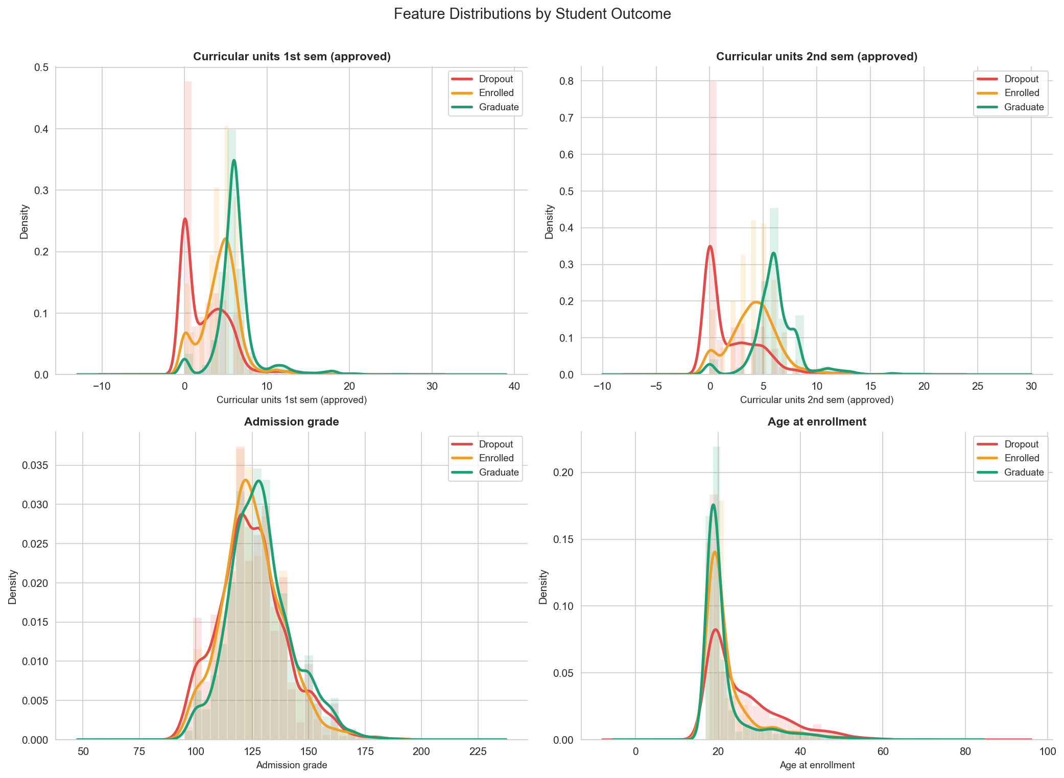
07 · EDA — DISTRIBUTIONS
Approved curricular units separate the classes
SPEARMAN Ρ VS TARGET (TOP 9 BY |Ρ|)
FEATURE
Ρ
Curricular units 2nd sem (approved)
+0.65
Curricular units 1st sem (approved)
+0.59
Curricular units 2nd sem (grade)
+0.56
Curricular units 1st sem (grade)
+0.49
Tuition fees up to date
+0.40
Scholarship holder
+0.30
Admission grade
+0.12
Debtor
−0.24
Age at enrollment
−0.29
Dropout students cluster near zero approved units, while graduates spread across higher values. 2nd-semester approved units has the largest |ρ| ≈ 0.65 — the single strongest monotonic predictor in the dataset.
08/19
Notes:
SLIDE 8 — EDA Distributions (Lam, ~50 seconds)
This is probably the most important EDA slide. "On the left, four KDE plots — top row is approved curricular units in semester 1 and 2, bottom row is admission grade and age at enrollment. The top two show clear separation: dropouts pile up at zero, graduates spread across higher values. The bottom two are interesting because they don't separate as cleanly — admission grade overlaps for all three classes, telling us it's a weak univariate predictor. Age has a heavier dropout tail toward the right, meaning older entrants drop out more."
On the right is a ranking of features by Spearman correlation with the target. The top four are all semester performance measures. Second-semester approved units has rho of 0.65 — that's the single strongest predictor in the entire dataset. First-semester approved is 0.59, then grades follow.
Below the academic features, we see tuition fees up to date at 0.40, scholarship at 0.30, and then two negative correlations — debtors and older students tend to drop out more.
We used Spearman instead of Pearson because several features are ordinal and the relationships aren't necessarily linear.

Slide 9
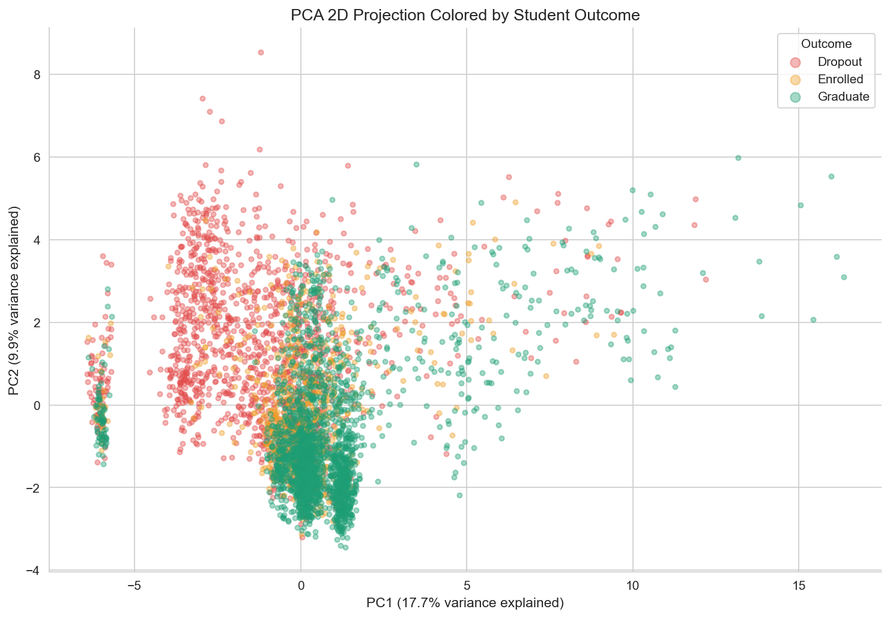
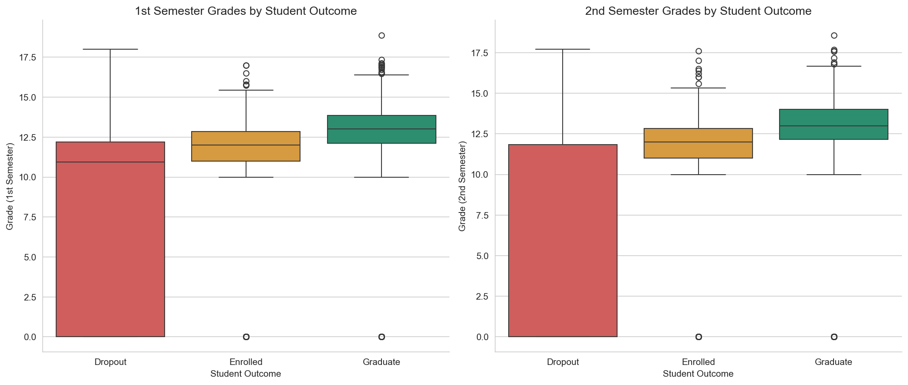
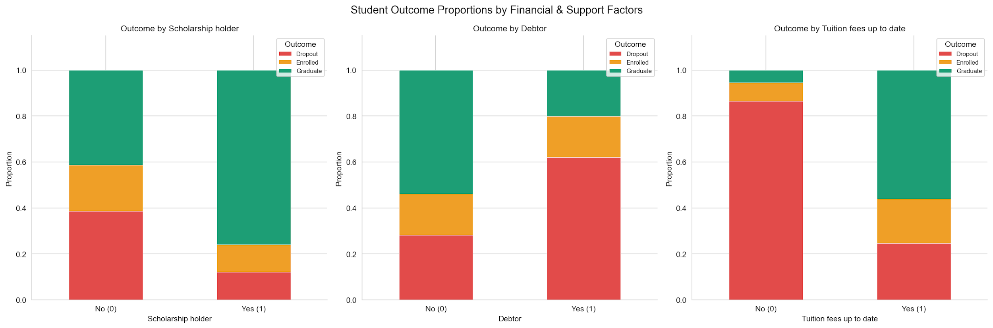
08 · EDA — THREE LENSES
Grades, finance, and a 2D projection
SEMESTER GRADES BY OUTCOME
FINANCIAL FACTORS VS OUTCOME
PCA 2D PROJECTION
DROPOUT RATE BY FINANCIAL FACTOR (FROM MIDDLE CHART)
Scholarship holders drop out at 12% vs 39% for non-holders — a 3.3× lower rate. Tuition status is the most decisive single binary signal in the data. PCA projection shows moderate but imperfect class separability — a non-trivial classification problem.
FACTOR
DROPOUT IF NO
DROPOUT IF YES
Δ
Scholarship holder
39%
12%
−27 pp
Debtor
28%
62%
+34 pp
Tuition fees up to date
86%
25%
−61 pp
09/19
Notes:
SLIDE 9 — EDA Three Lenses (Lam, ~60 seconds)
Three different views here. On the left, boxplots of semester grades by outcome. You can see the medians step up clearly — Dropout is lowest, then Enrolled, then Graduate.
The really striking thing is the Dropout box for second semester — the median line sits right at the bottom edge because the median is actually zero. More than half of dropout students had a second-semester grade of zero. They'd essentially stopped attending. (And if anyone wants the exact 5-number summary, we have a code cell right after the boxplot that prints it.")
In the middle, financial factors. The table summarizes it: scholarship holders drop out at only 12% versus 39% for non-holders. Debtors drop out at 62%. And the biggest one — students who aren't up to date on tuition have an 86% dropout rate. Now, that's partly because students who are disengaging also stop paying, so the causal direction isn't clear. But as an early warning signal, it's incredibly strong.
On the right, PCA projection down to two dimensions. PC1 and PC2 together explain about 27% of the variance. You can see some grouping but a lot of overlap, especially Enrolled mixing into both other classes. That overlap is why we need supervised learning — the classes don't separate neatly on their own.

Slide 10
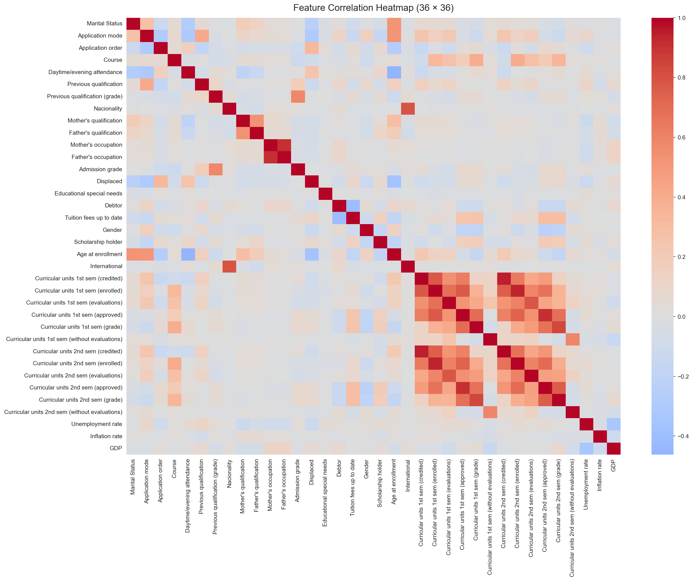
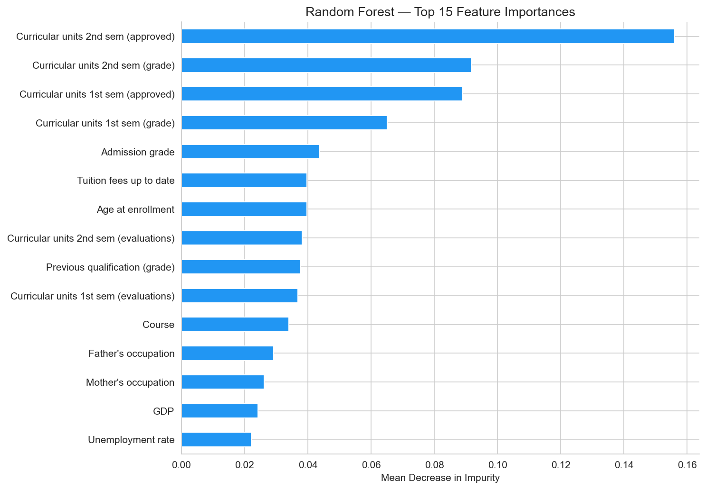
09 · VISUALIZATION TOOLKIT
Six chart types, one consistent palette
Correlation Heatmap
KDE Distribution
Boxplots
TREE
max_depth = 10
Stacked Bar Charts
PCA Scatter
Feature Importance
LINEAR
multinomial · max_iter=1000
10/19
Notes:
SLIDE 10 — Visualization Toolkit (Tri, ~15 seconds)
Quick summary of the six chart types we used throughout — heatmap, KDE, boxplots, stacked bars, PCA scatter, and feature importance. One consistent color palette across the whole deck: red for Dropout, amber for Enrolled, green for Graduate.
(If someone asks about the model parameters showing on this slide: "That's a template artifact from the modeling slide — the actual parameters are on the next slide.")

Slide 11
10 · MODELING
Six classifiers across five algorithm families
TREE
ENSEMBLE
INSTANCE
Decision Tree
Random Forest
KNN
max_depth = 10
n_estimators = 200
best k = 11 (tuned)
LINEAR
KERNEL
BOOSTING
Logistic Regression
SVM
XGBoost
multinomial · max_iter=1000
RBF kernel · probability=True
n_est=200 · depth=6 · lr=0.1
random_state = 42
80 / 20 stratified split
5-fold cross-validation
Primary metric: F1-macro
11/19
Notes:
SLIDE 11 — Modeling (Tri, ~40 seconds)
We ran six classifiers across five algorithm families. Decision Tree as our interpretable baseline. Random Forest for bagging. KNN — we tuned k and landed on 11. Logistic Regression as the linear baseline. SVM with an RBF kernel. And XGBoost for gradient boosting.
Same protocol for all six: random_state=42, same stratified 80/20 split, 5-fold cross-validation on the training set, and F1-macro as the primary metric. The test set was only touched once per model for the final evaluation.

Slide 12
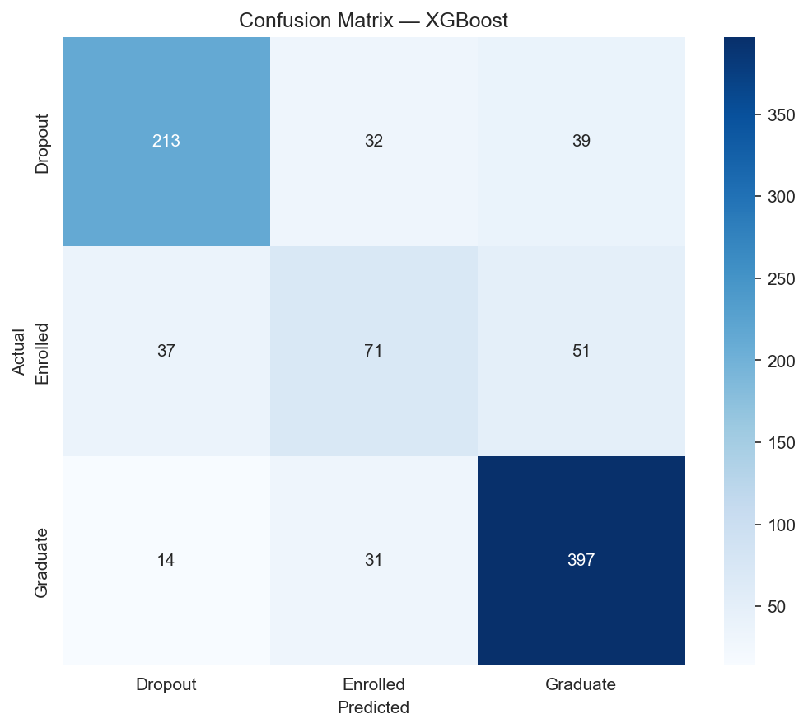
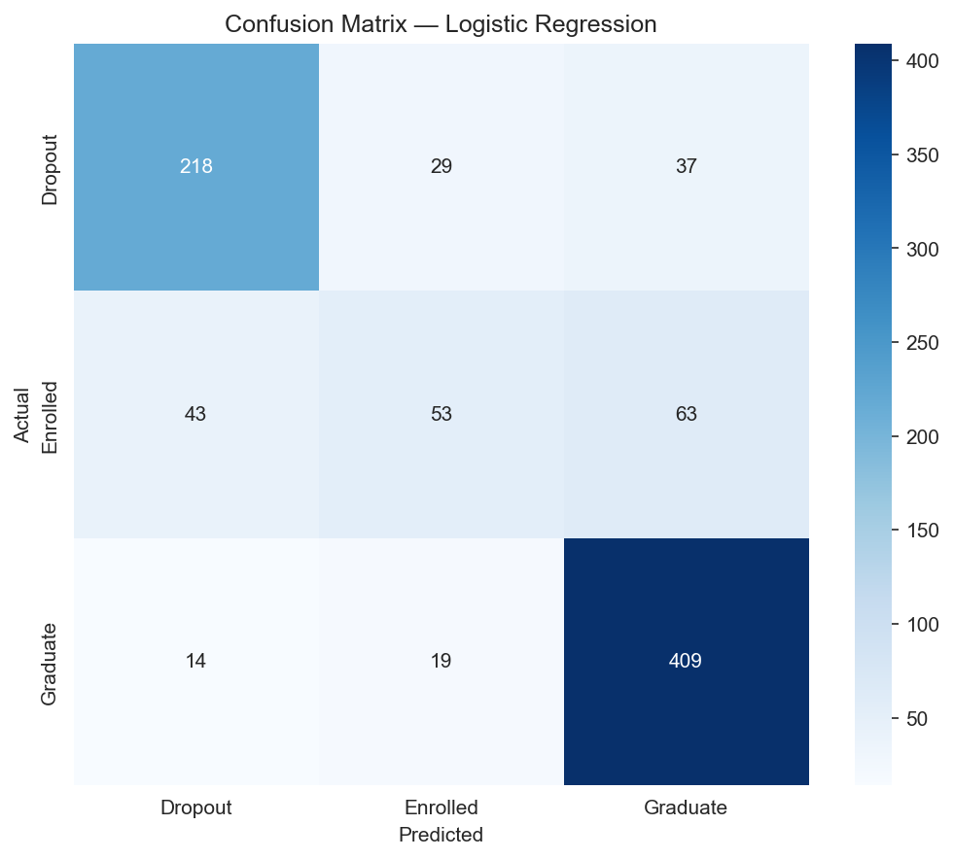
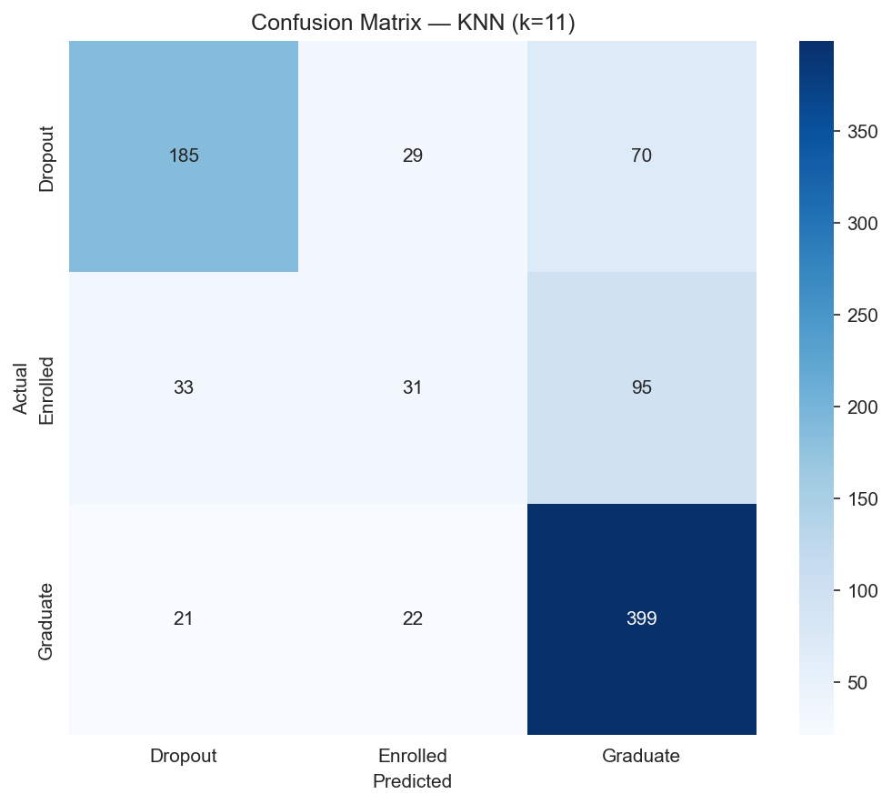
11 · CLASSIFICATION RESULTS
Best, middle, and worst — side by side
BEST
MID-RANGE
WEAKEST
XGBoost
Logistic Regression
KNN (k=11)
F1-MACRO
0.706
F1-MACRO
0.683
F1-MACRO
0.586
PER-CLASS RECALL — XGBOOST (N = 885 TEST SET)
The Enrolled class is recovered at only 44.7% — half the rate of Graduate. With just 159 test instances vs 442 for Graduate, the model has fewer training examples to learn its boundary, and the class sits geometrically between the other two — confusions go in both directions (37 → Dropout, 51 → Graduate).
CLASS
TEST N
CORRECT
RECALL
Dropout
284
213
75.0%
Enrolled
159
71
44.7%
Graduate
442
397
89.8%
12/19
Notes:
SLIDE 12 — Classification Results (Tri, ~55 seconds)
Three confusion matrices — best, middle, and weakest. We wanted to show the full range, not just the winner.
XGBoost on the left with F1-macro of 0.706. Logistic Regression in the middle at 0.683 — honestly a strong showing for a linear model. And KNN on the right at 0.586.
Looking at the XGBoost per-class recall: Graduate is 89.8% — the model handles the majority class well. Dropout is 75%. But Enrolled... only 44.7%. That's the hard class. Three reasons: it's the smallest group, it sits geometrically between the other two, and when the model gets it wrong, the errors split both ways — some get called Dropout, some get called Graduate. The model is genuinely uncertain about these students, which honestly reflects reality.
Quick arithmetic check: 213 plus 71 plus 397 correct gives us 681 out of 885, which is 76.95% accuracy. "Notice F1-macro is 0.706 but accuracy is 76.95% — that gap is the imbalance story. Accuracy weights every student equally, so Graduates dominate. F1-macro weights every class equally, and the 0.48 F1 on Enrolled drags the average down. That gap is exactly what F1-macro is designed to surface."

Slide 13
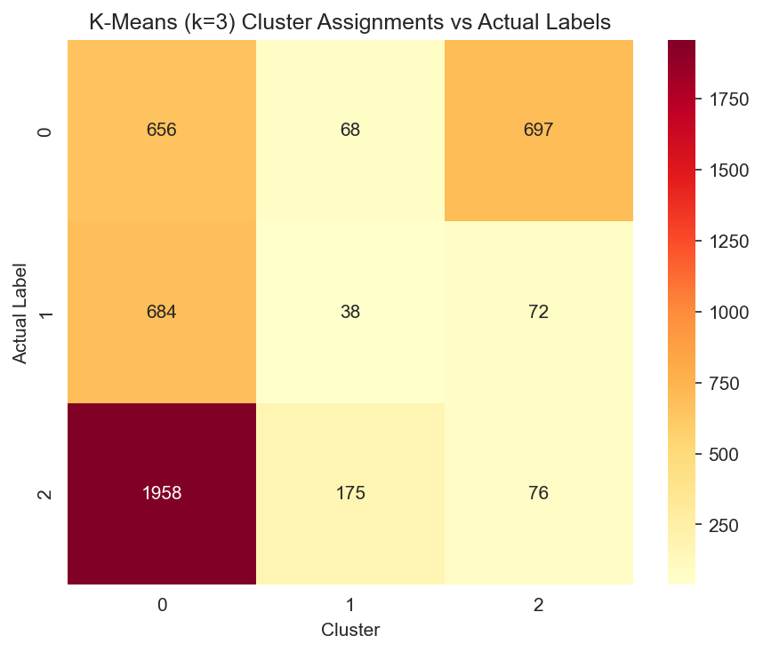
12 · UNSUPERVISED ANALYSIS
Clustering reveals overlap, not boundaries
K-MEANS (K=3) SILHOUETTE
0.2145
HIERARCHICAL (WARD) SILHOUETTE
0.1158
Silhouette interpretation (Rousseeuw, 1987): > 0.7 strong · 0.5–0.7 reasonable · 0.25–0.5 weak · < 0.25 no substantial structure
WHAT THIS TELLS US
Low silhouette scores indicate soft, overlapping boundaries. Unsupervised methods alone cannot reliably predict outcomes — supervision is required.
13/19
Notes:
SLIDE 13 — Unsupervised Analysis (Tri, ~40 seconds)
We ran K-Means with k=3 and Hierarchical clustering with Ward linkage. The results are... not great, and that's actually informative.
K-Means silhouette score: 0.21. Hierarchical: 0.12. Using Rousseeuw's standard interpretation, anything below 0.25 means no substantial cluster structure.
The crosstab heatmap tells the story — the biggest cluster absorbs graduates, dropouts, and enrolled students all mixed together. The classes just don't separate geometrically in the feature space.
But this is a useful negative result. It tells us supervision is genuinely required — we can't just group students and hope the groups match outcomes. We need the labels.

Slide 14
13 · ASSOCIATION RULE MINING
Apriori on binned features
ANTECEDENT
→ CONSEQUENT
SUP.
CONF.
LIFT
CU1_Low + Age_Mid
Dropout
0.058
0.874
2.72
MIN_SUPPORT
0.05
AdmGrade_Low + CU1_Low
Dropout
0.069
0.860
2.68
MIN_CONFIDENCE
0.60
CU1_Low
Dropout
0.175
0.771
2.40
FREQUENT ITEMSETS
189
CU1_Low + AdmGrade_Med
Dropout
0.084
0.764
2.38
TOTAL RULES
334
TuitionUpToDate + CU1_Low
Dropout
0.115
0.696
2.17
85
TuitionUpToDate + CU1_High + Scholarship + AdmGrade_Med
Age_Young + Graduate
0.078
0.801
2.09
TARGET RULES
Top finding:low 1st-semester approved units + mid age → Dropout · conf 87.4% · lift 2.72×
14/19
Notes:
SLIDE 14 — Association Rules (Tri, ~55 seconds)
We binned numeric features into Low, Mid, and High terciles, then ran Apriori with minimum support of 0.05 and minimum confidence of 0.60. That gave us 189 frequent itemsets, 334 total rules, and 85 where the target is in the consequent — those are the actionable ones.
The top rule: students with low first-semester approved units who are in the mid-age band drop out 87% of the time, with a lift of 2.72 — meaning that's 2.7 times the base dropout rate.
If you look down the table, four of the top five rules involve low first-semester approved units in some combination. That feature keeps showing up no matter how we look at the data — EDA, models, and now rules.
The last row is a graduation rule, just to show the mining works in both directions. Students who have tuition paid, high approved units, a scholarship, and mid admission grade tend to be young graduates — confidence 80%.

Slide 15
14 · MODEL COMPARISON
XGBoost wins on F1-macro · Random Forest on accuracy
MODEL
ACCURACY
F1 (MACRO)
F1 (WEIGHTED)
CV F1 MEAN ± STD
XGBoost BEST F1
76.95%
0.7056
0.7634
0.7136 ± 0.0131
Random Forest BEST ACC
77.06%
0.6887
0.7548
0.6956 ± 0.0087
Logistic Regression
76.84%
0.6826
0.7531
0.6782 ± 0.0089
SVM
75.93%
0.6797
0.7466
0.6798 ± 0.0220
Decision Tree
71.19%
0.6346
0.7052
0.6443 ± 0.0101
KNN (k=11)
69.49%
0.5860
0.6694
0.6036 ± 0.0094
Cross-validation standard deviations are tight across all models — performance is consistent, not lucky. F1-macro is our primary metric because it weights all three classes equally despite the imbalance.
15/19
Notes:
SLIDE 15 — Model Comparison (Tri, ~50 seconds)
This is the money table. Six models, sorted by F1-macro.
XGBoost wins on F1-macro at 0.706. Random Forest actually has the highest accuracy at 77.06%, but its F1-macro is lower at 0.689. The difference is how they handle the Enrolled class — XGBoost is better at the minority.
What's interesting is the top three — XGBoost, Random Forest, Logistic Regression — are all within less than one percentage point on accuracy. They're essentially tied there. The separation happens on F1-macro, which is why we chose that as our primary metric.
The CV standard deviations in the last column are all tight — between 0.009 and 0.022. So these results are stable across folds, not a lucky split.
Decision Tree and KNN trail noticeably. KNN struggles because of the curse of dimensionality — with 36 features, distances become less meaningful.

Slide 16
15 · FEATURE IMPORTANCE
Semester performance dominates · finance plays second
Random Forest
MEAN DECREASE IN IMPURITY
XGBoost
GAIN-BASED IMPORTANCE
1
Curricular units 2nd sem (approved)
0.155
1
Curricular units 2nd sem (approved)
0.215
2
Curricular units 2nd sem (grade)
0.092
2
Tuition fees up to date
0.117
3
Curricular units 1st sem (approved)
0.089
3
Curricular units 1st sem (enrolled)
0.052
4
Curricular units 1st sem (grade)
0.066
4
Curricular units 2nd sem (enrolled)
0.038
5
Admission grade
0.044
5
Scholarship holder
0.032
Both models converge on 2nd-semester approved units as the #1 predictor — RF MDI 0.155, XGB gain 0.215. XGBoost weighs financial signals (tuition 0.117, scholarship 0.032) more heavily; Random Forest leans on grade variables (4 of top 5 are grade-related).
16/19
Notes:
SLIDE 16 — Feature Importance (Tri, ~45 seconds)
Two models, two importance methods, same conclusion.
Both Random Forest and XGBoost agree that second-semester approved units is the number one predictor. Random Forest gives it 0.155 by mean decrease in impurity; XGBoost gives it 0.215 by gain.
Where they diverge is interesting. Random Forest's top 5 are all grade or unit measures — it's very grade-centric. XGBoost puts tuition fees as its number 2 at 0.117, and scholarship makes the top 5. XGBoost is picking up on those financial signals we saw on slide 9 — the 61-point gap in dropout rate between paid and unpaid tuition.
The practical takeaway: if you could only monitor one thing, monitor second-semester approved units. If you could monitor two, add tuition payment status.

Slide 17
16 · CONCLUSIONS
What we learned, and what to do about it
BEST MODEL
XGBoost · F1-macro0.7056(vs RF 0.689, LR 0.683)
RECOMMENDATION
TOP PREDICTOR
2nd-sem approved units · ρ ≈ 0.65 · RF MDI 0.155 · XGB gain 0.215
Flag students with fewer than 3 approved units after semester 1 for immediate academic advising.
STRONGEST RULE
Low 1st-sem approved units →77.1% dropout · lift 2.40× (Apriori, slide 14)
"Data mining can reliably identify at-risk students early enough for meaningful intervention."
CLUSTERING
K-Means k=3 silhouette 0.21 · Hierarchical 0.12 — overlapping
17/19
Notes:
SLIDE 17 — Conclusions (Tri, ~45 seconds)
Five takeaways.
Best model: XGBoost at F1-macro 0.706. Top predictor: second-semester approved units, confirmed by correlation, by Random Forest, and by XGBoost — three independent methods all pointing the same way.
Strongest association rule: low first-semester approved units predicts dropout with 77% confidence and a lift of 2.4.
Clustering showed weak structure — silhouettes of 0.21 and 0.12 — which confirms that supervised learning is genuinely necessary for this problem.
And the recommendation — and this is the real-world deliverable: flag any student with fewer than 3 approved units after semester 1 for immediate academic advising. That threshold comes directly from the tercile binning where the 77% dropout rule applies.
One sentence summary: data mining can reliably identify at-risk students early enough for meaningful intervention.

Slide 18
17 · FUTURE WORK
Where this work could go next
01
Real-time prediction
02
Advisor dashboard
Incorporate live semester data for dynamic risk scoring throughout the academic year
Web app (Streamlit / Flask) so advisors can query student risk in real time
03
Multi-institution validation
04
Deep learning
Test model generalizability across universities and countries
Explore TabNet and other neural architectures for tabular gains
05
Temporal modeling
Each direction addresses a current limitation — limitations → opportunities
Sequence models that track how student risk evolves semester by semester
18/19
Notes:
SLIDE 18 — Future Work (Tri, ~35 seconds)
Five directions, each closing a current limitation.
Real-time prediction instead of our one-shot end-of-semester approach. An advisor dashboard in Streamlit or Flask — probably the highest-leverage next step for actual deployment. Multi-institution validation since we only trained on one Portuguese school. Deep learning with something like TabNet to see if it adds a few points. And temporal modeling — tracking how risk evolves semester by semester instead of treating each student as a static snapshot.
Every one of these is an honest limitation reframed as an opportunity.

Slide 19
18 · END
Thank you.
Questions welcome.
Lam Nguyen· 018229432
Tri Ngo· 015712749
REPOSITORY
CMPE 255 · Data Mining · Spring 2026
github.com/Lambert-Nguyen/ cmpe255-student-dropout-prediction
19/19
Notes:
SLIDE 19 — End (Tri, ~15 seconds)
That's our project. Thank you for listening. Full code, notebooks, and all figures are in the GitHub repo linked on the slide. We're happy to take any questions.

