Slide 1
Predicting Student Dropout and Academic Success Using Data Mining
CMPE 255 — Data Mining | Spring 2026
Lam Nguyen (018229432) • Tri Ngo (015712749)
San José State University
April 2026
1 / 19
Notes:
Welcome everyone. Today we present our CMPE 255 project on predicting student dropout using data mining techniques. We analyzed a dataset of over 4,400 students from a Portuguese university to identify key risk factors and build predictive models.

Slide 2
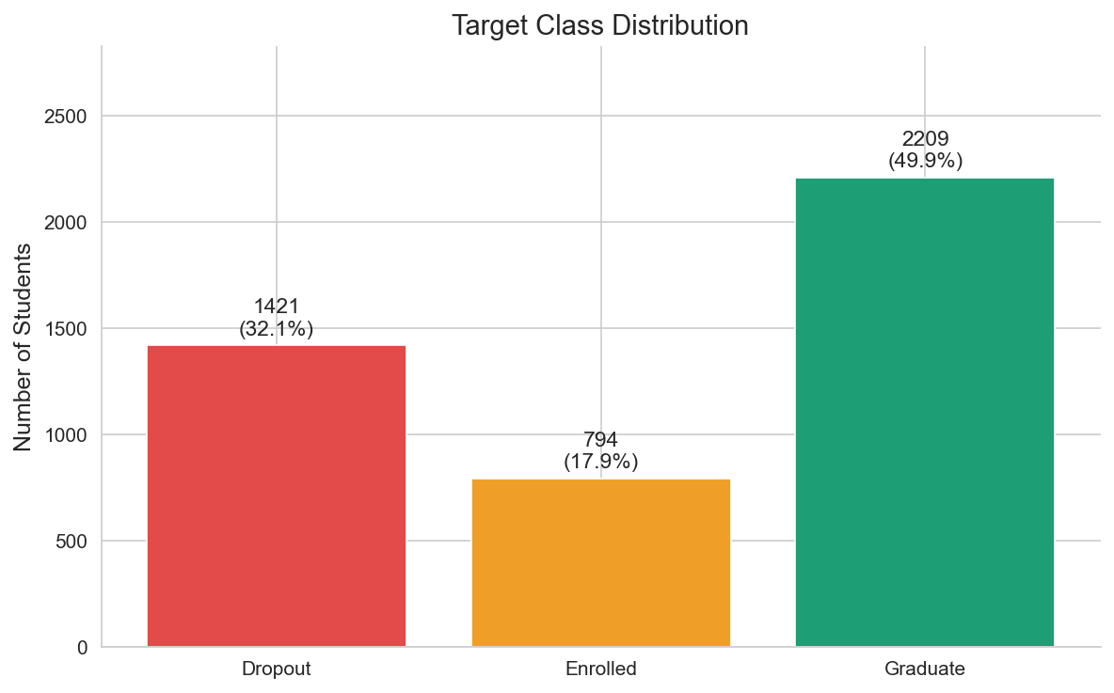
Introduction & Motivation
Higher education dropout is a significant global challenge — it affects students, families, and institutions alike
~32% of students in our dataset dropped out before graduating
Early identification of at-risk students enables targeted academic advising and intervention programs
Data mining can uncover hidden patterns in enrollment, demographic, and academic performance data
Goal: "Apply classification, clustering, and association rule mining to predict student outcomes and identify key dropout risk factors"
2 / 19
Notes:
Student dropout is costly — both for students who invest time and money, and for universities that lose funding and reputation. In our dataset, nearly one-third of students dropped out. Our goal is to use data mining to build an early-warning system that flags at-risk students so advisors can intervene before it's too late.

Slide 3
Problem Statement
Research Question: Can we predict whether a student will drop out, remain enrolled, or graduate based on enrollment-time data?
Target Variable: 3-class classification — Dropout / Enrolled / Graduate
Scope: Supervised classification + unsupervised clustering for risk profiling
Challenge: Class imbalance — Graduate ~50%, Dropout ~32%, Enrolled ~18%
Expected Outcome: An early-warning framework to flag at-risk students for academic advising
3 / 19
Notes:
Our core research question is whether we can predict student outcomes using data available at enrollment time and after the first semesters. This is a multi-class problem with three outcomes. The class imbalance is a key challenge — Enrolled students make up only 18% of the data, making them harder to predict correctly.

Slide 4
Data Sources
Source: UCI Machine Learning Repository (Dataset ID: 697)
Origin: Instituto Politécnico de Portalegre, Portugal
Size: 4,424 students × 37 columns (36 features + 1 target)
Missing values: None | License: CC BY 4.0
Citation: Realinho et al. (2021)
Demographic
Marital status
Nationality
Gender
Age at enrollment
Academic
Previous qualification
Admission grade
Course
Application mode
Socio-Economic
Scholarship holder
Debtor
Tuition fees
Parental education
Performance
Units enrolled (sem 1 & 2)
Units approved (sem 1 & 2)
Grades (sem 1 & 2)
4 / 19
Notes:
Our dataset comes from the UCI repository — compiled from institutional databases at a Portuguese polytechnic. It contains 4,424 student records with 36 features spanning demographics, prior academics, socio-economic factors, and semester performance. Importantly, there are no missing values, so we could focus on modeling rather than imputation.

Slide 5
Data Warehouse Design — Star Schema
ETL: Source DBs → Extract → Transform (encode, normalize) → Load → Star Schema
Student_Dim
age
gender
marital_status
nationality
Academic_Dim
prev_qualification
application_mode
admission_grade
course
Student_Enrollment_Fact
student_id (PK)
course_id (FK)
sem1_grade, sem2_grade
sem1_approved, sem2_approved
target_outcome
Family_Dim
mother_qualification
father_qualification
mother_occupation
father_occupation
Economic_Dim
scholarship
debtor
tuition_fees
unemployment_rate, GDP
5 / 19
Notes:
Here we show a conceptual star schema for our data warehouse design. The central fact table stores each student's enrollment record with semester grades and outcome. Four dimension tables capture student demographics, academic background, family information, and economic factors. The ETL pipeline encodes categorical features and normalizes numerics.

Slide 6
Data Preprocessing Pipeline
1. Inspection
4,424 rows, 36 features, 0 missing values
2. Feature Typing
Identified categorical (int-coded) vs continuous
3. Target Encoding
Dropout → 0, Enrolled → 1, Graduate → 2
4. Normalization
StandardScaler on all numeric features
5. Stratified Split
80% train (3,539) / 20% test (885)
random_state=42 for full reproducibility across all operations
Stratified split preserves class ratios in both train and test sets
Unscaled copy saved separately for EDA visualizations
6 / 19
Notes:
Our preprocessing pipeline has five steps. First we verified data quality — no missing values. We identified feature types, encoded the target variable numerically, standardized all features, and performed a stratified 80/20 split to preserve the class distribution in both train and test sets.

Slide 7
EDA — Class Distribution
Graduate: 2,209 students (49.9%)
Dropout: 1,421 students (32.1%)
Enrolled: 794 students (17.9%)
Total: 4,424 students
Notable imbalance — Enrolled class is underrepresented
Stratified sampling ensures all classes represented in train/test
7 / 19
Notes:
Our target distribution shows moderate class imbalance. About half the students graduated, a third dropped out, and only 18% remain enrolled. This imbalance affects model performance, particularly for the Enrolled class. We use stratified splitting and F1-macro scoring to handle this.

Slide 8
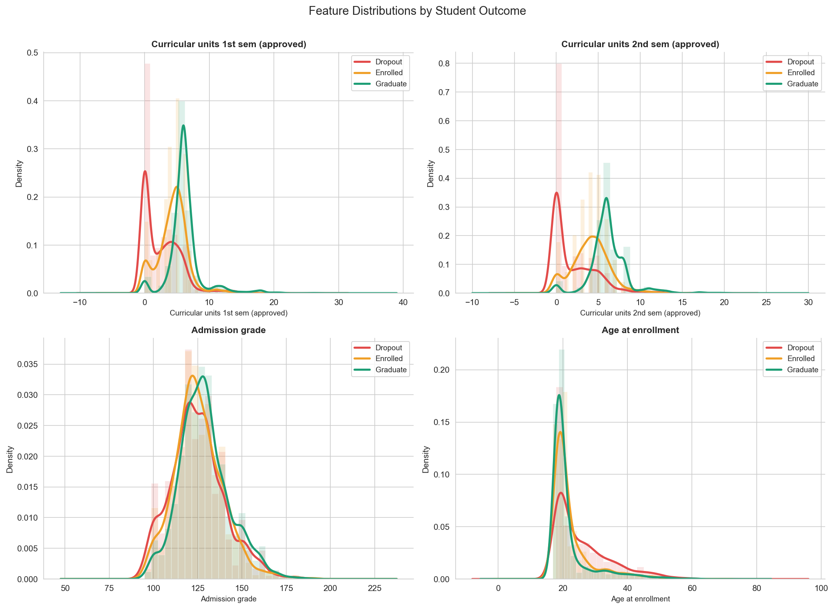
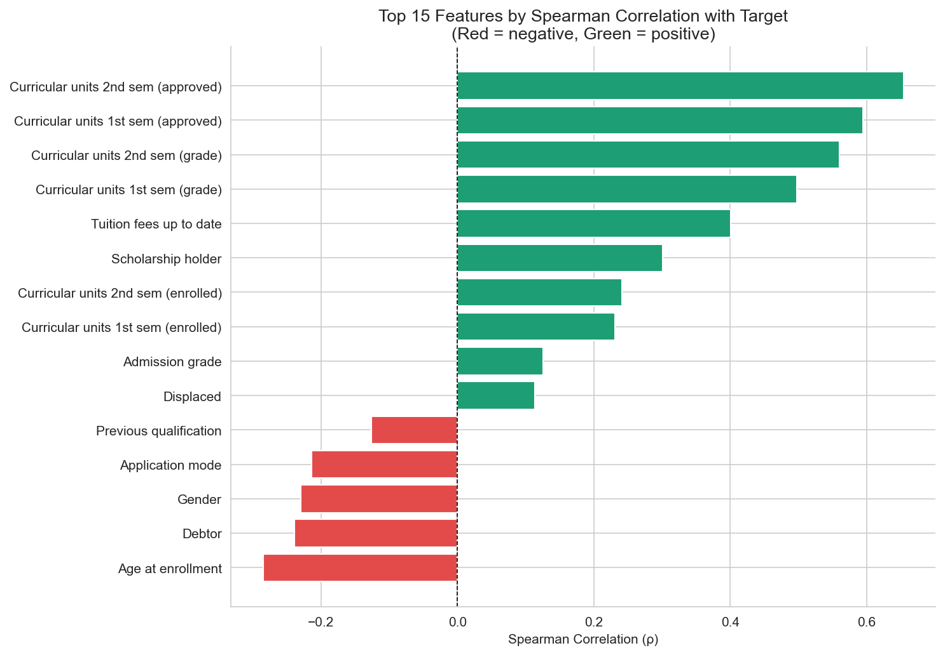
EDA — Feature Distributions & Correlations
Key Insight: Students who drop out have dramatically fewer approved curricular units in both semesters
8 / 19
Notes:
The KDE plots on the left show clear separation — dropout students cluster near zero approved units while graduates spread across higher values. The Spearman correlation chart on the right confirms that 2nd semester approved units is the single strongest predictor of student outcome.

Slide 9
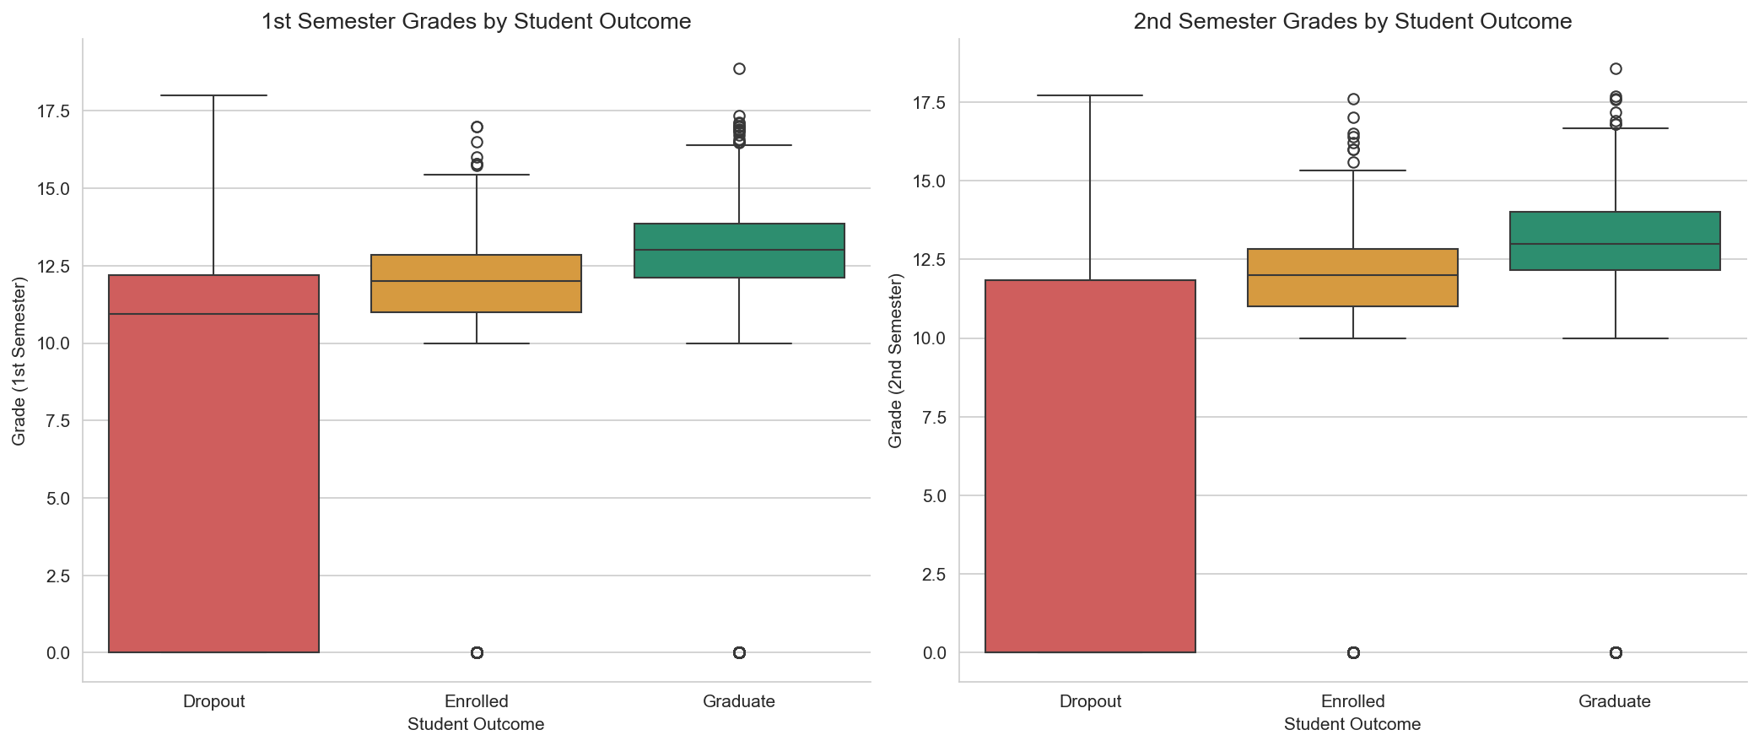
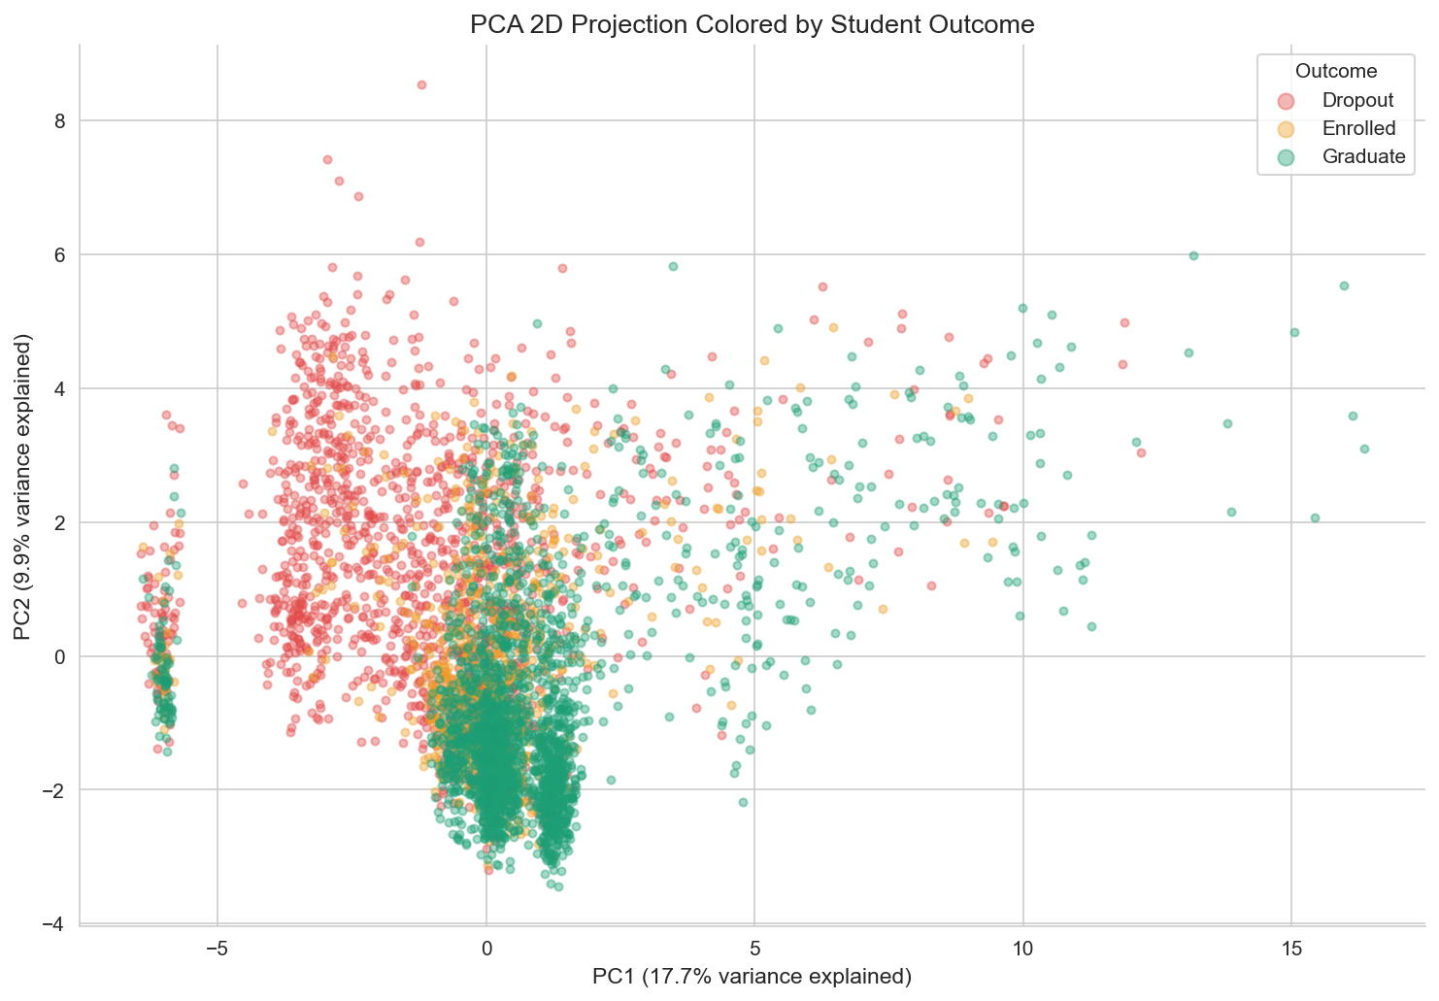
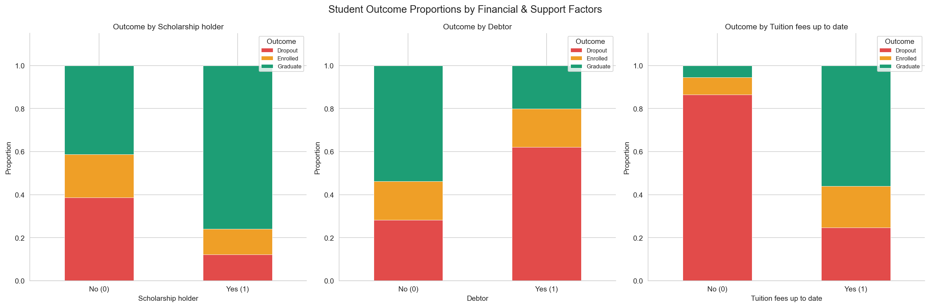
EDA — Deeper Insights
Semester grades by outcome
PCA 2D projection
Financial factors vs outcome
PCA shows moderate class separability; scholarship holders show significantly lower dropout rates
9 / 19
Notes:
Three key views here. Left: boxplots show dramatic separation in semester grades — dropout students score much lower. Center: stacked bars reveal that being a debtor or not having tuition up to date increases dropout risk. Right: PCA projects all 36 features to 2D, showing clusters but with overlap, suggesting a non-trivial classification problem.

Slide 10
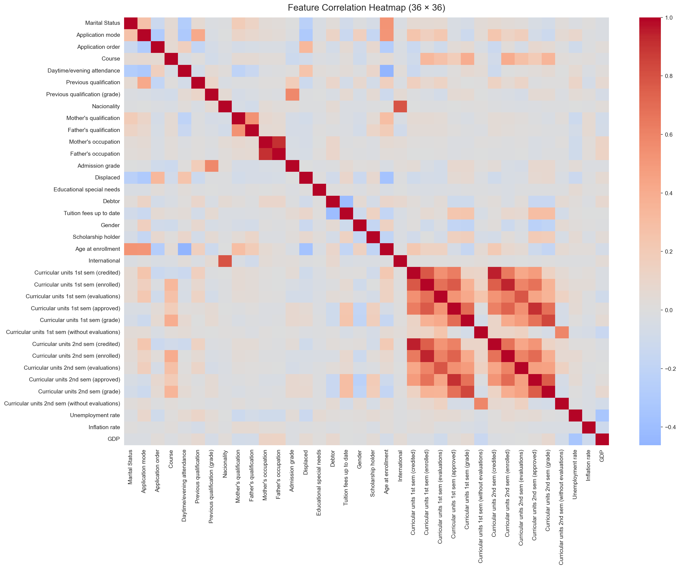
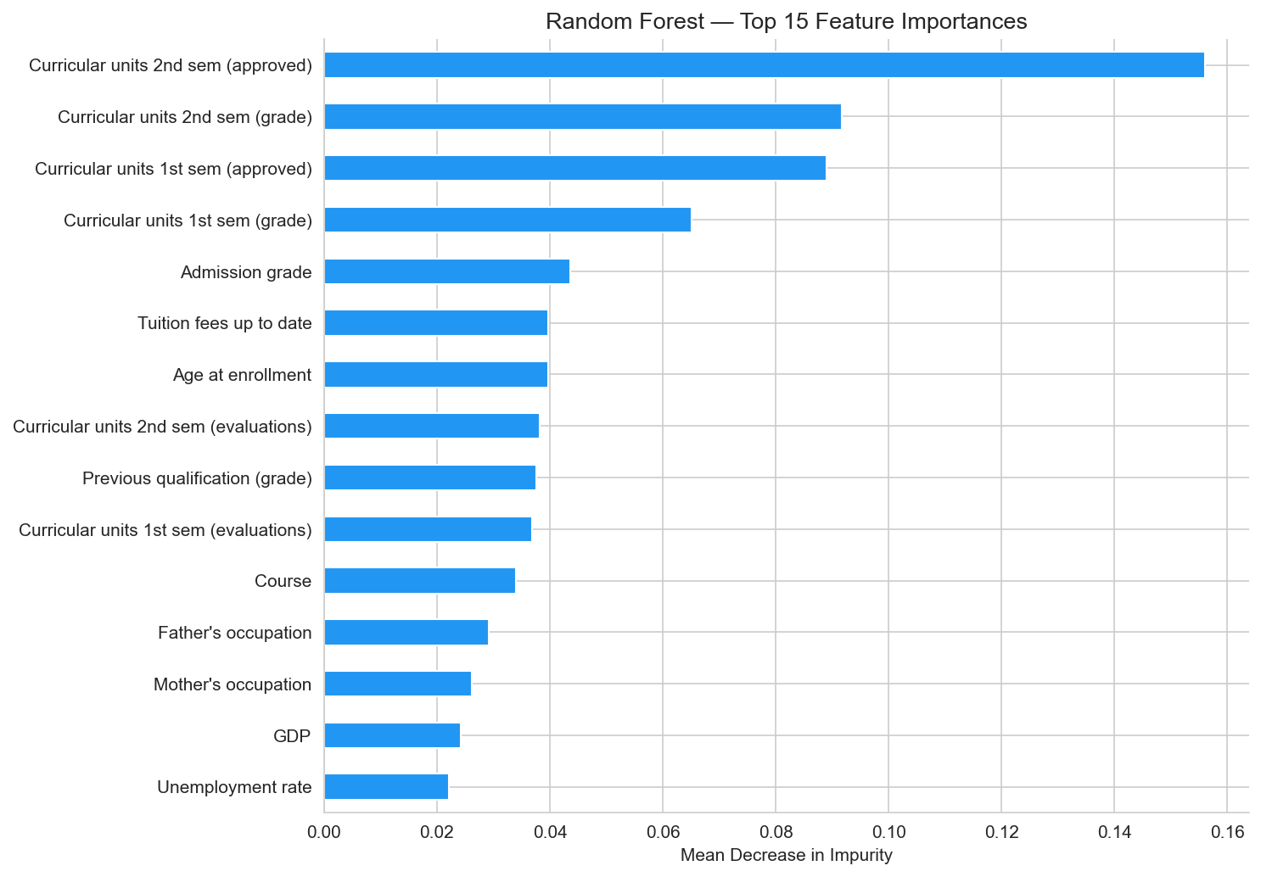
Visualization Techniques Summary
Correlation Heatmap
KDE Distributions
Boxplots
Stacked Bar Charts
PCA Scatter Plot
Feature Importance
All visualizations generated with Matplotlib & Seaborn | Consistent color coding: Red = Dropout, Amber = Enrolled, Green = Graduate
10 / 19
Notes:
This slide showcases the breadth of visualization techniques we used — heatmaps, KDE distributions, boxplots, stacked bars, PCA, and feature importance charts. All use a consistent color scheme throughout the project.

Slide 11
Classification Models — Overview
Decision Tree
max_depth=10
Random Forest
n_estimators=200
KNN
best k=11 (tuned via accuracy)
Logistic Regression
multinomial, max_iter=1000
SVM
RBF kernel, probability=True
XGBoost
n_estimators=200, max_depth=6, lr=0.1
All models: random_state=42 | 80/20 stratified split | 5-fold cross-validation | F1-macro as primary metric
11 / 19
Notes:
We trained six classification models, covering tree-based, instance-based, linear, kernel, and boosting approaches. All use random_state=42 for reproducibility. KNN's k was tuned by testing 3, 5, 7, 9, and 11, with k=11 yielding the best accuracy. We evaluate all models using F1-macro to account for class imbalance.

Slide 12
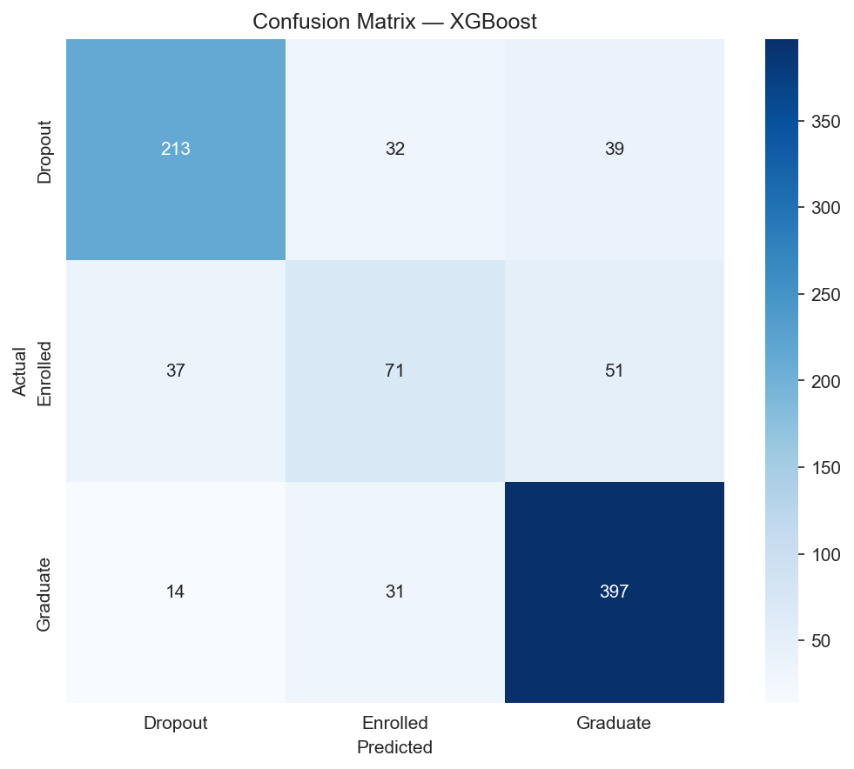
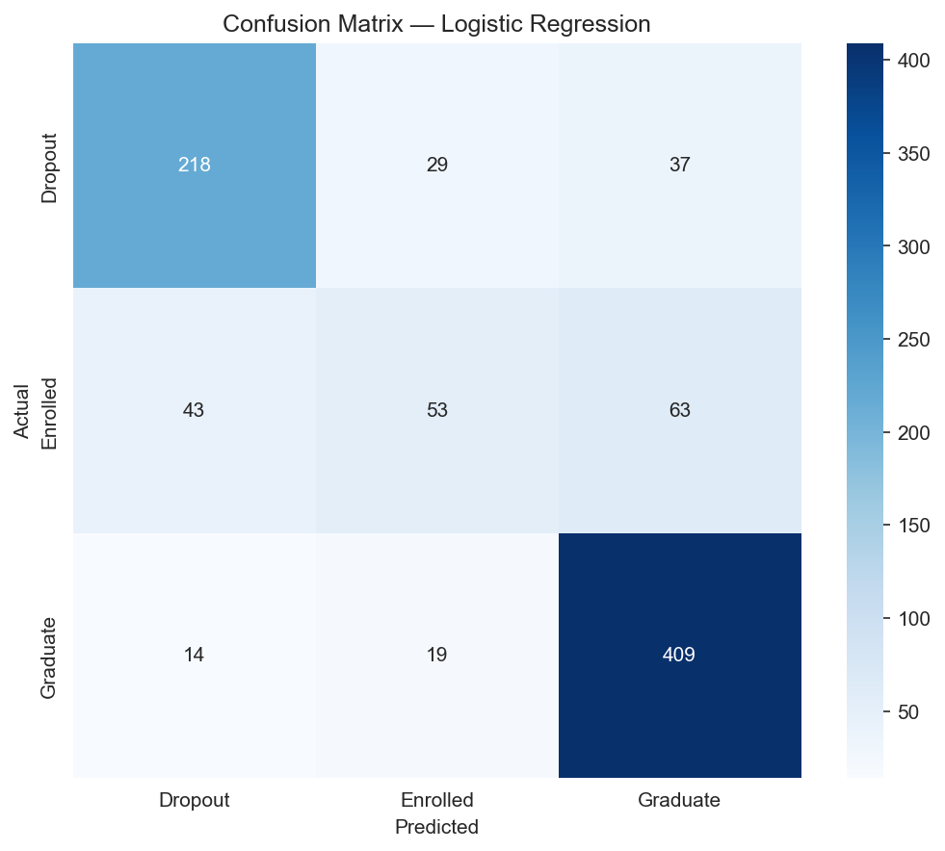
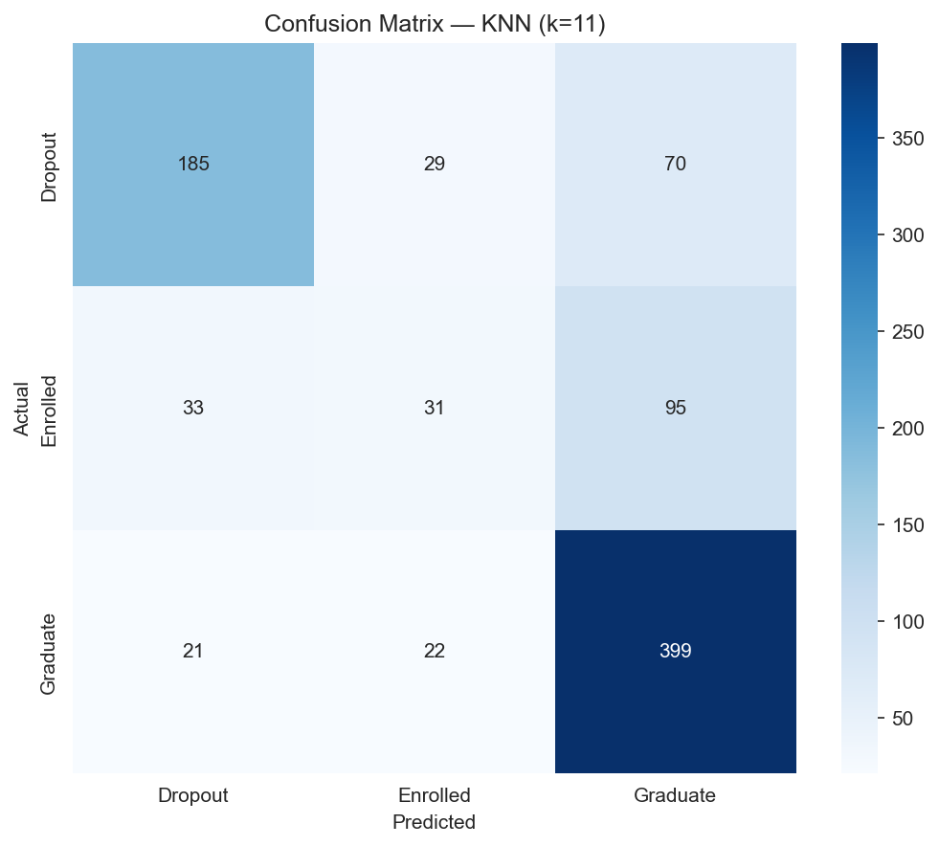
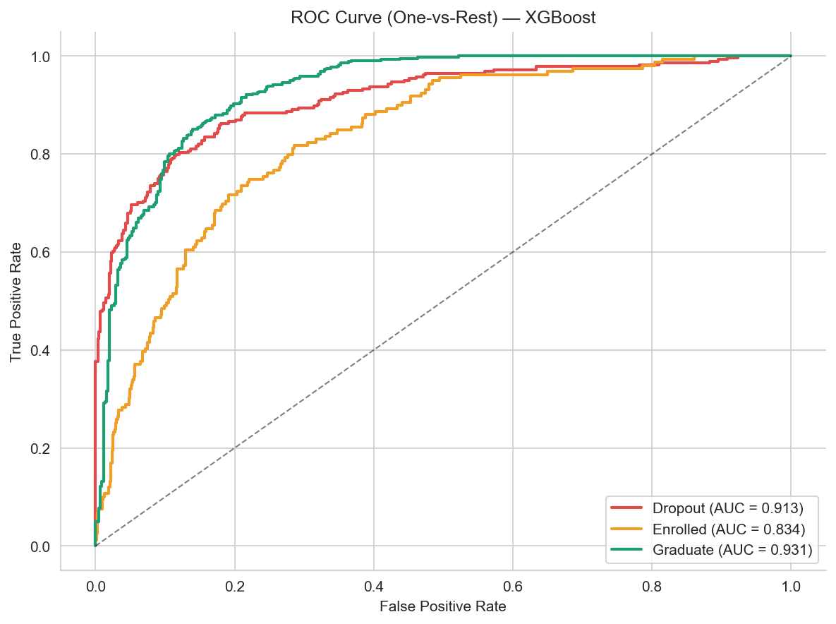
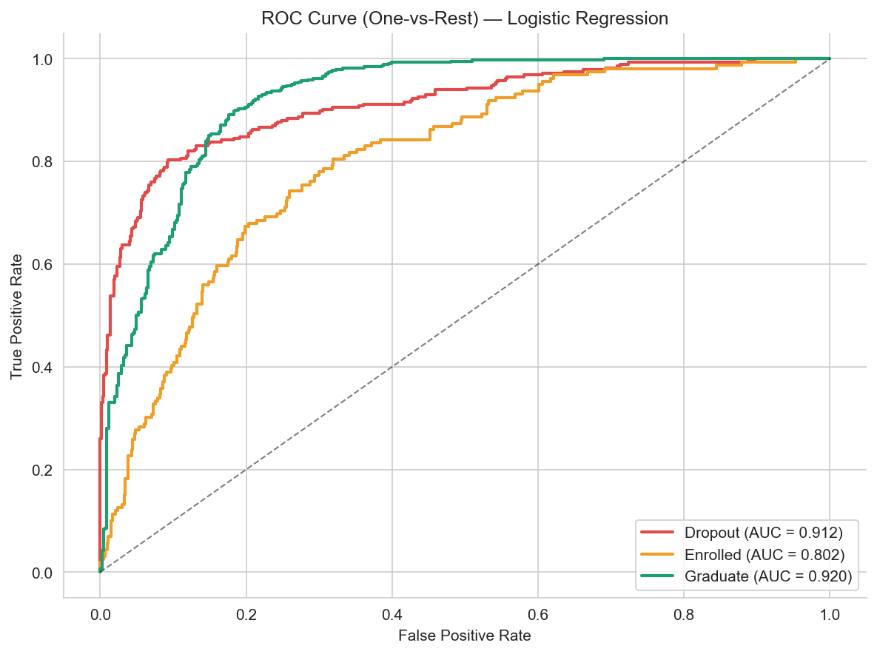
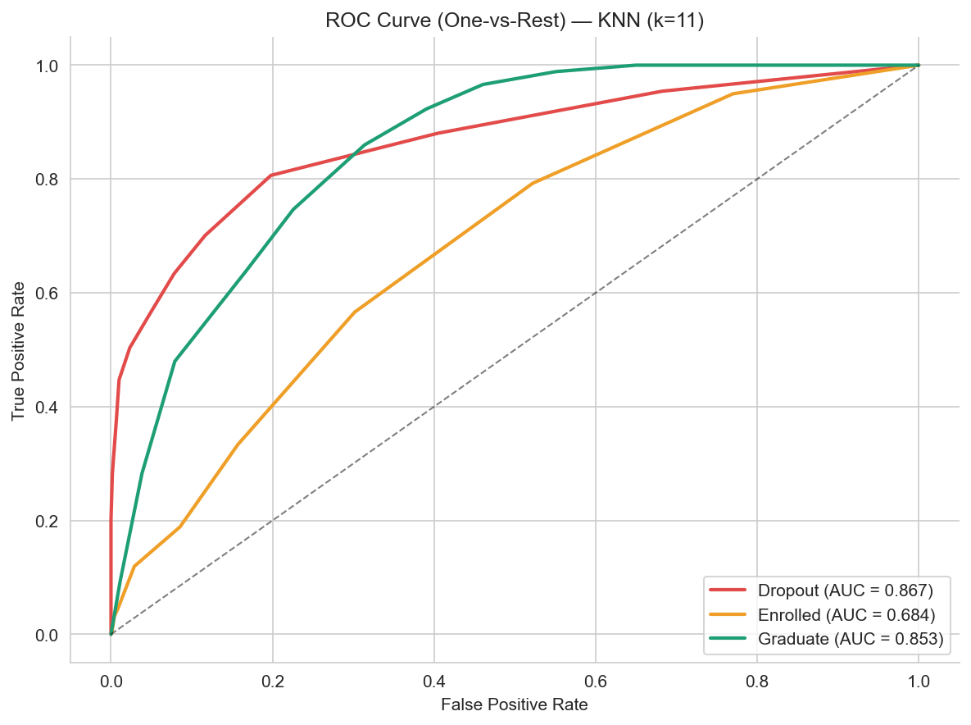
Classification Results — Best vs Worst
12 / 19
Notes:
Comparing our best model (XGBoost, F1-macro 0.706), a mid-range model (Logistic Regression, 0.683), and the weakest (KNN, 0.586). The confusion matrices show that all models struggle most with the Enrolled class due to its small size. ROC curves show strong AUC values across all three classes, especially for Dropout and Graduate.

Slide 13
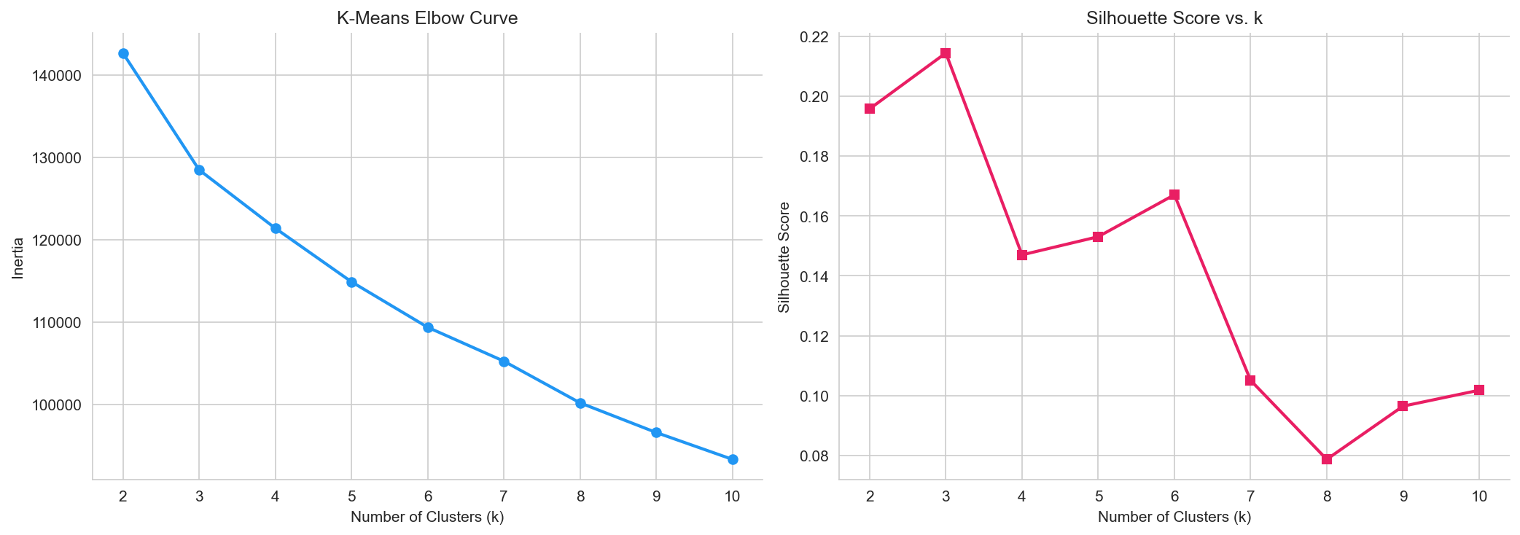
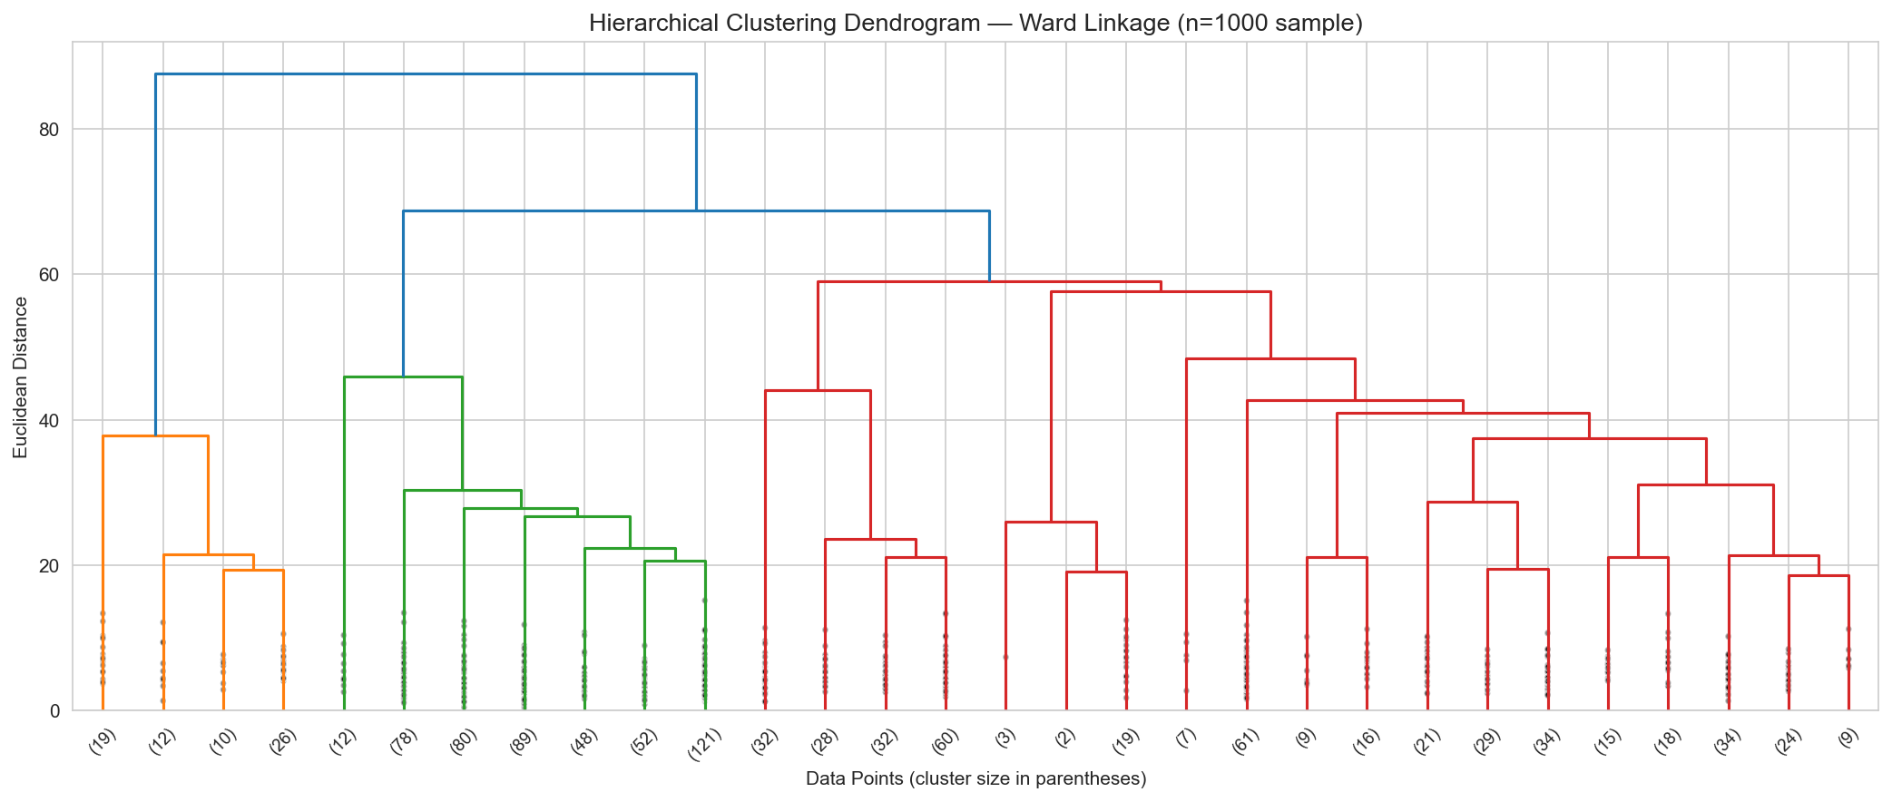
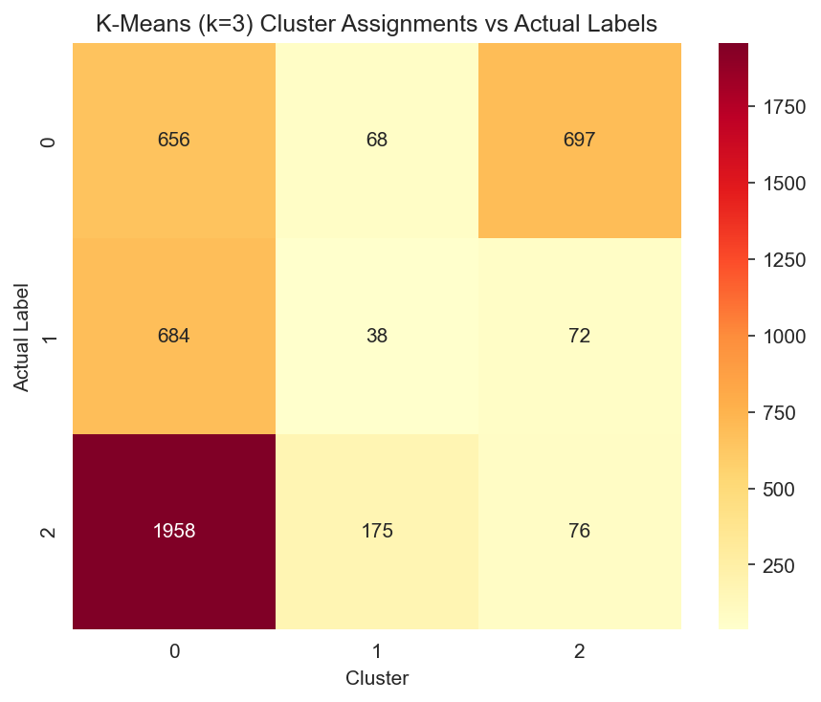
Clustering Analysis
K-Means (k=3): Silhouette = 0.2145
Clusters partially recover outcome classes
Hierarchical (Ward): Silhouette = 0.1158
Low scores confirm hard boundary problem
Supervision needed for reliable prediction
13 / 19
Notes:
K-Means with k=3 shows the best silhouette score at 0.21, confirming three natural groupings. However, the crosstab shows significant overlap — clusters don't cleanly separate the three outcome classes. Hierarchical clustering with Ward linkage confirms this. The low silhouette scores indicate that unsupervised methods alone cannot reliably predict outcomes, justifying our supervised classification approach.

Slide 14
Association Rule Mining (Apriori)
Binned numeric features into categorical ranges
Applied Apriori: min_support=0.05, min_confidence=0.60
189 frequent itemsets → 334 rules → 85 with Target as consequent
Antecedent | Consequent | Support | Conf. | Lift
CU1_Low, Age_Mid | Target_Dropout | 0.058 | 0.874 | 2.72
AdmGrade_Low, CU1_Low | Target_Dropout | 0.069 | 0.860 | 2.68
CU1_Low | Target_Dropout | 0.175 | 0.771 | 2.40
CU1_Low, AdmGrade_Med | Target_Dropout | 0.084 | 0.764 | 2.38
TuitionUpToDate, CU1_Low | Target_Dropout | 0.115 | 0.696 | 2.17
TuitionUpToDate, CU1_High, Scholarship, AdmGrade_Med | Age_Young, Target_Graduate | 0.078 | 0.801 | 2.09
Top finding: Low 1st-semester approved units + Mid age → Dropout (confidence = 87.4%, lift = 2.72)
14 / 19
Notes:
We applied the Apriori algorithm after binning numeric features. The strongest association rule says: students with low first-semester approved units who are mid-age have an 87% probability of dropping out, with a lift of 2.72 — meaning they are 2.7 times more likely to drop out than the baseline. This is actionable intelligence for academic advisors.

Slide 15
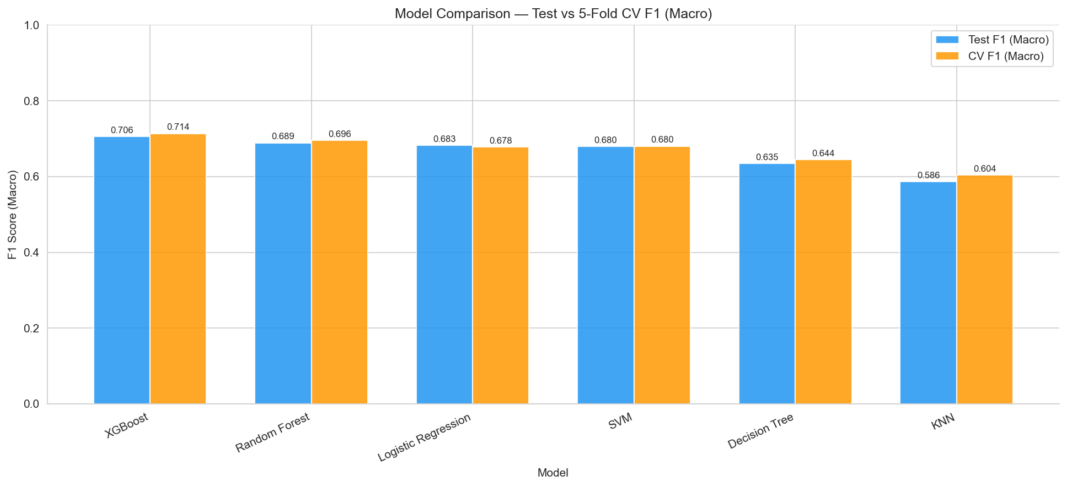
Model Comparison — Results Summary
Model | Accuracy | F1 (Macro) | F1 (Weighted) | CV F1 Mean ± Std
XGBoost | 77.0% | 0.7056 | 0.7634 | 0.7136 ± 0.0131
Random Forest | 77.1% | 0.6887 | 0.7548 | 0.6956 ± 0.0087
Logistic Regression | 76.8% | 0.6826 | 0.7531 | 0.6782 ± 0.0089
SVM | 75.9% | 0.6797 | 0.7466 | 0.6798 ± 0.0220
Decision Tree | 71.2% | 0.6346 | 0.7052 | 0.6443 ± 0.0101
KNN (k=11) | 69.5% | 0.5860 | 0.6694 | 0.6036 ± 0.0094
XGBoost achieves the highest F1-macro (0.7056) with strong cross-validation (0.7136 ± 0.0131) Random Forest leads in accuracy (77.1%) with the most stable CV (± 0.0087)
15 / 19
Notes:
This is our key results slide. XGBoost achieves the best F1-macro score of 0.706, which is our primary metric since it accounts for class imbalance. Random Forest has the highest raw accuracy at 77.1% and the most stable cross-validation performance. KNN and Decision Tree trail behind. The cross-validation results confirm these models generalize well — the small standard deviations show consistent performance across folds.

Slide 16
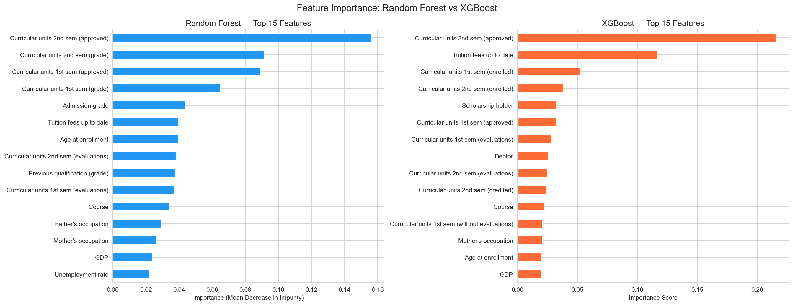
Feature Importance & Key Findings
#1: Curricular units 2nd sem (approved)
#2: Curricular units 2nd sem (grade)
#3: Curricular units 1st sem (approved)
#4: Tuition fees up to date
#5: Age at enrollment
Both Random Forest and XGBoost agree: semester performance is the dominant predictor of student outcomes
16 / 19
Notes:
Feature importance analysis from both Random Forest and XGBoost consistently ranks 2nd semester approved units as the single strongest predictor. Academic performance features dominate the top 5, followed by financial indicators like tuition status. This tells us that early semester performance is the most reliable signal for identifying at-risk students.

Slide 17
Conclusions
XGBoost achieved the highest F1-macro of 0.7056, outperforming all other models including Random Forest (0.6887) and Logistic Regression (0.6826)
1st and 2nd semester academic performance (approved units, grades) are the dominant predictors of student outcome
Association rules reveal: students with ≤2 approved units in semester 1 have a 77% dropout probability (lift = 2.4×)
K-Means clustering reveals natural risk profiles that partially align with outcome labels (silhouette = 0.21)
Recommendation: Universities should flag students with fewer than 3 approved units after semester 1 for immediate academic advising intervention
"Data mining techniques can reliably identify at-risk students early enough for meaningful intervention."
17 / 19
Notes:
To summarize: XGBoost is our best model by F1-macro, semester performance is the strongest predictor, and association rules provide actionable thresholds for intervention. Our key recommendation is simple — track first-semester approved units and flag students with fewer than 3 for immediate advising.

Slide 18
Future Work
Real-time prediction: Incorporate live semester data for dynamic risk scoring throughout the academic year
Deployment: Build a web dashboard (Streamlit/Flask) for academic advisors to query student risk in real time
Multi-institution validation: Test model generalizability across universities in different countries
Deep learning: Explore neural network architectures (e.g., TabNet) for potential performance gains
Temporal modeling: Apply sequence models to track how student risk evolves semester by semester
Limitations → Opportunities: Each future direction addresses a current constraint
18 / 19
Notes:
Looking ahead, the most impactful next step would be building a real-time dashboard that advisors can use during the semester. We'd also like to validate our models across multiple institutions. Deep learning approaches like TabNet could potentially improve performance, and temporal modeling could track how risk evolves over time.

Slide 19
Thank You!
Questions?
Lam Nguyen (018229432) • Tri Ngo (015712749)
CMPE 255 — Data Mining | Spring 2026
San José State University
github.com/duylam1407/CMPE255-Student-Dropout-Prediction
19 / 19
Notes:
Thank you for your attention. We're happy to take any questions about our methodology, results, or potential applications of this work.

