Slide 1
CMPE 255 · DATA MINING · SPRING 2026
Predicting Student Dropout & Academic Success
A data-mining study of 4,424 university students
Lam Nguyen· 018229432
Tri Ngo· 015712749
San José State University
APRIL 2026
01/19
Notes:
[OPEN — 30s]
Good [morning/afternoon], everyone. I'm Lam Nguyen and this is Tri Ngo. We're presenting our CMPE 255 data-mining project: predicting student dropout and academic success.
Our dataset is 4,424 university students from a Portuguese polytechnic, published in the UCI ML Repository as dataset 697 by Realinho and colleagues in 2021. Over the next ~15 minutes, we'll cover the motivation, the data, our preprocessing, EDA, six classification models, clustering, association-rule mining, the comparison, and what we recommend institutions actually do with this.
[TRANSITION] Let's start with why this problem matters.

Slide 2
01 · MOTIVATION
Why student dropout matters
32.1%
Dropout costs students years of investment and costs universities funding, reputation, and capacity. Early identification of at-risk students unlocks targeted academic advising before it's too late.
of students in our dataset dropped out before graduating
OUTCOME
COUNT
SHARE
Dropout
1,421
32.1%
Enrolled
794
17.9%
Graduate
2,209
49.9%
Total
4,424
100%
Source: UCI ML Repository, Dataset 697 (Realinho et al., 2021)
02/19
Notes:
[MOTIVATION — 45s]
Dropout is expensive on both sides of the relationship. Students lose tuition, time, and opportunity cost — often years of investment. Universities lose recurring tuition, lose state funding tied to retention metrics, and take a reputational hit on rankings. The 32.1% headline number on the slide is from our own dataset, not a general statistic — 1,421 of the 4,424 students dropped out.
The table is the full target distribution: 1,421 Dropout, 794 still Enrolled at the cutoff date, 2,209 Graduate, totaling 4,424 — that's our sanity-check arithmetic.
The framing for this whole talk is: if we can predict who is at risk early — at enrollment plus the first one or two semesters — advisors can intervene while there's still time. That's the value proposition.
[TRANSITION] So can we actually predict it from the data we have?

Slide 3
02 · PROBLEM STATEMENT
Can we predict a student's outcome from enrollment-time data?
TASK
APPROACH
CHALLENGE
3-class
Sup. + Unsup.
Imbalance
Supervised classification: Dropout / Enrolled / Graduate
Classification, clustering, and association rule mining
Graduate 2,209 (49.9%) · Dropout 1,421 (32.1%) · Enrolled 794 (17.9%)
OUTCOME →
An early-warning framework that flags at-risk students for intervention
03/19
Notes:
[PROBLEM STATEMENT — 40s]
Three things to anchor here. First, the TASK: this is a supervised 3-class classification problem — Dropout, Enrolled, or Graduate. We deliberately kept all three classes rather than collapsing Enrolled into one of the others, because mid-degree students are a real, distinct population.
Second, APPROACH: we combine supervised learning (six classifiers), unsupervised clustering (K-Means and Hierarchical), and association-rule mining (Apriori). The three give us complementary views — predictive accuracy, structural overlap, and human-readable rules.
Third, the CHALLENGE: class imbalance. Graduate is 49.9%, Dropout 32.1%, Enrolled only 17.9%. A naive model that always predicts Graduate would get 50% accuracy with zero useful information. That's why our primary metric is F1-macro, not accuracy.
[TRANSITION] Here's the dataset itself.

Slide 4
03 · DATASET
UCI Repository Dataset 697
DEMOGRAPHIC
ACADEMIC BACKGROUND
Marital status
Nationality
Gender
Age at enrollment
Previous qualification
Admission grade
Course
Application mode
INSTANCES
4,424 students
36 + 1 target
SOCIO-ECONOMIC
PERFORMANCE (SEM 1 & 2)
FEATURES
Scholarship holder
Debtor
Tuition fees up to date
Parental education / occupation
Units enrolled
Units approved
Semester grade
Evaluations taken
MISSING VALUES
None
LICENSE
CC BY 4.0
Source: Instituto Politécnico de Portalegre, PT Citation: Realinho et al., 2021
04/19
Notes:
[DATASET — 45s]
The dataset is UCI Repository (entry 697, donated by Realinho, Vieira Martins, Machado, and Baptista in 2021. Source institution is the Instituto Politécnico de Portalegre in Portugal. License is CC BY 4.0, so no usage restrictions for academic work.)
Four key facts on the slide:
- 4,424 student instances- 36 input features plus 1 target — the full schema, no derived feature explosion.
— large enough for stable 80/20 split, small enough to train every model in seconds.
- Zero missing values — meaning we didn't have to make imputation choices that could bias results.
- CC BY 4.0 license.
The features fall into four buckets shown on the right: Demographic (age, gender, marital status, nationality), Academic background (previous qualification, admission grade, course, application mode), Socio-economic (scholarship, debtor status, tuition fees, parental education and occupation), and Performance for both semester 1 and semester 2 — units enrolled, units approved, semester grade, and evaluations taken. That last bucket, semester performance, ends up being where almost all the predictive signal lives.
[TRANSITION] Before modeling, we designed a star schema for the analytical layer.

Slide 5
04 · DATA WAREHOUSE
Star schema for the analytical layer
STUDENT_DIM
ACADEMIC_DIM
age
gender
marital_status
nationality
FACT
prev_qualification
application_mode
admission_grade
course
Student_Enrollment_Fact
student_id PK
course_id FK
sem1_grade · sem1_approved
sem2_grade · sem2_approved
target_outcome
FAMILY_DIM
ECONOMIC_DIM
mother_qualification
father_qualification
mother_occupation
father_occupation
scholarship
debtor
tuition_fees
unemployment_rate · GDP
ETL ›
Source DBs
→
Extract
→
Transform(encode · normalize)
→
Load
→
Star Schema
05/19
Notes:
[DATA WAREHOUSE — 40s]
This slide shows the conceptual star schema we designed for an institution that wanted to operationalize this. The center is the Student_Enrollment_Fact table, keyed by student_id, with course_id as a foreign key and the measures we actually mine on — semester 1 and 2 grades, units approved per semester, and the target outcome.
Around it sit four dimension tables: Student_Dim (age, gender, marital, nationality), Family_Dim (parental qualifications and occupations), Academic_Dim (previous qualification, application mode, admission grade, course), and Economic_Dim (scholarship, debtor, tuition status, plus macro indicators like unemployment rate and GDP).
The arrow row at the bottom is the ETL pipeline: pull from source databases, encode categoricals, normalize numerics with StandardScaler, load into the star schema. This isn't running in production — it's a design artifact showing how the project would integrate with a real institutional warehouse.
[TRANSITION] Now the actual preprocessing we ran.

Slide 6
05 · PREPROCESSING
From raw CSV to model-ready matrix
1
Inspection
2
Feature typing
4,424 rows · 36 features · 0 missing values
Categorical (int-coded) vs continuous
3
Target encoding
4
Normalization
Dropout 0 · Enrolled 1 · Graduate 2
StandardScaler on all numeric features
5
Stratified split
6
Reproducibility
80% train (3,539) · 20% test (885)
random_state=42 across all operations
Stratified split preserves class ratios in both train and test sets. An unscaled copy is kept for EDA.
06/19
Notes:
[PREPROCESSING — 45s]
Six numbered steps, all reproducible.
1. Inspection — confirmed 4,424 rows, 36 features, zero missing. No imputation needed.
2. Feature typing — separated integer-coded categoricals (e.g., marital status, course code) from continuous variables (grades, age).
3. Target encoding — Dropout=0, Enrolled=1, Graduate=2. Numeric labels for sklearn.
4. Normalization — StandardScaler on all numeric features. Required for distance-based methods (KNN, SVM-RBF) and helpful for logistic regression's convergence; tree models don't need it but we apply uniformly to keep one matrix.
5. Stratified 80/20 split — 3,539 train, 885 test. Stratification preserves the class ratios (32/18/50) in both folds so test-set evaluation is meaningful for every class.
6. Reproducibility — random_state=42 everywhere, including model init, train/test split, and CV folds.
The footnote: we keep an unscaled copy for EDA so plot axes are in real units (grades 0–20, age in years), not z-scores.
[TRANSITION] Onto exploratory analysis — first the target distribution.

Slide 7
06 · EDA — TARGET DISTRIBUTION
Three classes, uneven sizes
Graduate
2,209 49.9%
4,424
Dropout
1,421 32.1%
students total
Enrolled
794 17.9%
Enrolled is the underrepresented class — stratified sampling and F1-macro keep it visible.
07/19
Notes:
[EDA · TARGET DISTRIBUTION — 30s]
Headline number: 4,424 students total. The distribution: Graduate 2,209 (49.9%), Dropout 1,421 (32.1%), Enrolled 794 (17.9%).
Two things to take away. First, this is moderate, not severe imbalance — Enrolled is roughly 1:2.8 vs Graduate, not 1:100 like fraud detection. So we don't need SMOTE or aggressive resampling. Second, the imbalance is still enough that accuracy alone would be misleading, which is why our headline metric is F1-macro — it averages per-class F1 with equal weight, so the 794 Enrolled students count as much as the 2,209 Graduates.
[TRANSITION] Now the most important univariate signal.

Slide 8
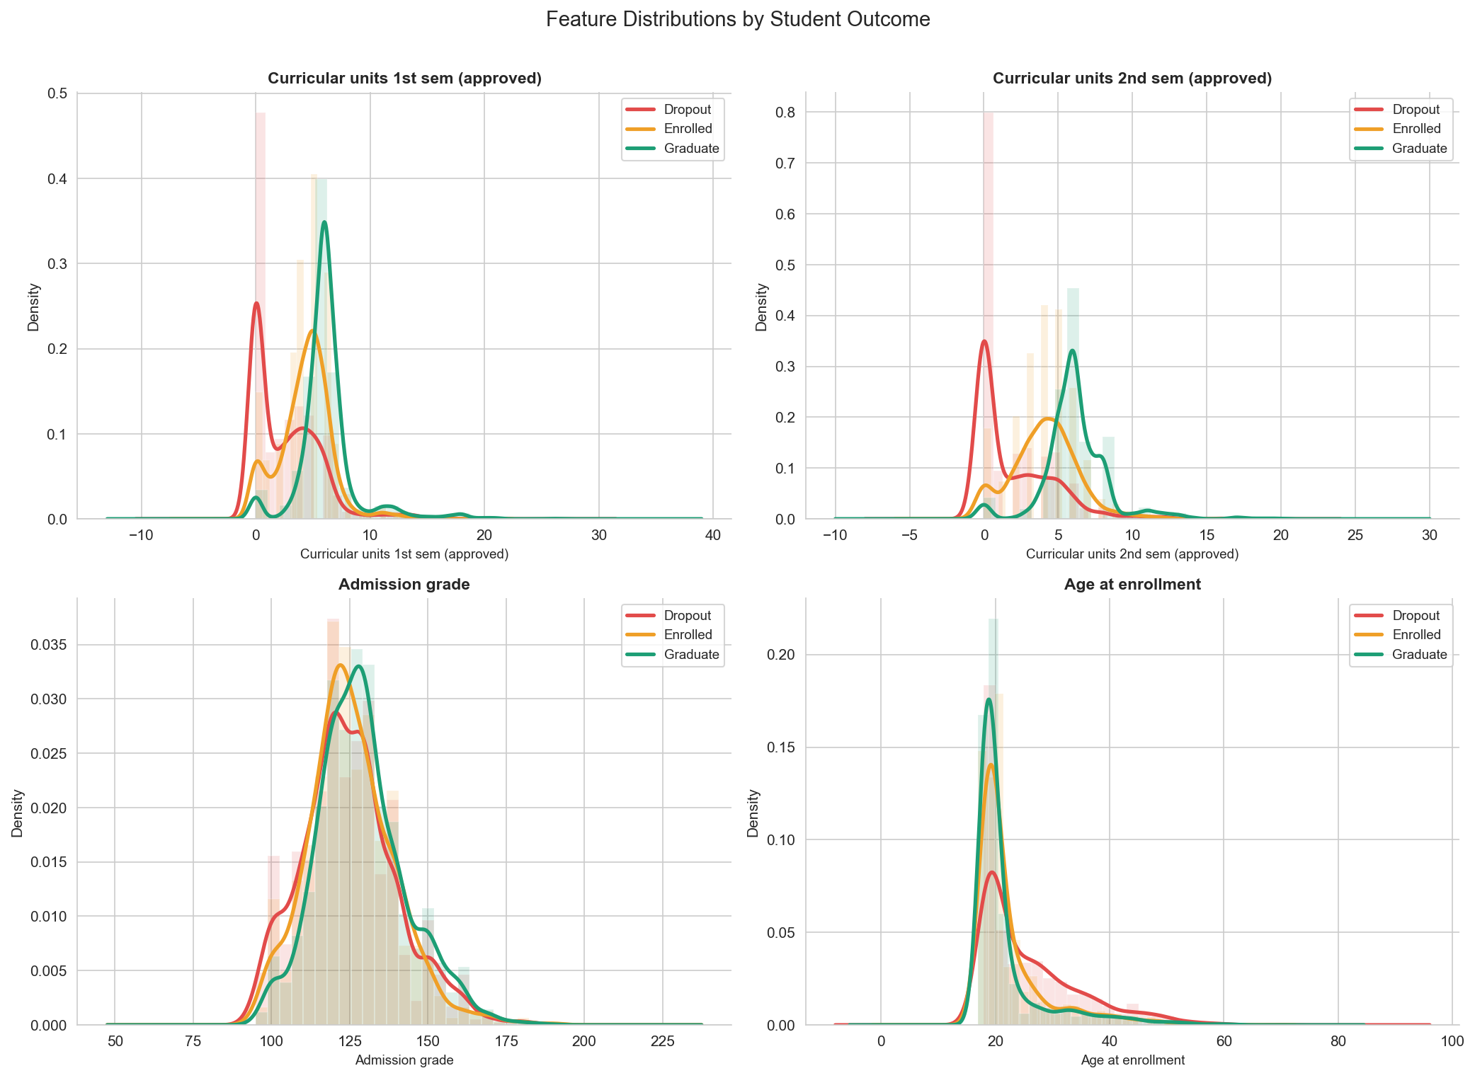
07 · EDA — DISTRIBUTIONS
Approved curricular units separate the classes
SPEARMAN Ρ VS TARGET (TOP 9 BY |Ρ|)
FEATURE
Ρ
Curricular units 2nd sem (approved)
+0.65
Curricular units 1st sem (approved)
+0.59
Curricular units 2nd sem (grade)
+0.56
Curricular units 1st sem (grade)
+0.49
Tuition fees up to date
+0.40
Scholarship holder
+0.30
Admission grade
+0.12
Debtor
−0.24
Age at enrollment
−0.29
Dropout students cluster near zero approved units, while graduates spread across higher values. 2nd-semester approved units has the largest |ρ| ≈ 0.65 — the single strongest monotonic predictor in the dataset.
08/19
Notes:
[EDA · DISTRIBUTIONS — 60s]
Two visuals. Left: KDE plots of approved curricular units, broken out by outcome. Dropout students pile up at zero — they're failing or not completing courses. Graduates spread across higher values. Enrolled sits in between. The separation is visually obvious, which tells us this single feature carries strong signal even before any model sees it.
Right: top 9 features ranked by absolute Spearman rank correlation with the target. Reading them top to bottom — the four highest are all curricular-unit measures: 2nd-sem approved at +0.65, 1st-sem approved +0.59, 2nd-sem grade +0.56, 1st-sem grade +0.49. That +0.65 is the largest monotonic relationship in the entire dataset.
Below the academic block: tuition fees up to date +0.40, scholarship holder +0.30, admission grade +0.12. And two negative correlations: debtor at −0.24 (more debt → more dropout) and age at enrollment at −0.29 (older entrants drop out more often).
We use Spearman rather than Pearson because several variables are ordinal or have non-linear relationships with the outcome.
[TRANSITION] Three more views — grades, finance, and a 2D projection.

Slide 9
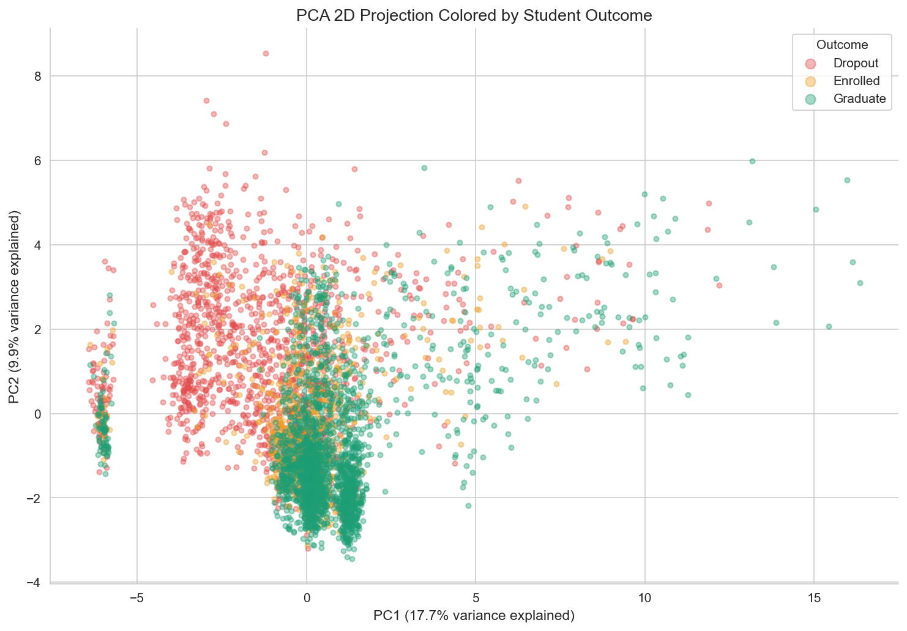
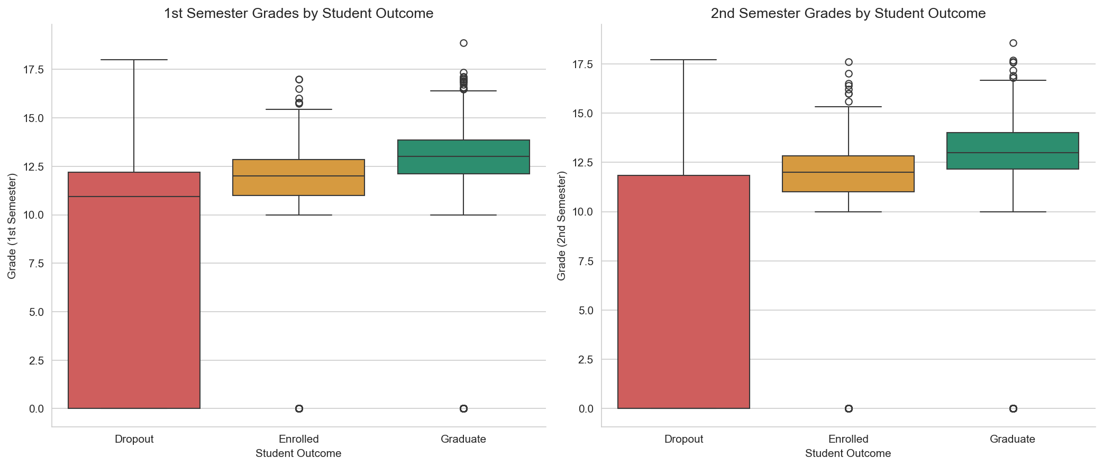
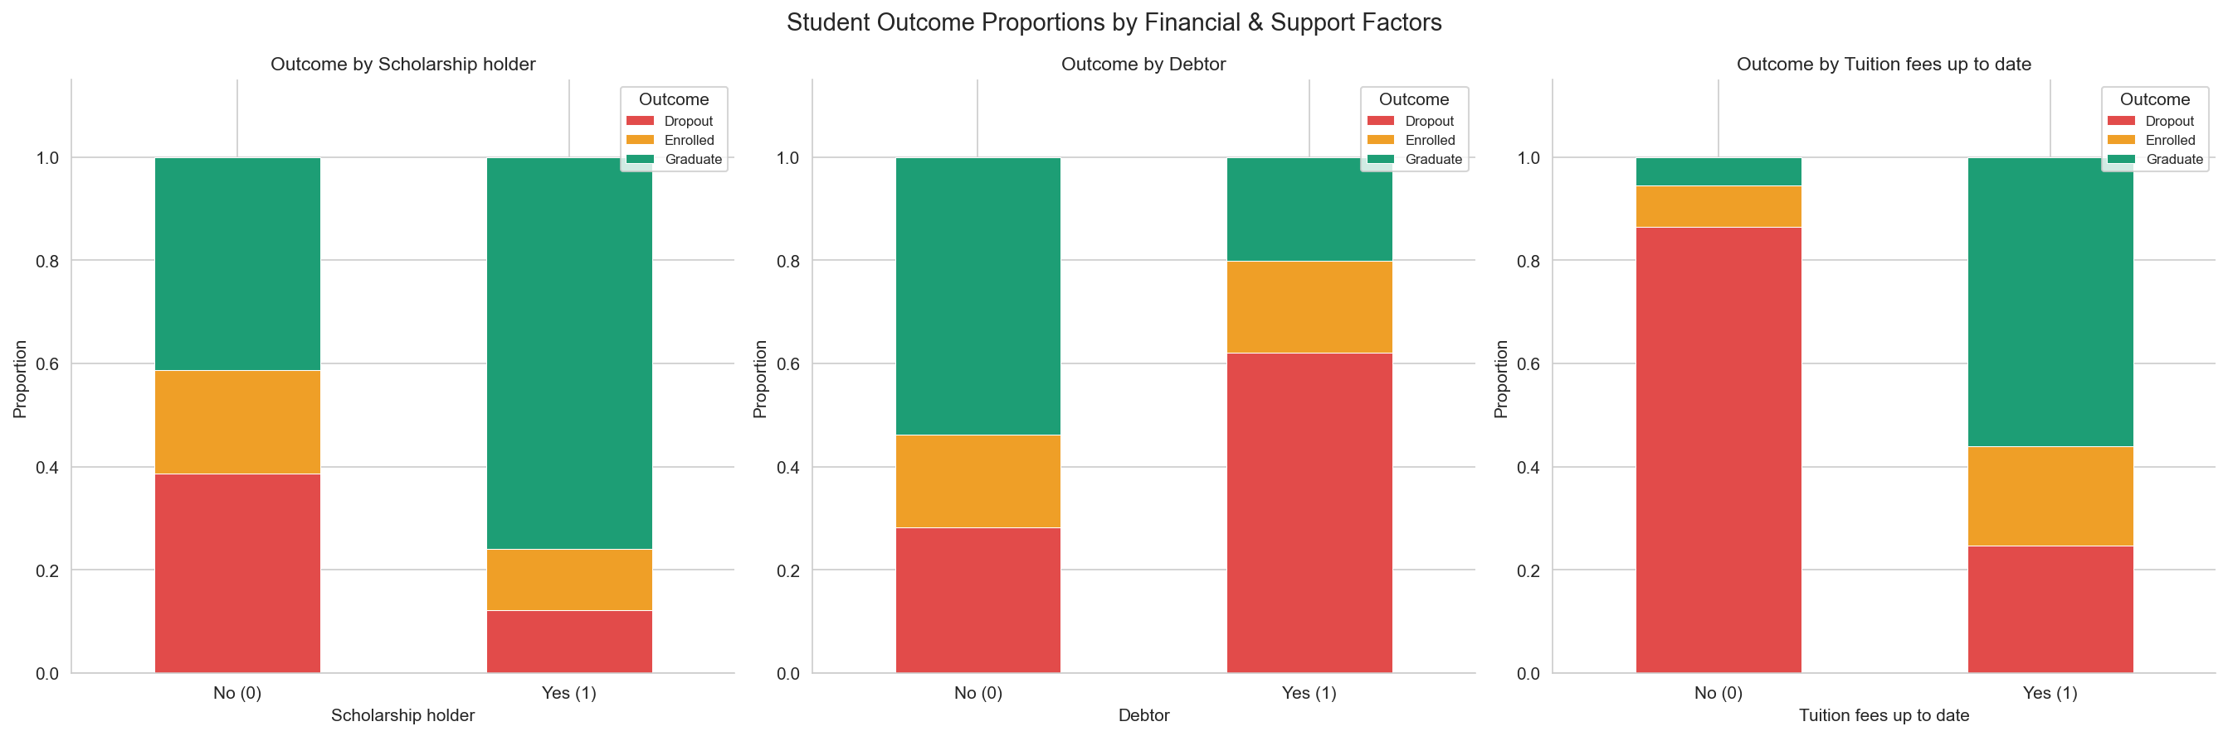
08 · EDA — THREE LENSES
Grades, finance, and a 2D projection
SEMESTER GRADES BY OUTCOME
FINANCIAL FACTORS VS OUTCOME
PCA 2D PROJECTION
DROPOUT RATE BY FINANCIAL FACTOR (FROM MIDDLE CHART)
Scholarship holders drop out at 12% vs 39% for non-holders — a 3.3× lower rate. Tuition status is the most decisive single binary signal in the data. PCA projection shows moderate but imperfect class separability — a non-trivial classification problem.
FACTOR
DROPOUT IF NO
DROPOUT IF YES
Δ
Scholarship holder
39%
12%
−27 pp
Debtor
28%
62%
+34 pp
Tuition fees up to date
86%
25%
−61 pp
09/19
Notes:
[EDA · THREE LENSES — 70s]
Left chart — boxplots of semester grades by outcome. Graduate medians sit clearly above Enrolled which sit above Dropout. Same pattern in both semesters.
[5-NUMBER SUMMARY — 1st semester grade]
- Dropout (n=1421): min 0.00, Q1 0.00, MEDIAN 10.93, Q3 12.20, max 18.00 (IQR 12.20).
- Enrolled (n=794): min 0.00, Q1 11.00, MEDIAN 12.00, Q3 12.86, max 17.00 (IQR 1.86).
- Graduate (n=2209): min 0.00, Q1 12.12, MEDIAN 13.00, Q3 13.86, max 18.88 (IQR 1.74).
[5-NUMBER SUMMARY — 2nd semester grade]
- Dropout (n=1421): min 0.00, Q1 0.00, MEDIAN 0.00, Q3 11.83, max 17.71 — note: median = Q1 = 0, so the median line sits at the bottom edge of the box. More than half of dropouts had a 2nd-semester grade of zero.
- Enrolled (n=794): min 0.00, Q1 11.00, MEDIAN 12.00, Q3 12.82, max 17.60 (IQR 1.82).
- Graduate (n=2209): min 0.00, Q1 12.17, MEDIAN 13.00, Q3 14.00, max 18.57 (IQR 1.83).
Whiskers follow Tukey's 1.5·IQR rule. Outlier circles below the Enrolled and Graduate boxes are real students who eventually persisted despite a zero grade in that semester.
Middle chart — financial factors versus outcome. Three binary signals split on the outcome distribution.
The table summarizes the dropout rate by financial factor:
- Scholarship holders drop out at 12% versus 39% for non-holders — a 27-point reduction, or 3.3× lower rate.
- Debtors drop out at 62% versus 28% for non-debtors — a 34-point increase.
- Tuition up to date is the most decisive single binary in the dataset: 25% dropout when paid versus 86% when not — a 61-point gap.
The causal direction is debatable — students likely stop paying because they're disengaging, not the other way around — but as a leading indicator it's extraordinary.
Right chart — PCA projection of the full 36-feature space down to 2 components. PC1 explains 17.7% of variance, PC2 explains 9.5% — together about 27%. We see three identifiable regions but with substantial overlap, especially Enrolled mixing into both Dropout and Graduate.
[CODE TO SHOW IF ASKED]
- Boxplot: notebooks/02_eda_visualization.ipynb cell 9 (sns.boxplot, palette=COLORS, order=['Dropout','Enrolled','Graduate']).
- Stacked bars: same notebook cell 13 (pd.crosstab + normalize='index').
- PCA: same notebook cell 15 (StandardScaler then PCA(n_components=2, random_state=42)).
[TRANSITION] Quick note on the plotting toolkit, then onto modeling.

Slide 10
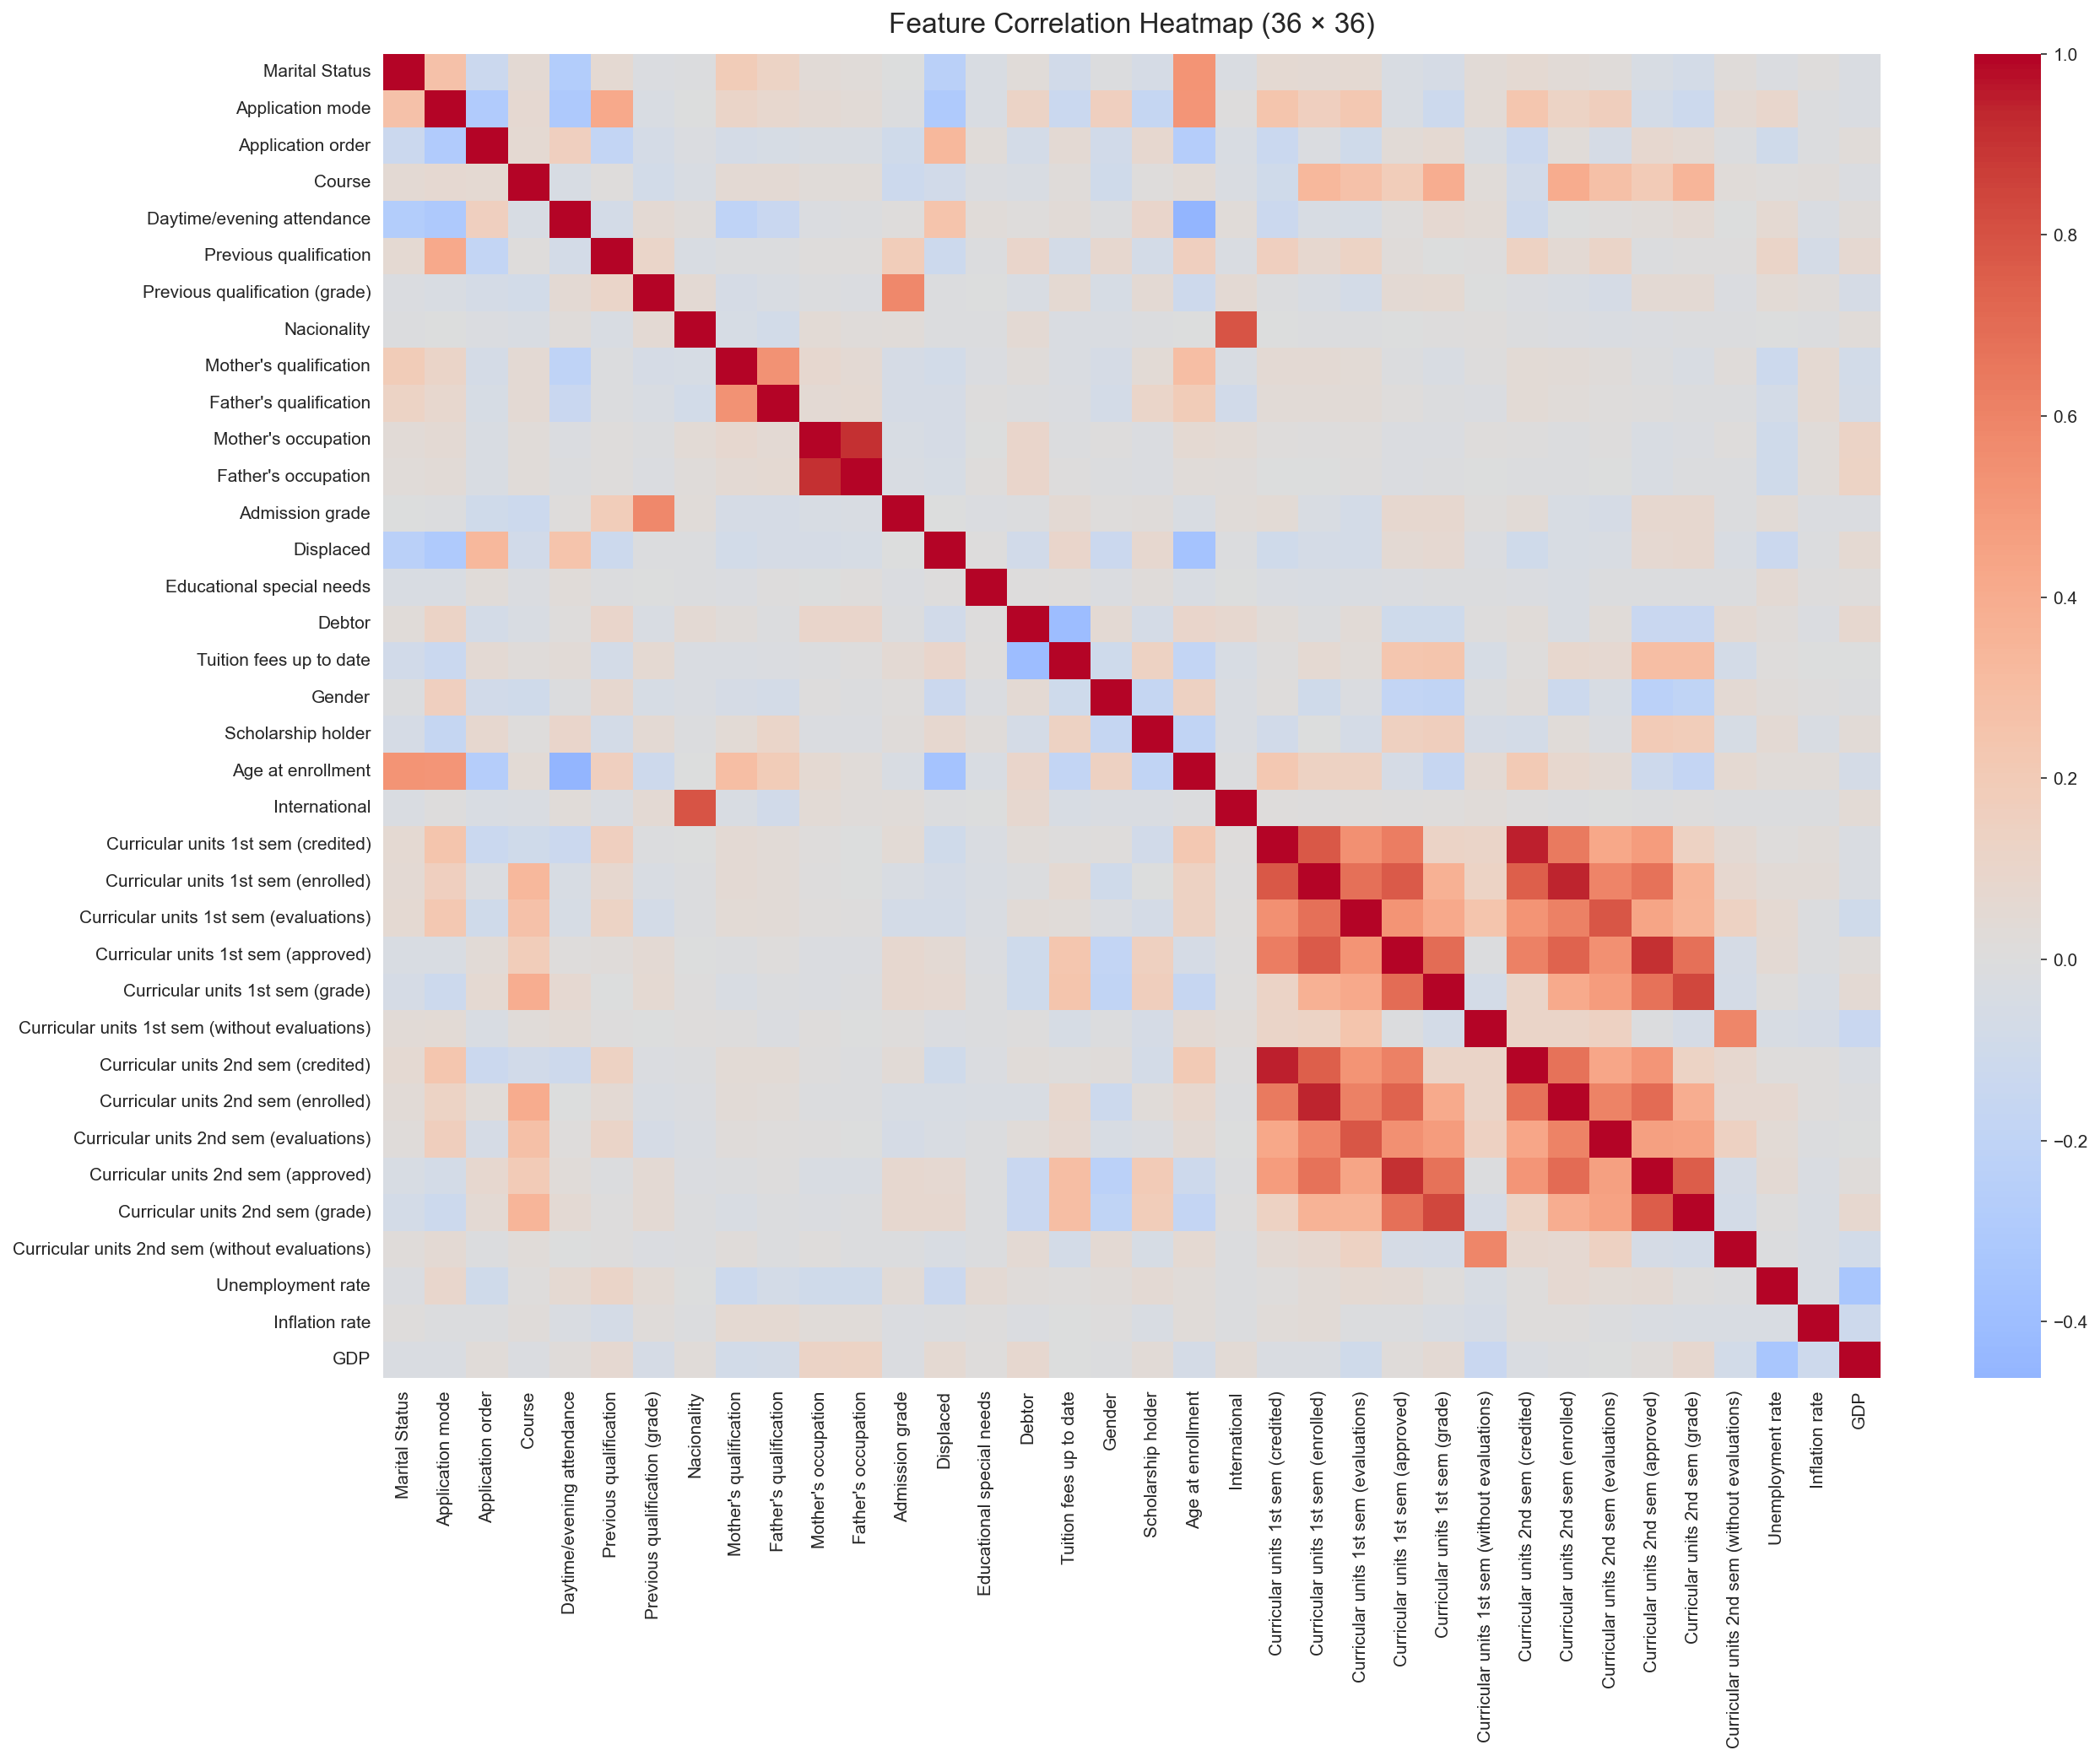
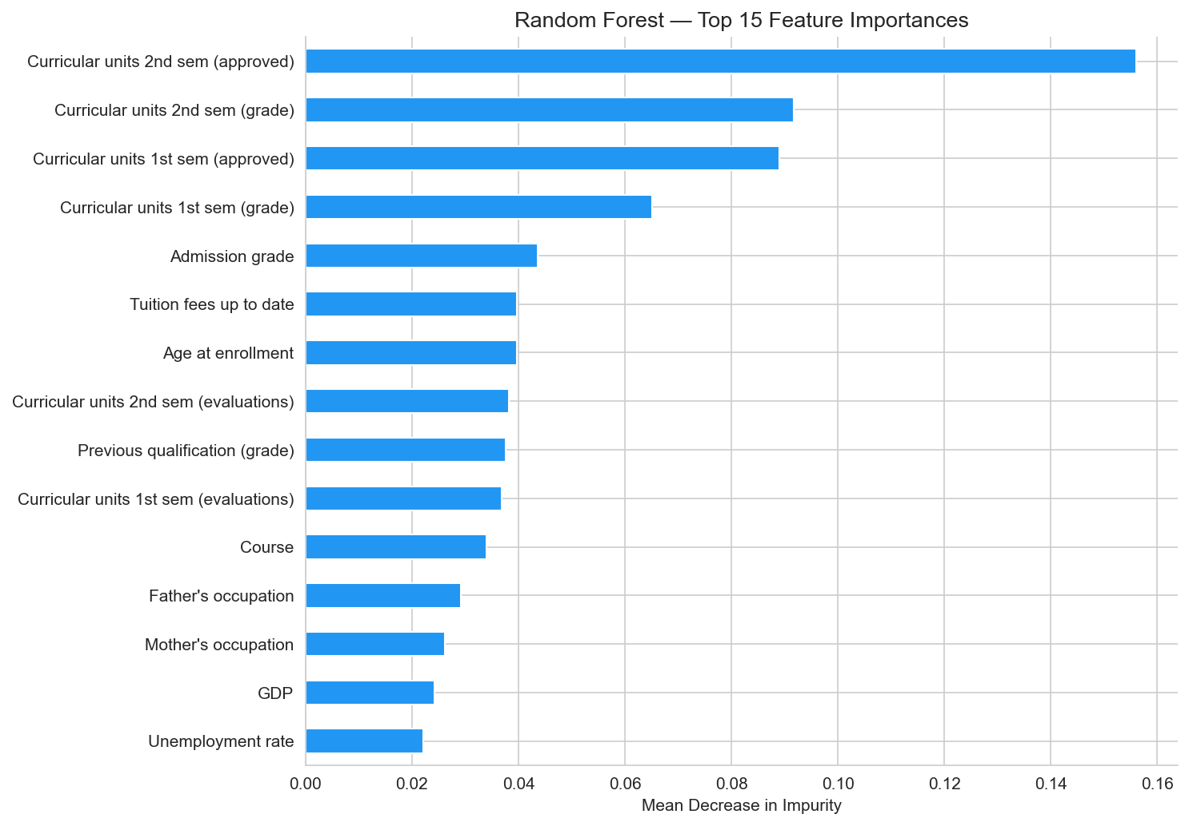
09 · VISUALIZATION TOOLKIT
Six chart types, one consistent palette
Correlation Heatmap
KDE Distribution
Boxplots
TREE
max_depth = 10
Stacked Bar Charts
PCA Scatter
Feature Importance
LINEAR
multinomial · max_iter=1000
10/19
Notes:
[VISUALIZATION TOOLKIT — 25s]
Quick survey of the chart types we used throughout the analysis: correlation heatmap for global feature relationships, KDE plots for per-class distributions, boxplots for grade comparisons, stacked bar charts for categorical breakdowns, PCA scatter for low-dimensional structure, and feature-importance bar charts for the trained models. One consistent palette keeps the deck readable.
[NOTE — speaker only] If asked: the model-parameter text on this slide (max_depth=10, multinomial max_iter=1000) bled in from a slide template; the actual modeling parameters are on the next slide.
[TRANSITION] Now the modeling itself.

Slide 11
10 · MODELING
Six classifiers across five algorithm families
TREE
ENSEMBLE
INSTANCE
Decision Tree
Random Forest
KNN
max_depth = 10
n_estimators = 200
best k = 11 (tuned)
LINEAR
KERNEL
BOOSTING
Logistic Regression
SVM
XGBoost
multinomial · max_iter=1000
RBF kernel · probability=True
n_est=200 · depth=6 · lr=0.1
random_state = 42
80 / 20 stratified split
5-fold cross-validation
Primary metric: F1-macro
11/19
Notes:
[MODELING — 50s]
Six classifiers across five algorithm families — picked to span the methodology landscape, not because we expected all of them to win.
- TREE: Decision Tree, max_depth=10. Interpretable baseline.
- ENSEMBLE: Random Forest, n_estimators=200. Bagging baseline.
- INSTANCE: KNN, k=11 — chosen by grid search over k=1..30 on the validation fold.
- LINEAR: Logistic Regression, multinomial with softmax, max_iter=1000.
- KERNEL: SVM with RBF kernel, probability=True so we can compute ROC curves.
- BOOSTING: XGBoost, n_estimators=200, max_depth=6, learning_rate=0.1.
Common protocol across all six: random_state=42, the same 80/20 stratified split from preprocessing, 5-fold cross-validation on the train fold, and F1-macro as the primary metric. Test set is held out and only touched once per model for the final number.
[TRANSITION] How they did.

Slide 12
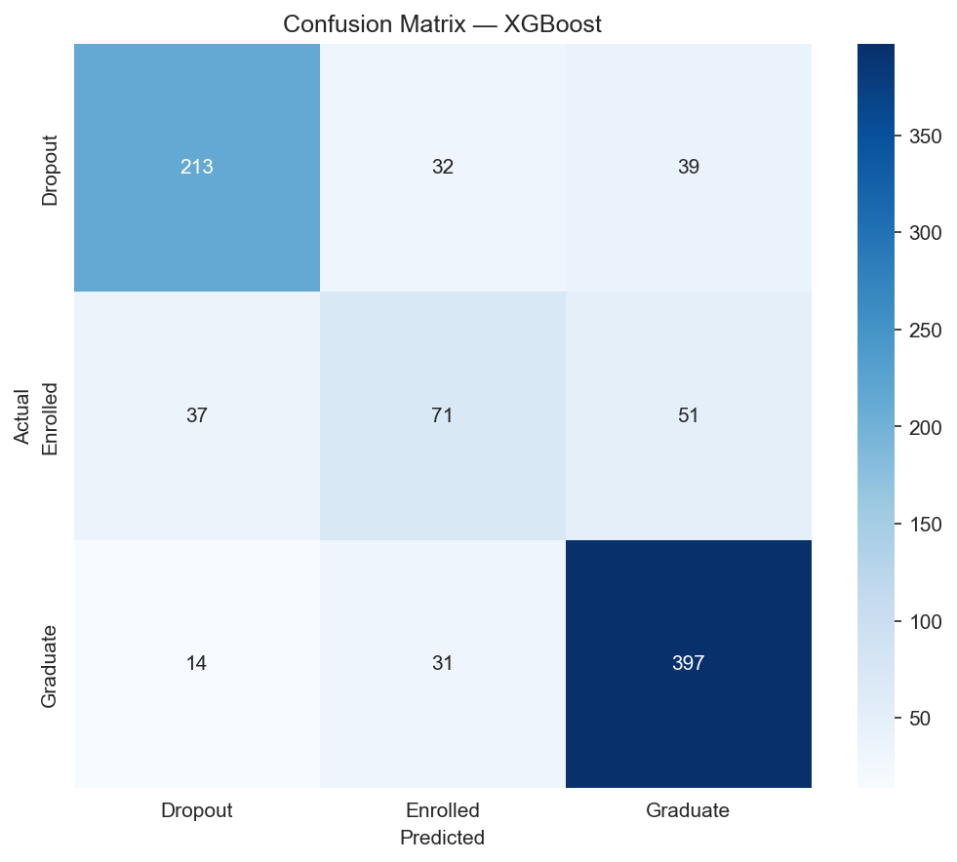
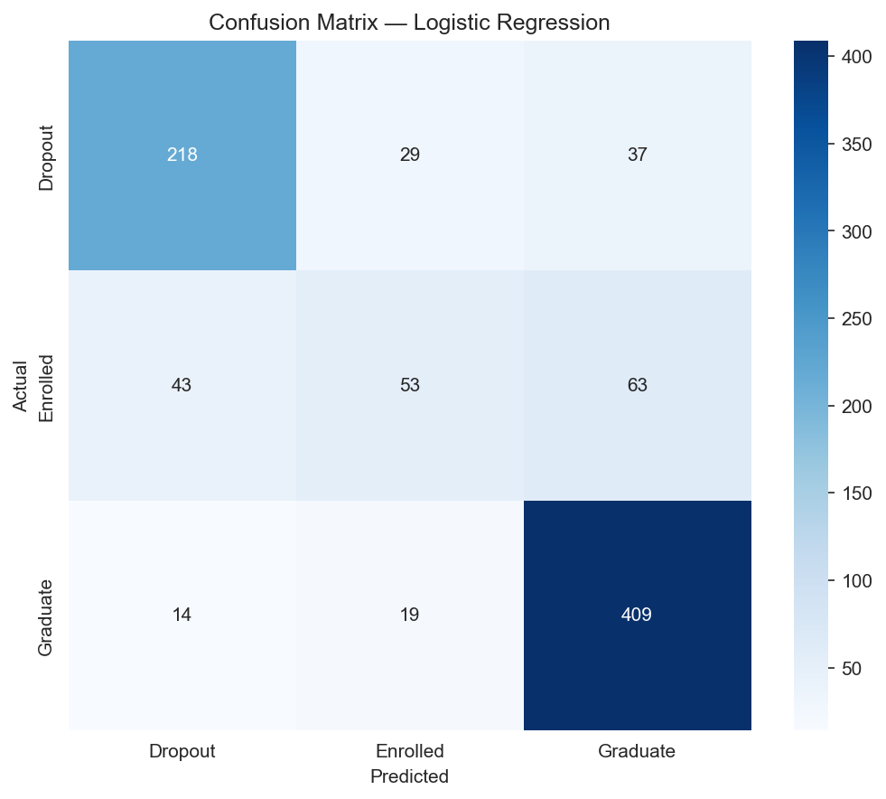
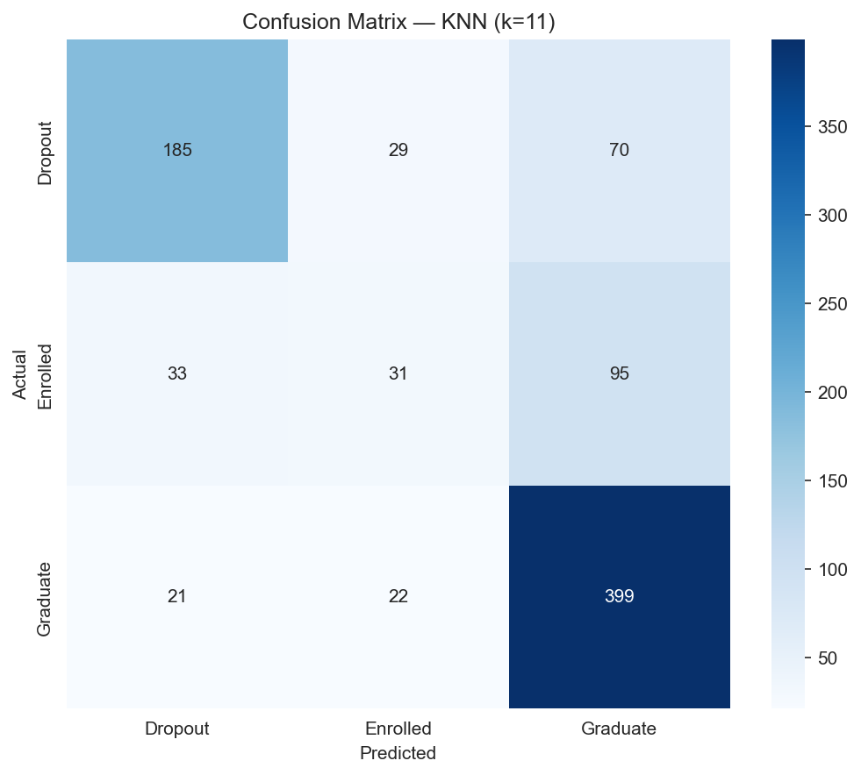
11 · CLASSIFICATION RESULTS
Best, middle, and worst — side by side
BEST
MID-RANGE
WEAKEST
XGBoost
Logistic Regression
KNN (k=11)
F1-MACRO
0.706
F1-MACRO
0.683
F1-MACRO
0.586
PER-CLASS RECALL — XGBOOST (N = 885 TEST SET)
The Enrolled class is recovered at only 44.7% — half the rate of Graduate. With just 159 test instances vs 442 for Graduate, the model has fewer training examples to learn its boundary, and the class sits geometrically between the other two — confusions go in both directions (37 → Dropout, 51 → Graduate).
CLASS
TEST N
CORRECT
RECALL
Dropout
284
213
75.0%
Enrolled
159
71
44.7%
Graduate
442
397
89.8%
12/19
Notes:
[CLASSIFICATION RESULTS — 70s]
Three confusion matrices side by side — best, mid-range, weakest — so we're showing the full performance spectrum, not just the headline.
XGBoost on the left: F1-macro 0.706. Logistic Regression in the middle: 0.683 — a strong linear baseline, only 2-3 points behind boosting. KNN on the right: 0.586 — clearly the weakest, but useful as a non-parametric reference point.
Per-class recall on the XGBoost test set, n=885:
- Dropout: 213 correct out of 284 = 75.0% recall.
- Enrolled: 71 correct out of 159 = 44.7% recall.
- Graduate: 397 correct out of 442 = 89.8% recall.
Total correct = 213+71+397 = 681 out of 885 = 76.95% accuracy — matches our headline.
The Enrolled gap is the story to tell. Three drivers:
1. Smallest class — 159 test instances vs 442 Graduate, so fewer training examples to fit a boundary.
2. Geometrically wedged between the other two — students mid-degree look like graduates one year, dropouts the next.
3. The 88 misclassified Enrolled split nearly evenly — 37 → Dropout, 51 → Graduate — so the model isn't biased toward one direction; it's genuinely uncertain.
This is also why we report F1-macro rather than accuracy — the Enrolled class would be invisible in an accuracy number.
[TRANSITION] What unsupervised methods say about the same data.

Slide 13
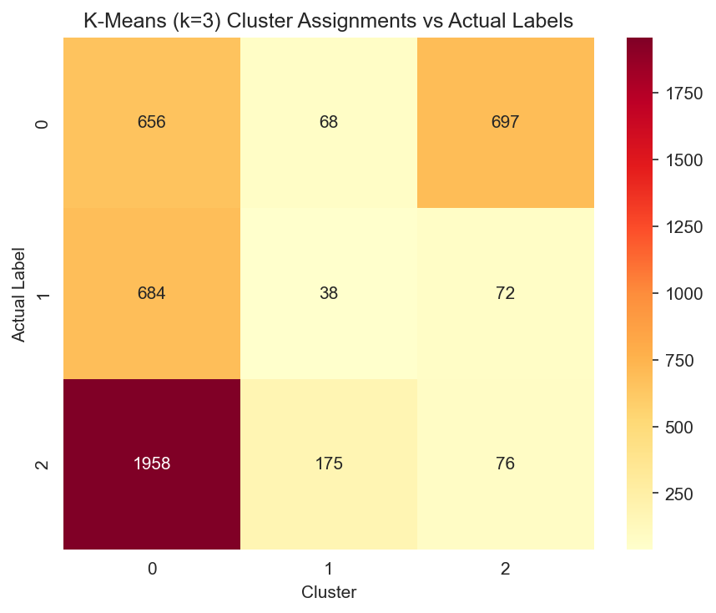
12 · UNSUPERVISED ANALYSIS
Clustering reveals overlap, not boundaries
K-MEANS (K=3) SILHOUETTE
0.2145
HIERARCHICAL (WARD) SILHOUETTE
0.1158
Silhouette interpretation (Rousseeuw, 1987): > 0.7 strong · 0.5–0.7 reasonable · 0.25–0.5 weak · < 0.25 no substantial structure
WHAT THIS TELLS US
Low silhouette scores indicate soft, overlapping boundaries. Unsupervised methods alone cannot reliably predict outcomes — supervision is required.
13/19
Notes:
[UNSUPERVISED ANALYSIS — 50s]
We ran K-Means with k=3 (matching the three target classes) and Hierarchical Agglomerative with Ward linkage. Silhouette scores: K-Means 0.2145, Hierarchical 0.1158.
Calibration on the slide is from Rousseeuw's original 1987 paper: above 0.7 is strong structure, 0.5 to 0.7 reasonable, 0.25 to 0.5 weak, below 0.25 means no substantial structure.
So K-Means lands in the "weak / no substantial structure" boundary; Hierarchical is firmly in the no-structure zone.
What this tells us — and this is the slide's punchline: the natural geometry of the feature space does not separate cleanly into three groups. Dropout, Enrolled, and Graduate students live in overlapping regions. That's why supervised learning is required — we need the labels to draw boundaries that wouldn't emerge on their own.
This is also a defense of our methodology: we tried clustering, it didn't yield separable structure, and that result motivated leaning on supervised models.
[TRANSITION] One more lens — association rules.

Slide 14
13 · ASSOCIATION RULE MINING
Apriori on binned features
ANTECEDENT
→ CONSEQUENT
SUP.
CONF.
LIFT
CU1_Low + Age_Mid
Dropout
0.058
0.874
2.72
MIN_SUPPORT
0.05
AdmGrade_Low + CU1_Low
Dropout
0.069
0.860
2.68
MIN_CONFIDENCE
0.60
CU1_Low
Dropout
0.175
0.771
2.40
FREQUENT ITEMSETS
189
CU1_Low + AdmGrade_Med
Dropout
0.084
0.764
2.38
TOTAL RULES
334
TuitionUpToDate + CU1_Low
Dropout
0.115
0.696
2.17
85
TuitionUpToDate + CU1_High + Scholarship + AdmGrade_Med
Age_Young + Graduate
0.078
0.801
2.09
TARGET RULES
Top finding:low 1st-semester approved units + mid age → Dropout · conf 87.4% · lift 2.72×
14/19
Notes:
[ASSOCIATION RULE MINING — 70s]
We binned numeric features (grades, age, admission scores into Low/Mid/High terciles) and ran Apriori at min_support=0.05 and min_confidence=0.60. Output: 189 frequent itemsets, 334 total rules, of which 85 have the target as the consequent — those are the actionable ones for an advisor.
Top rules table — read each as: antecedent → consequent | support | confidence | lift.
Headline: CU1_Low + Age_Mid → Dropout, support 5.8%, confidence 87.4%, lift 2.72×. In plain English: students with low first-semester approved units who fall in the mid-age band drop out 87% of the time — and that's 2.7× the base dropout rate.
The next four rules all involve CU1_Low — low first-semester approved units — combined with low admission grade or unpaid tuition, all predicting dropout with confidence 70-86% and lift around 2.2-2.7×.
The last row is the inverse — a graduation rule. Tuition up to date plus high CU1 plus scholarship plus mid admission grade predicts the Young + Graduate combination at confidence 80%, lift 2.09×. We kept it to show the rule mining works in both directions.
Why this matters operationally: confidence and lift give advisors a defensible threshold. "Low first-semester approved units" alone — slide row 3 — already has 77% confidence of dropout at 17.5% support, meaning the rule covers a non-trivial slice of the population.
[TRANSITION] Side-by-side model comparison.

Slide 15
14 · MODEL COMPARISON
XGBoost wins on F1-macro · Random Forest on accuracy
MODEL
ACCURACY
F1 (MACRO)
F1 (WEIGHTED)
CV F1 MEAN ± STD
XGBoost BEST F1
76.95%
0.7056
0.7634
0.7136 ± 0.0131
Random Forest BEST ACC
77.06%
0.6887
0.7548
0.6956 ± 0.0087
Logistic Regression
76.84%
0.6826
0.7531
0.6782 ± 0.0089
SVM
75.93%
0.6797
0.7466
0.6798 ± 0.0220
Decision Tree
71.19%
0.6346
0.7052
0.6443 ± 0.0101
KNN (k=11)
69.49%
0.5860
0.6694
0.6036 ± 0.0094
Cross-validation standard deviations are tight across all models — performance is consistent, not lucky. F1-macro is our primary metric because it weights all three classes equally despite the imbalance.
15/19
Notes:
[MODEL COMPARISON — 60s]
Single table, six rows, sorted by F1-macro descending.
- XGBoost — F1-macro 0.7056 (best), accuracy 76.95%, weighted F1 0.7634, CV mean 0.7136 ± 0.0131.
- Random Forest — accuracy 77.06% (best), F1-macro 0.6887, weighted F1 0.7548, CV 0.6956 ± 0.0087 (tightest CV).
- Logistic Regression — 76.84% / 0.6826 / 0.7531 / 0.6782 ± 0.0089.
- SVM — 75.93% / 0.6797 / 0.7466 / 0.6798 ± 0.0220.
- Decision Tree — 71.19% / 0.6346 / 0.7052 / 0.6443 ± 0.0101.
- KNN k=11 — 69.49% / 0.5860 / 0.6694 / 0.6036 ± 0.0094.
Two things to notice. First, top three models cluster within 0.7 percentage points on accuracy — XGBoost, Random Forest, Logistic Regression are all essentially tied on accuracy. The differentiator is F1-macro, where XGBoost opens a clear 1.7-point gap. That's because XGBoost handles the Enrolled minority class better.
Second, the CV standard deviations are all tight — between 0.009 and 0.022. Performance is consistent across folds, not luck.
We declare XGBoost our best model on F1-macro, while acknowledging Random Forest narrowly wins on raw accuracy with the most stable CV.
[TRANSITION] What the models care about.

Slide 16
15 · FEATURE IMPORTANCE
Semester performance dominates · finance plays second
Random Forest
MEAN DECREASE IN IMPURITY
XGBoost
GAIN-BASED IMPORTANCE
1
Curricular units 2nd sem (approved)
0.155
1
Curricular units 2nd sem (approved)
0.215
2
Curricular units 2nd sem (grade)
0.092
2
Tuition fees up to date
0.117
3
Curricular units 1st sem (approved)
0.089
3
Curricular units 1st sem (enrolled)
0.052
4
Curricular units 1st sem (grade)
0.066
4
Curricular units 2nd sem (enrolled)
0.038
5
Admission grade
0.044
5
Scholarship holder
0.032
Both models converge on 2nd-semester approved units as the #1 predictor — RF MDI 0.155, XGB gain 0.215. XGBoost weighs financial signals (tuition 0.117, scholarship 0.032) more heavily; Random Forest leans on grade variables (4 of top 5 are grade-related).
16/19
Notes:
[FEATURE IMPORTANCE — 60s]
Two methods, two views.
Random Forest mean decrease in impurity, top 5:
1. Curricular units 2nd sem (approved) — 0.155
2. Curricular units 2nd sem (grade) — 0.092
3. Curricular units 1st sem (approved) — 0.089
4. Curricular units 1st sem (grade) — 0.066
5. Admission grade — 0.044
XGBoost gain-based importance, top 5:
1. Curricular units 2nd sem (approved) — 0.215
2. Tuition fees up to date — 0.117
3. Curricular units 1st sem (enrolled) — 0.052
4. Curricular units 2nd sem (enrolled) — 0.038
5. Scholarship holder — 0.032
Both models converge on 2nd-semester approved units as the #1 predictor — Random Forest 0.155, XGBoost 0.215. Same top feature, two different importance methods.
The interesting divergence: Random Forest is grade-centric — four of its top five are grade or unit measures. XGBoost gives much more weight to financial signals — tuition is its #2 at 0.117 and scholarship makes the top 5. That's consistent with what we saw on slide 9: tuition status creates a 61-point swing in dropout rate. XGBoost is just better at exploiting that.
Practically: if you only had one feature to monitor, monitor 2nd-semester approved units. If you have two, add tuition status.
[TRANSITION] What to take away.

Slide 17
16 · CONCLUSIONS
What we learned, and what to do about it
BEST MODEL
XGBoost · F1-macro0.7056(vs RF 0.689, LR 0.683)
RECOMMENDATION
TOP PREDICTOR
2nd-sem approved units · ρ ≈ 0.65 · RF MDI 0.155 · XGB gain 0.215
Flag students with fewer than 3 approved units after semester 1 for immediate academic advising.
STRONGEST RULE
Low 1st-sem approved units →77.1% dropout · lift 2.40× (Apriori, slide 14)
"Data mining can reliably identify at-risk students early enough for meaningful intervention."
CLUSTERING
K-Means k=3 silhouette 0.21 · Hierarchical 0.12 — overlapping
17/19
Notes:
[CONCLUSIONS — 60s]
Five takeaways summarizing the whole project.
1. BEST MODEL: XGBoost wins on F1-macro at 0.7056 — vs Random Forest 0.689 and Logistic Regression 0.683.
2. TOP PREDICTOR: Second-semester approved units, by every measure — Spearman ρ ≈ 0.65, Random Forest MDI 0.155, XGBoost gain 0.215.
3. STRONGEST RULE: Low first-semester approved units → 77.1% dropout probability, lift 2.40×. Pulled from the Apriori results on slide 14.
4. CLUSTERING: K-Means k=3 silhouette only 0.21, Hierarchical 0.12 — confirms that classes overlap geometrically and supervision is required.
5. RECOMMENDATION — and this is the real-world deliverable: flag any student with fewer than 3 approved curricular units after semester 1 for immediate academic advising. Concrete, defensible, and based on the rule with the highest support among Dropout consequents.
The closing line: data mining can reliably identify at-risk students early enough for meaningful intervention. That's the project in one sentence.
[TRANSITION] Where this could go next.

Slide 18
17 · FUTURE WORK
Where this work could go next
01
Real-time prediction
02
Advisor dashboard
Incorporate live semester data for dynamic risk scoring throughout the academic year
Web app (Streamlit / Flask) so advisors can query student risk in real time
03
Multi-institution validation
04
Deep learning
Test model generalizability across universities and countries
Explore TabNet and other neural architectures for tabular gains
05
Temporal modeling
Each direction addresses a current limitation — limitations → opportunities
Sequence models that track how student risk evolves semester by semester
18/19
Notes:
[FUTURE WORK — 50s]
Five directions, each closing a current limitation.
1. Real-time prediction — current system is one-shot at end of semester; live ingestion would let risk update mid-term.
2. Advisor dashboard — Streamlit or Flask front end so advisors can query a student's risk score without running a notebook. This is the highest-leverage next step for actual deployment.
3. Multi-institution validation — our model trained on one Portuguese polytechnic. Cross-institution and cross-country tests would validate generalizability.
4. Deep learning — TabNet and similar architectures often add a few points on tabular data; worth benchmarking against XGBoost.
5. Temporal modeling — sequence models like LSTM or temporal transformers tracking how risk evolves semester by semester, instead of treating each student as a static snapshot.
The honest framing: every direction here is a current limitation reframed as an opportunity.
[TRANSITION] That's our project.

Slide 19
18 · END
Thank you.
Questions welcome.
Lam Nguyen· 018229432
Tri Ngo· 015712749
REPOSITORY
CMPE 255 · Data Mining · Spring 2026
github.com/Lambert-Nguyen/ cmpe255-student-dropout-prediction
19/19
Notes:
[CLOSE — 20s]
Thank you. We're happy to take questions on any part of the methodology, the modeling choices, the dataset, or how this would apply in a real institution.
Full code, notebooks, and figures are in the GitHub repo at github.com/Lambert-Nguyen/cmpe255-student-dropout-prediction.
[Pause for Q&A]

