Slide 1
First Order Motion Model for Image Animation
0652087戴勵揚

Slide 2
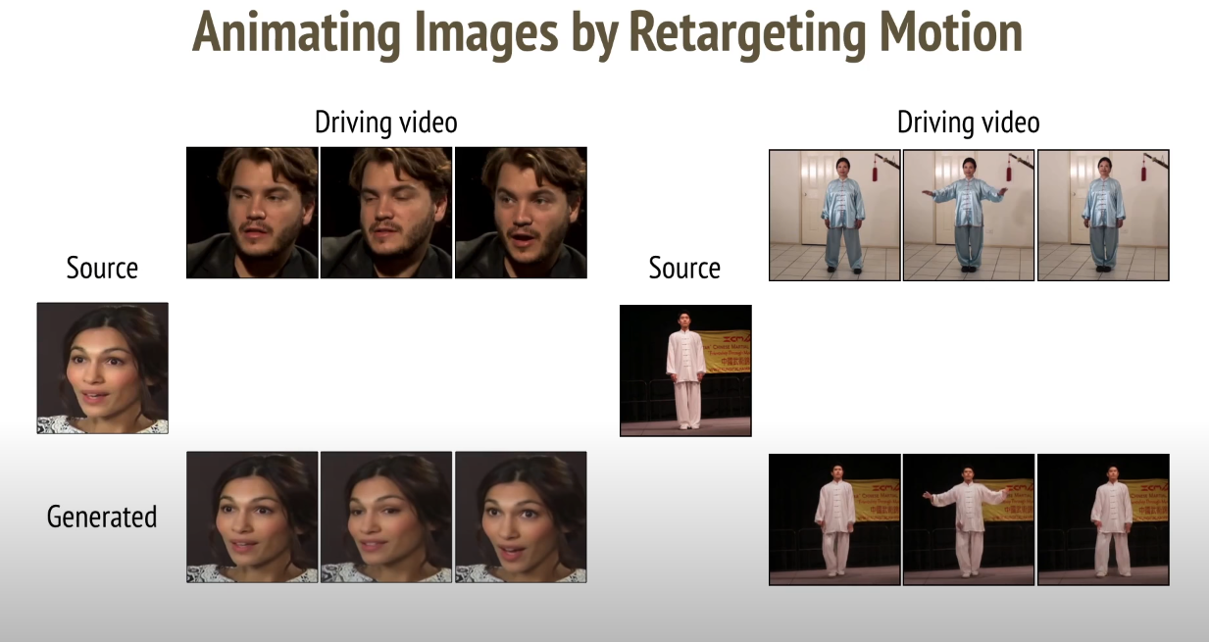

Slide 3
類別定義
Use a set of self-learned keypoints together with local affine transformations to model complex motions. Therefore called a first-order motion model.

Slide 4
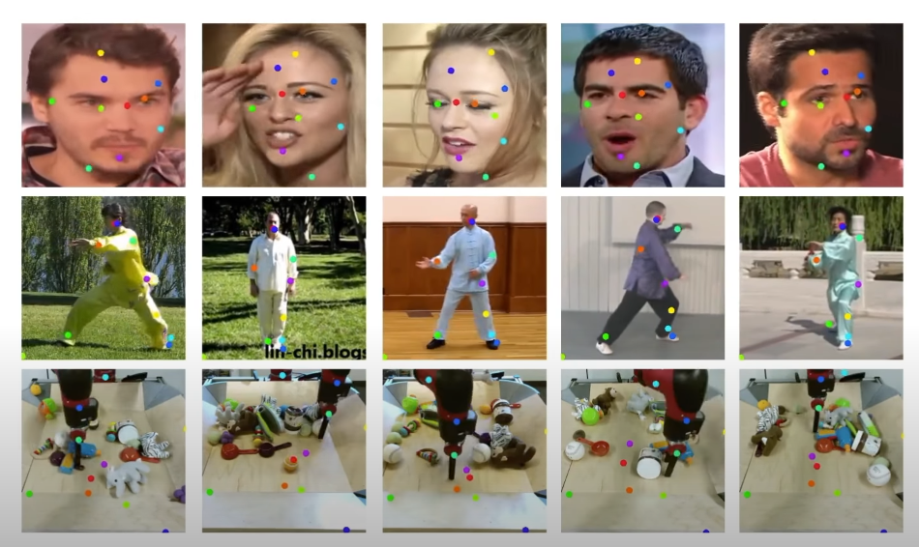
特徵定義

Slide 5
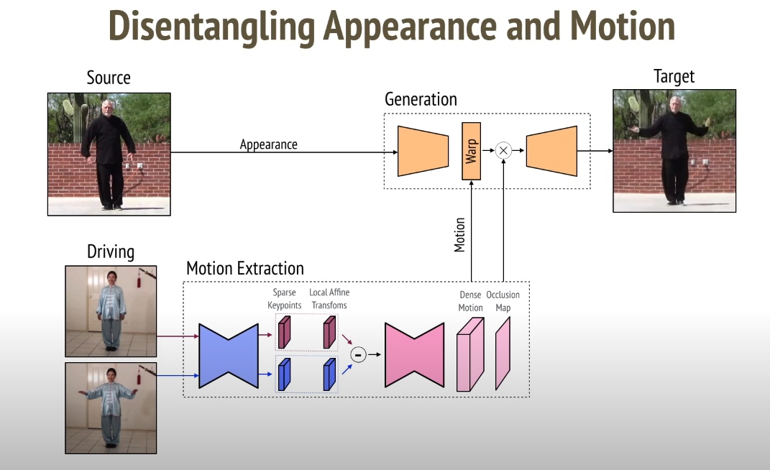
架構

Slide 6
資料來源
https://papers.nips.cc/paper/2019/file/31c0b36aef265d9221af80872ceb62f9-Paper.pdf
https://www.youtube.com/watch?v=u-0cQ-grXBQ

