Slide 1
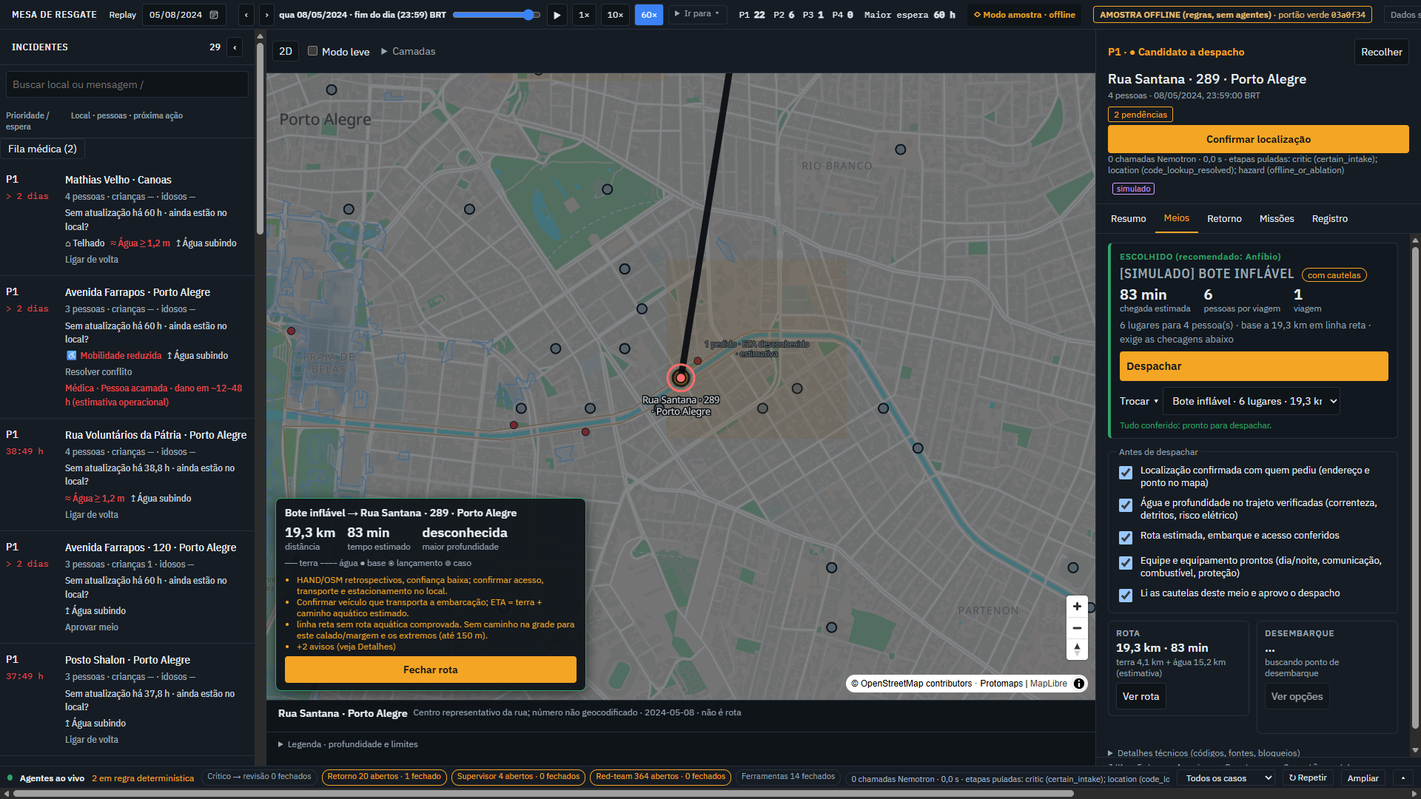
Rescue Triage Desk
Messy flood messages in, human-approved rescue dispatch out
Built and replayed on the May 2024 Rio Grande do Sul floods
Portuguese rescue requests become evidence-linked cases
Code checks, agents explain, a human approves every dispatch
Retrospective replay desk, not a deployed emergency system.
Rescue Triage Desk | May 2024 RS floods replay | synthetic data | screenshots: offline sample mode
1/10

Slide 2
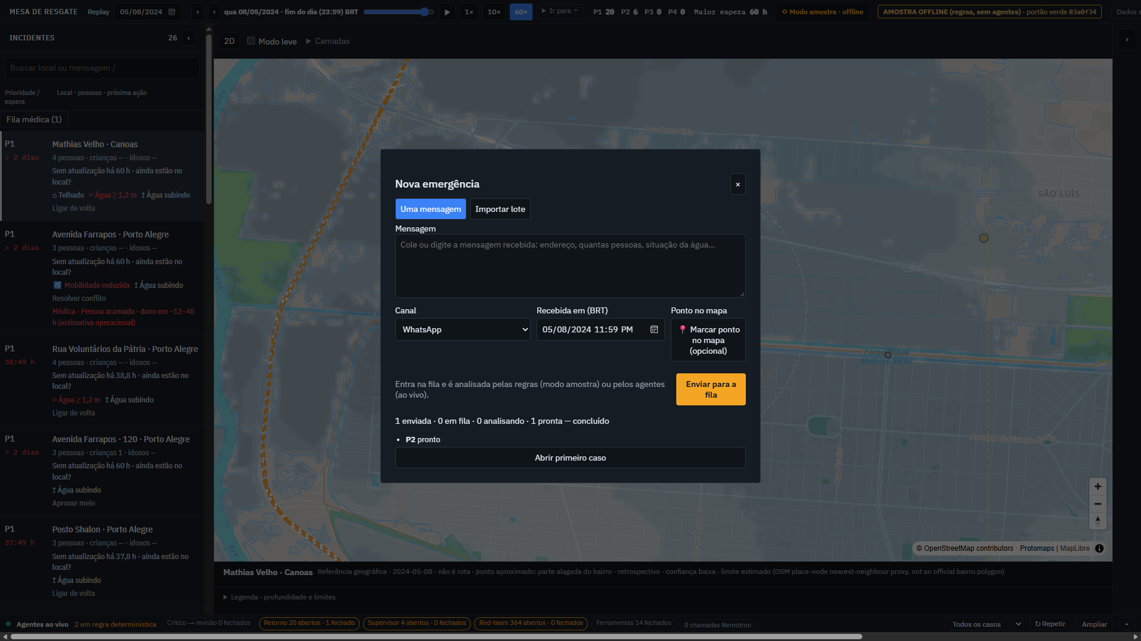
The problem: requests are messy, decisions are urgent
Users: dispatchers, coordinators, volunteer boat crews
Citizens write half an address, "my two babies", a landmark, a rumour of rescue
Dispatchers must decide where, how many, who is vulnerable, what is already rescued
A wrong guess sends a boat to the wrong street, or leaves a family waiting
They need evidence they can check, not a black-box score
Rescue Triage Desk | May 2024 RS floods replay | synthetic data | screenshots: offline sample mode
2/10

Slide 3
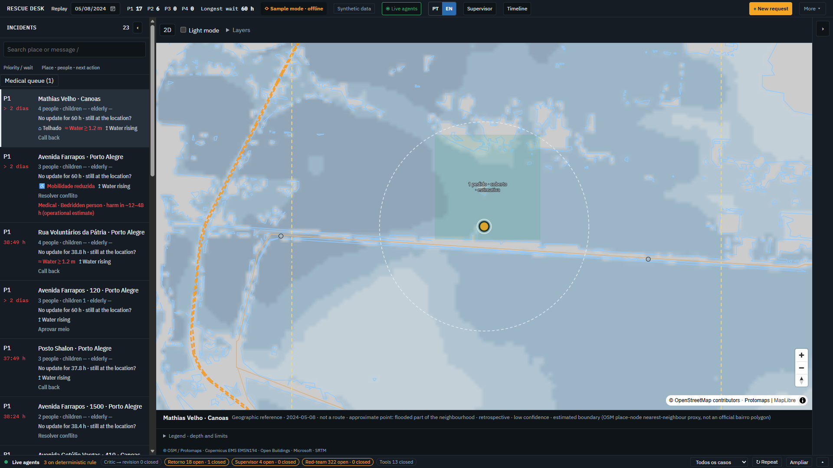
The solution: an evidence-linked dispatch desk
From message to approved mission, every step checkable
Reads PT/EN/ES messages; every extracted field carries an exact quote
Code verifies places, counts, hazards, freshness and asset safety
Callback agent asks the citizen at most three questions, then re-triages
Groups cases into missions, routes land and water legs, tracks field feedback
Human confirms the location and approves; undo is available
Rescue Triage Desk | May 2024 RS floods replay | synthetic data | screenshots: offline sample mode
3/10

Slide 4
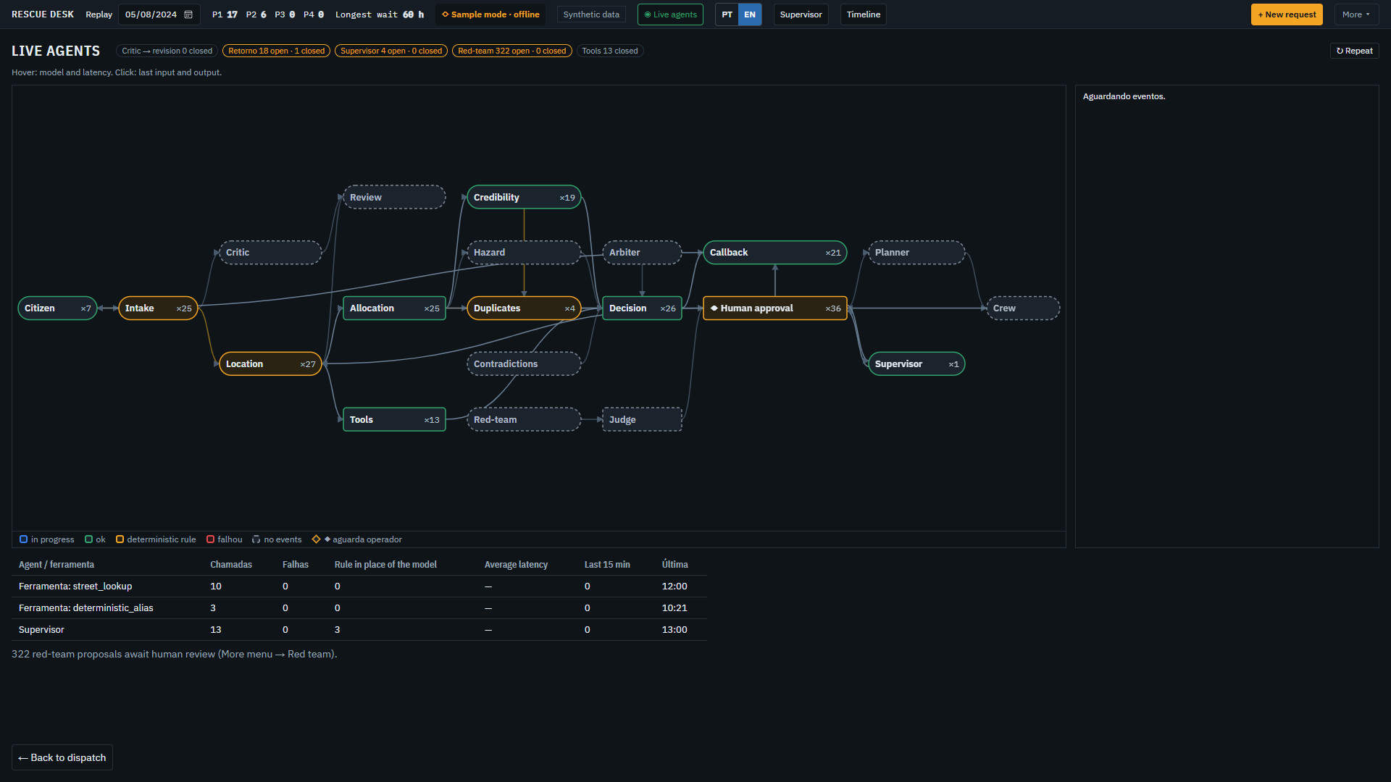
Agent workflow and architecture
An agent exists only where it decides something code cannot
Message
Redact + injection check
Intake
Critic (max 1 revision)
Location + tools
Code checks + hazards
Human approval
Also: Needs, Duplicate reviewer, Callback planner, Field feedback, Mission brief, Supervisor, Red team
Strict JSON, one retry, visible fallback; unsafe asset or injection blocks dispatch
Rescue Triage Desk | May 2024 RS floods replay | synthetic data | screenshots: offline sample mode
4/10

Slide 5
Technology stack
Small, auditable, runs on a 16 GB laptop
Python 3.12 standard library only; no pip install
Nemotron 3.5 (Super VL 120B, Lightning 30B) via Meterless Nightshift, thinking on
Zetaris REST + SeaweedFS S3 for streets, landmarks, shelters, pumps
MapLibre GL, OSM, Copernicus EMS flood extent and HAND depth, IBGE
SAMPLE_MODE=true runs everything offline; Docker image included
Rescue Triage Desk | May 2024 RS floods replay | synthetic data | screenshots: offline sample mode
5/10

Slide 6
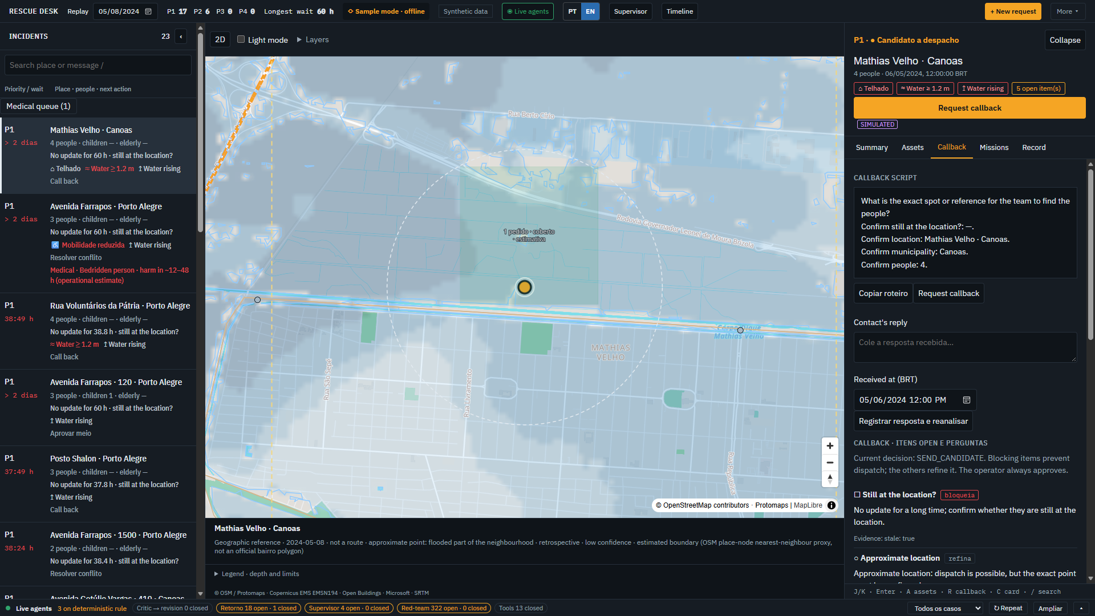
Zetaris and Meterless in the product
Sponsor technology is used in user-facing features
Nightshift: every call logs the routed model and a receipt (lanes race)
World Model engine: append-only journal, replay, 409 on stale versions, human-only transitions; 6 conformance tests
Zetaris: 5 sources onboarded, 3 semantic views; Rodoviária in flood extent, 4,514 flooded segments
Data-quality rule: 62 of 734 shelter snapshots over capacity
Rescue Triage Desk | May 2024 RS floods replay | synthetic data | screenshots: offline sample mode
6/10

Slide 7
What is different
Safety by construction, not by prompt
Every model claim is tied to a quote or fact id and validated by code
Counts, distances and ranks are never model output; derived counts are flagged "confirm"
Red-team attacker declares its expected outcome first; failures become human-approved regressions
Straight-line water legs and retrospective depth are labelled estimates, never safe-route claims
Place memory is exact, city-scoped and revocable
Rescue Triage Desk | May 2024 RS floods replay | synthetic data | screenshots: offline sample mode
7/10

Slide 8
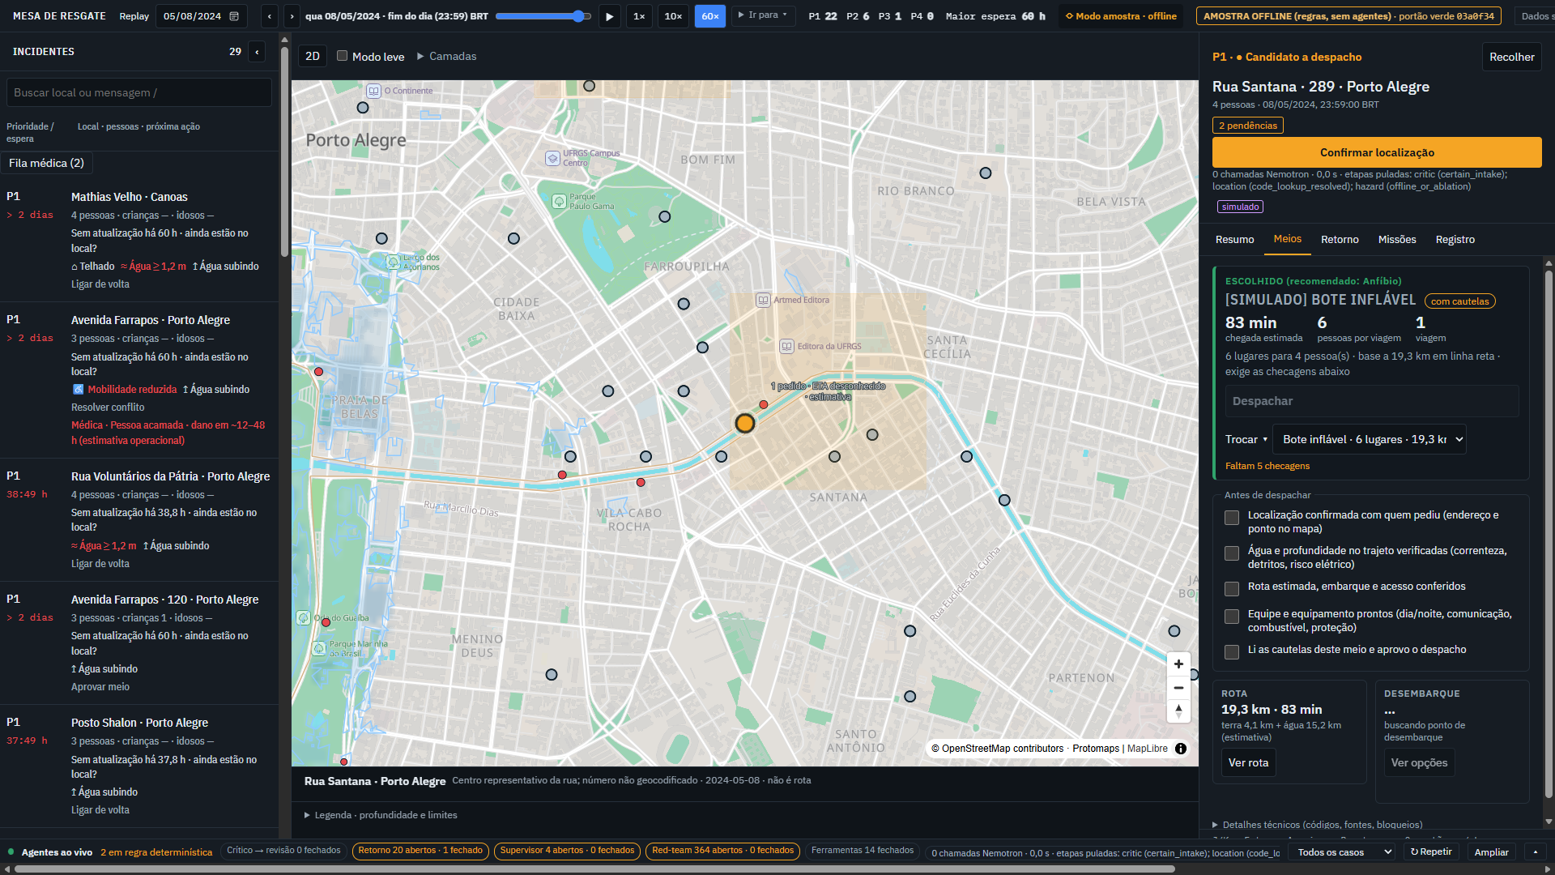
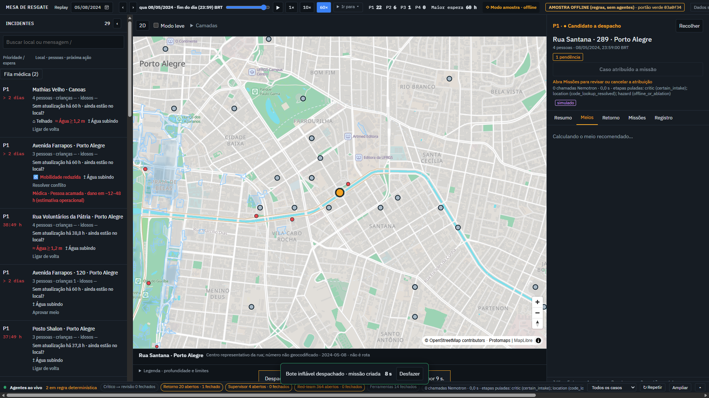
The product
Dispatcher console (offline sample mode shown, synthetic data)
Meios: assets ranked, unsafe ones blocked
Ver rota: land + labelled water leg
Despachar: human decision recorded
Rescue Triage Desk | May 2024 RS floods replay | synthetic data | screenshots: offline sample mode
8/10

Slide 9
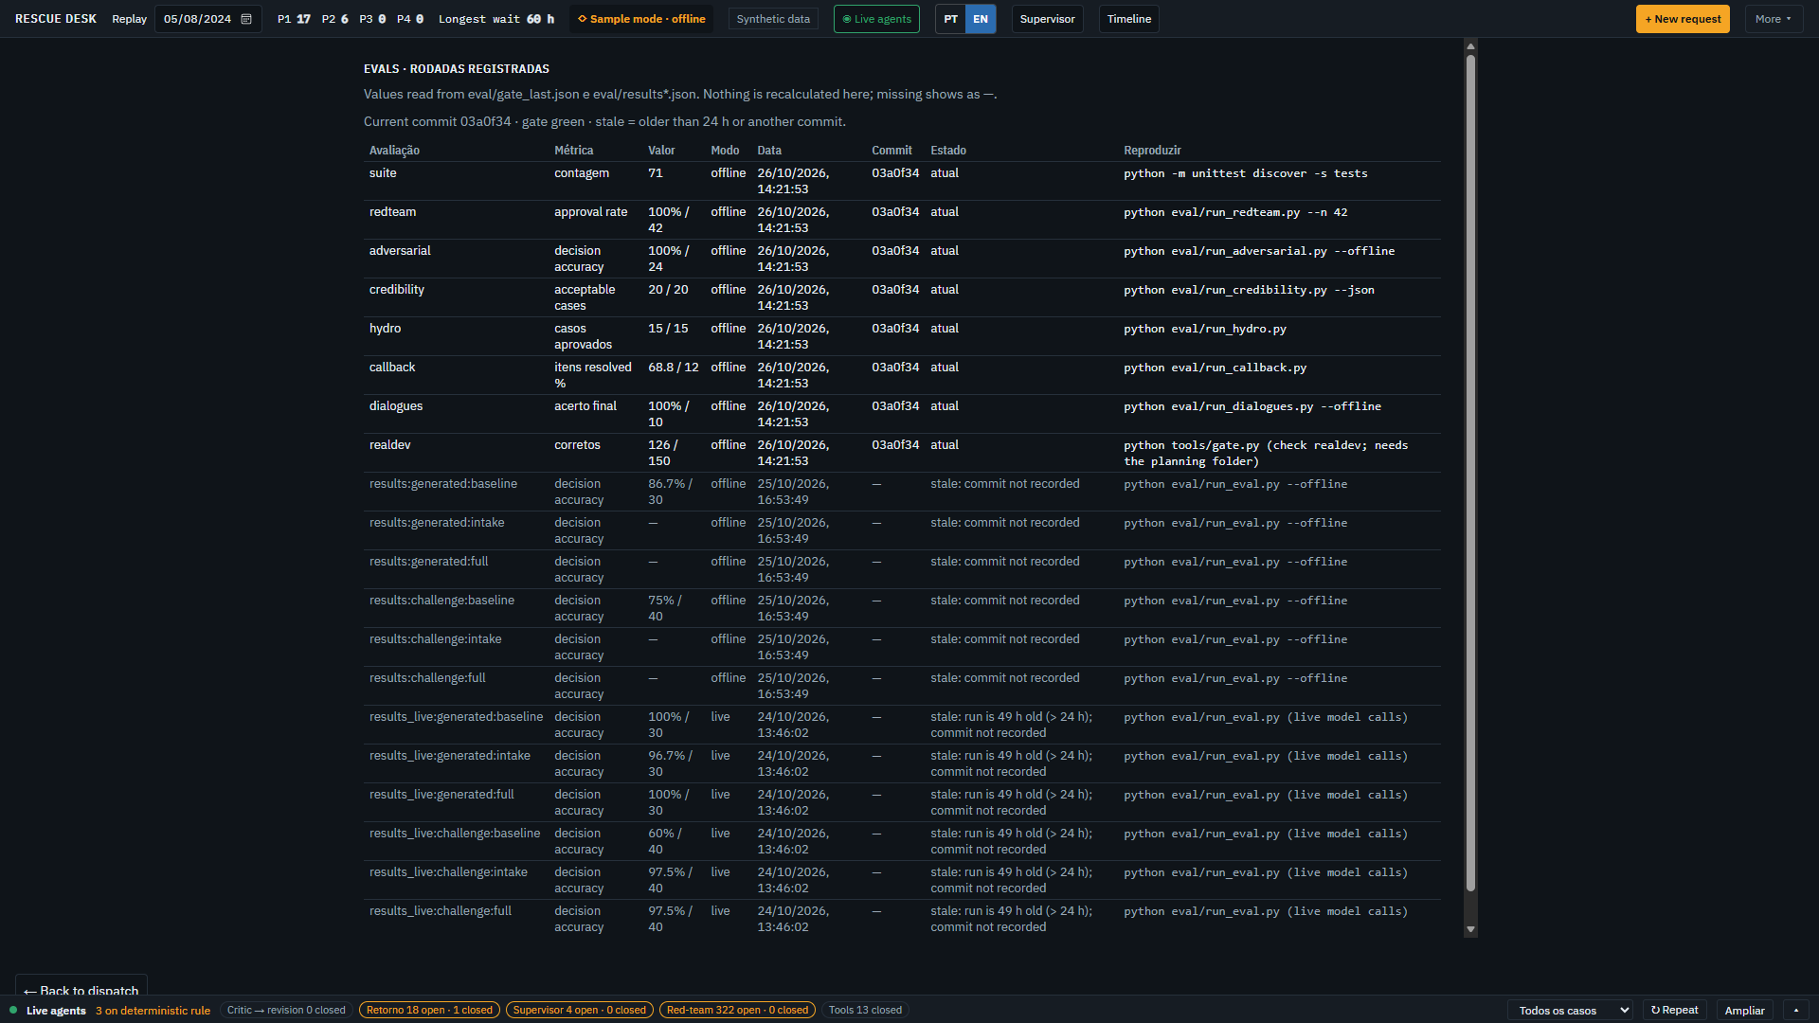
Results (our own sets, labelled)
Commit 4867ff0; live run 26 Oct 2026 19:40
Live realdev 30-sample: 29/30, 0 unsafe, mean 20.6 s, p95 53 s
Offline: realdev 134/150, 0 unsafe; red team 42/42; adversarial 24/24; 1170 tests
dev2 (180 author-written messages), live 60-sample before fixes: 36/46 non-ambiguous, people count 28/29
Sealed 50: [TBD-sealed50]. Holdout 2: [TBD-holdout2] (run once after freeze)
Limits: dev sets are ours; fleet and GPS simulated; HAND depth retrospective
Rescue Triage Desk | May 2024 RS floods replay | synthetic data | screenshots: offline sample mode
9/10

Slide 10
Future enhancements
Reproduce it: clone, SAMPLE_MODE=true python run.py serve --sample, open /v2
Real fleet and GPS feeds; authentication and roles for operators
Real-message evaluation with responders; sealed and held-out results
Navigable water routing with verified depth; live gauge data
Persist the Zetaris semantic views through the product UI
Repo, video and deck links: [fill in at submission]
Rescue Triage Desk | May 2024 RS floods replay | synthetic data | screenshots: offline sample mode
10/10

