Slide 1
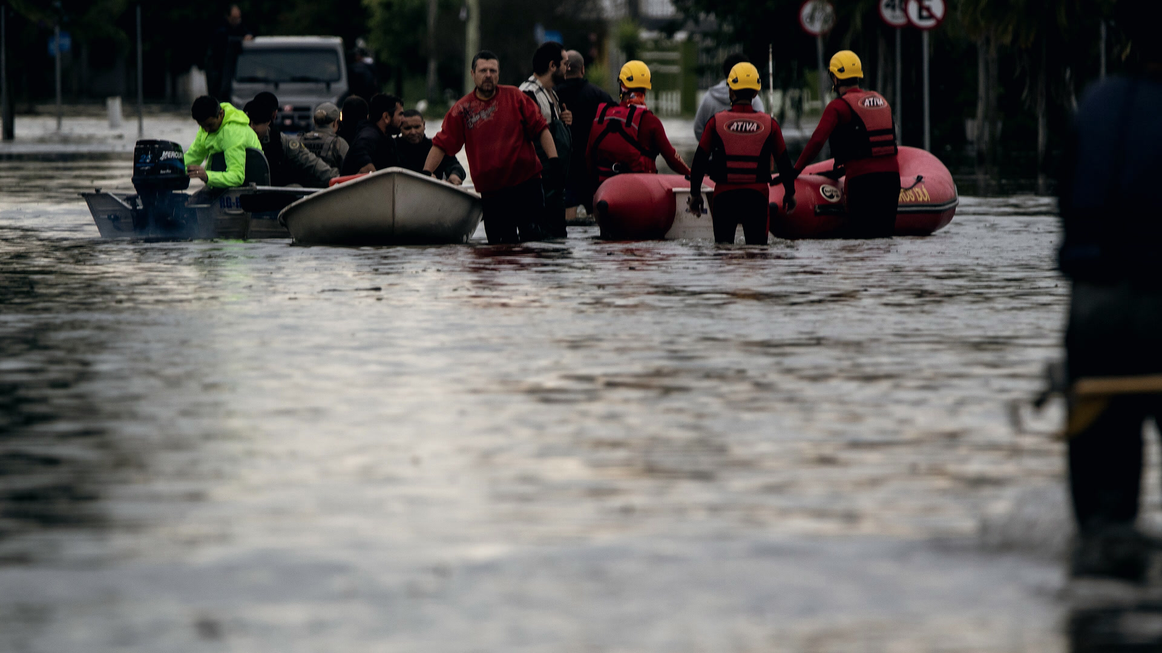
Arca
AI agents for flood rescue
No call for help should go unheard.
Team Orbital · Open Agent Hackathon 2026
Photo: rescuers in Laranjal, Pelotas, 10 May 2024 · Michel Corvello / Prefeitura de Pelotas · public domain
01
Notes:
In May 2024 the worst floods in the history of Rio Grande do Sul, in southern Brazil, put whole cities under water. People asked for help any way they could, and many requests were hard to read, hard to locate, or simply lost in the noise. We built Arca, Portuguese for ark: a team of AI agents that reads every request, finds the place, plans the rescue and hands it to a human dispatcher, who approves every boat that leaves. This is a replay of 6 May 2024.

Slide 2
May 2024: the worst flood in Rio Grande do Sul’s history.
185
May 2024
5.35 m
1941 record
4.76 m
lives lost
2.4 million
people affected
478 of 497
municipalities hit
Guaíba river, Porto Alegre
59 cm above the 1941 record
Defesa Civil RS (final bulletin, 19 Aug 2025); G1 / Serviço Geológico do Brasil
02
Notes:
The scale first. One hundred and eighty-five people died. Two point four million were affected, in 478 of the state's 497 municipalities. On the right is the Guaíba river at Porto Alegre: it peaked at 5.35 metres, above the 1941 record of 4.76. Whole neighbourhoods stayed under water for weeks, and rescue was done street by street, by boat. Every number on this slide comes from Defesa Civil's final bulletin and the Brazilian Geological Service; sources are in the appendix.

Slide 3
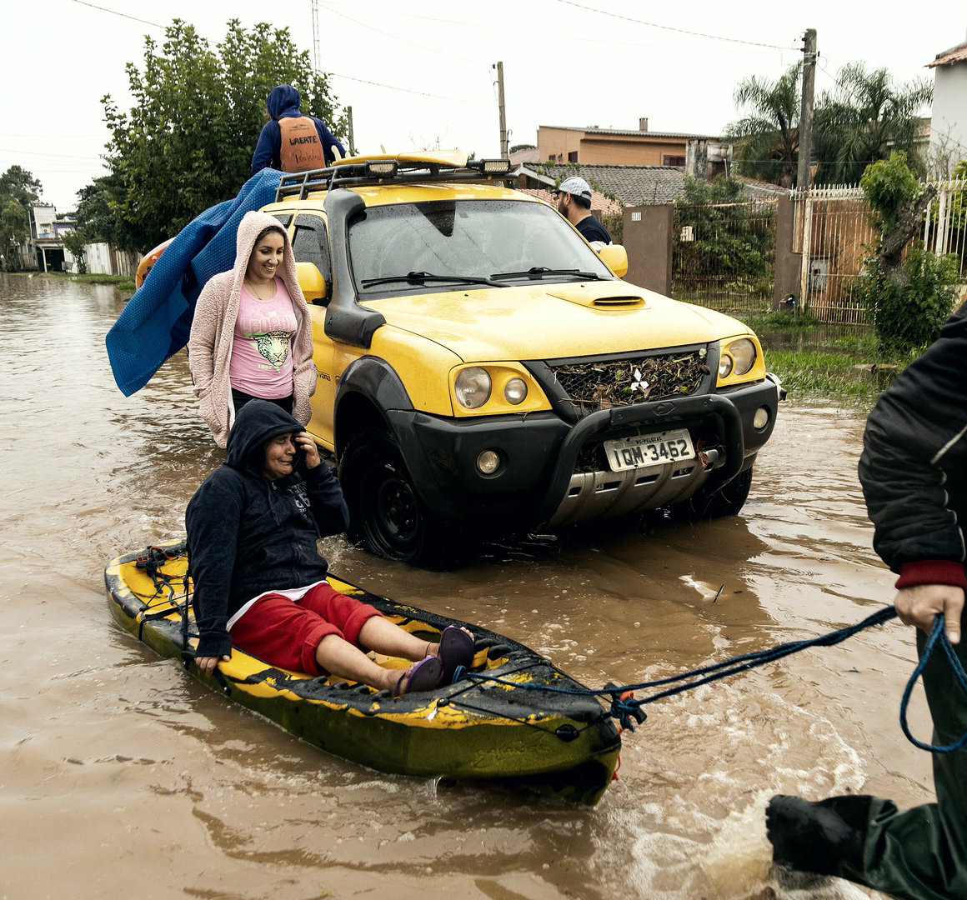
Calls came
from everywhere.
77,000+
people rescued
Dozens of WhatsApp groups.
No shared picture.
For civil-defence dispatch rooms and
volunteer rescue coordinators.
Defesa Civil RS (30 May 2024); Exame; Agência Lupa · Photo: Laranjal, Pelotas, 10 May 2024 · M. Corvello / Pref. de Pelotas · public domain
03
Notes:
More than 77,000 people were rescued, many by volunteers in their own boats. The requests arrived through dozens of WhatsApp groups, phone calls, social media posts and single texts sent with the last bar of signal. The volunteers were brave and fast; what they lacked was one shared picture of who needed help, where, and how urgently. Arca is built for the municipal Defesa Civil dispatch rooms and the volunteer rescue coordinators who face that flood of requests.

Slide 4
A strong El Niño is coming again.
83%
chance of a strong-to-very-strong El Niño
through early 2027
The next flood season will need every call answered, fast.
NOAA Climate Prediction Center, ENSO discussion, 8 Oct 2026
04
Notes:
Why now. NOAA's Climate Prediction Center, in its 8 October 2026 discussion, gives a better-than-83 percent chance of a strong to very strong El Niño through early 2027. El Niño years bring heavy rain to southern Brazil. We cannot say when the next flood comes, but the planning window is short, and the next time requests flood in, the people answering them should not be reading messages one by one with no shared picture.

Slide 5
One call for help. The agents read it.
WhatsApp · 6 May 2024, 12:00 · replay
Case card · produced live by the agents
“Help!! We’re on the second floor
at Voluntários da Pátria 1067,
Porto Alegre: me, my bedridden
mother and my 8-year-old son.
The water won’t stop rising.”
P1 medical · top priority
Voluntários da Pátria 1067
✓ address verified in Zetaris
3 people
me · bedridden mother · son, 8
Original, as written:
Water ≥ 1.2 m
→ ready to dispatch, pending a human
“socorro!! estamos no segundo andar na rua voluntários
da pátria 1067, porto alegre, eu, minha mãe acamada
e meu filho de 8 anos, a água não para de subir”
Live capture, English UI (values redrawn for legibility) · the message is a synthetic replay case written for the demo
05
Notes:
Here is one call for help, followed end to end. A woman writes on WhatsApp: socorro, we are on the second floor at Voluntários da Pátria 1067, Porto Alegre, me, my bedridden mother and my 8-year-old son, the water won't stop rising. Our agents read it in Portuguese, as written. They count three people, see that the mother is bedridden, so this is medical and P1, top priority, and they verify the street address in Zetaris. On the right is the case card Arca produced, live.

Slide 6
Agents check each other’s work, live.
Checker agents
Message
Intake
Location
Human
WhatsApp,
call, post
reads people,
needs, risk
finds the street
via Zetaris
Critic
Credibility
dispatcher
approves
Hazard
Duplicates
An objection sends it back: Intake re-reads
Every model call carries a Nemotron receipt.
Each agent quotes its evidence.
MODEL
RECEIPT
nvidia/nemotron-3.5-super-vl-120b-a12b
rcpt_req_7ngfp01b · Intake · 5.3 s
“minha mãe acamada”
✓ my mother is bedridden → medical
Live run (Oct 2026) on the 6 May 2024 replay · values from the Intake agent’s record · checkers run when a case needs them
06
Notes:
This is how the agents handle that message. Intake reads it, the Location agent finds the street through Zetaris, and checker agents challenge the reading: a critic, a credibility reviewer, a hazard checker and a duplicate reviewer. An objection sends it back and Intake re-reads the message. Only then does a proposal reach a human dispatcher. Every model call carries a Nemotron receipt with model, receipt id and time, and every fact quotes the exact words it came from: minha mãe acamada, my mother is bedridden.

Slide 7
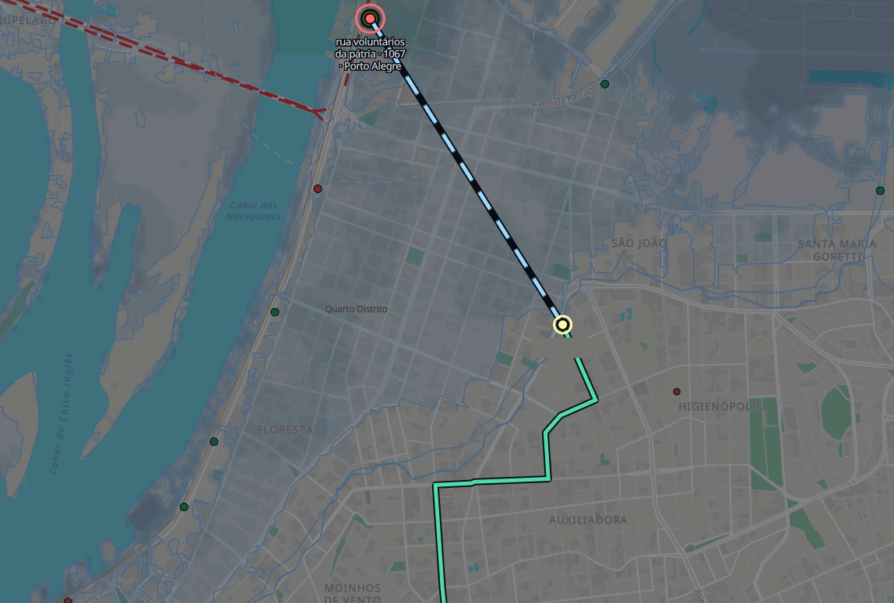
The agents plan the rescue. A person approves it.
Her house
1 The fleet agent picks the boat
Aluminium boat
24 min · 6 seats · 1 trip
By boat · estimated
2 A person ticks the checks
✓ 5 safety checks
Launch point
3 Only then: dispatch
Dispatch
10 s to undo
By road
Simulated fleet & GPS.
Water leg is an estimate.
8.9 km · 24 min
Live capture, English UI, 6 May 2024 replay · map labels are local names · © OpenStreetMap contributors · Protomaps · MapLibre
07
Notes:
Then the planning agents take over. The fleet agent checks every boat on shift and finds the one that can reach her: here, a simulated aluminium boat for six, 24 minutes away. Routing plans the road to the water's edge, then the water leg by boat, which is an estimate: 8.9 kilometres in total. Nothing moves until a human dispatcher ticks five safety checks and presses Dispatch, and even then there are ten seconds to undo. When the crew reports resgatamos 3, we rescued 3, the case closes.

Slide 8
How the agents work together.
28 agents and loops · 19 model agents + 9 operational loops
Callback: ask back, same channel
Reroute on a new P1
Supervisor alerts
Read
Plan
Watch
Human
Intake · Location
Critic · Hazard
Fleet · Routing
Landing · Shelter
Supervisor
Field feedback
approves
every boat
METERLESS WORLD MODEL
Intake → Location
One shared event log
Location → street lookup
Every agent action recorded and replayable.
Decision → human approval
Counted from the code’s agent roster: 19 model agents + 9 operational loops · event log entries from the live run
08
Notes:
Here is the whole team on one page. 28 agents and loops, 19 of them model agents and 9 operational loops, work in four stages: read, plan, watch, and a human who approves. Three loops keep the picture current: the callback agent asks the citizen one question on the same channel the request came from and re-reads the reply, a new P1 can reroute a boat, and the supervisor keeps alerting until a problem is closed. Underneath, the Meterless World Model keeps one shared event log: every agent action recorded and replayable.

Slide 9
Built safety-first. Tested hard.
29/30
42/42
94/100
live requests
triaged correctly
red-team attacks
stopped
safe recommendations on
never-seen blind requests
11 s average
offline attack set
run once, live
When unsure, the agents ask again instead of guessing —
and no boat moves without a human.
Blind sets (never seen, run once live, commit 6ba4233): set A 34/50 correct, set B 29/50 correct, 3 unsafe sends each = 94 of 100 safe.
Dev set is ours: 29/30 live, was 19/30; mean 11.3 s, was 46.7 s. Red team 42/42 offline. The blind gap is our next work.
Live and offline runs, 27 Oct 2026 · details in the README evaluation table
09
Notes:
We built this safety-first and tested it hard. On live requests the agents triage 29 of 30 correctly, in 11 seconds on average. They stopped all 42 red-team attacks. On 100 never-seen blind requests, run once live, 94 recommendations were safe. To be exact: 34 of 50 and 29 of 50 correct, with 3 unsafe sends in each set, so the blind gap is our next work. When unsure, the agents ask again instead of guessing, and no boat moves without a human.

Slide 10


Built on three sponsor technologies.
Zetaris knows the ground · Nemotron reads and reasons · Nightshift makes every call accountable ·
the World Model makes “no boat without a human” a rule
METERLESS
NVIDIA Nemotron
Meterless Nightshift
+ World Model
Zetaris
The model behind every
agent decision
Streets, landmarks and
flood data in one query
One gateway for every call;
one shared event log
Where each one sits in the live pipeline
Message
Zetaris
finds the place
Nemotron agents
via Nightshift
World Model
logs every step
Human
approves
Logos: official brand assets (NVIDIA, Zetaris), shown monochrome · Meterless shown as a wordmark
10
Notes:
Three sponsor technologies carry the system. NVIDIA Nemotron is the model behind every agent decision, and every call leaves a receipt we can audit. Meterless Nightshift is the single gateway every agent call goes through, and our event log follows the Meterless World Model: one shared, replayable record of every agent action. Zetaris holds the city: streets, landmarks and flood data, queried in one place, which is how the agents verified Voluntários da Pátria 1067 in the demo.

Slide 11
A small stack. Every decision replayable.
AGENTS
Nemotron via Meterless Nightshift
MEMORY
METERLESS
World Model engine · one event log
PLACE & FLOOD
REST · S3 · USL views + OpenStreetMap roads
APP
Python
Python standard library · HTTP /run API
SHIP
Docker
Docker · SAMPLE_MODE: offline, no keys
Architecture and setup: repository README · no keys or tokens are shown or needed for SAMPLE_MODE
11
Notes:
Under the hood the stack is small on purpose. The agents run on NVIDIA Nemotron, reached through Meterless Nightshift. The Meterless World Model engine keeps one event log of every action. Zetaris serves place and flood data through REST, S3 and USL views, next to an OpenStreetMap road graph. The app itself is a Python standard-library server with an HTTP run API, shipped in Docker, and SAMPLE_MODE runs the whole desk offline with no keys. What is unique: agents cite their receipts, and every decision can be replayed.

Slide 12
What comes next.
1
2
3
WhatsApp Business
+ the 193 line
Live river gauges
Defesa Civil pilot
requests flow into the
same queue
Guaíba, Jacuí, Taquari
levels via Zetaris
before the next
El Niño season
Before any real use: close the gap on never-seen tests.
Roadmap: repository README · call transcripts are text input today; no speech recognition is built
12
Notes:
What comes next. First, intake where people already ask for help: the WhatsApp Business API and the 193 fire-brigade line, feeding the same queue. Second, live river gauges for the Guaíba, Jacuí and Taquari through Zetaris, replacing retrospective flood layers with observed levels. Third, a Defesa Civil pilot before the next El Niño season: a tabletop exercise on replayed messages, then a supervised pilot. And before any real use, we close the gap on the blind tests.

Slide 13
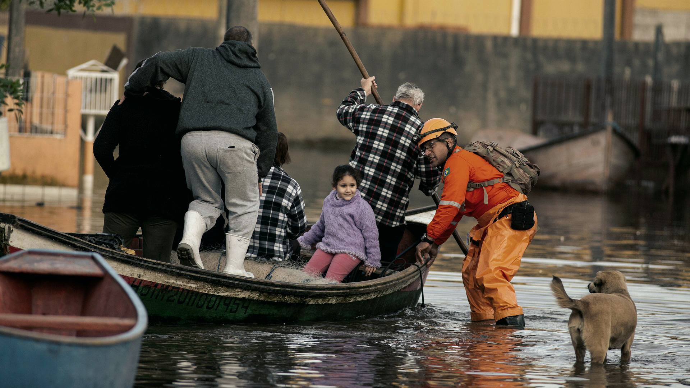
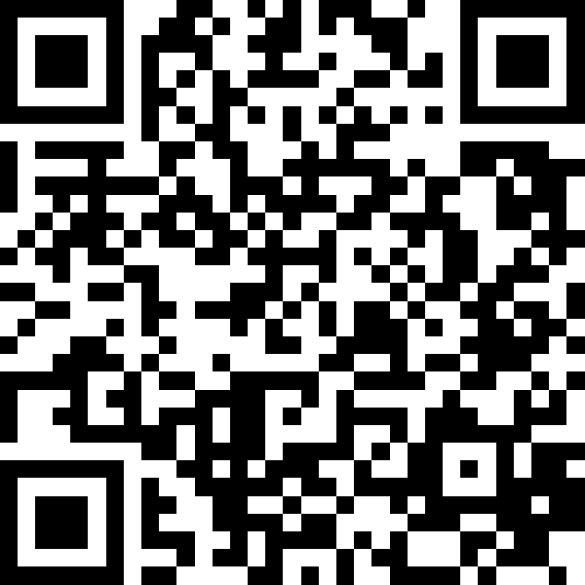
Every request heard.
Every agent working together.
When the next flood comes,
no call for help gets lost.
Arca
Help us pilot it with Defesa Civil before the next El Niño.
github.com/LamboKiller/rescue-triage-desk
Team Orbital · code, evaluations and this deck, open source
Photo: Colônia Z-3, Pelotas, 31 May 2024 · G. Vara / Pref. de Pelotas · public domain
13
Notes:
Every request heard. Every agent working together. When the next flood comes, no call for help should get lost. Today this is a replay of 6 May 2024 with a simulated fleet and GPS; we do not claim lives saved, only the potential. Our ask is concrete: help us pilot it with Defesa Civil before the next El Niño, with real dispatchers, real channels and real boats, measured honestly. The code, the evaluations and this deck are open at github.com/LamboKiller/rescue-triage-desk.

Slide 14
Appendix · Sources & credits
Numbers
185 deaths · 478 of 497 municipalities · 2,398,255 affected
Defesa Civil RS final bulletin, 19 Aug 2025 (sosenchentes.rs.gov.br); IPEA
Over 77,000 rescued (77,729 on 30 May 2024)
Defesa Civil RS bulletin, 30 May 2024
Guaíba 5.35 m (5 May 2024); 1941 record 4.76 m
G1; Serviço Geológico do Brasil
Channels: Exame; Agência Lupa
>83 % strong-to-very-strong El Niño, Jan–Mar 2027
NOAA CPC ENSO discussion, 8 Oct 2026
Dev 29/30 (was 19/30), 11.3 s (was 46.7 s): live, 27 Oct 2026
Red team 42/42: offline attack set
Blind A 34/50, 3 unsafe · Blind B 29/50, 3 unsafe (94/100 safe)
live, run once, commit 6ba4233
28 agents and loops = 19 model agents + 9 operational loops
agents_roster.json
Photographs (Wikimedia Commons)
S1: Resgates, bairro Laranjal (53712679145)
Michel Corvello / Prefeitura de Pelotas · public domain
S3: Resgates, bairro Laranjal (53712420573)
Michel Corvello / Prefeitura de Pelotas · public domain
S11: Missão humanitária, Colônia Z-3 (53761203109)
Gustavo Vara / Prefeitura de Pelotas · public domain
Full URLs: CREDITS.md
Product frames: live captures, English UI
Map: © OpenStreetMap contributors · Protomaps · MapLibre
Logos: NVIDIA, Zetaris official assets
Typeface: Inter (OFL)
Team Orbital · all work built during the build window
Replay of 6 May 2024. Fleet and GPS simulated. Lives saved shown only as potential.
14
Notes:
Every number in the deck, with its source and date, and every photograph with author and licence; full URLs are in CREDITS.md. The hero message is a synthetic case written for the replay; the product frames are live captures of Arca on 27 October 2026 with real Nemotron calls through Nightshift. The fleet, GPS, shelter and ambulance data are simulated. Development tooling not shown on the slides, such as our red-team generator, is described in the repository.

