Slide 1
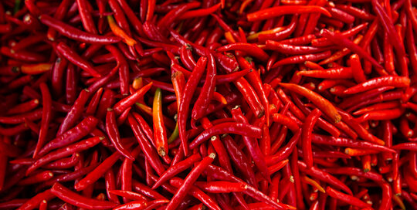
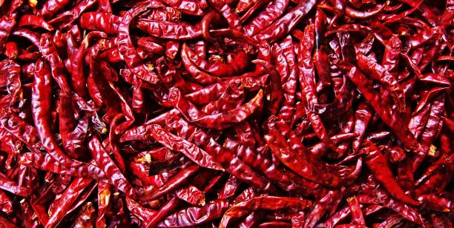
Undergraduate Project
Name: U.Anojan SLIIT Northern Uni

Slide 2
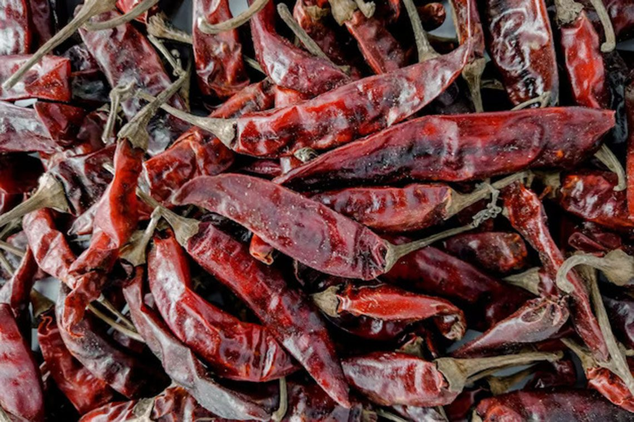
Early Prediction of Aflatoxin Contamination in Red Chili Using ML
Why This Project?
• Aflatoxin: Invisible, toxic substance produced by fungi.
• Causes serious health risks (liver damage, cancer).
• Traditional detection (ELISA/HPLC) is expensive and lab-dependent.
• Need for early, low-cost, practical detection.
•Goal: Predict aflatoxin risk using measurable factors and mobile application for real-world use

Slide 3
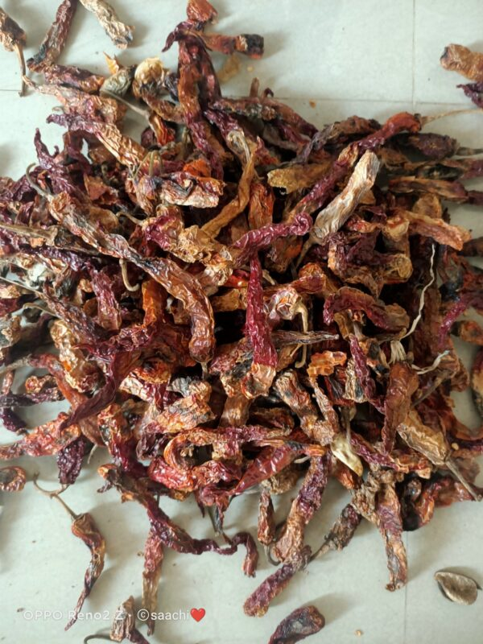
Why This Approach & Factors
Why Not Images?
• Aflatoxin is invisible to the naked eye.
• Image-based ML cannot reliably detect contamination.
• Solution: Predict risk using measurable factors. Input Factors for Prediction:
• Moisture Content – High moisture promotes fungal growth • Temperature – Warm storage increases risk • Humidity – Influences fungal activity • pH Value – Certain levels favor fungi • Water Activity (aw) – Free water available for microbial growth • Color Intensity – Slight changes may indicate spoilage These factors are easy to measure and biologically linked to aflatoxin formation.

Slide 4
Benefits of Our Approach
Advantages of Predicting Aflatoxin Using Measurable Factors & ML:
• Early Detection: Identify high-risk chili before invisible contamination occurs. • Practical & Low-Cost: No expensive lab equipment required for routine checks. • Prevention-Oriented: Helps take preventive actions to reduce contamination. • Scalable & Adaptable: Can be extended to other crops or storage conditions in the future.
• Implemented via mobile application.

Slide 5
Thank You

