Slide 1
PHP2Shell and How AI is Impacting
the Security of Critical Open Source Software
Weilin Du, a PHP core developer
-- with the support of the PHP’s security team

Slide 2
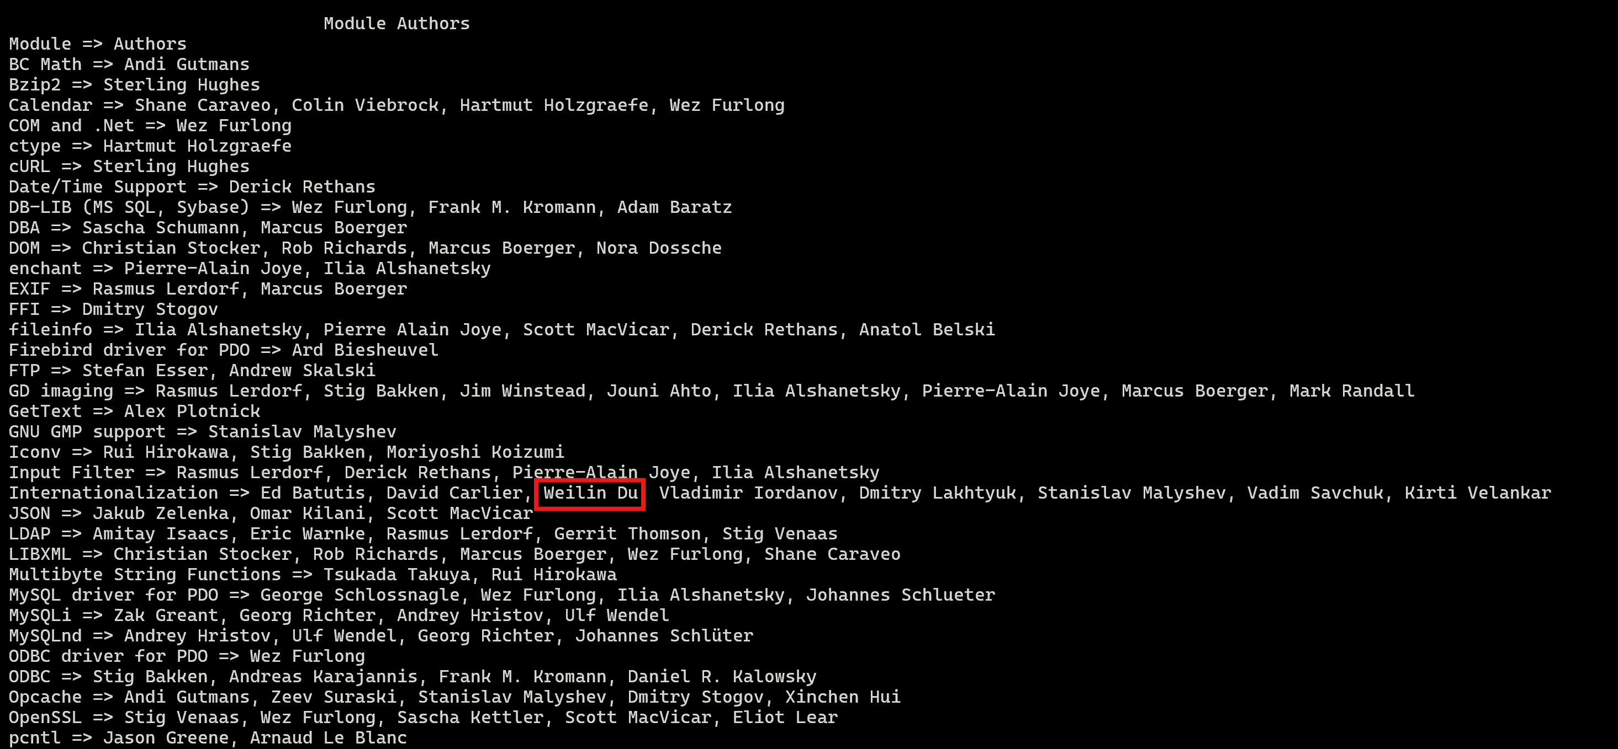

Hi👋. My name is Weilin Du (杜伟霖)
👉
I am a PHP core developer and a cybersecurity fan. Maintainer of:
- ext/zip/*: zip file support
- ext/phar/*: phar file support
- ext/intl/*: PHP’s i18n module
- ext/readline/*: PHP’s interactive shell interface

Slide 3
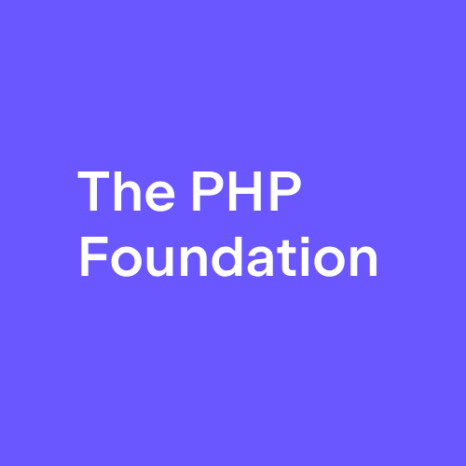
So, where do you get internal stuff of how the team deal with it?
The security team sponsored by the PHP foundation has been working perfectly on this matter.
This talk is reviewed and supported by the internal security team content-wise!
We’ll get to it soon :)

Slide 4
01
How PHP2Shell Works?
OOM -> UAF -> RCE ?

Slide 5
One runtime serves many request lifecycles (mod_php & php_fpm)
MINIT
Request A
Request B
MSHUTDOWN
Module startup
Shared infrastructure
RINIT
Execute application
RSHUTDOWN
RINIT
Execute application
RSHUTDOWN
Module shutdown
Release persistent state
What will happen, when things aren’t fully cleaned-up between requests?
Request B might somehow unexpectedly get Request A’s stuff!

Slide 6
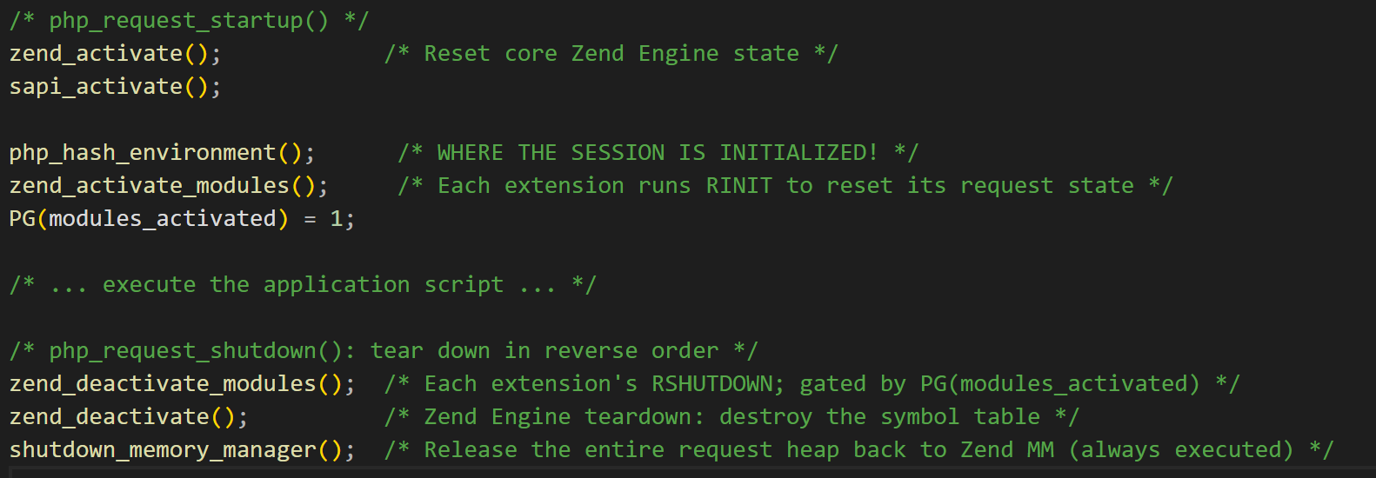
To achieve this: first we need to skip clean-ups from Request A (the former request)
This usually works just *fine*.
However, when a OOM is triggered, the engine is forced to run bailouts (zend_bailouts), which in our case is caught in zend_active_modules.
The bailout triggers a long jump. PG(modules_activated) is still 0, and RSHUTDOWN is *skipped*

Slide 7
Secondly, we need to skip initialization from Request B (the latter request)
As we can see. Before zend_activate_modules. There is php_hash_environment.
If the former request (Request A) has bailed out, nobody does the cleanup. the memory is a mess full of treasures from Request A.
What if– We can use that memory before RINIT in the next request (i.e. in php_hash_environment)? Will that cause memory bugs? YES!

Slide 8
Last thing we need: “Global” Vars that can be alive across RINIT and RSHUTDOWN
Session globals in a non-thread-safe build
Global container
Request heap
#define PS(v) (ps_globals.v)
PS(id)
zend_string
zend_string *id;
zval http_session_vars;
Think about it: Assume we have a global pointer which is pointing to a memory in Request A. However, since clean-ups are skipped, the pointer is still pointing to that memory in request B
EVEN THE MEMORY IT POINTS TO IS NO LONGER USEABLE!

Slide 9
Now. Let’s move the puzzles together.
To trigger a UAF we need:
A OOM to skip cleanup from Request A after malicious session memory is set
A global pointer that survives across request that points to a invalid memory in A
A way to dereference that pointer before Request B initialize

Slide 10
a. The OOM
We need a OOM after session data is loaded and before zend_active_modules so our bailout can skip clean-ups. Which makes the perfect time to be when the interpreter is interpreting requests!

Slide 11
a. The OOM
We need some ways hint the memory limit of a PHP worker in a relatively small request.
- Chunked multipart with no Content-Length can bypass the pre-check of post_max_size
- If filename is ‘’, that file in the request bodywon’t be counted into max_file_uploads, but we still construct the $FILES array in memory.
- Also you can put a million headers in a part :)

Slide 12
b. A dangling global pointer
Since PHP 5.4, a feature known as session.upload_progress is added.The feature is designed to send upload progress from the front-end through session. Yes, as you may wonder, because that information should be ready before the script is executed, the deserialization of that session header happens *before* RINIT, which is where the vulnerability is triggered.

Slide 13
b. A dangling global pointer
After the OOM:
PS(id) and PS(http_session_vars) point into Request A’s heap. PG(modules_activated) stays false so Session RSHUTDOWN is skipped. Request shutdown frees the heap while the globals pointer is still valid, causing a dangling
global pointer.

Slide 14
c. Dereference it!
Now Request A end. Request B arrived.
It sends a Session ID and progress field, but no file part. Without FILE_START we just simply run php_session_initialize() *before* RINIT, using the stale global variables we just set in Request A.
BOOM!

Slide 15
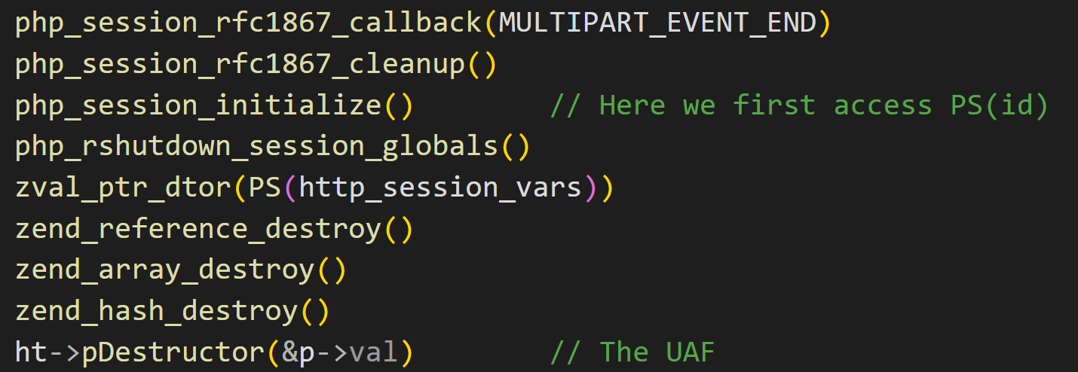
Okay. What’s now?
Since the invalid memory in request A that is pointed by the dangling global pointer is very controllable. Let’s see how PHP use that controlled memory (i.e. the sink)
By sending a fake zend_string length structure, we can let the engine split that much length of heap memory out through the Set-Cookie header. From that, we can derive the base address of heap, and finally php’s address to bypass aslr.
We can also write malicious stuff into php’s session file. If the framework that target use (Wordpress, Laravel) has a POP chain towards functions like system(), we win!

Slide 16
02
The Fix and How AI Is Impacting
From the first report to the final patch

Slide 17
PHP2Shell disclosure and fix timeline
2024
30 Jul 2026
11 Aug
24 Aug / 18 Sep
20 Oct
21 Oct, 14:00 UTC
OOM risk identified
Calif audit begins
RCE confirmed
More attack vectors
Disclosure disrupted
Security release
Audit follow-up finds
the OOM flaw. No concrete
exploit path yet.
Patch the Planet brings
another external audit
to PHP.
Calif reports RCE with
the same root cause.
Fix becomes top priority.
Wiz reports on 24 Aug.
OpenAI adds vectors
on 18 Sep.
CVE IDs leak. A PoC
video follows. Release
moves forward one day.
Two critical CVEs fixed
across supported branches.
Originally due on 22 Oct.
But hey! I certainly heard someone on social media reproduced this way earlier than you guys right?
Notes:
Timeline dates are in 2026 unless marked 2024. Times are UTC. Milestones are spaced for readability, not to scale.
The 2024 OOM concern stalled over compatibility, denial-of-service trade-offs, extension coordination and limited staffing. OpenAI independently reported the root cause before its additional 18 September vectors; its initial report date is not specified.
According to the Foundation, on 20 October CVE IDs circulated around 15:00 UTC, PHP pre-announced at 19:30 UTC, and Calif mistakenly published a demonstration video around 20:00 UTC. On 21 October at 07:41 UTC, Chainguard published patched images ahead of the coordinated release. The release moved from 22 October to 21 October at 14:00 UTC.
CVE-2026-109618: OOM corruption. CVE-2026-109619: stale global state. The patch changes interruption timing and resets request-owned state.
Sources:
https://thephp.foundation/blog/2026/10/21/todays-php-security-release-and-how-were-strengthening-php-security/
https://www.php.net/archive/2026.php
https://github.com/php/php-src/security/advisories/GHSA-w8hw-w9fx-j79w
https://github.com/php/php-src/security/advisories/GHSA-6wmf-4rv5-p3rp
https://github.com/php/php-src/commit/3584a98bda0f2c0d367255b046798b0d3a221a19

Slide 18
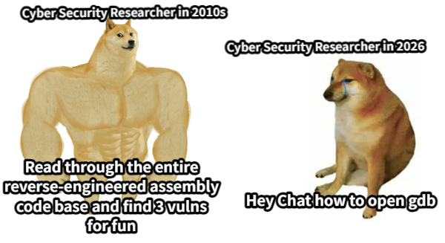
The hype of “stupid” irresponsible disclosing is out of control

Slide 19
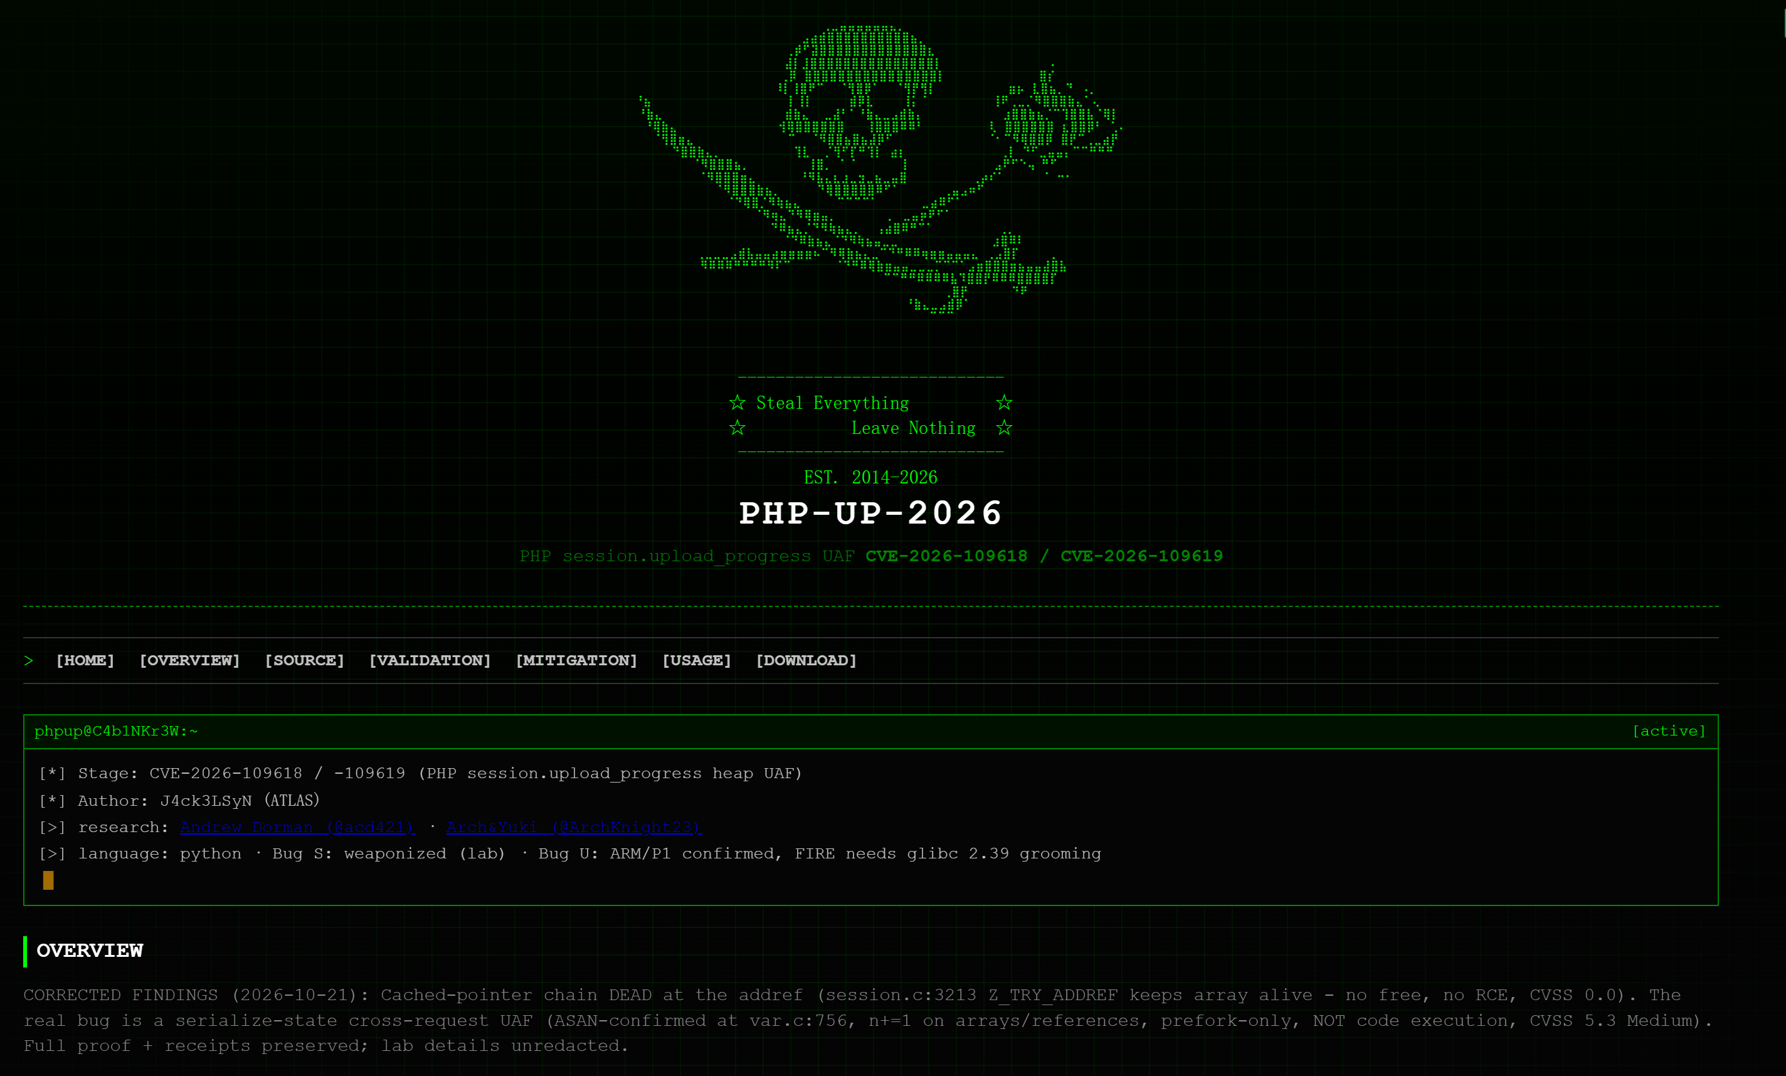
The hype of “stupid” irresponsible disclosing is out of control
Before, a security research takes a lot of time & effort
Now, anyone can prompt a AI to claim that they “reproduce” or “find” any vulnerability with a seemingly reasonable and fancy proof.

Slide 20
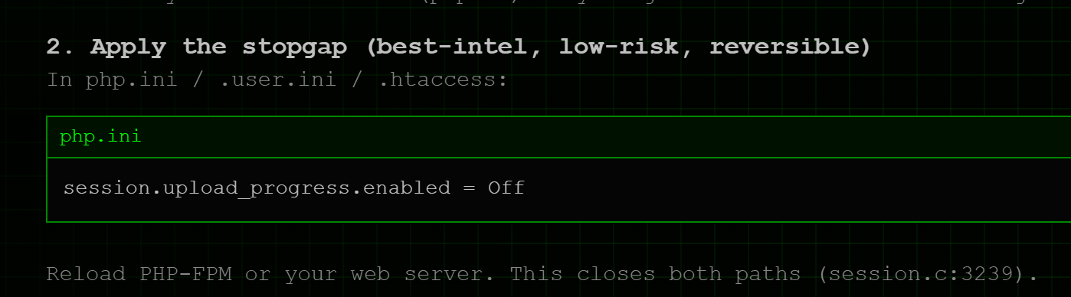
But why is this harmful?
Wrong mitigation is widespread.
People getting horrified.
Most of the analyzes are slop, causing it difficult to do any further research.

Slide 21
But why is this harmful?
Artificial Intelligence does not empower everyone to do cybersecurity work. It provides a vibe on public platforms which encourage people to gather attention by one-shotting any critical vulnerabilities through AI models.
It is once a basic decency to respect everyone and do responsible reports, now it’s the opposite.

Slide 22
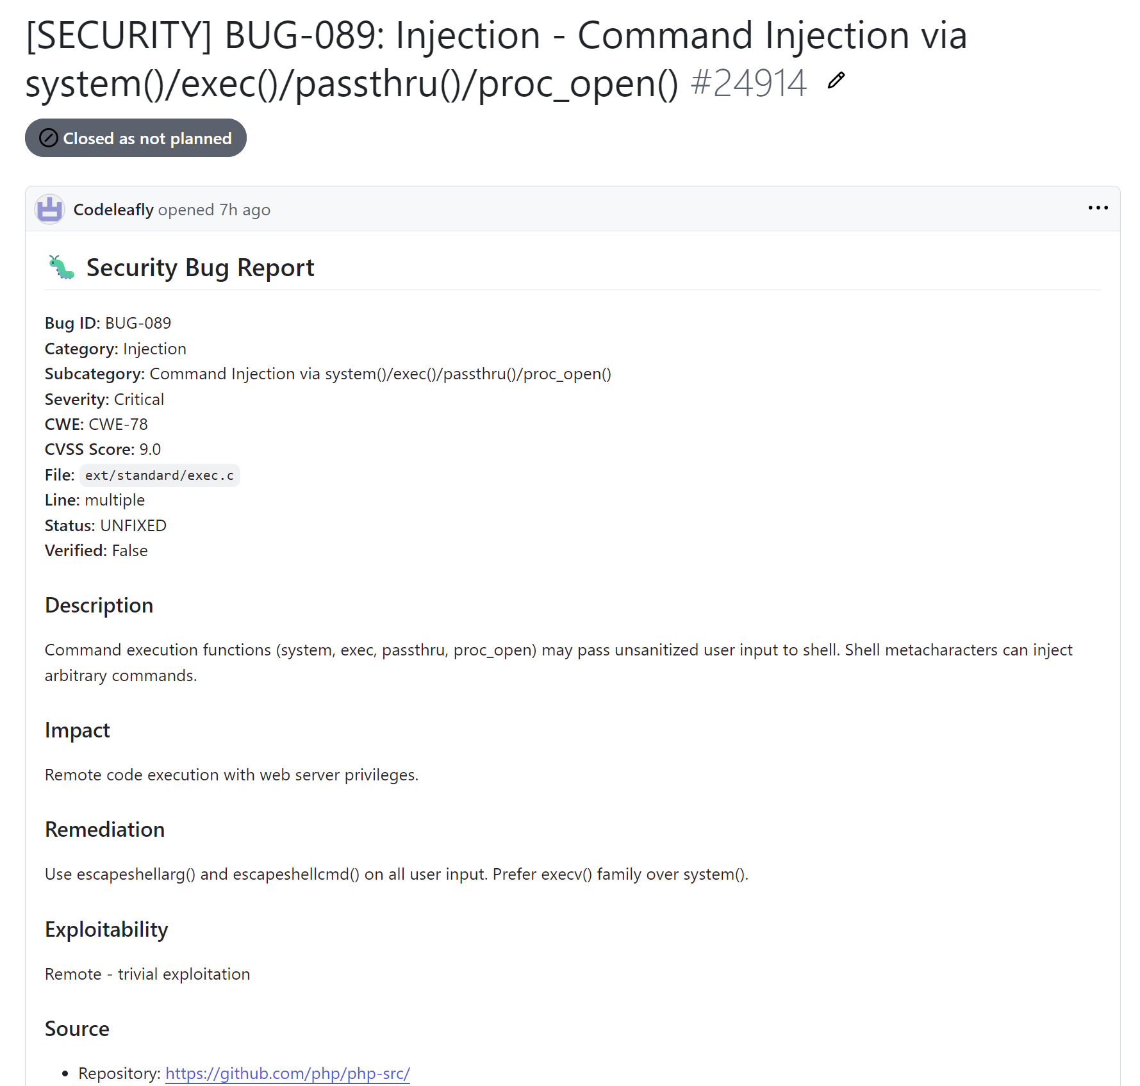
But how about responsible disclosures?

Slide 23
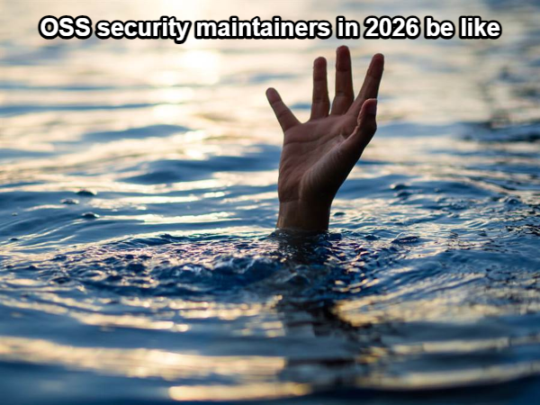
But how about responsible disclosures?

Slide 24
Step back to look in a broader view
AI is powerful only if the person behind it is powerful.
Although AI is good at finding bugs, it can be very harmful to the whole cybersecurity ecosystem.
Support the OSS project everyone is depending on!

Slide 25
So, what have the PHP foundation done for PHP security?
Apply & Utilize the Alpha-Omega Grant
Form a ecosystem team to improve the maintenance of vital PHP packages & projects
Sponsor the PHP security team
…

Slide 26
THANKS
E-mail: weilindu@php.net
Blog: lamentxu.top
Github: LamentXU123

