Slide 1
Eco-Friendly Travel: Grenoble to Abuja
An Environmental Analysis of Travel Options

Slide 2
Introduction
Departure: Lycée Pierre Termier – Grenoble – France
Arrival: Abuja, Nigeria
Distance: ~4,019 km (direct)
Objective: Analyze cost, duration, and carbon footprint of travel options.
Scenarios: 1-week vs. 1-month vacation (including travel time)

Slide 3
Transportation Options Overview
Air Travel: ~10 hrs one-way, 1153.8 kg CO2e one-way, €410 one-way
Mixed Transport: ~175 hrs one-way, 210.4 kg CO2e one-way, €600 one-way
Land & Sea: ~165 hrs one-way, 177.2 kg CO2e one-way, €575 one-way

Slide 4
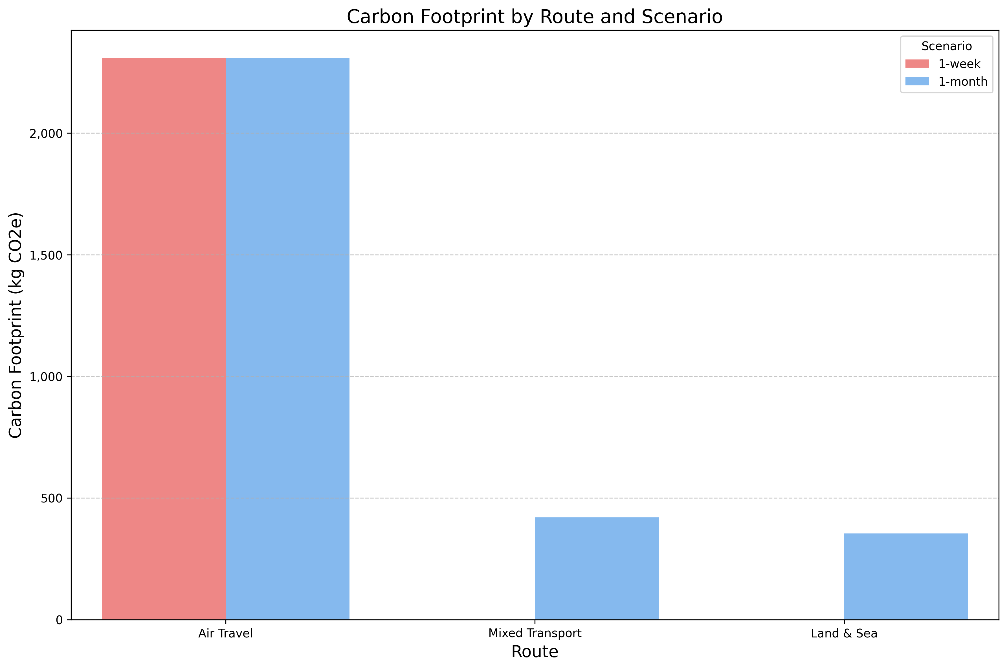
Carbon Footprint Comparison (Round Trip)
Notes:
This chart compares the total CO2 equivalent emissions for each route under both scenarios. Note the significant difference between air travel and the land/sea options.

Slide 5
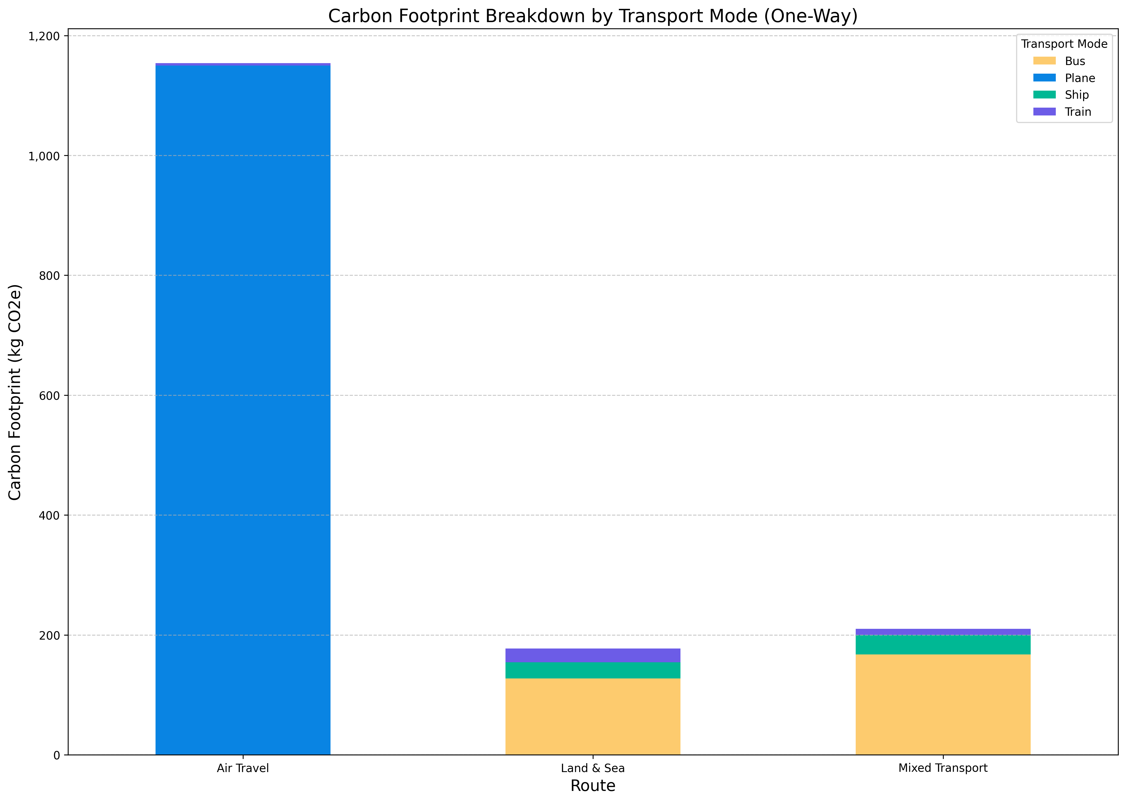
Carbon Footprint Breakdown (One-Way)
Notes:
This shows which modes of transport contribute most to the carbon footprint for each route. For air travel, the flight itself dominates. For others, contributions are more varied.

Slide 6
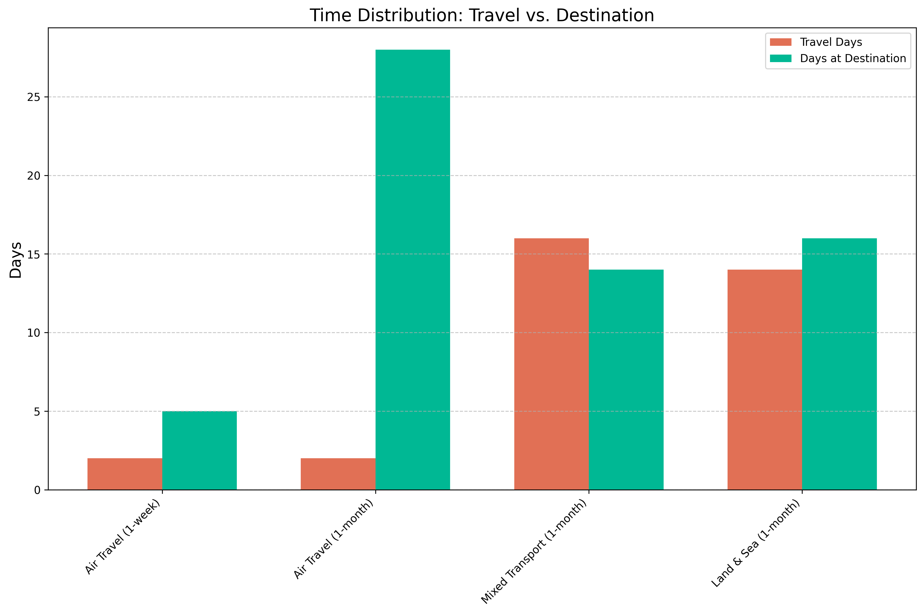
Time Distribution: Travel vs. Destination
Notes:
This visualizes how total vacation time is split between traveling and being at the destination. Overland routes consume much more travel time, making them infeasible for the 1-week scenario.

Slide 7
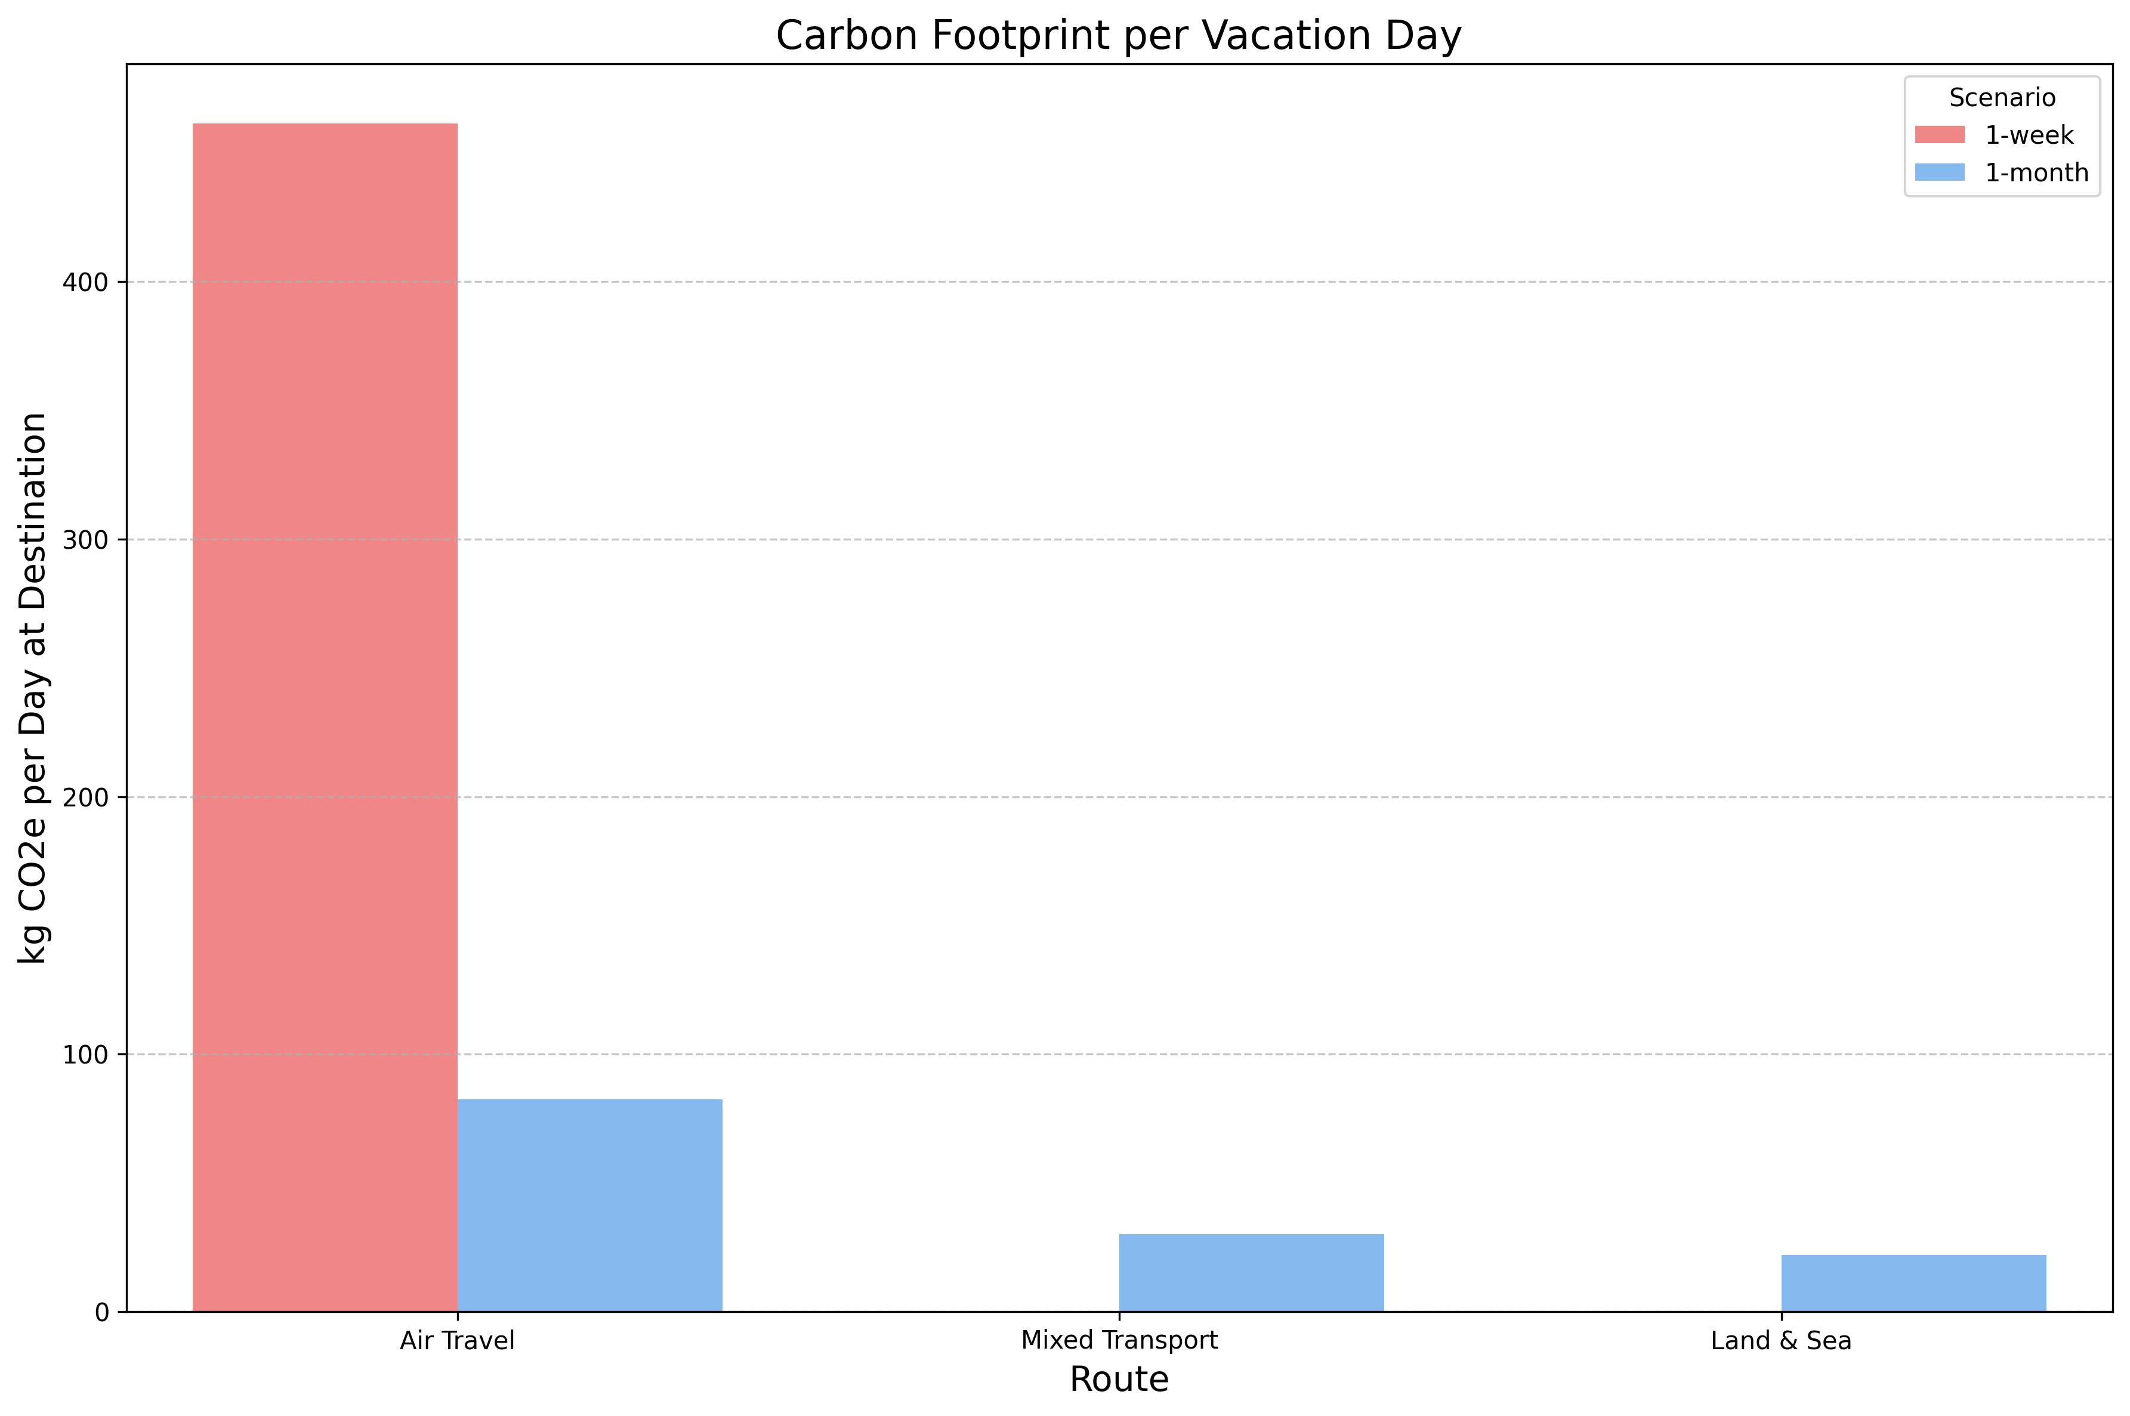
Carbon Footprint per Vacation Day
Notes:
This metric shows the carbon 'cost' per day actually spent enjoying the destination. Longer trips with low-carbon transport become much more efficient by this measure.

Slide 8
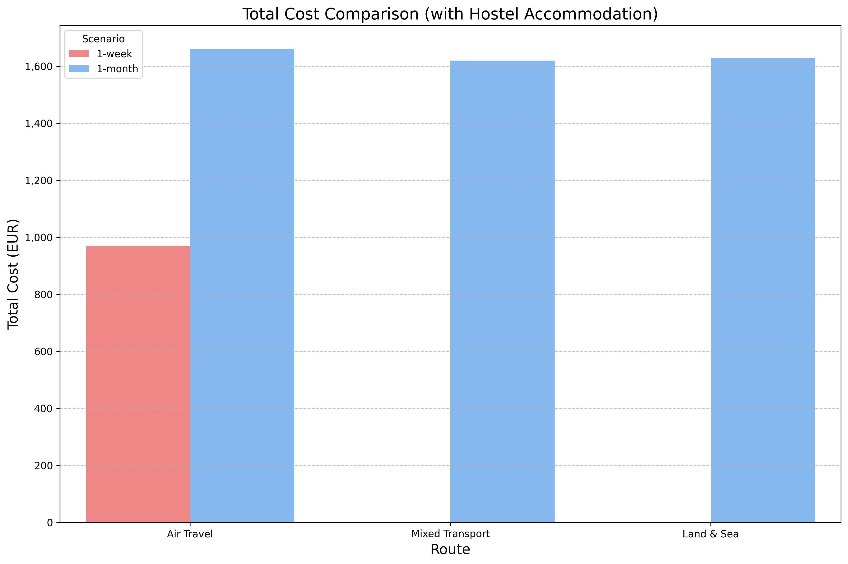
Total Cost Comparison (Hostel)
Notes:
Compares the estimated total trip cost (transport + hostel accommodation) for feasible options. Costs are relatively similar for the 1-month scenario across different routes.

Slide 9
Key Findings
1. Carbon Footprint: 'Land & Sea' has the lowest average carbon footprint (354.5 kg CO2e round trip).
- This is 84.6% less than 'Air Travel' (2307.7 kg CO2e).
2. 1-Week Feasibility: Only these routes are feasible for a 1-week trip: Air Travel.
3. 1-Month Carbon Efficiency: 'Land & Sea' has the lowest carbon footprint per day at the destination (22.2 kg CO2e/day).
4. Cheapest Options (Hostel Accommodation):
- 1-month: 'Mixed Transport' at approximately €1620.
- 1-week: 'Air Travel' at approximately €970.
5. Environmental Recommendation Summary:
- 1-week vacation: 'Air Travel' (lowest carbon among feasible options).
- 1-month vacation: 'Land & Sea' (lowest overall carbon footprint among feasible options).

Slide 10
Recommendations
1-week vacation: 'Air Travel' (lowest carbon among feasible options).
1-month vacation: 'Land & Sea' (lowest overall carbon footprint among feasible options).

Slide 11
Conclusion
1-Week Trip: Flying is the only feasible option. Focus on mitigation.
1-Month Trip: Land/Sea routes offer >80% carbon reduction vs. flying.
'Land & Sea' is the most carbon-efficient overall.
Trade-offs: Time, cost, complexity vs. environmental impact.
Longer travel time enables significantly greener choices.

Slide 12
Q&A
Thank you!

