Slide 1
Data Modeling with
dbt & BigQuery
NYC 311 Service Requests · Data Engineering Graduation Project · DEPI 2026
Milestone 1: Ingestion
Milestone 2: dbt Models
Milestone 3: CI/CD
Milestone 4: MLOps
Milestone 5: Docs & Demo

Slide 2
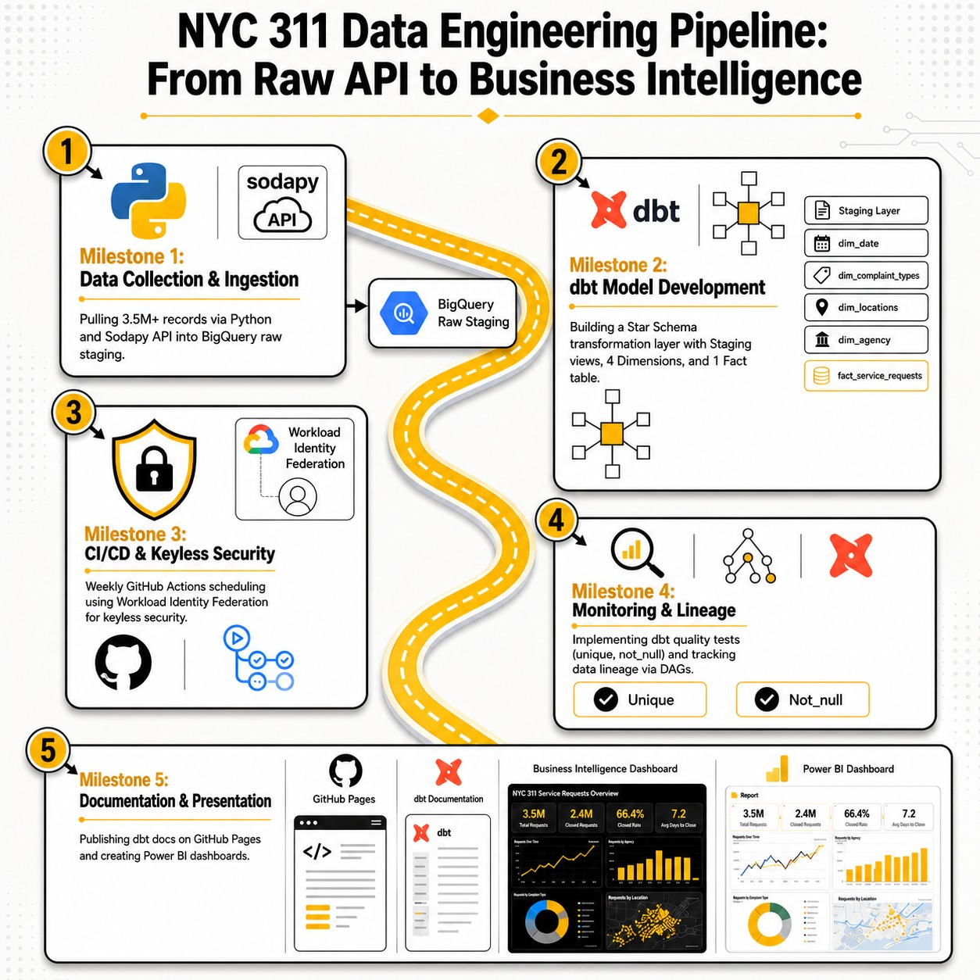
Project Overview — Five Milestones
End-to-end data pipeline for NYC 311 citizen service requests
1
Data Collection & Ingestion
2
dbt Model Development & Testing
3
CI/CD Deployment (Batch Scheduled)
4
MLOps — Monitoring & Automation
5
Documentation, Demo & Presentation

Slide 3
Milestone 1 — Data Ingestion
Pulling 3,500,000+ NYC citizen complaint records into Google BigQuery
🌐
NYC 311 Open Data API
Sodapy client + App Token to bypass rate limits. Pulls 6.5M+ records dynamically.
🐍
Python Ingestion Script
Pandas-based script connects to the API and uploads directly to BigQuery raw_service_requests table.
☁️
BigQuery — Raw Staging Area
Dataset: nyc_311_raw_data · Table: raw_service_requests · 40+ columns of raw citizen complaint data.

Slide 4
Milestone 2 — dbt Modeling
dbt Modeling
Building the transformation layer — Staging, Dimensions & Fact Table
NYC 311 Service Requests · Data Engineering Graduation Project · DEPI 2026

Slide 5
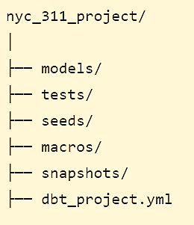
dbt Local Development Setup
Milestone 2 — dbt Modeling
Steps to connect dbt to BigQuery to run the first model
1
Create Project Folder in VS Code
5
Initialize dbt Project
dbt init nyc_311_project
NYC_311_PROJECT/
2
Create Virtual Env & Activate it
python -m venv SMAL
SMAL\Scripts\activate
3
Install dbt (pinned versions)
6
Configure profiles.yml
pip install dbt-core==1.8.9 dbt-bigquery==1.8.2
C:\Users\NAME\.dbt\profiles.yml (kept outside repo)
4
Authenticate with Google Cloud
7
Test the Connection
gcloud auth application-default login
dbt debug → All checks passed! ✅

Slide 6

Data Auditing
Milestone 2 — dbt Modeling
Audit query to choose the useful columns
DONE
Raw Table — Key Columns
Staging view code
🌐
الجدول الخام — أبرز الأعمدة
unique_key
created_date
🐍
closed_date
agency
agency_name
complaint_type
Stag. view on Big Query
descriptor
city
☁️
borough
latitude
longitude
status
+ 28 more columns (40 total)
Audit query was used to choose the useful columns

Slide 7
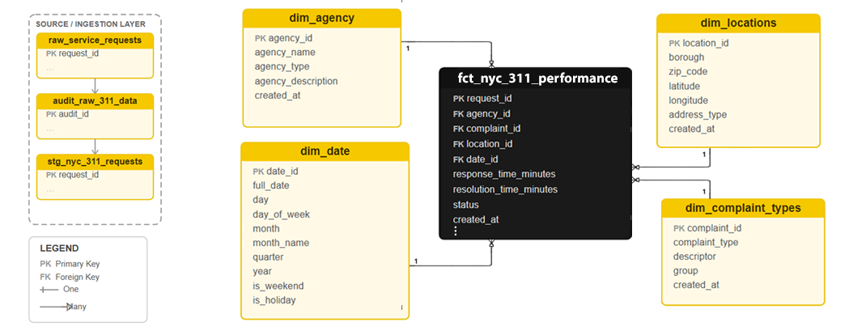
Star Schema Design
Milestone 2 — dbt Modeling
Staging VIEW → 4 Dimension Tables → 1 Central Fact Table
Staging Layer: stg_nyc_311_requests (VIEW) — cleans raw data · selects 15 of 40 columns · fixes Timestamp types

Slide 8
Milestone 3 — CI/CD Deployment
CI/CD Deployment
Security: Workload Identity Federation
NYC 311 Service Requests · Data Engineering Graduation Project · DEPI 2026

Slide 9
Milestone 3 — CI/CD Deployment
Automated Orchestration & Cloud Security
1. Scheduled Batch Pipeline (GitHub Actions)
• Fully automated CI/CD pipeline scheduled using Cron job notation ('0 0 * * 0').
• (To be updated) Triggers weekly batches dynamically to refresh data without human intervention.
2. Keyless Authentication via WIF
• Avoided static, long-lived Service Account JSON keys entirely to ensure zero-trust security.
• Implemented Workload Identity Federation (WIF) to exchange GitHub tokens for short-lived GCP credentials.
3. Execution Flow
• Code checkout -> WIF handshake -> Install dbt -> dbt run & dbt test inside Google BigQuery.

Slide 10
Milestone 3 — CI/CD Deployment
Security: Workload Identity Federation
Connecting GitHub Actions to Google Cloud — zero JSON keys stored
1
Create Identity Pool
أنشئ Identity Pool · depi-pool — in Google Cloud Shell
2
Create Identity Provider
أنشئ مزود الهوية · github-provider — links to github.com
3
Create Service Account
أنشئ حساب الخدمة · github-action-bot
4
Grant 3 IAM Roles
امنح 3 صلاحيات IAM · BigQuery Admin · Data Editor · Job User
5
Bind Provider → Service Account
اربط المزود بحساب الخدمة · GitHub gets temporary secure credentials only

Slide 11
Milestone 3 — Security: Workload Identity Federation
Connecting GitHub Actions to Google Cloud — zero JSON keys stored
GitHub Actions — nyc_311_refresh.yml
What CI/CD Means Here
CI
Auto-install libs · dbt test on every push
CD
Cron deploys fresh data (coming update) every Sunday to BigQuery production
🔒
WIF issues short-lived tokens — no keys in the repo ever

Slide 12
Milestone 4 — Monitoring & Automation
Monitoring & Automation
NYC 311 Service Requests · Data Engineering Graduation Project · DEPI 2026

Slide 13
Testing & Results
dbt data quality tests · anomaly detection · automation outcomes
NYC 311 Service Requests · Data Engineering Graduation Project · DEPI 2026

Slide 14
Milestone 4 — Monitoring & Automation
Data Quality, Alerting & MLOps Integration
1. Data Quality & Freshness (dbt Tests)
Automated Quality Checks: Enforced constraints (unique, not_null) via dbt on critical fields like complaint_id.
2. Proactive Observability & Alerting
Instant Failure Detection: GitHub Actions workflow triggers immediate status alerts upon any step failure.
Error Diagnosis & Logging: Leveraged GitHub Actions execution logs for rapid identification of API drops or schema mismatches, preventing faulty production updates.

Slide 15
Results & Achievements
What was built and delivered end-to-end
+6.5M
5
100%
0
Records Processed
dbt SQL Models Built
Automated — Zero Manual Steps
JSON Keys in Repo
Data Lineage DAG — Automated by dbt
raw_service
_requests
stg_nyc_311
(VIEW)
dim_date
dim_locations
dim_complaint
dim_agency
fact_service
_requests
Power BI
Dashboard
→
→
→
→

Slide 16
End-to-End Pipeline Architecture
From raw API data to automated Star Schema in the cloud
NYC 311 API
BigQuery Raw
dbt Staging
Star Schema
▶
▶
▶
Sodapy + Python
raw_service_requests
stg_nyc_311
(VIEW)
dim × 4 + fact
Power BI Dashboards — Final business intelligence output
GitHub Actions CI/CD — Runs Every Sunday Automatically
🔒
WIF Auth
(no JSON keys)
🐍
python
ingest_nyc_311.py
⚙️
dbt run
rebuild tables
✅
dbt test
validate quality
→
→
→

Slide 17
Power BI
Dashboards
Live analysis of NYC citizen complaints using the Star Schema output
NYC 311 Service Requests · Data Engineering Graduation Project · DEPI 2026

Slide 18
Thank You
Project Team
Lamiaa Dardeer
Aliaa El-Baz
Sayed Gouda
Makary Makin

Slide 19
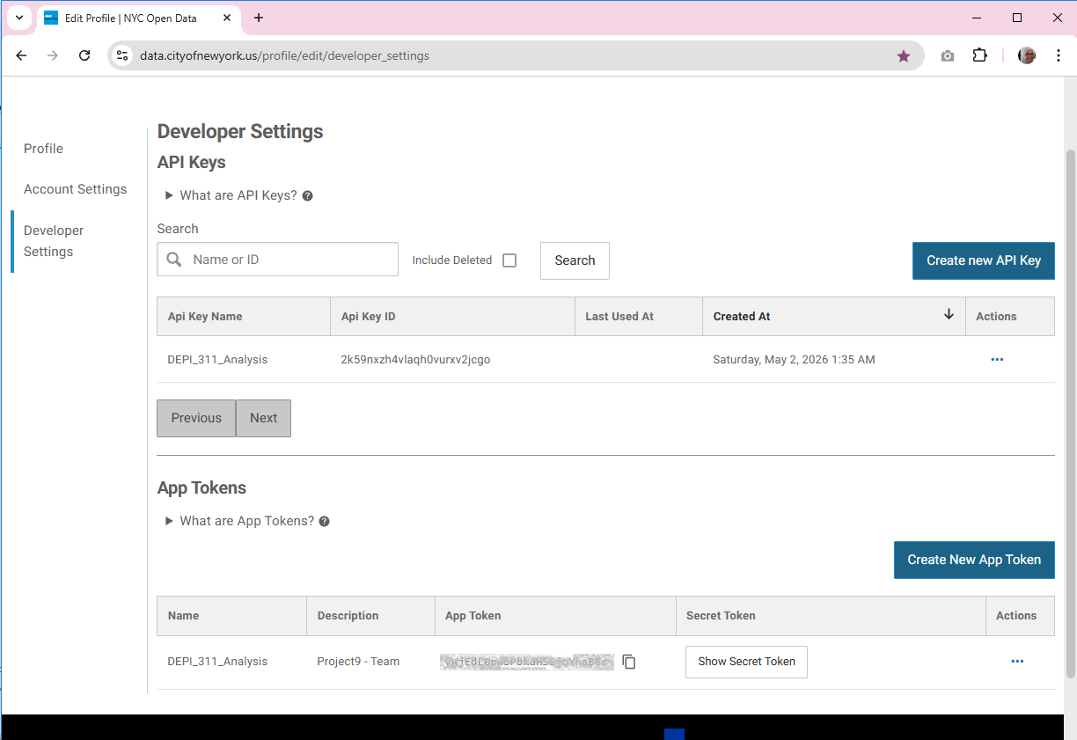
NYC 311 Open Data API

Slide 20
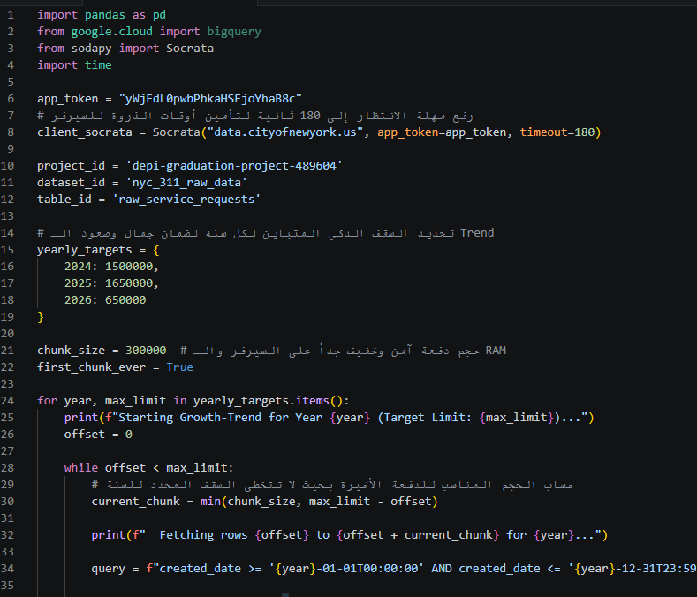
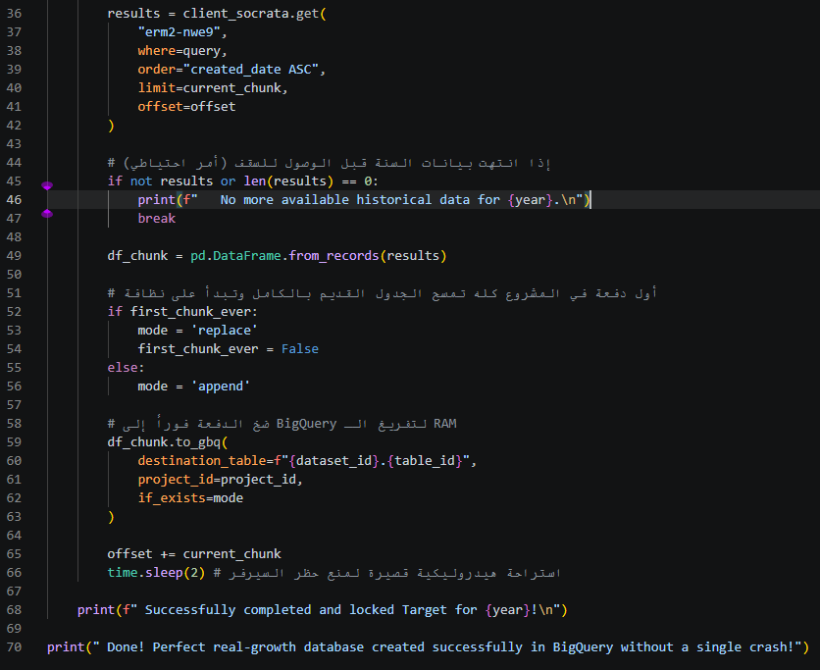
Python Ingestion Script

Slide 21
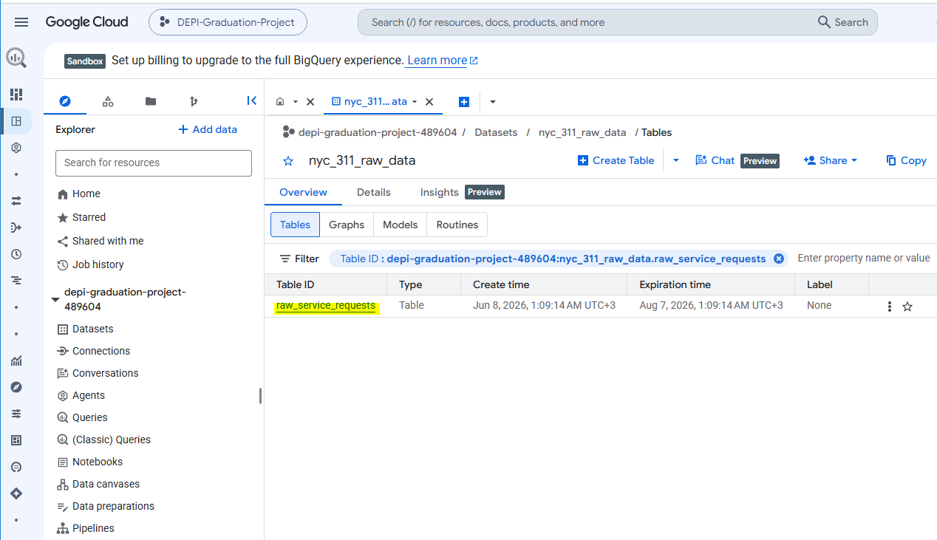
BigQuery — Raw Staging Area

Slide 22
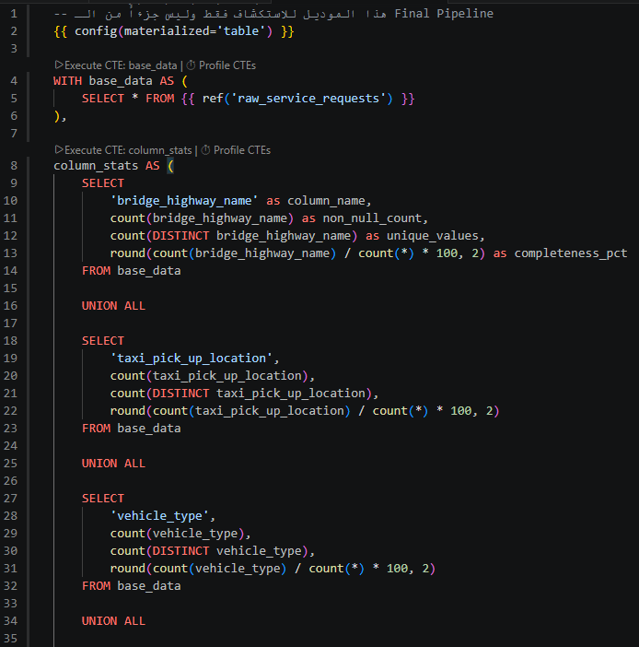
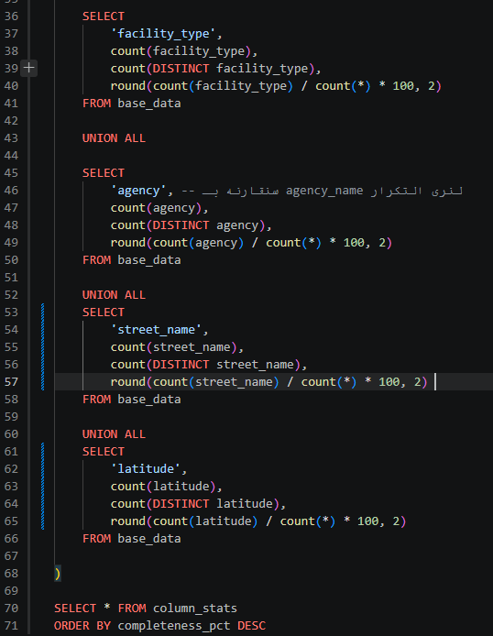
Audit query

Slide 23
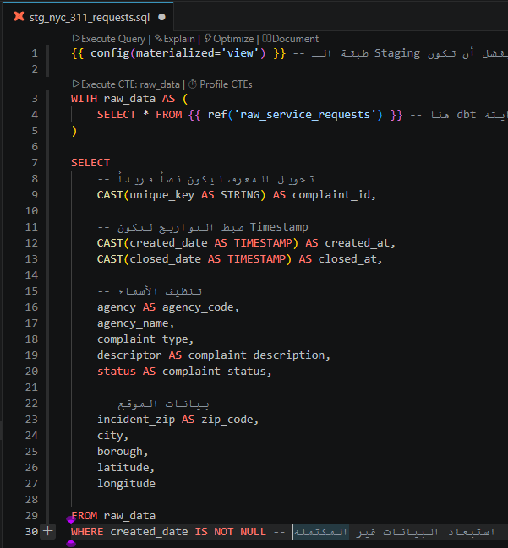
Stage View

Slide 24
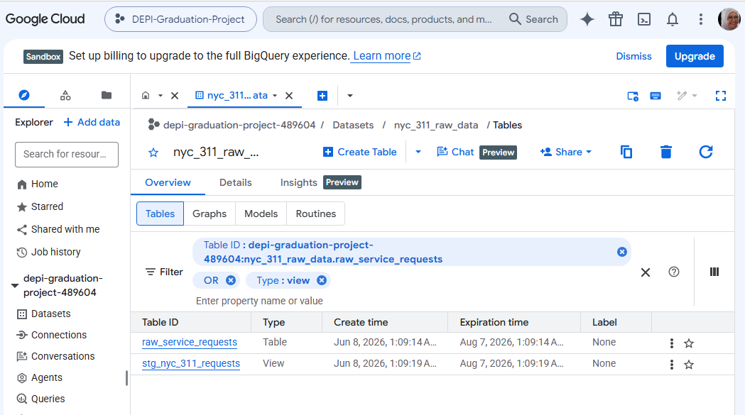
Stage View

Slide 25
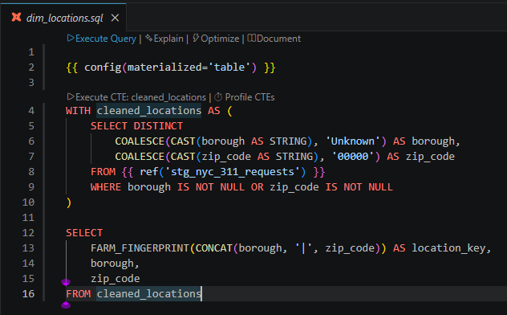
Dim Tables 1

Slide 26
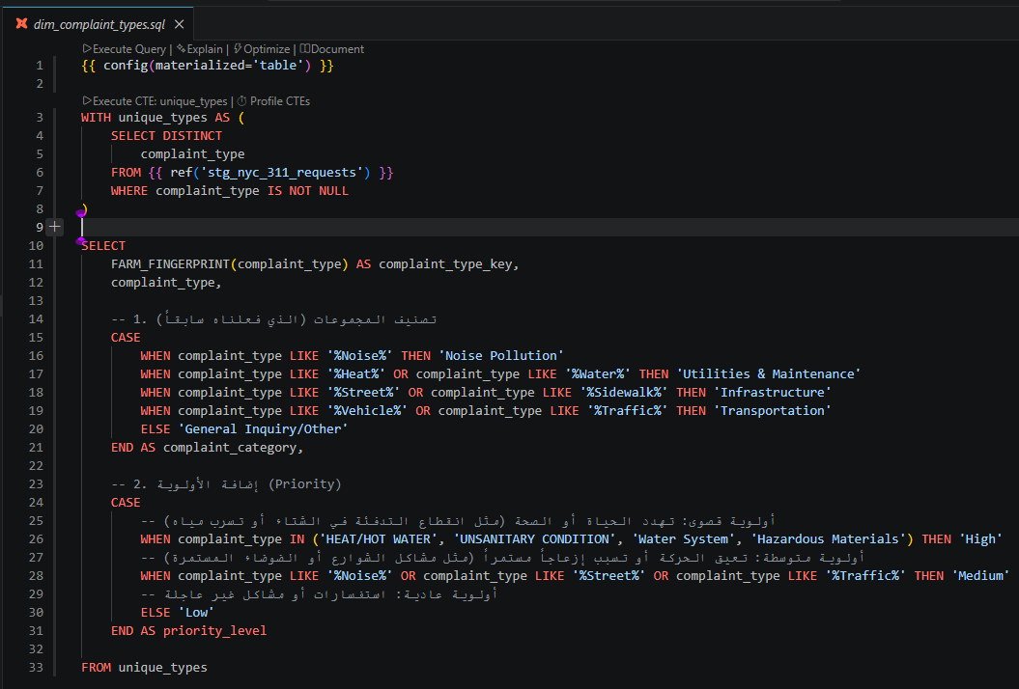
Dim Tables2

Slide 27
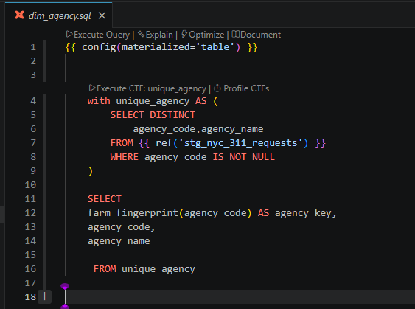
Dim Tables3

Slide 28
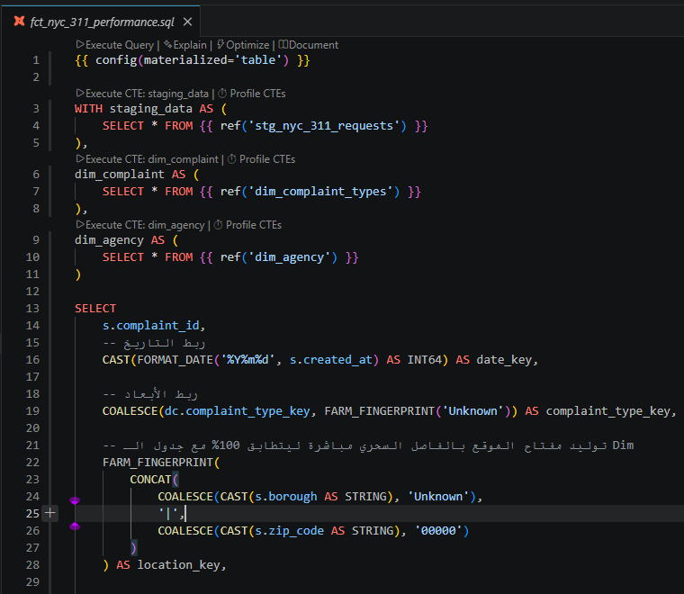
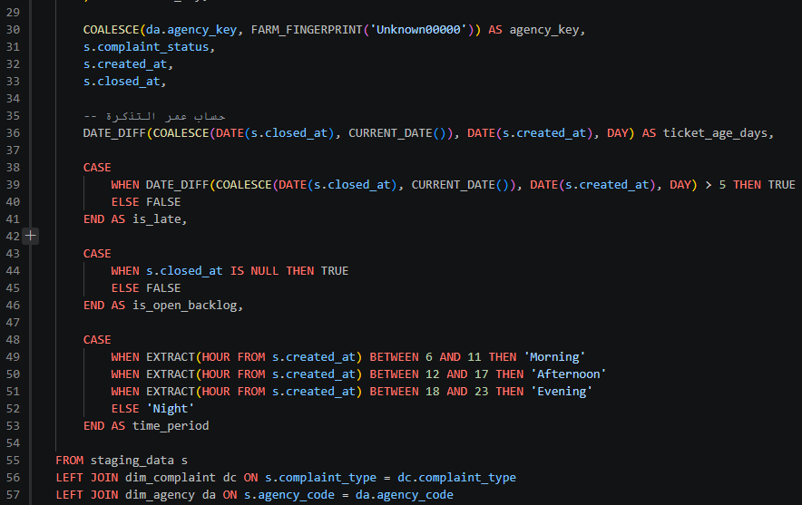
Fact Table

Slide 29
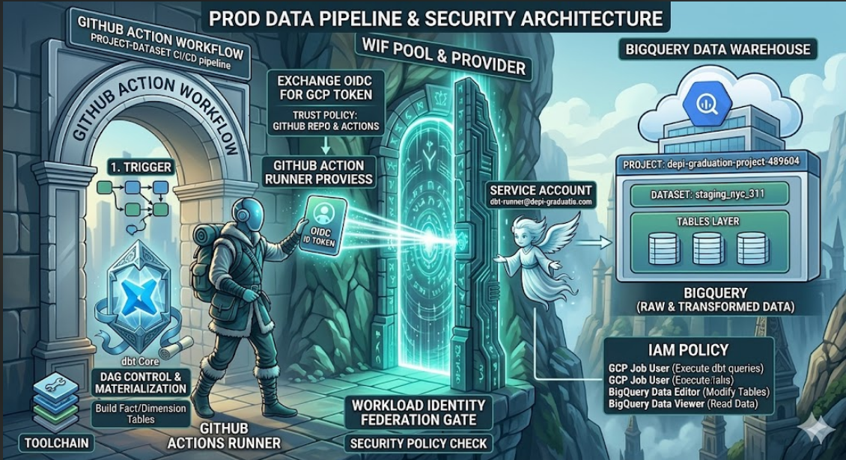
WIF

Slide 30
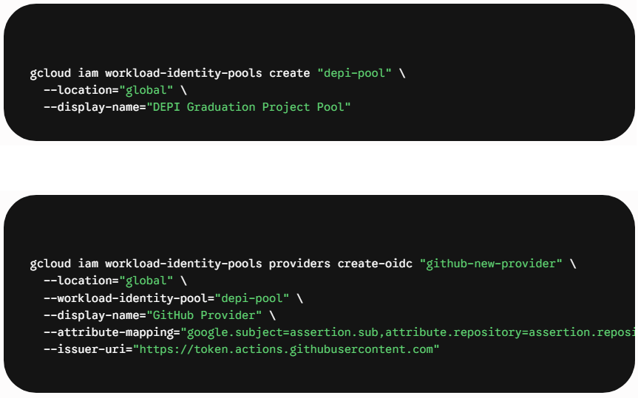
WIF
Create Identity Pool
Create Identity Provider

Slide 31
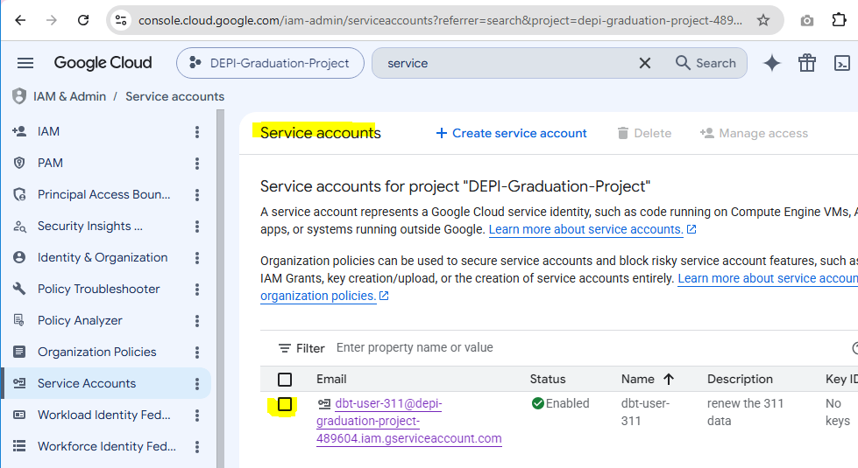
WIF
Create Service Account

Slide 32
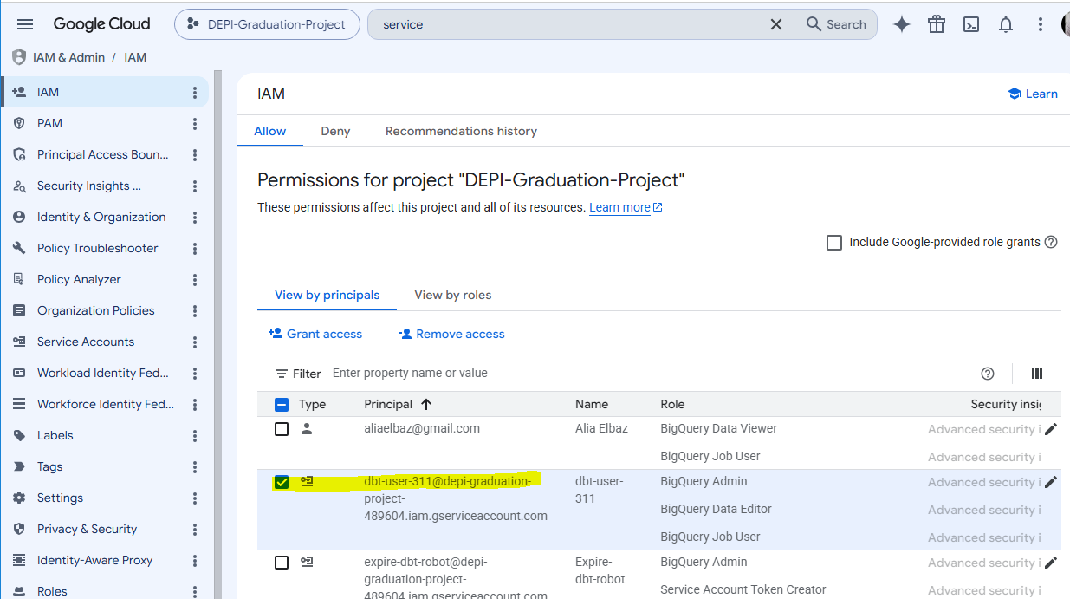
WIF
Grant 3 IAM Roles

Slide 33
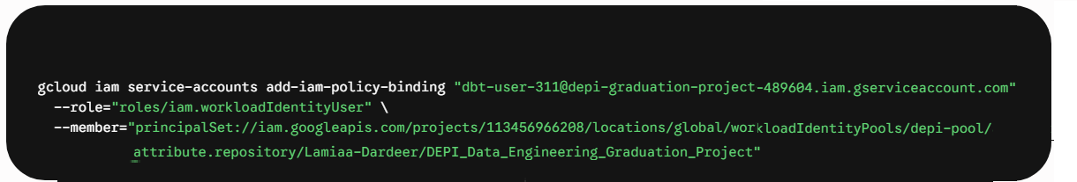
WIF
Bind Provider → Service Account

Slide 34
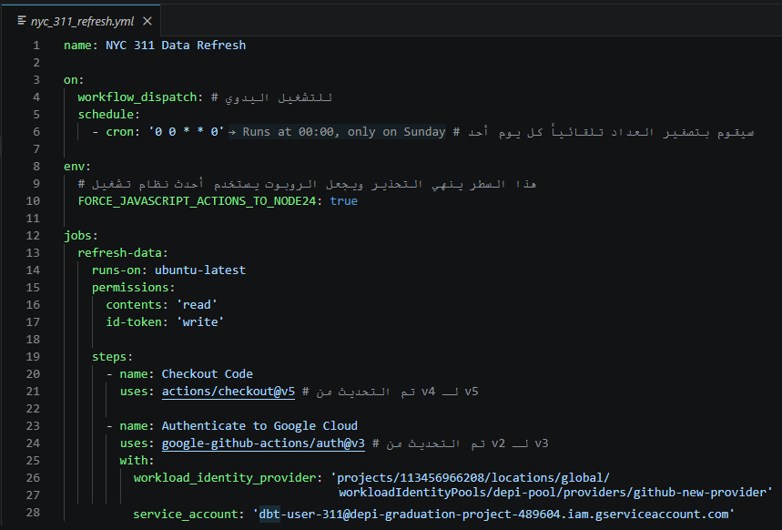
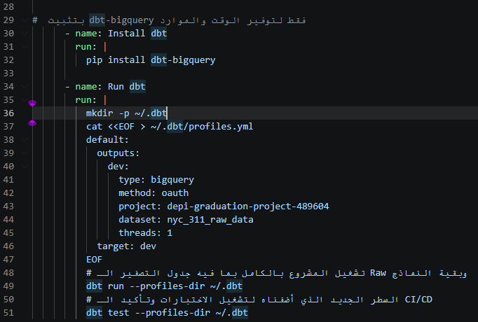
Git-Hub Action

Slide 35
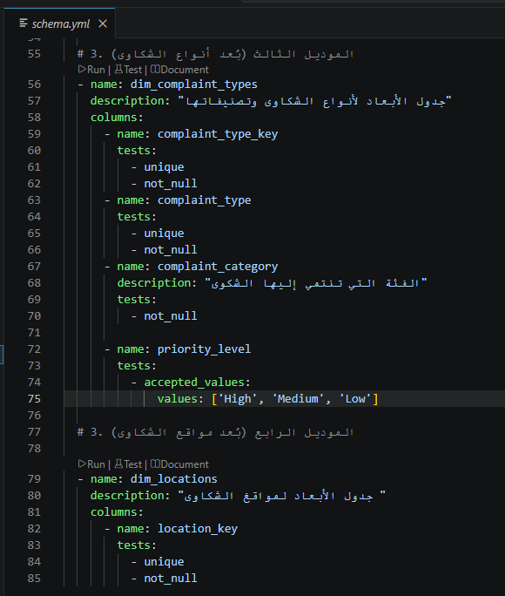
Schema.yml files

Slide 36
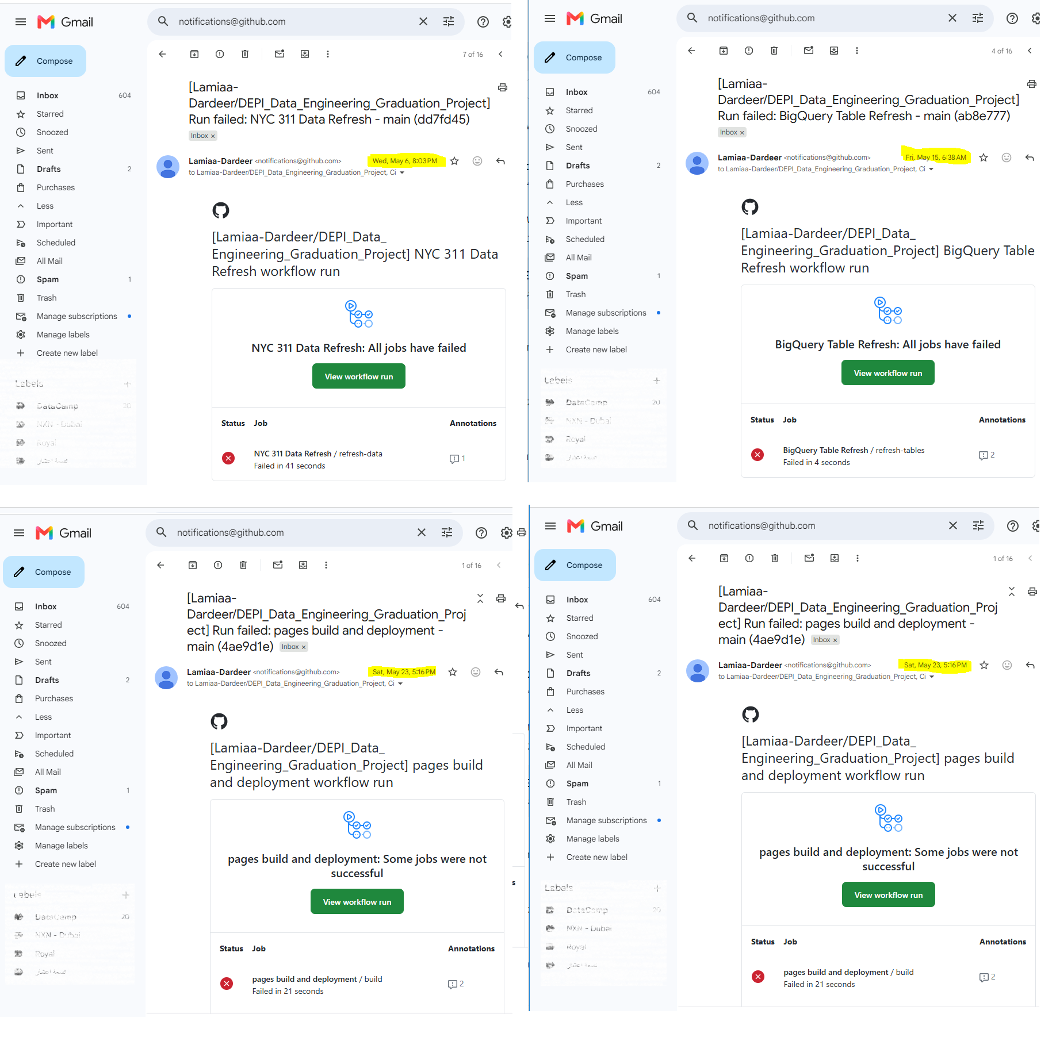
Alerts

Slide 37
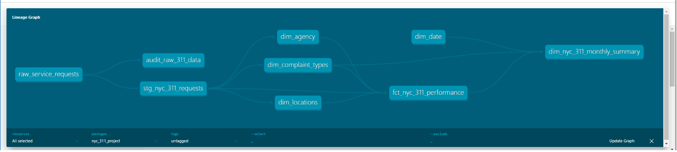
DAG
dbt docs generate dbt docs serve
https://lamiaa-dardeer.github.io/DEPI_Data_Engineering_Graduation_Project/

Slide 38
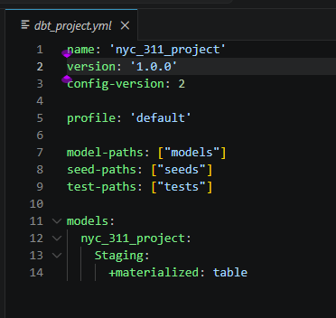
Project

Slide 39
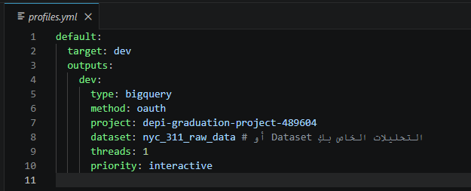
Profile

