Slide 1

TEAM WING-93
Reimagining Tender
e-Tender

Slide 2

WHAT IS TENDER?
A tender is a fixed prize offer to execute a work or supply products .During the first step of this tender procedure ,contractors are invited to submit bids for construction or provide particularly planned services or items within a specific time limit.
Initiatives
Implementation

Slide 3
Problem Analysis
Government purchases various components through tender which takes a lot of time as the process of allocation of tender takes more than 2 months.
Often it is observed after allocation of tender the fulfillment of the required tender takes more than the required time for contact period.
From tender allocation to tender completion it takes more than 6 months to complete all the process as government itself have to compare all the required items.
Addressing this issue will help the government in having transparency and parity in rates of items procured by different Govt organizations and the entire process of tender allocation will take very less time than what is taking now.
Objective: There is a requirement of software(Mobile/Web App) for Govt procurements which lists various items with specifications, rates, warranty and compare them and decide the best option I.e one available for car insurance etc.
Initiatives
Implementation

Slide 4




Digital Presence Problems
identifying loopholes in the current digital channels
Less way of knowing the better fit contractor among the huge list
Selection process is done manually without any recommendation based on past record
Consumes too much time for selection process
Even after having the online website, the time, taken for selection
Lengthy Registration process
Content in all Has to go through a lengthy registration process everytime
Lack of direct interaction between tenderer and government
No efficient way of selection of tenders due to lack of information about company records
Analysis
Initiatives
Implementation
Impact
4

Slide 5
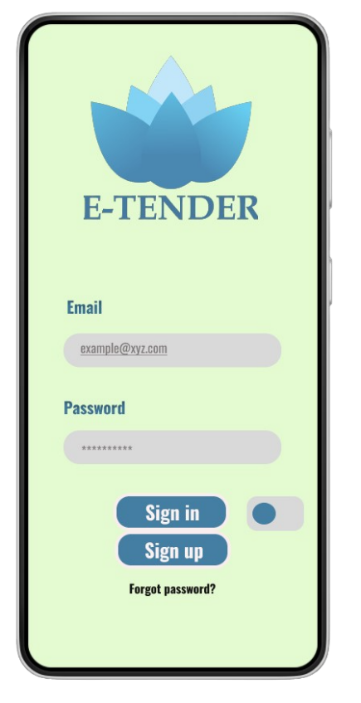
Solution Overview
Introducing e-Tender Application
Solution
Implementation

Slide 6
WHAT IS e-TENDER?
Our e-tender application is an automated system for e-tenders which will suggest and bring out the best tender contracts for a specific job according to the sector and previous company records amongst the long list of tenders based on ratings of works.
Solution
Implementation
Analysis
Solution

Slide 7
The Big Idea (Our Solution)
UTILITY BASED(SAVING THE TIME FOR SCREENING PROCESS)
Re-lmagining e-Tender by a suggestion based system where the algorithm selects the best contract for a specific type of work in a specific area.
The big idea is to incorporate the existing tenders into automated system, shifting its strategy from a manual approach to algorithmic suggestion based paradigm – one that appeals to government’s needs and saves the work time by multiplier.
Solution
Implementation
Analysis
Solution

Slide 8
WHY IS IT IMPORTANT?
For Government
Brings out better interoperability for both the government and tenderers
The best tenderer company or contractors are suggested automatically based on the category, subcategory and ratings.
The suggestion is automated by selection algorithm discussed in the later part.
We intend to use Machine Learning for better selection in future.
After every completed tender, reports are submitted and ratings are updated.
Direct interaction between the tenderers and the governments.
Solution
Implementation
Analysis
Initiatives

Slide 9






Algorithm Criteria
Rating
Grade
Budget
Previously Done Projects
Contract Time
Criteria Based on a category
Initiatives
Implementation

Slide 10
WHY IS IT IMPORTANT?
For Tenderers
Only one time registration process.
Sorting & searching system method for finding the perfect contract.
Tenders according to the organization.
Easy Interface for tenders and bidding.
Automation of the whole process
Better communication and operability with the ministry.
Direct interaction with the government.
Easy paperwork submission and selection system.
Solution
Implementation
Analysis
Initiatives

Slide 11

SWOT Analysis: Sprint, by Apex
Strengths First mover, implementing the automated selection of contracts Reduces the time Smooth interface for both the government and the tenderers Rating system for track progression | Weaknesses Budget restriction Implementing machine learning will be tricky. Needs to have better marketing for the inclusion of all organization. Government Support
Opportunities High potential in the tender management system. Increasing demand in the automation of every sector. | Threats Poor marketing could result in less participation Less Government Patronization
Initiatives
Implementation

Slide 12





Target Audience
Public Sectors
Local Organizations
Government Agencies
Public Sector Businesses
Private Sector
Initiatives
Implementation

Slide 13
Implementation Timeline (18 months)
Activity
Q1 Y1
Q2 Y1
Q3 Y1
Q4 Y1
Q1 Y2
Q2 Y2
Beta Testing
Publicity
Listing Organizations Beta Launch
Machine Learning
Fully Upgraded System
Initiatives
Implementation

Slide 14
Key Performance Indicators (KPIs)
Reduced time
Automated selection reduced manually selection time
2 mode layout
Upon email verification, 2 types of portal are selected: Government & Tenderer
Rating System based on reports
After a contract has ended, reports are submitted according to the criteria of the tender and rating is updated according to it.
Penalty system for sharks
Penalty system is introduced so that new tenderers can rise
Direct Ministry to Tenderer Interaction system
Easy access of communication between govt and service providers
Multiple registration system for multiple works
There will be system for the registration of multiple works by single company
Initiatives
Implementation

Slide 15

Risks and Mitigation
STRATEGY | RISK TYPE | DESCRIPTION | MITIGATION TACTICS | URGENCY
Marketing | Low Impact | Not getting enough traction or engagement | Refocus targeted advertisement criteria to the ones performing well | High
App bugs and issues | User Dissatisfaction | Features properly not doing the works due to bugs | Always having a maintenance IT team dedicated for this application | Medium
Direct Interaction | Low Engagement | Target audience not engaging with the apps | Opting for more interactive communication with audience | Low
Less Government Patronization | Lack of main authority | Government not prioritizing enough | Refocused preaching the government about the digital Bangladesh and how the automation system serves the purpose | High
Initiatives
Implementation

Slide 16






Subscription Revenue Business Model
Products
Period
Our Team
customers
Revenue
Initiatives
Implementation

Slide 17
Machine Learning Model
Work Flow->
Feature Selection-> Extract Data on Selected Feature-> Create Training Model
Get Perfect Weight Value
Food Grade
Storage Grade
Transportation Grade
Collect data that in which feature importance was put more and how it affected the reward
Feature 1 * Weight 1+Feature 1 * Weight 1 =Final Ranking Score
Initiatives
Implementation

