Slide 1
Bangla Text Summarization from Video Content using Sequential Method of Abstractive and Extractive Summarization
Course No.:4000
Supervisor:
Abdul Aziz
Assistant Professor
Department of CSE,
Khulna University of Engineering & Technology, Khulna-9203
Presented by
Farhatun Shama
Roll: 1907033
Lamisa Bintee Mizan Deya
Roll: 1907049
Department of CSE, KUET

Slide 2
Outline
Introduction
Objectives
Contribution
Literature Review
Methodology
Result Analysis
Thesis Planning
Conclusion
References

Slide 3
Introduction
Abstractive summarization
Captures underlying context
Generative
Paraphrases content
Extractive summarization
Identifies key sentences
Classification problem
Preserves original sentences
Video
Audio
Text
Abstractive
Summary
Extractive
Summary
Figure 1: Video summarization steps

Slide 4

Introduction (Cont.)
Why video summarization?
Manage information overload
Save time and effort
Quick access to relevant information
Why Bangla video summarization?
Increasing number of Bangla video content
Low resource challenge of Bangla
Lack of dedicated Bangla summarizers

Slide 5
Objectives
To develop an efficient Bangla video summarization system
To develop a benchmark dataset
To generate concise summaries of lengthy videos
To enable users to identify relevant videos faster
To enhance existing summarization approaches

Slide 6
Contribution
Dataset collection for abstractive and extractive summatization
Combining different techniques for concise and coherent summary
Development of a dedicated Bangla extractive summarizer
Enhancing performance of existing Bangla abstractive summarizer

Slide 7
Literature Review
Table 1: Abstractive Summarization Techniques in Bangla
Models | Key Approach | Dataset | Research Gap
Seq2Seq LSTM with Attention [1] | Bi-directional LSTM with attention mechanism | Manually collected Bengali texts | Lacks handling of informal content and video-based data
Unsupervised Learning (BenSumm) [2] | POS tagging, sentence fusion using word graphs | NCTB Bengali Text Dataset | No parallel dataset, works only with unsupervised methods
BanglaT5 [3] | Pretrained sequence-to-sequence model for Bangla | Diverse Bengali datasets | Best model for Bengali tasks but needs video content-specific tuning
7

Slide 8
Literature Review (Cont.)
Table 2: Relevant Papers for Bangla Extractive Summarization
Models | Key Approach | Dataset | Research Gap
Unsupervised Summarization [4] | Extractive summari-zation using BERT with K-Means clustering | Lecture transcripts | Less precise summary than supervised approach
BERTSum [5] | Modified BERT based model for summari-zation | CNN/DailyMail datasets | Not pre-trained for multiple languages
Bangla-BERT [6] | BERT-based model pre-trained for NLU tasks in Bangla | 40GB data of BanglaLM | Can not perform extractive summarization and many other NLU tasks
8

Slide 9






Methodology
Preprocessing
Audio Extraction (MoviePy)
Google’s Speech Recognition
DeepPunct Model
Ready to Go to the Model
Stop Words Remove
Figure 2: Preprocessing steps

Slide 10
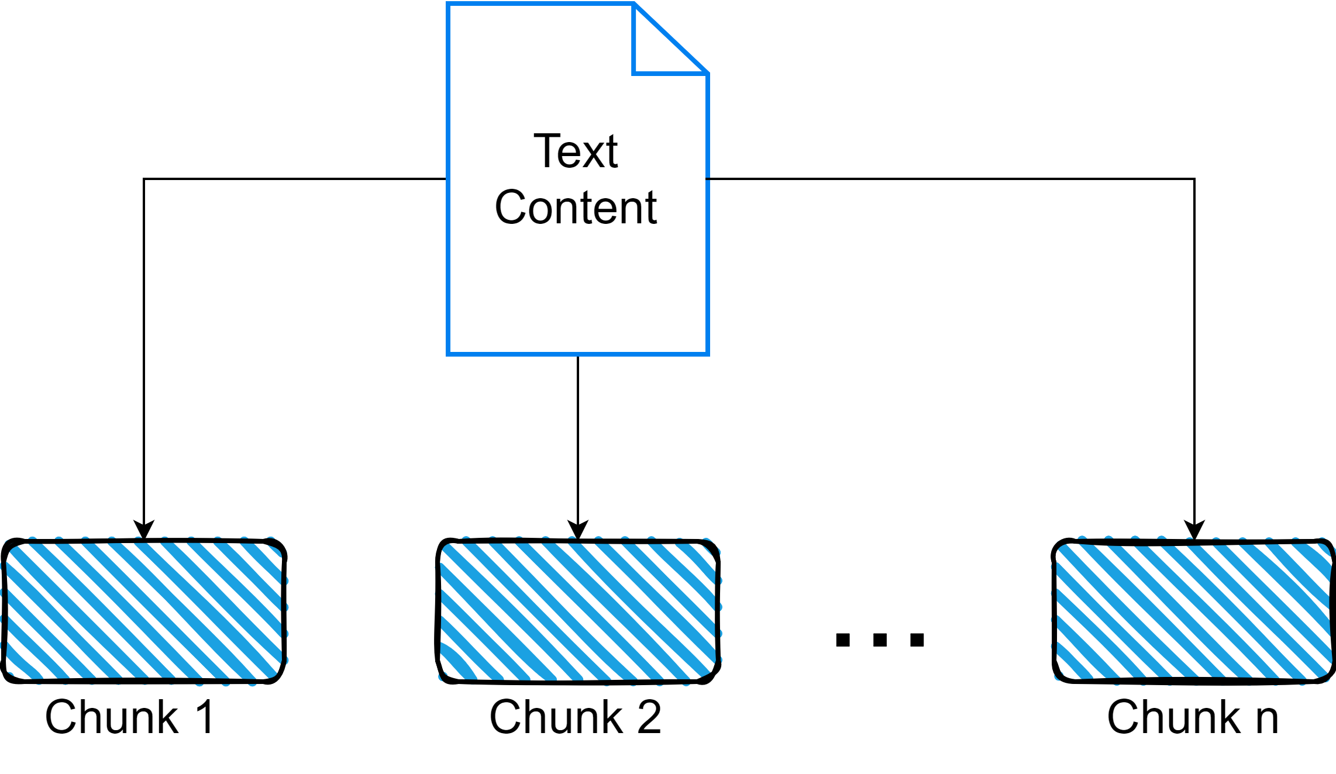
Methodology (Cont.)
Preprocessing (Cont.)
Figure 3: Split the Texts into Chunks
Take maximum 6 sentences from the input text
Take maximum 4 sentences from the abstractive summarized text

Slide 11
Methodology (Cont.)
Dataset Collection
Table 3: Statistics of the Dataset for Abstractive Summarization
Total No. of Articles | 19396
Total No. of Summaries | 19396
Maximum No. of Words in Articles | 401
Maximum No. of Words in Summaries | 65
Minimum No. of Words in Articles | 312
Minimum No. of Words in Summaries | 49
Collected 19096 articles and their summaries from BANS dataset
Manually collected 300 article-summaries pairs on our own.

Slide 12
Methodology (Cont.)
Dataset Collection (Cont.)
Table 4: Statistics of the Dataset for Extractive Summarization
Total No. of Articles | 300
Total No. of Summaries | 700
Maximum No. of Words in Articles | 324
Maximum No. of Words in Summaries | 43
Minimum No. of Words in Articles | 260
Minimum No. of Words in Summaries | 34
Collected 200 data points, each with three summaries from a public dataset named BNLPC
Manually collected 100 articles each with one summary on our own.

Slide 13
Methodology (Cont.)
Model Design (Bangla-T5) [3]
A seq2seq model specially designed for Bangla NLG tasks.
A bidirectional and auto regressive transformer.
Generates abstractive summary.
Normalization, tokenization, and cleaning of the input text.
Pretrained on the Bangla2B+ dataset, which contains 27.5 GB of clean Bangla text.

Slide 14
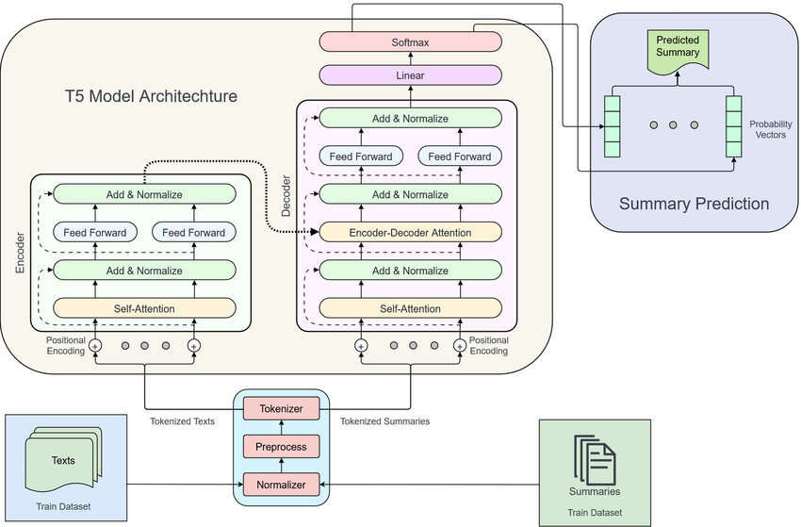
Methodology (Cont.)
Figure 4: T5 Model
Architecture [7]

Slide 15
Methodology (Cont.)
Model Design (Bangla-T5)[3]
Self-Attention Layer: Captures relationships between words to focus on key parts of the text.
Feed-Forward Network: Processes the self-attention output to capture nonlinear transformations.
Layer Normalization: Stabilizes learning and improves efficiency
Encoder-Decoder Attention: Helps the decoder focus on relevant parts of the encoded input while generating the summary.
Linear Layer: Converts the decoder’s output into a logits vector.
Softmax Layer: Converts the logits vector into probabilities to predict the most likely summary words.
Encoder
Decoder

Slide 16
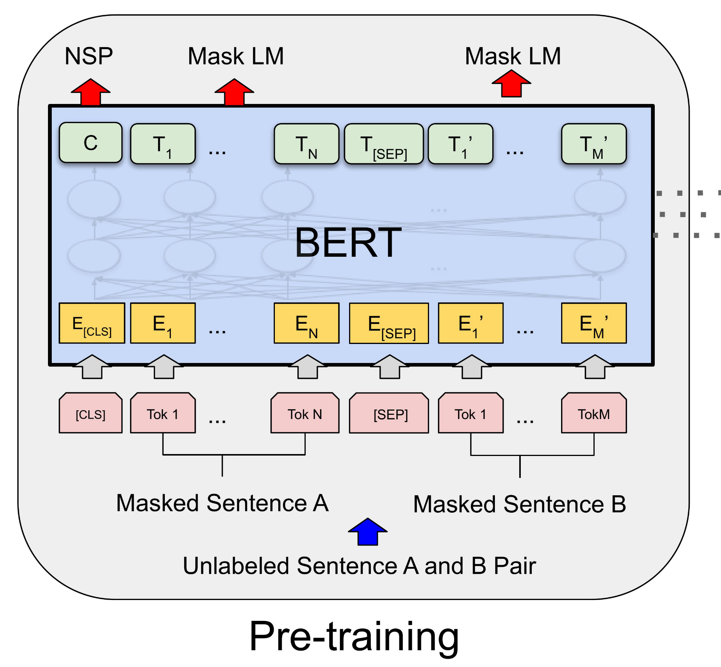
Methodology (Cont.)
Model Design (Bangla-BERTSum)
i) Bangla-BERT
Based on BERT
Pre-trained with a large Bangla dataset
Not capable of extractive summarization
Encoder only architecture
Bidirectional
Self attention mechanism for capturing context
Figure 5: Architecture of BERT [8]

Slide 17
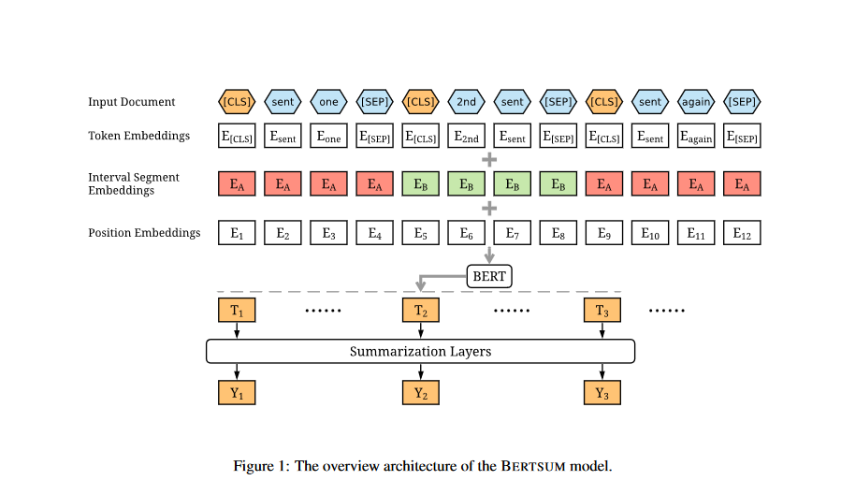
Methodology (Cont.)
Model Design (Bangla-BERTSum)
ii) BERTSum
Based on BERT
Not pretrained on Bangla
Can process multiple sentences
Replaces last layer of BERT by a binary
classifier layer
Scoring based on attention
Can generate extractive summary
Figure 6: Architecture of BERTSum [5]

Slide 18

Methodology (Cont.)
Model Design (Bangla-BERTSum)
iii) Replace the BERT base of BERTSum with Bangla-BERT
Bangla-BERTSum
Uses pre-trained Bangla-BERT
Understands Bangla
Can generate extractive Summary
Bangla-BERTSum
BERT
Figure 7: Architecture of Bangla-BERTSum
This is our proposed model for extractive summarization in Bangla

Slide 19
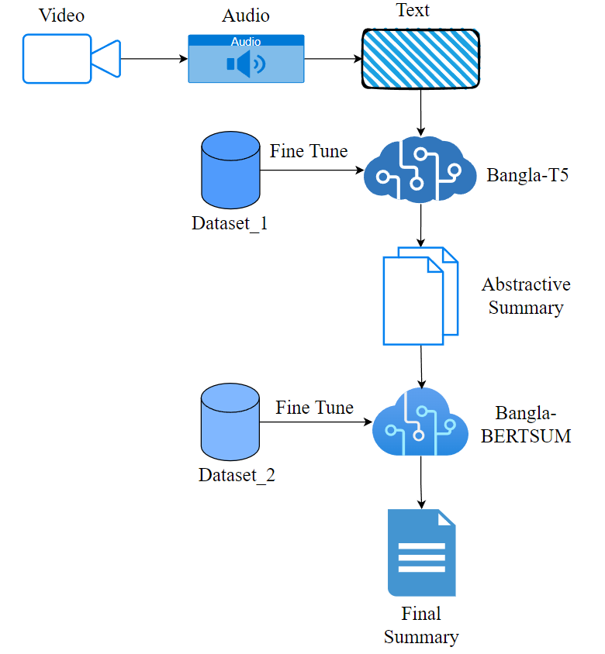
Methodology (Cont.)
Why not only extractive?
Spoken data may deviate from formal sentence structure
Why not only abstractive?
May result in long summaries
Why not extractive before abstractive?
Abstractive summaries take longer data to capture context
Figure 8: Our Proposed Model Architecture (BanglaSUM)
This is our proposed sequence is first abstractive then extractive

Slide 20
Result Analysis
Table 5: Quantitative Results
Method | ROUGE-1 | ROUGE-2 | ROUGE-L
Abstractive only | 2.04% | 0.1% | 2.04%
Extractive after Abstractive | 4% | 1.1% | 4%
Abstractive after Extractive | 3.01% | 0.2% | 3.01%

Slide 21
Result Analysis (Cont.)
Table 6: Qualitative Result
Expected Summary | বাংলাপিডিয়া বাংলাদেশের জাতীয় জ্ঞানকোষ, যা ১৪৫০ জন পণ্ডিতের সৃজনশীল কাজের মাধ্যমে প্রাচীন থেকে বর্তমান পর্যন্ত বাংলাদেশের গুরুত্বপূর্ণ বিষয়সমূহ অন্তর্ভুক্ত করেছে। এটি শিক্ষক, শিক্ষার্থী, গবেষক ও সাধারণ পাঠকদের জন্য অপরিহার্য একটি উৎস, যা জাতীয় ও আন্তর্জাতিকভাবে প্রশংসিত হয়েছে। বর্তমানে দ্বিতীয় সংস্করণটি (২০১২) প্রথম সংস্করণ (২০০৩)-এর একটি পরিবর্ধিত ও হালনাগাদ রূপ হিসেবে প্রকাশিত হয়েছে। অনলাইন সংস্করণে কোন ভুল বা অসংগতি থাকলে তা সংশোধনের জন্য অবহিত করার অনুরোধ করা হয়েছে।
Abstractive Only | The current version (2012) is the national encyclopedia of Bangladesh. এটি বাংলাদেশের জাতীয় জ্ঞানকোষ বাংলাপিডিয়া - বাংলাদেশের একটি জাতীয়জ্ঞানকোষ। (২০০৩) (২০১২) (২০১১) - আমাদের সাথে থাকুন। Stay tuned. (হালকা) করা হয়েছে।
Extractive after Abstractive | The current version (2012) is the national encyclopedia of Bangladesh. এটি বাংলাদেশের জাতীয় জ্ঞানকোষ বাংলাপিডিয়া - বাংলাদেশের একটি জাতীয়জ্ঞানকোষ।
Abstractive after Extractive | বাংলাপিডিয়া - বাংলাদেশের জাতীয় জ্ঞানকোষ। Please inform us of any errors or irregularities in the online Banglapedia - Bangladesh National Encyclopedia of Bangladesh, Bangladesh.- Bangladesh অনলাইনু অনলাইনীী BanglaPedia - The Bangladesh national encyclopaedia Please let us know.

Slide 22
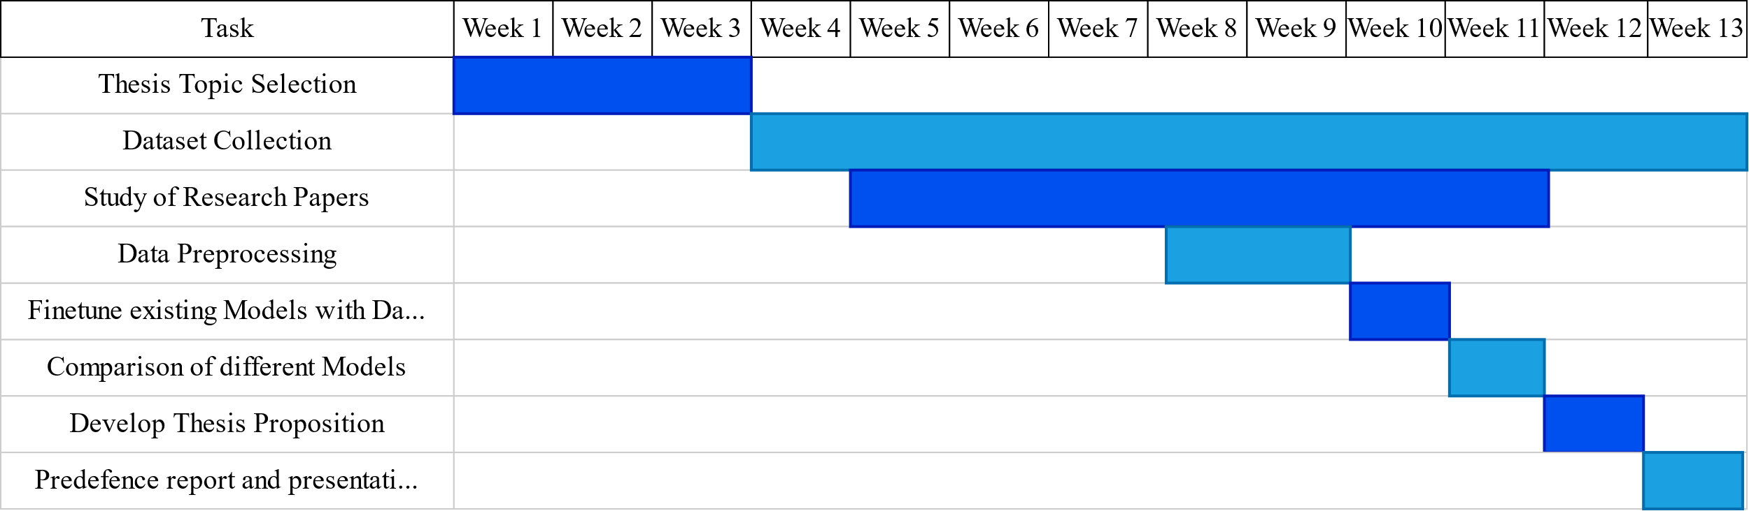
Thesis Planning
Figure 9: Thesis Progress in 4-1

Slide 23
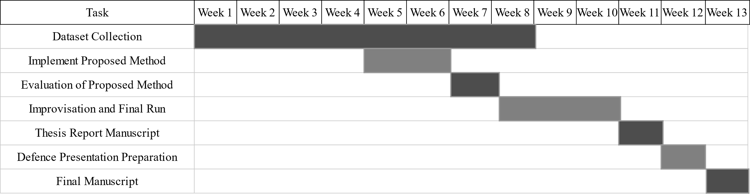
Thesis Planning (Cont.)
Figure 10: Thesis Planning in 4-2

Slide 24
Conclusion
Developed a novel approach for summarizing video content.
Applied Bangla-T5 for abstractive summarization to capture the overall context of the video content.
Incorporated Bangla-BERTSum for extractive summarization, ensuring sentence consistency and coherence in the summaries.
Used manually collected datasets and fine-tuned both models on these
Scarcity of large-scale annotated datasets

Slide 25
References
Talukder, Md & Abujar, Sheikh & Masum, Abu Kaisar Mohammad & Hossain, Syed. (2019). Bengali abstractive text summarization using sequence to sequence RNNs. 10.1109/ICCCNT45670.2019.8944839.
Chowdhury, Radia & Nayeem, Mir Tafseer & Mim, Tahsin & Chowdhury, Md & Jannat, Taufiqul. (2021). Unsupervised Abstractive Summarization of Bengali Text Documents. 10.18653/v1/2021.eacl-main.224.
Bhattacharjee, Abhik & Hasan, Tahmid & Ahmad, Wasi & Shahriyar, Rifat. (2023). BanglaNLG and BanglaT5: Benchmarks and Resources for Evaluating Low-Resource Natural Language Generation in Bangla. 726-735. 10.18653/v1/2023.findings-eacl.54.
D. Miller, “Leveraging BERT for extractive text summarization on lectures,” Georgia Institute of Technology, 2024. Available online.
Y. Liu and M. Lapata, “Text summarization with pretrained encoders,” in Proceedings of the 57th Annual Meeting of the Association for Computational Linguistics, pp. 163–171, Association for Computational Linguistics, 2019.

Slide 26
References (Cont.)
M. Kowsher, A. A. Sami, N. J. Prottasha, M. S. Arefin, P. K. Dhar, and T. Koshiba, “Bangla-bert: Transformer-based efficient model for transfer learning and language understanding,” IEEE Access, vol. 10, pp. 91855–91870, 2022.
K. M. Hasib, M. A. Rahman, M. I. Masum, F. D. Boer, S. Azam and A. Karim, "Bengali News Abstractive Summarization: T5 Transformer and Hybrid Approach," 2023 International Conference on Digital Image Computing: Techniques and Applications (DICTA), Port Macquarie, Australia, 2023, pp. 539-545, doi: 10.1109/DICTA60407.2023.00080.
J. Devlin, M.-W. Chang, K. Lee, and K. Toutanova, “BERT: Pre-training of deep bidirectional transformers for language understanding,” Proceedings of the 2019 Conference of the North American Chapter of the Association for Computational Linguistics: Human Language Technologies, Volume 1 (Long and Short Papers) (J. Burstein, C. Doran, and T. Solorio, eds.), (Minneapolis, Minnesota), pp. 4171–4186, Association for Computational Linguistics, June 2019.D. Miller, “Leveraging BERT for extractive text summarization on lectures,” Georgia Institute of Technology, 2024. Available online.

Slide 27
Thank you

