Slide 1
Teamwork Project
Team "Bast"

Slide 2
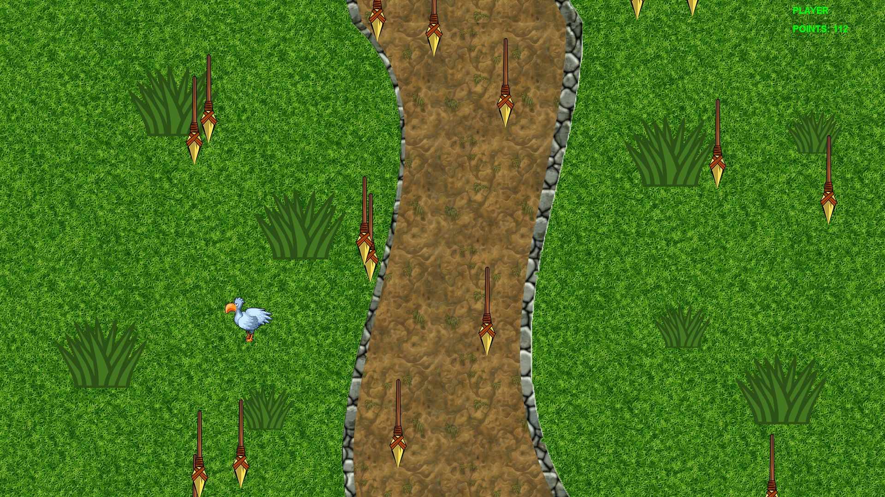
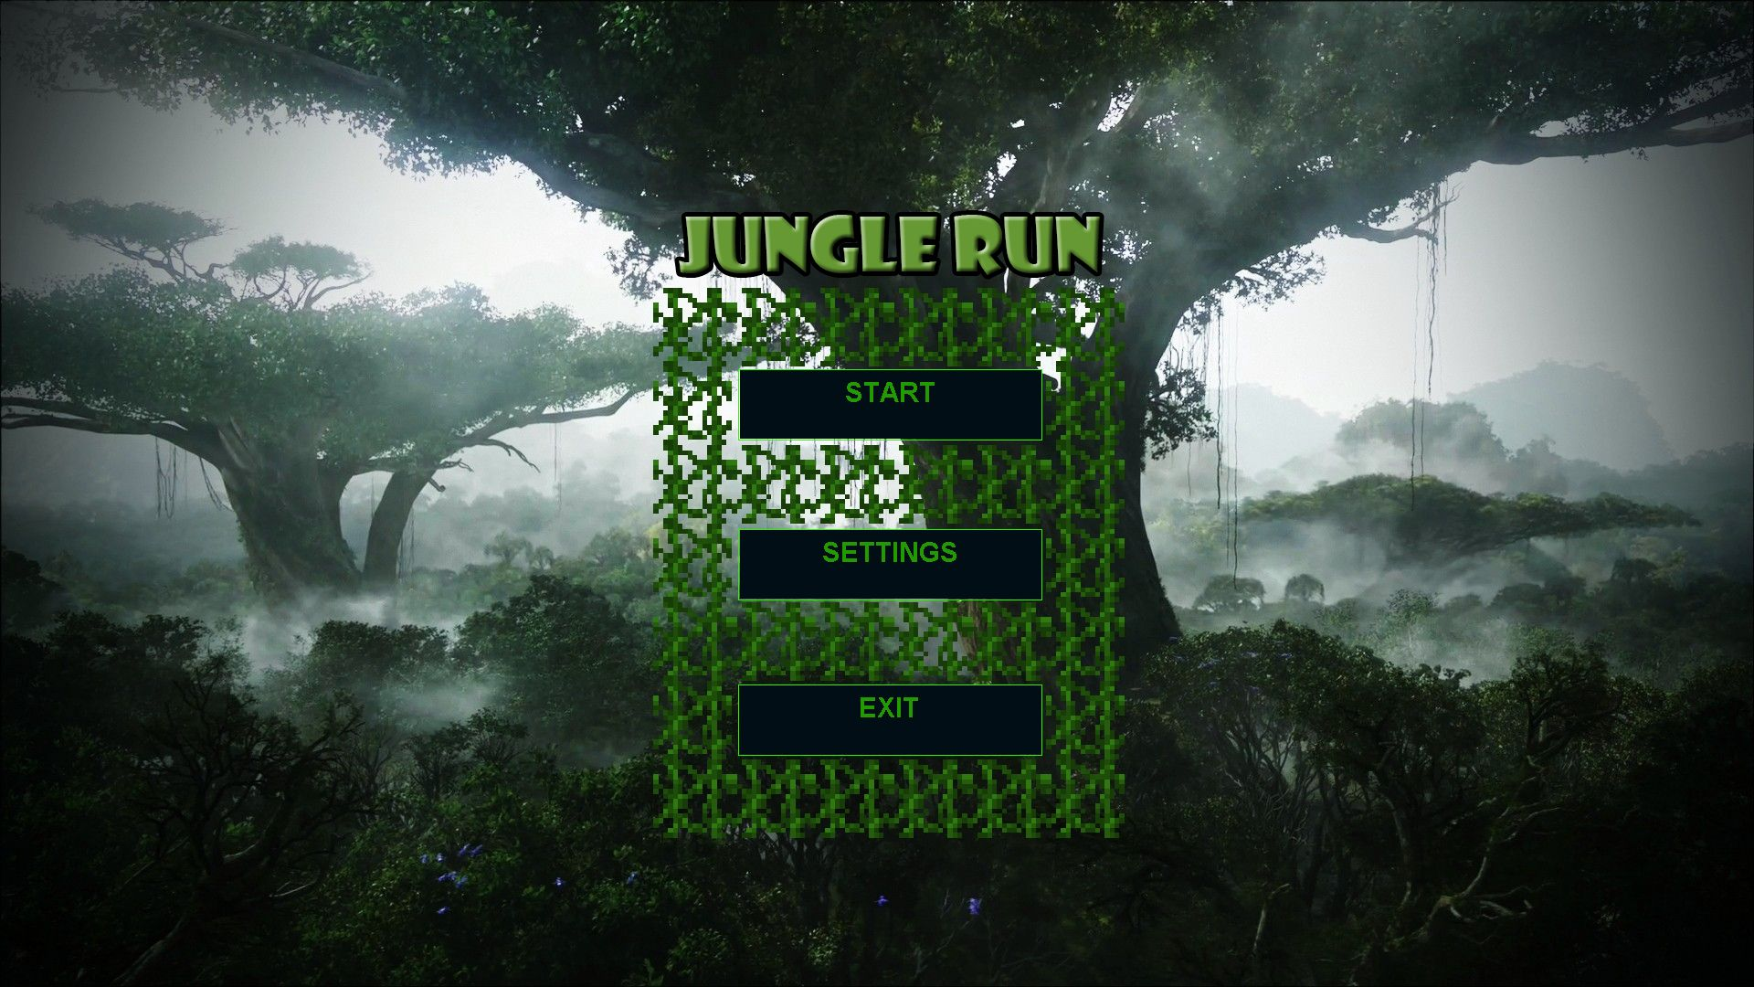
The Game

Slide 3
Game Description
You are a chicken trying to run away from the hungry African tribe.
Dodge all the spears, you have only 2 lifes.
Try to get a lot of points.

Slide 4
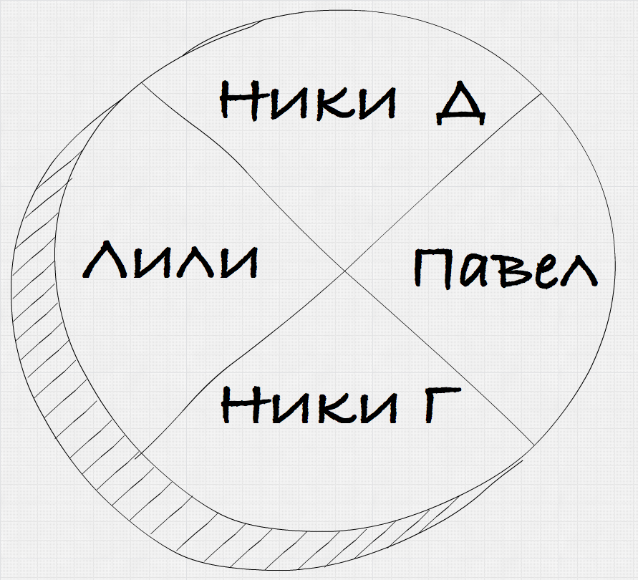
The team

Slide 5

Thanks for your attention

