Slide 1
Game Jams
How to Go From Nothing to a Full Game in 48 Hours
Dominik Lammer

Slide 2

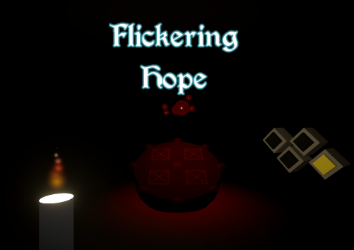
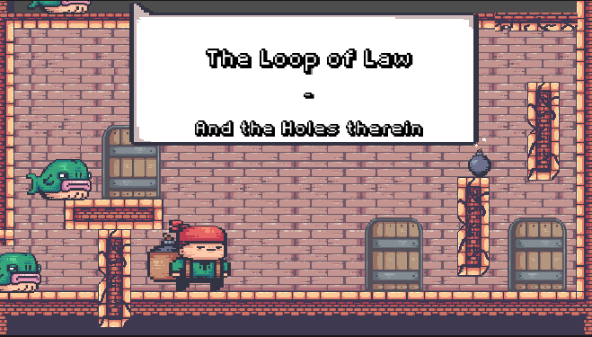
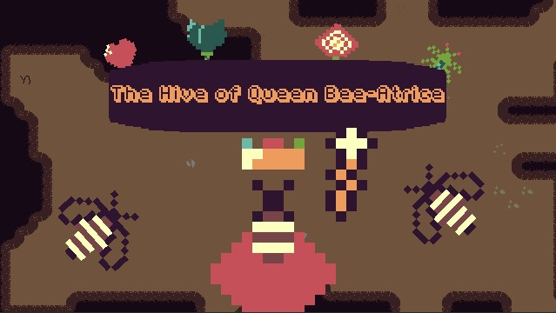
Notes:
You all probably know me from such hit games as:
- Growth Circles
- Flickering Hope
- The loop of Law – And the Holes therein
- The Hive of Queen Bee-Atrice
… or most likely you don’t.
Those games have all been created as part of a game jam. I have never released a commercial game. And allthough I work in the software sector it does not touch game development at all. It is simply something I am passionate about and I would love to kindle that interest in some of you. This presentation will hopefully give you a guiding light of how to manouver your first game jam successfully

Slide 3
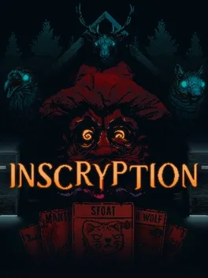
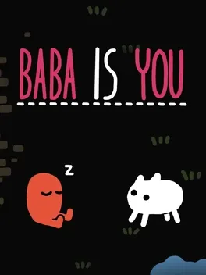
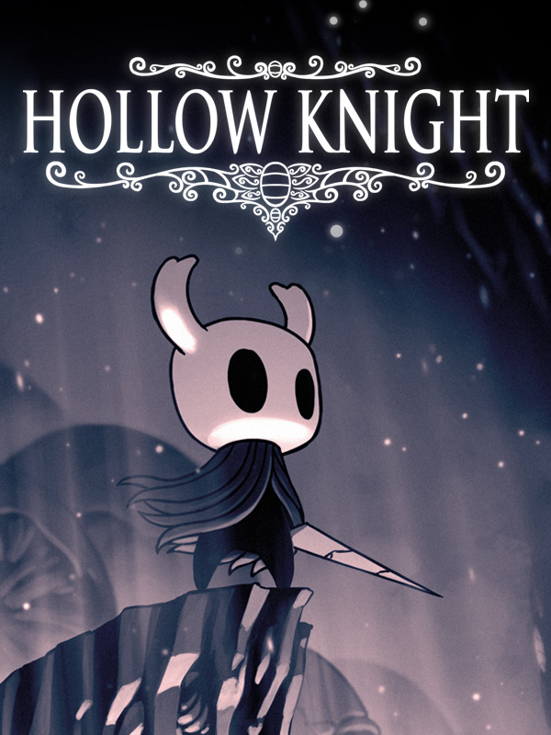
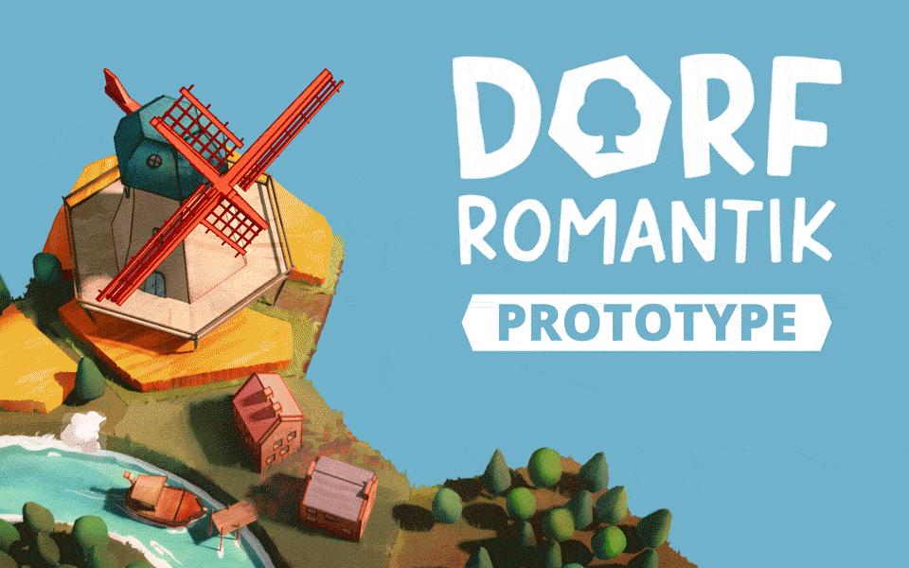
Daniel Mullins Games
Hempuli
Toukana
Team Cherry
Notes:
Some famous games started out as game jams:
Hollow Knight(LD 27) (https://www.newgrounds.com/portal/view/643636),
Dorfromantik(LD46) (https://ldjam.com/events/ludum-dare/46/dorfromantik), Baba is you (Nordic Game Jam 2017) (https://hempuli.itch.io/baba-is-you) , inscryption(LD43) (https://ldjam.com/events/ludum-dare/43/sacrifices-must-be-made-2)

Slide 4
Game Jam
Create a game in a limited amount of time
  48-72 hours
  Theme
  Rating
  Idea, code, art, music, sfx, vfx...
Join a team!
Get third party assets
  Recommendations at the end
Notes:
From a few Hours to Months
But most are between 48-72 Hours and fit nicely into a weekend of getting completely lost in a creative maelstrom
Theme often a phrase, sometimes voted on by the community
Rating on different categories, Visuals, Fun, Innovation, etc
Some have prices most don’t
Some make you share the source code

Slide 5
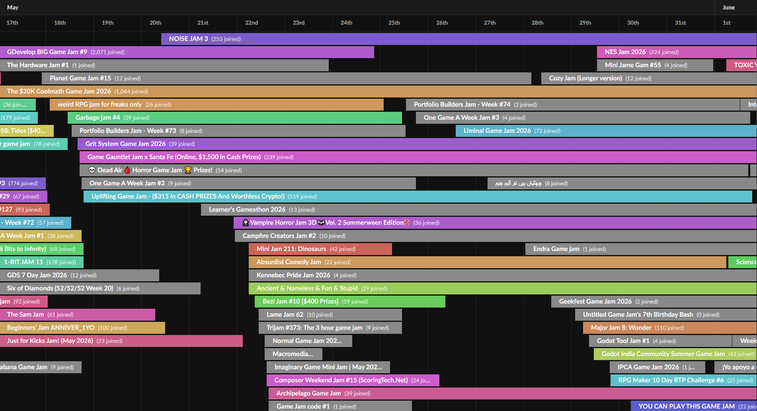
Where to find the Game Jam for you?
Itch.io
Ludum Dare
Global Game Jam
  Stuttgart
  Freiburg
Notes:
Most can be found on itch.io
There are literaly hundreds of Jams you could join
All with their own set of rules and incetives
Biggest GMTK over 37 thousand participants and over 9 thousand submitted games
Ludum Dare as one of the most influential ldjam.com most of the games metioned previously came from here. The first jam took place in 2002
https://globalgamejam.org/ largest in person all around the world Stuttgart, Freiburg, many other places.
Last weekend of January

Slide 6
From Theme To Idea
1-2 Hours
Brainstorm
  Chat with others!
Notes:
Mindmap
Association
Wikipedia
Synonyms
Translations

Slide 7
From Theme To Idea
WiFi
Radar
Signal
Morse Code
Flags
Social Queues
Animals
Notes:
The messaging app…
Flag system for ships
During a walk
You never know from where you will get an idea

Slide 8
From Theme To Idea
1-2 Hours
Brainstorm
  Chat with others!
Central game mechanic
Make a plan
Notes:
Mindmap
Association
Wikipedia
Synonyms
Translations

Slide 9
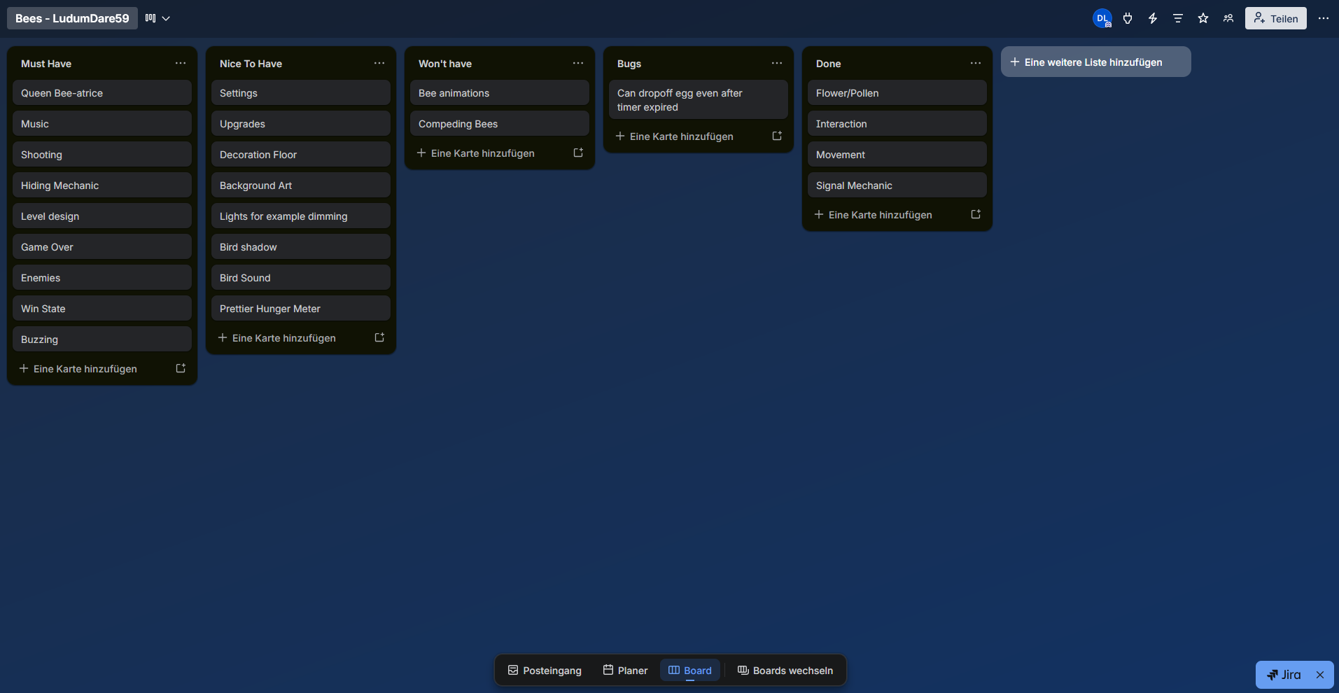
Plan
Must have
Nice to have
Won’t have
Split across team members
Notes:
Mindmap
Association
Wikipedia
Synonyms
Translations

Slide 10
Game Engines
Framework
  Physics
  Rendering
  Audio
Engine | Focus | Language | Webexport | Open Source
Godot | 2D & 3D | Gdscript C# | ✅ | ✅
Unity | 2D & 3D | C# | ✅
Unreal | 3D | C++
GDevelop | 2D & 3D | Visual | ✅ | ✅
GameMaker | 2D | Visual | ✅

Slide 11

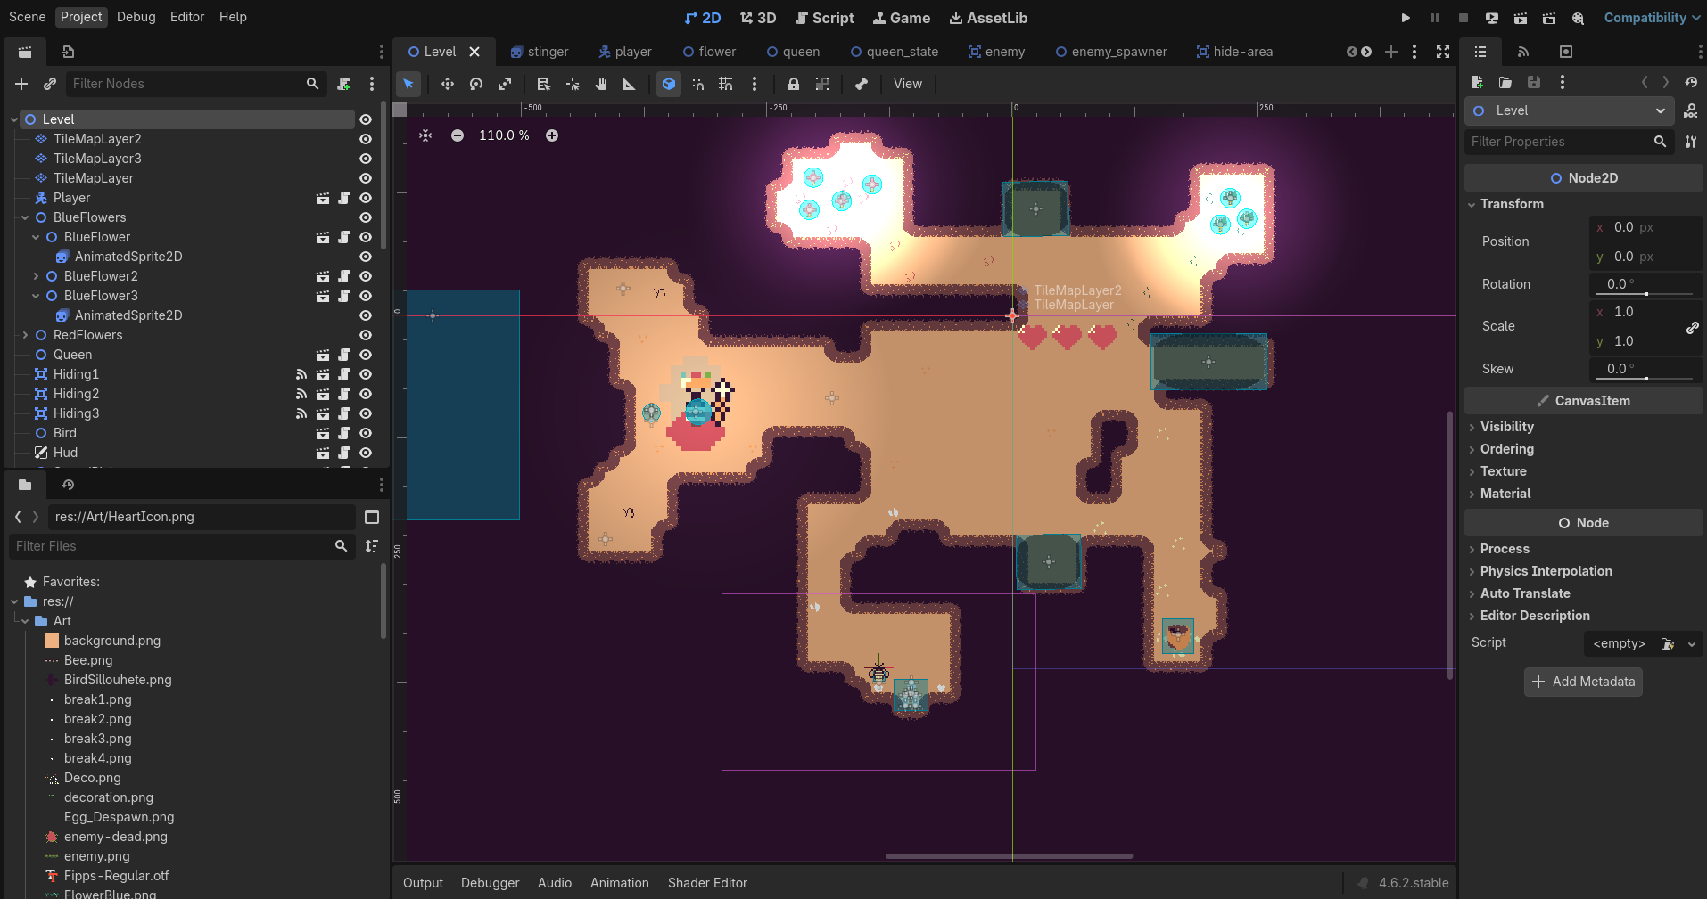
Game Engines

Slide 12
Game Engines
Framework
  Physics
  Rendering
  Audio
Do the tutorial

Slide 13
Implementation
Does not need to be pretty

Slide 14
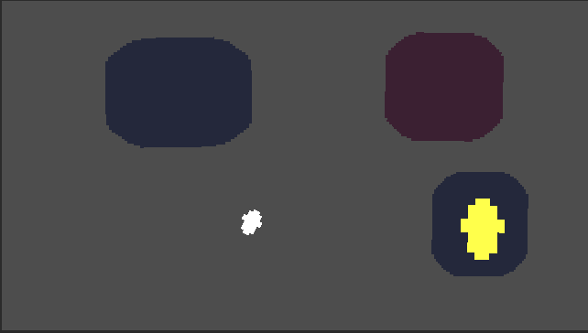
Implementation
Notes:
Central mechanic
Sound queue
Demand from the queen
Grab something

Slide 15
Implementation
Does not need to be pretty
Don’t stress over clean architecture
People will give your game a limited time
  One central mechanic
  Easier than you think
Everything will take slightly longer than you think
Notes:
Strong Coupling
Use singleton

Slide 16
Let other people play test your game!
Notes:
You know your game
You understand the controls and where to go
Others don’t
Don’t intervene just let them play even if they fail
If you can watch someone play your game even better
Friends Family etc

Slide 17
Polish
Good game vs great game
Art
Notes:
Tools that help non musicians make music
8-Bit sfx creators

Slide 18

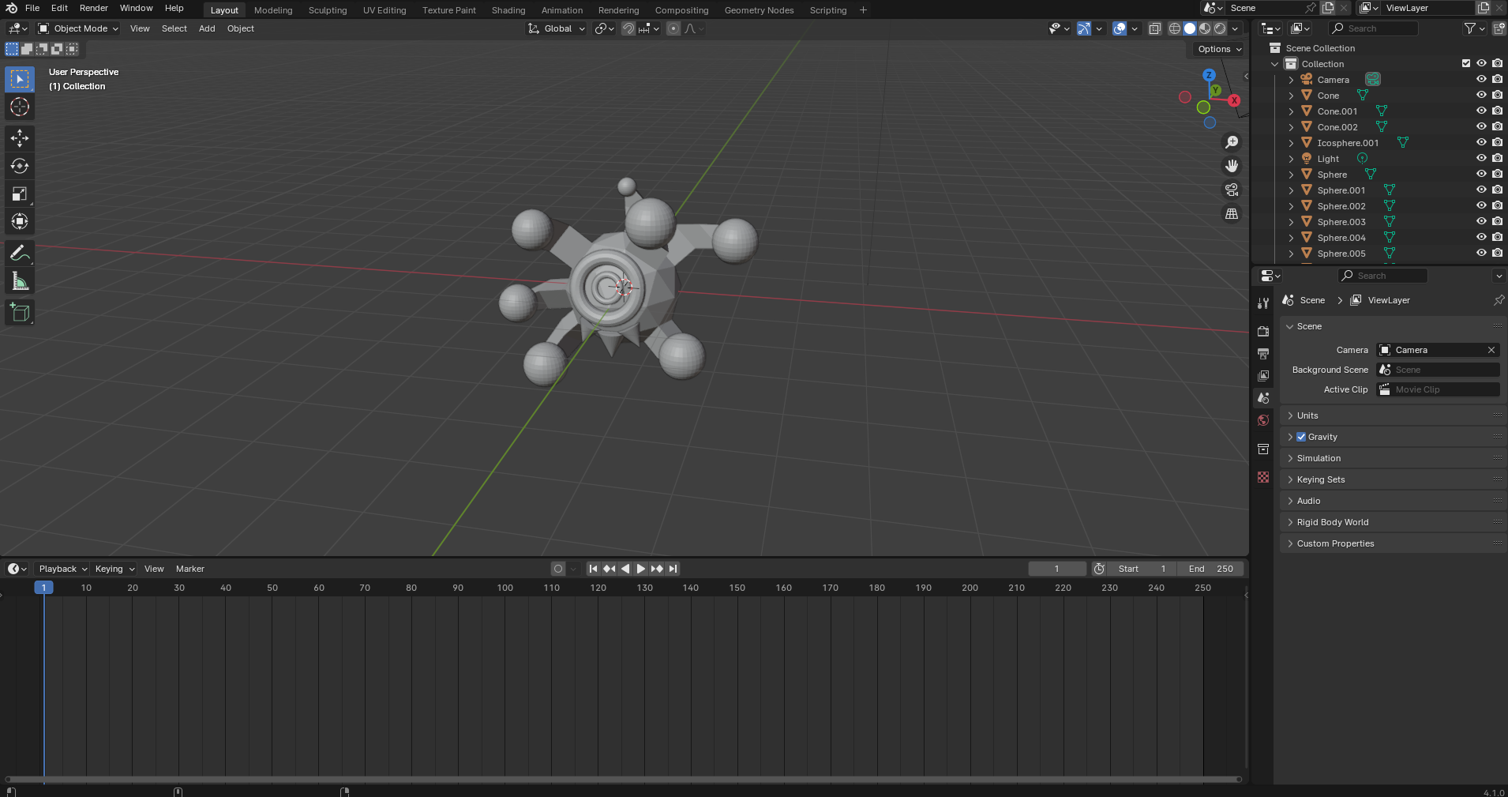
From Placeholder to Art

Slide 19

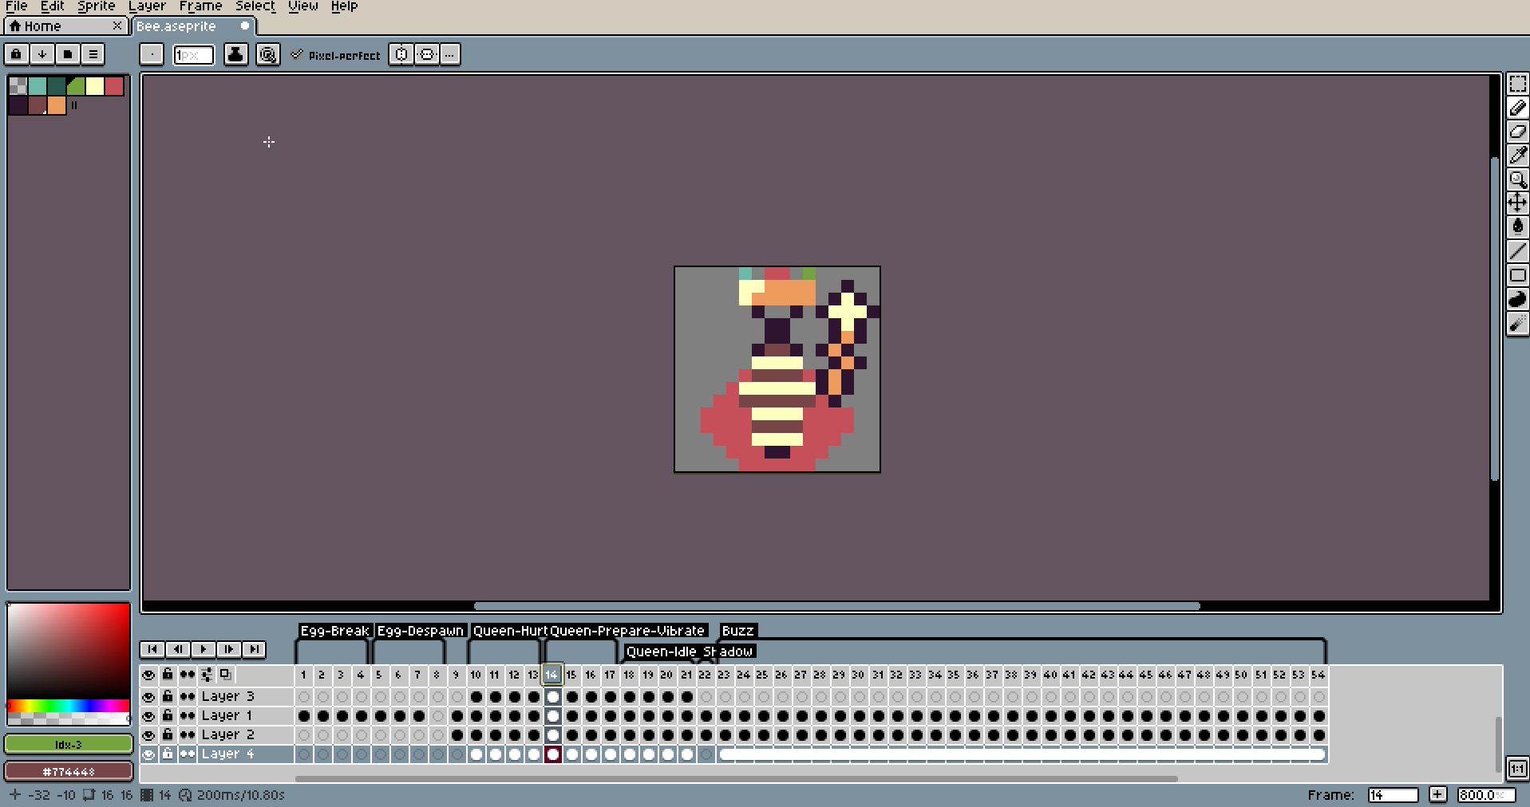
From Placeholder to Art

Slide 20
Polish
Good game vs great game
Art
Music and sound effects
  Voice acting
  Menu
In game tutorial
More oomph!
  Flashing
  Camera shake
Notes:
Tools that help non musicians make music
8-Bit sfx creators

Slide 21
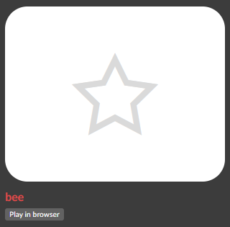
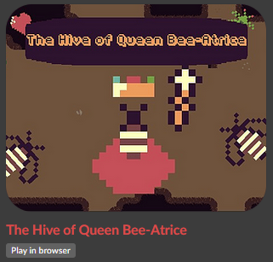
Submitting your game
Submission hour
Play in browser
Test early!
Presentation

Slide 22
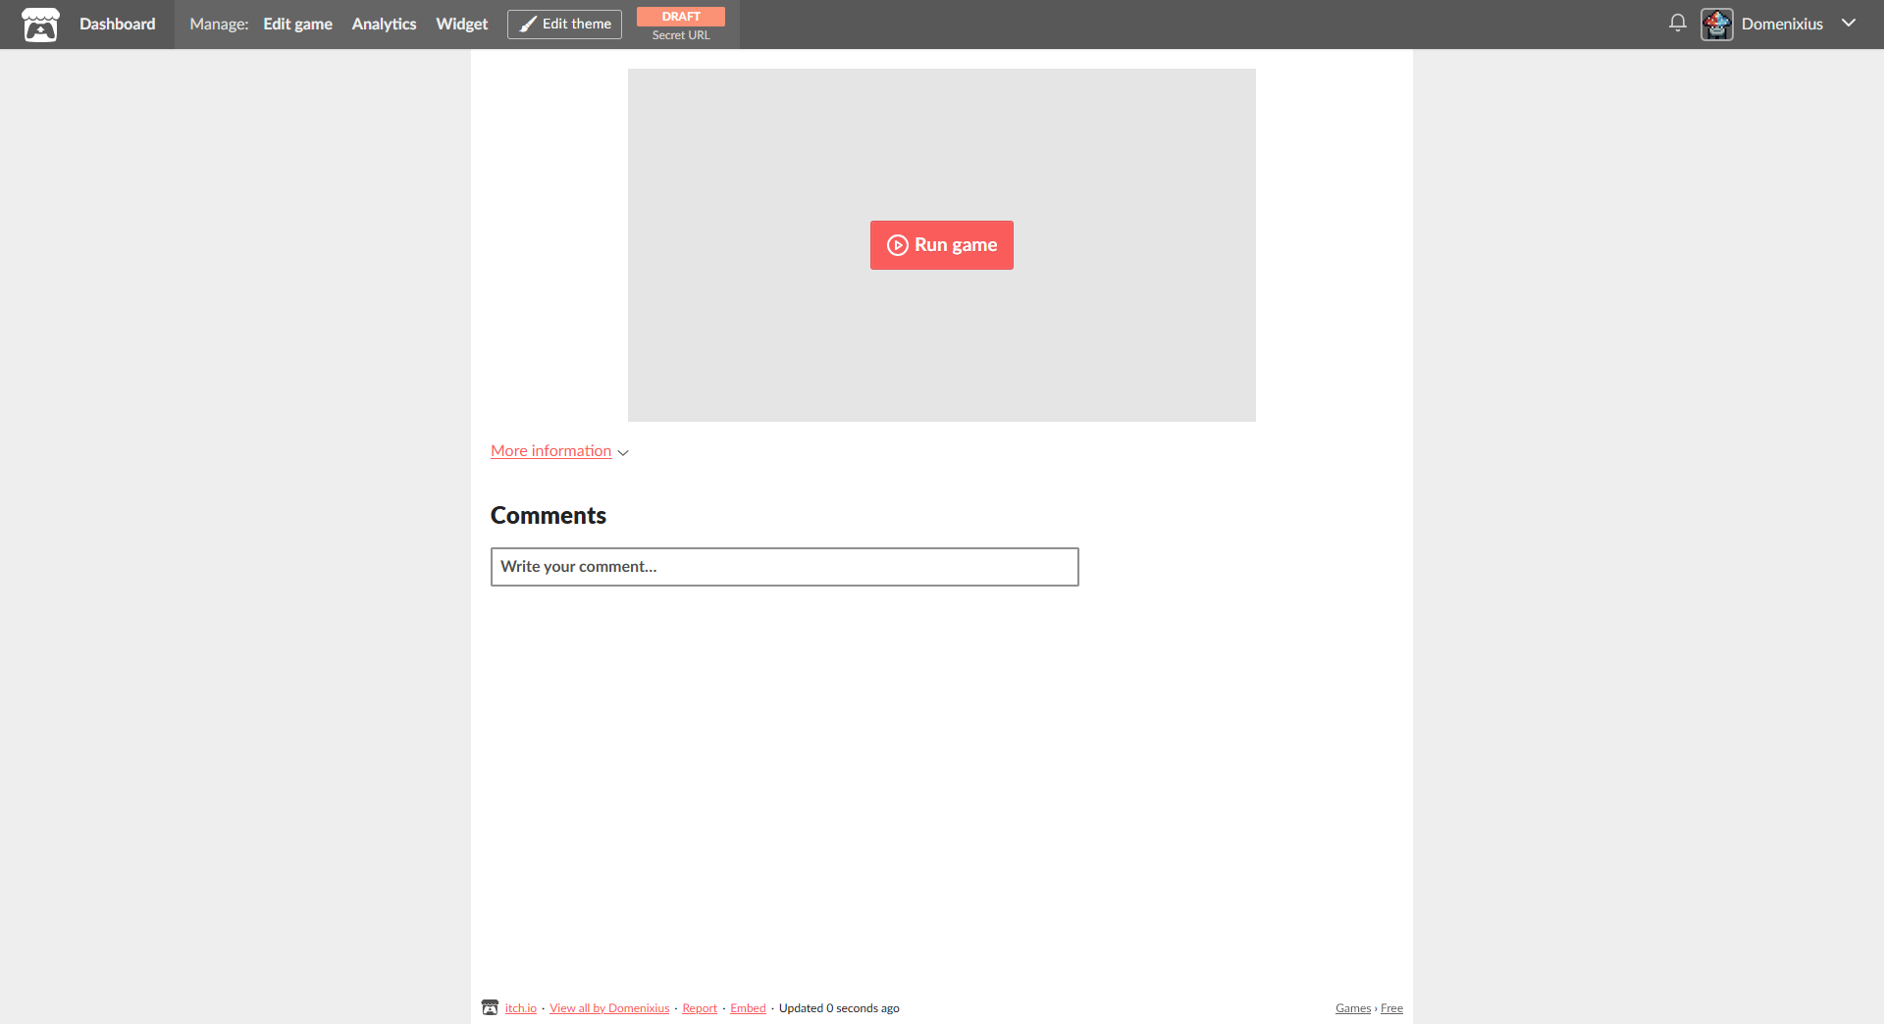
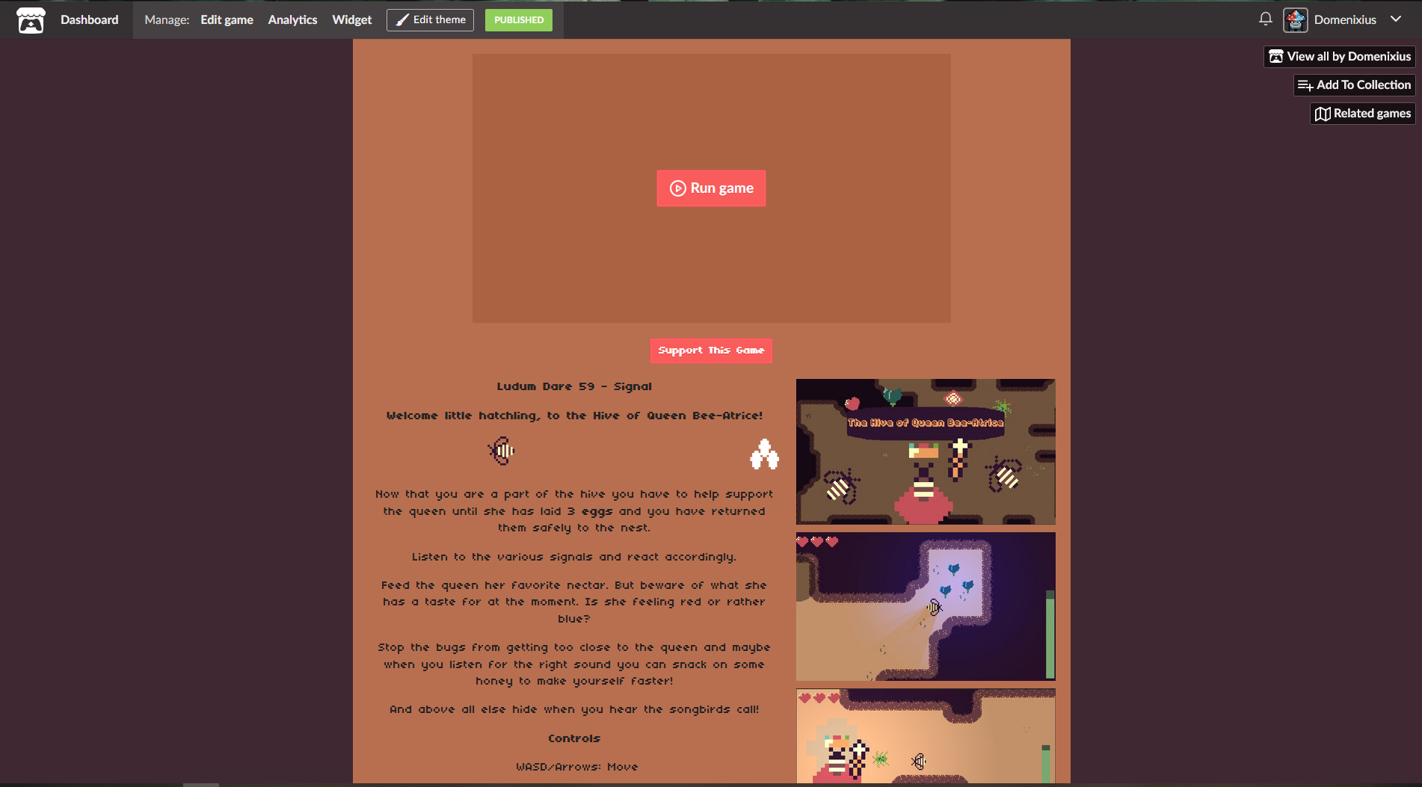
Submitting your game
Submission hour
WebGL
Cover image
Screenshots

Slide 23
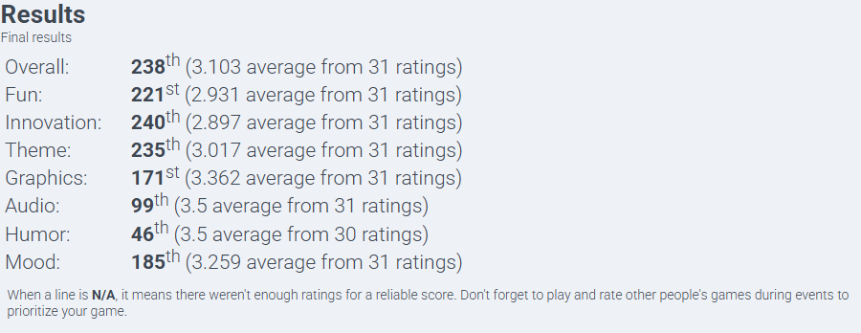
After the submission
Sleep
Play games!
  Rate them
  Give constructive feedback
(hopefully) Get constructive feedback
1-2 week rating period
Notes:
Engage with the community
Maybe watch a live stream of someone playing your game
Or if you are so inclined stream yourself

Slide 24
You made a game!
Notes:
- big and scary and so many parts go into it
- so rewarding
- What you can accomplish in so little time
- welcoming communities out there

Slide 25
Games
Hollow Knight – Team Cherry (2017)
Baba is you – Hempuli (2019)
Inscryption – Daniel Mullins Games (2021)
Dorfromantik – Toukana Interactive (2022)

Slide 26
Game Jams
Itch.io
globalgamejam.org
ldjam.com
  Collection of great jam tips!
  ldjam.com/events/ludum-dare/59/queen-bee-atrice/common-pitfalls-and-how-to-avoid-them

Slide 27
Engines
godotengine.org
unity.com
unrealengine.com
gdevelop.io
gamemaker.io

Slide 28
Make Art
3D – blender.org
2D – asesprite.org
2D – gimp.org

Slide 29
Make Sounds
Music
  beepbox.co (Great for non-musicians)
  lmms.io
Sound effects
  audacityteam.org
  sfxr.me

Slide 30
Find Stuff
Itch.io
opengameart.org
freesound.org
kenney.nl
dafont.com

