Slide 1
COMP2021 Project Presentation
Group 18
Group Members
Lam Chi Yuen (19052423D)
Lam Kwan Lok (19051723D)
Wong Tsz Fung (19059855D)

Slide 2
Overall Architecture of our CVFS

Slide 3
Overall Architecture of our CVFS

Slide 4
Overall Architecture of our CVFS

Slide 5
Overall Architecture of our CVFS

Slide 6
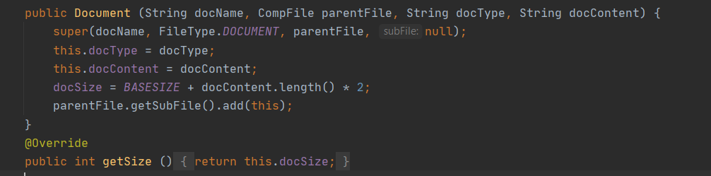
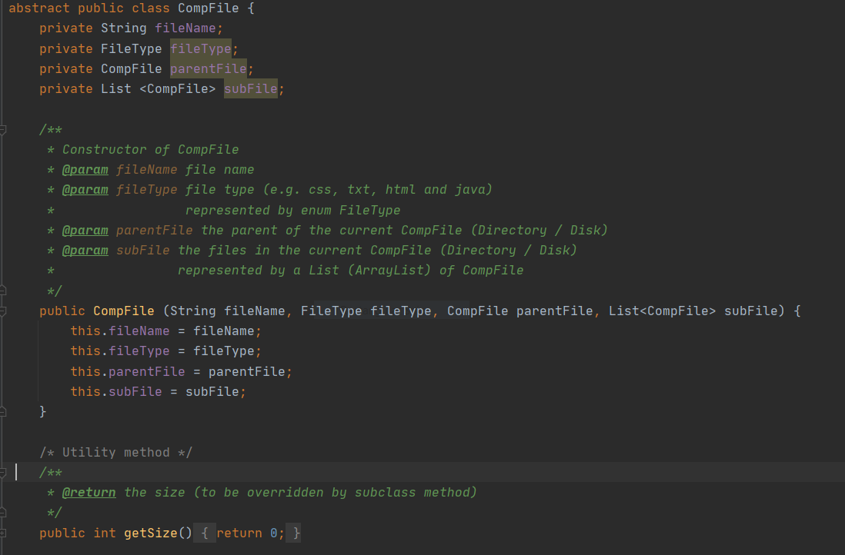
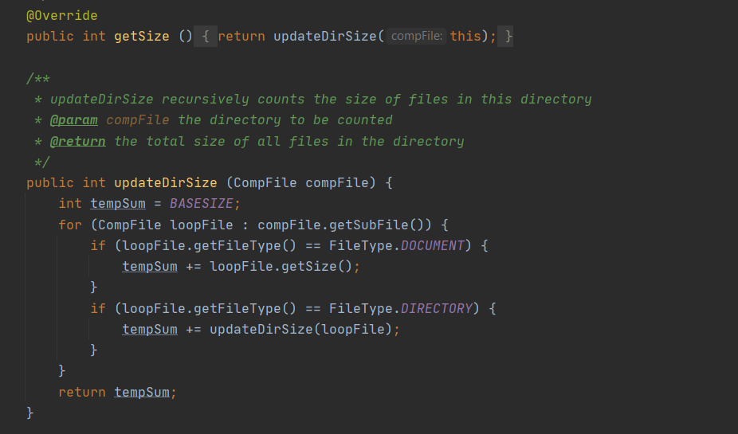
Inheritance and Polymorphism
Inheritance
Abstract class CompFile → Document, Directory and Disk
No need for casting and “instanceof” → less error and more efficient
E.g. calculating the size of a file

Slide 7
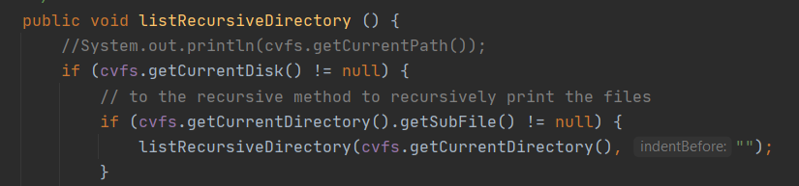
Inheritance and Polymorphism
Polymorphism
Constructor chaining
E.g. Document constructor calling super()
Constructor overloading
e.g. Criteria constructor
Method overriding
e.g. getSize() for different files
Method overloading
E.g. Wrapper for recursive listing

Slide 8
How OOP improve the reusability/scalability?
Inhertiance → Easy to reuse and expand → e.g. File Types
CompFile
Document
Directory

Slide 9
How OOP improve the reusability/scalability?
Encapsulation → Standard for data retrieval → less duplicated code → more reusable
Method1
getter1
Criteria
Method2
getter2

Slide 10
How OOP improve the reusability/scalability?
Encapsulation → Standard for data retrieval → less duplicated code → more reusable
Method1
Criteria
stdgetter
Method2

Slide 11
How OOP improve the reusability/scalability?
Scalability
Need for coordination → OOP provides a standard
Allow efficient and effective code building

Slide 12
The End

