Slide 1
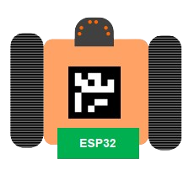

Self-Running Rover
Embedded System Lab
7219288 Nhat Quang Nguyen
7219037 Nhat Lam Nguyen
7219281 Igor Risteski

Slide 2
Outline
AWS
Motor Control & Collision
Rover Direction Algorithm
Demonstration
Conclusion

Slide 3
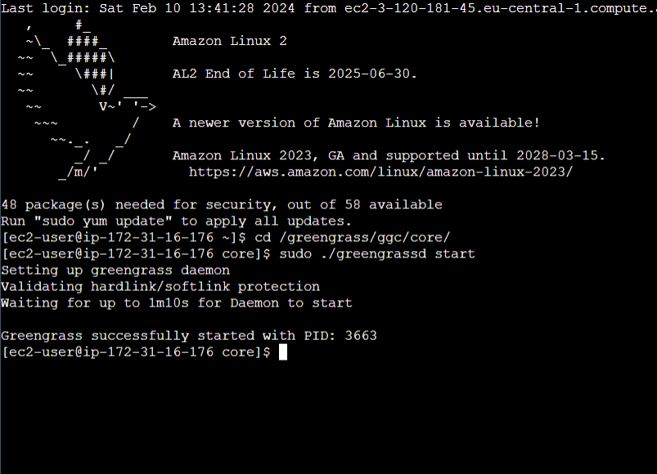
AWS
EC2 Instance

Slide 4
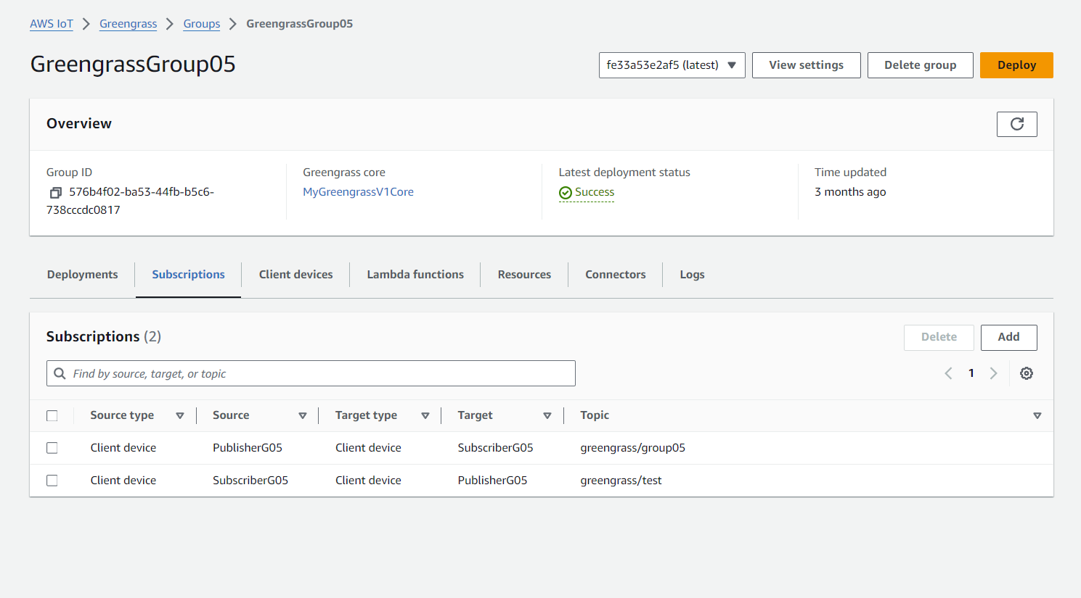
AWS
Greengrass Group & MQTT Subscriptions

Slide 5
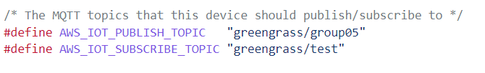
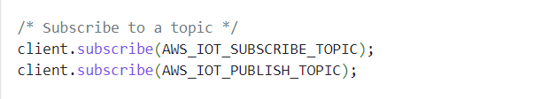
AWS
Setting up the subscription to the topics from the rover in file AWS.cpp

Slide 6
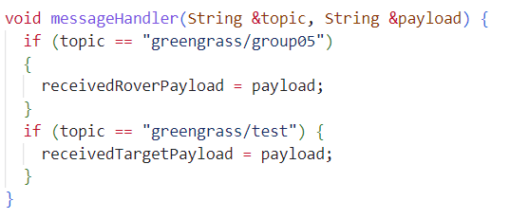
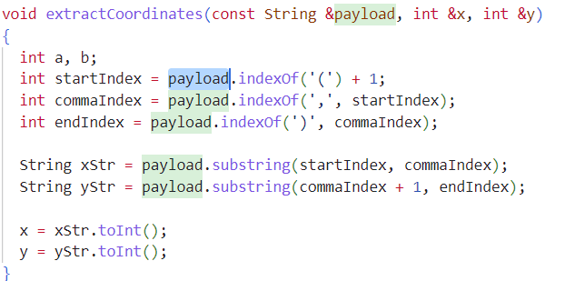

AWS
Function to receive message from AWS in AWS.cpp
Decoding Function to transform the Data from AWS to coordinates from the targe and the rover in main.cpp

Slide 7
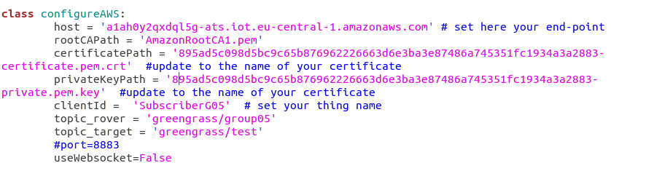
AWS
Configure the AWS Device for the Virtual Machine, which will be sending coordinates data of rover & target to AWS

Slide 8
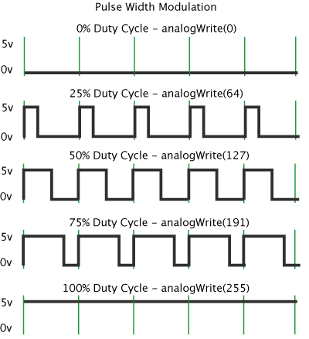
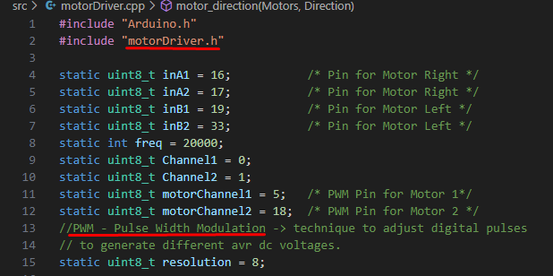
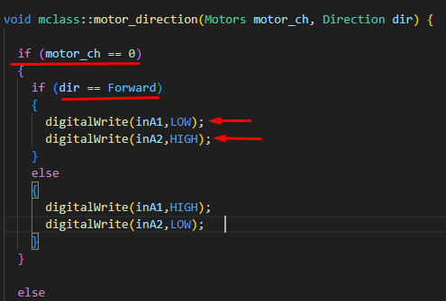
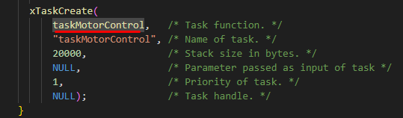
Motor Control
Include needed libraries
motorDriver library
-> Set pins
-> use PWM to control motors
-> control motor direction
Create task for motor control

Slide 9
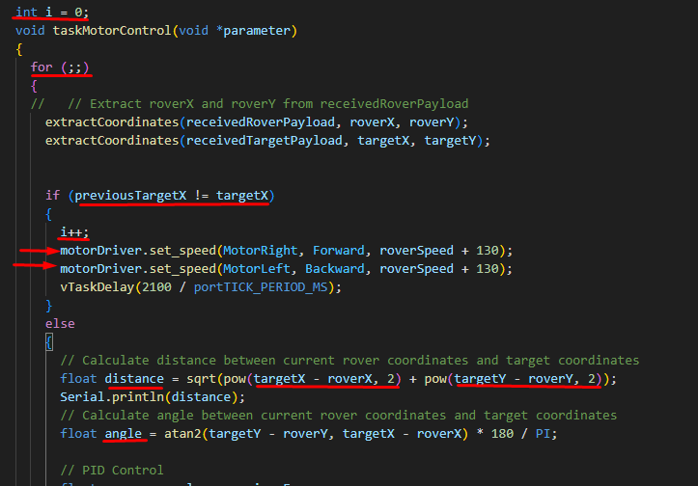
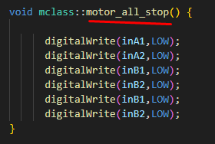
Motor Control - main
Infinite loop
Extract coordinates of rover and current target
Check target and update target num (i)
Rotate in place OR
Calculate smallest distance and angle
Update speeds using PID control
Call stop function when final destinaton reached 3 times

Slide 10
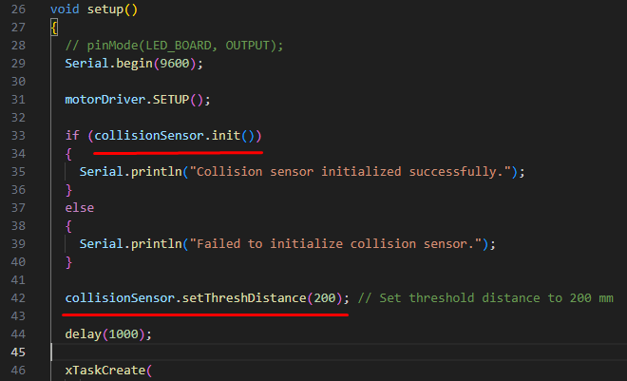
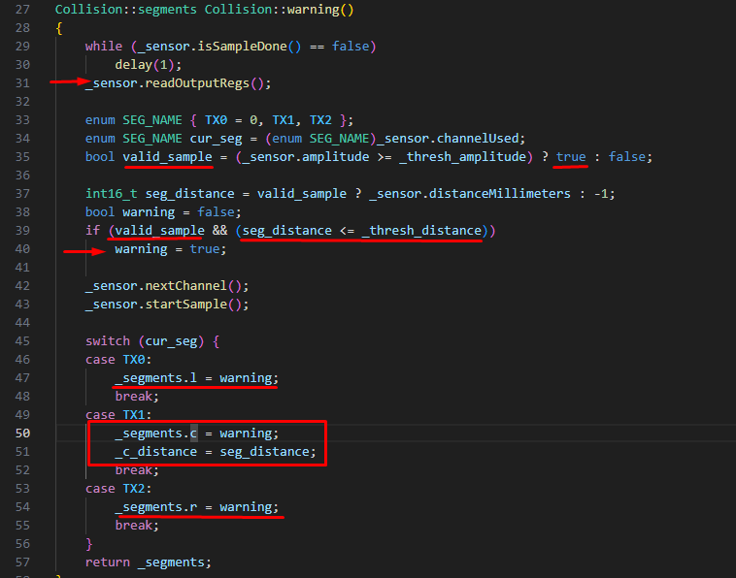
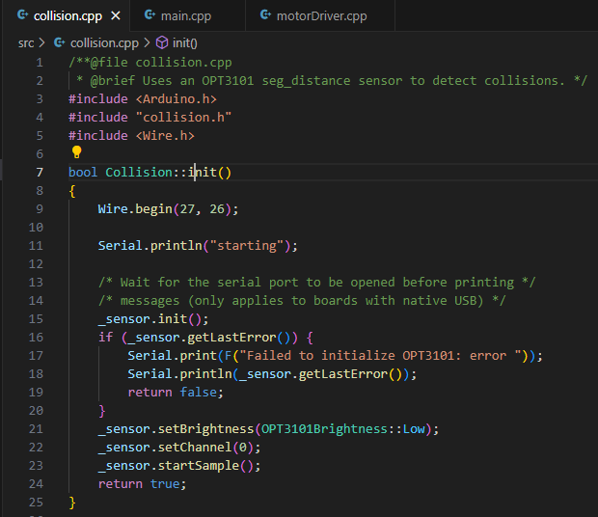
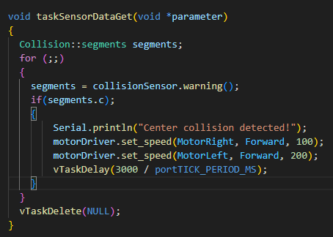
Collision and obstacle avoidance
In setup try to initialize collision sensor (OPT301)
Set threshold distance
Call collision class
Check sample and validity
Check sensor output and compare with threshold distance for all segments
Update motor speeds to turn more towards one side and avoid obstacle

Slide 11
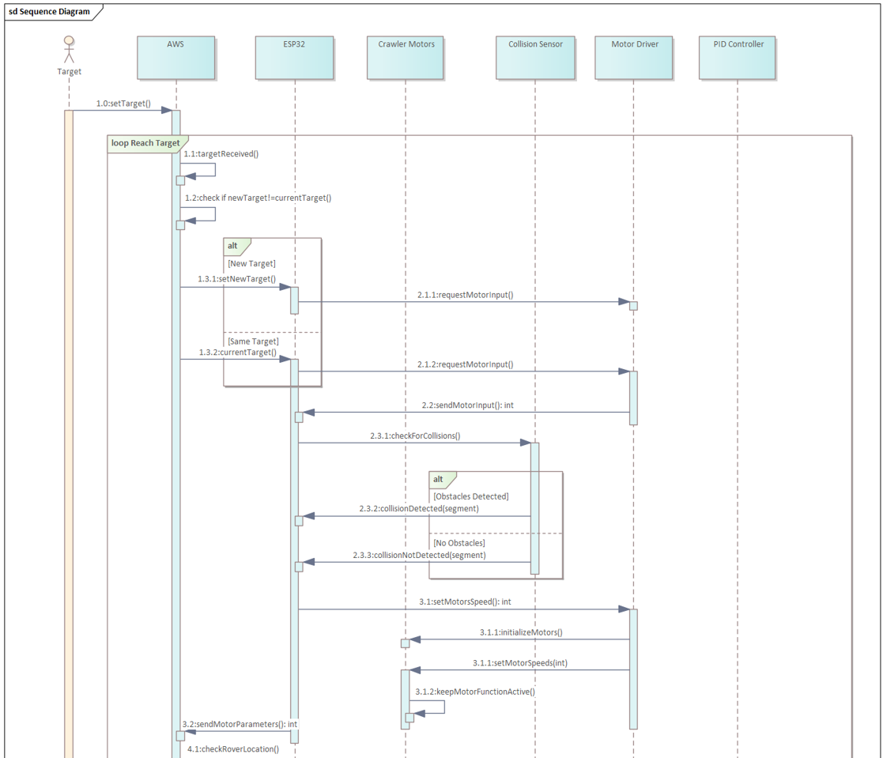
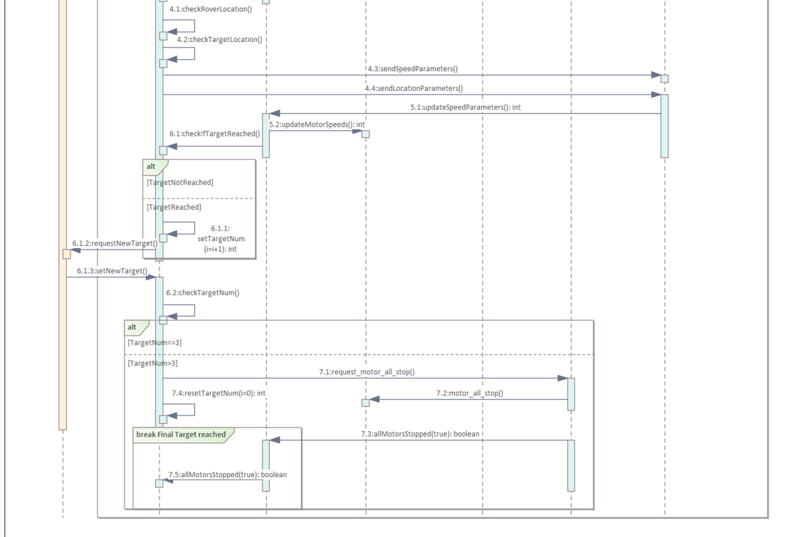
Sequence Diagram
Part 1 Part 2

Slide 12
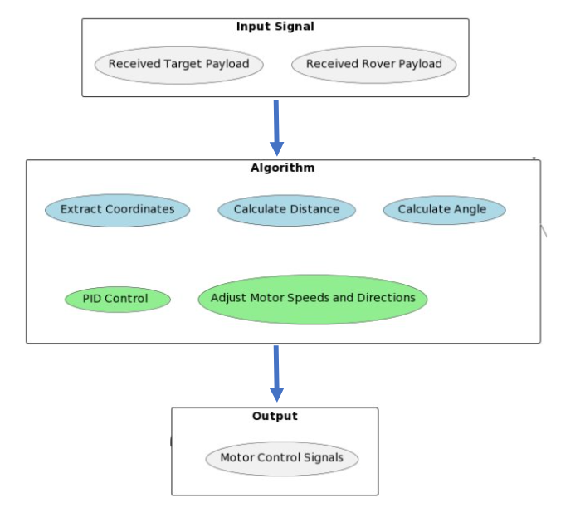
Control Algorithm

Slide 13
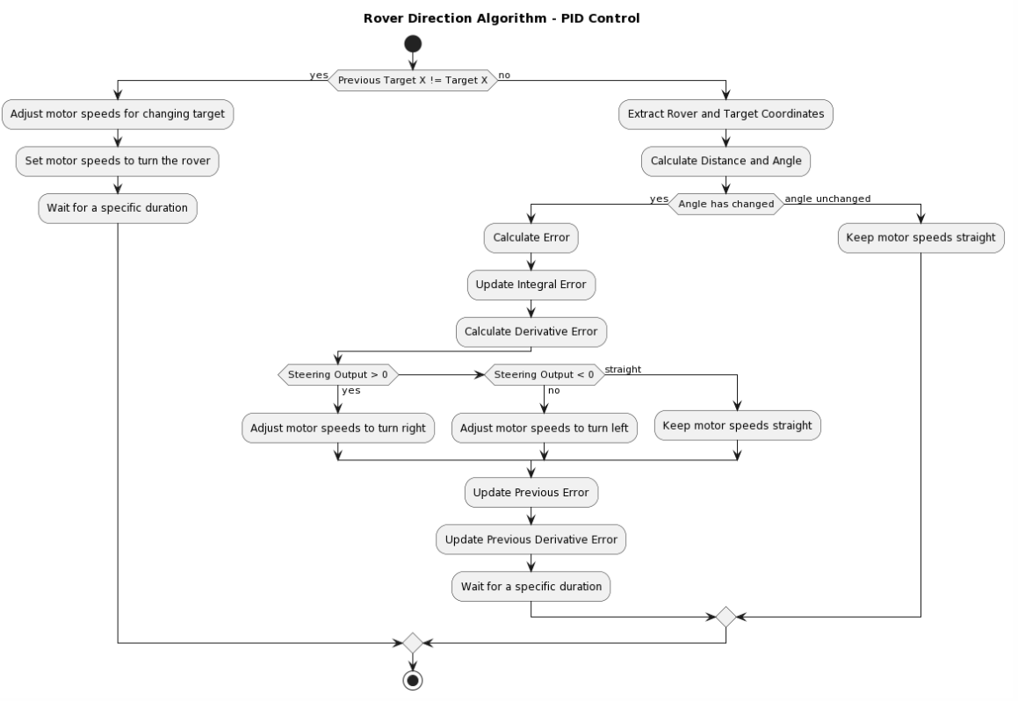
Rover Direction Algorithm

Slide 14
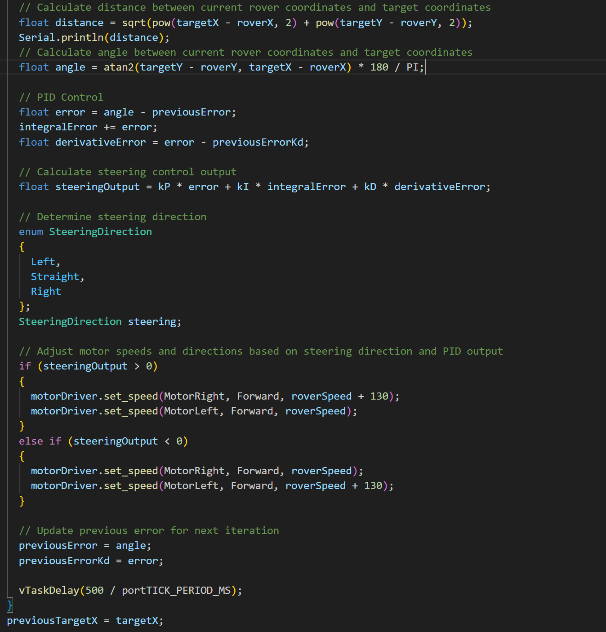
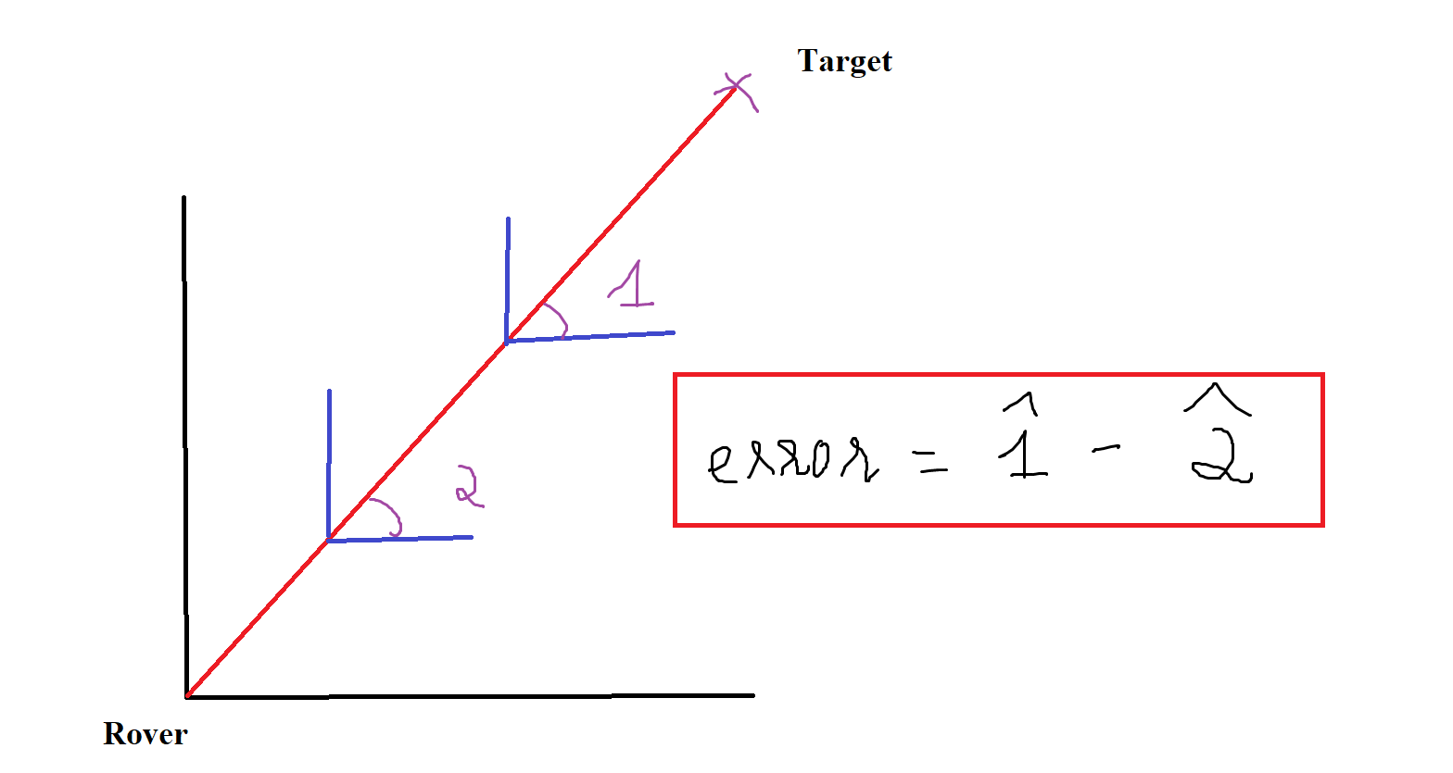
Rover Direction Algorithm

