Slide 1
WeDeliver
A web app for quick, cheap group delivery

Slide 2

Notes:
Let’s talk about a story. Amy wants to buy a new sofa.

Slide 3
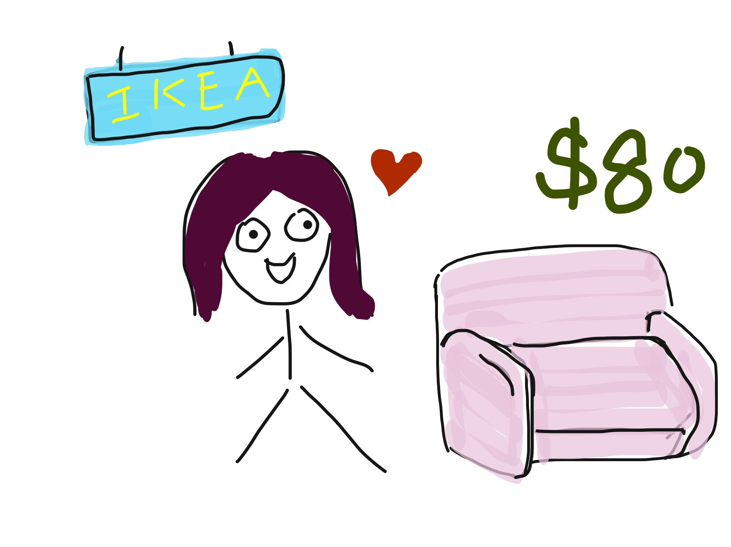
Notes:
So she goes to Ikea and picks a favorite one. The sofa costs her 80 dollars.

Slide 4
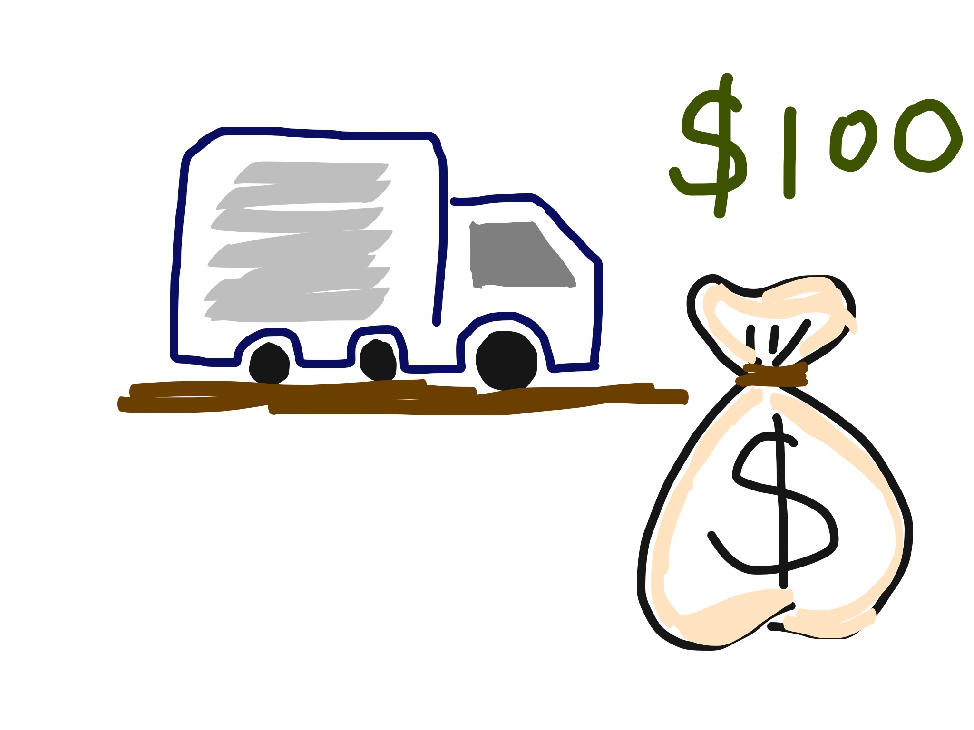
Notes:
Amy cannot drive. So she has to wait in line to pay Ikea extra 100 dollars for delivery. It’s a rather big fee compared with what she paid for the sofa. On the other hand, there are many shipping companies can’t find enough business.
So, why not solve this problem by the idea of group delivery?

Slide 5
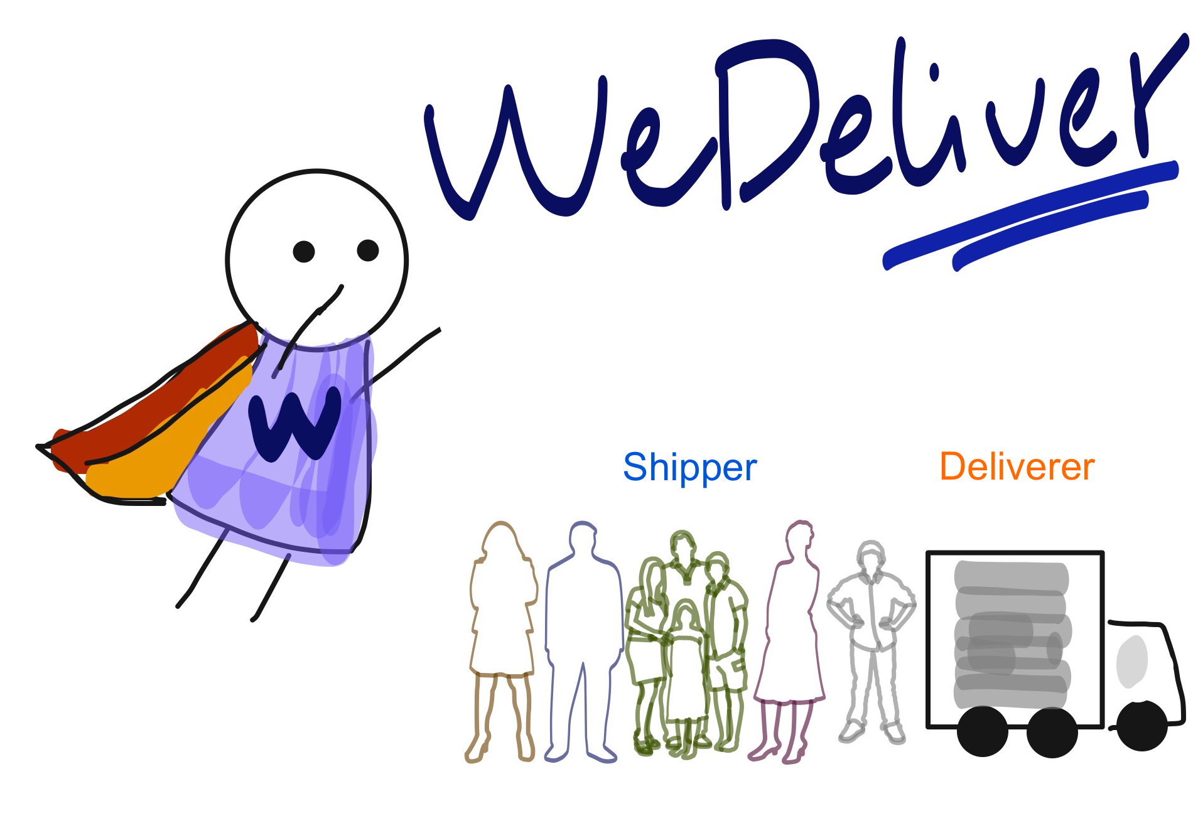
Notes:
Our web application, called WeDeliver, aims at providing a platform to match deliverer’s service with shipper’s requests.

Slide 6
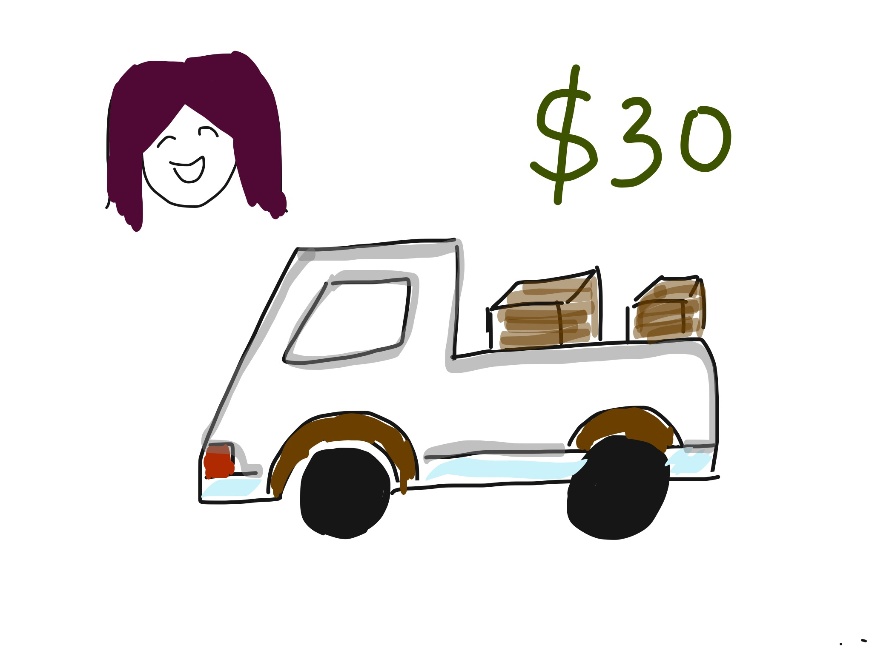
Notes:
By choosing our application, Amy will only spend about 30 dollars or even less for her sofa delivery.

Slide 7
Facts & Motivation
Large population of new students each year
Similar requests
Close location
Well-packed goods
Notes:
Each year, there is a large population of new students. They have similar requests, share close locations. And usually, goods are well-packed. These facts give us great motivations for our business plan.

Slide 8
Two Customers
Shipper (like Amy)
Deliverer (shipping company)
Notes:
In our plan, we classify users into two kinds, shipper and deliverer.
Shipper is the one who has delivery needs.
And deliverer provides delivery service.

Slide 9
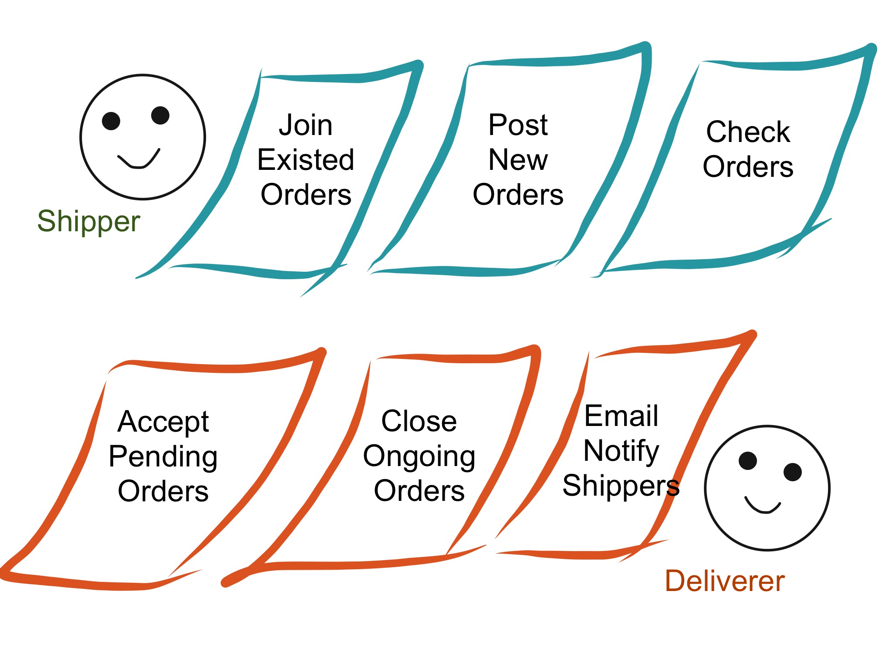
Notes:
These are operations for shippers and deliverers. I’ll show the detail in demo part.

Slide 10
Order Life Cycle
Shipper posts
Initial
Accepted
Closed
Finished
Review
Deliverer accepts
More shippers join;
Deliverer closes
Being delivered
Shipper can rate this order
Notes:
There are four status for an order. Once it’s posted by a shipper, its status is initial. When it’s accepted by a deliverer, its status switched to accepted. So that more shippers can join this order. When the deliverer closes this order, no more shipper can join it. And deliverer is going to ship this order. Once the delivery is done, the status ends up in finished. And shipper can rate this finished order.

Slide 11
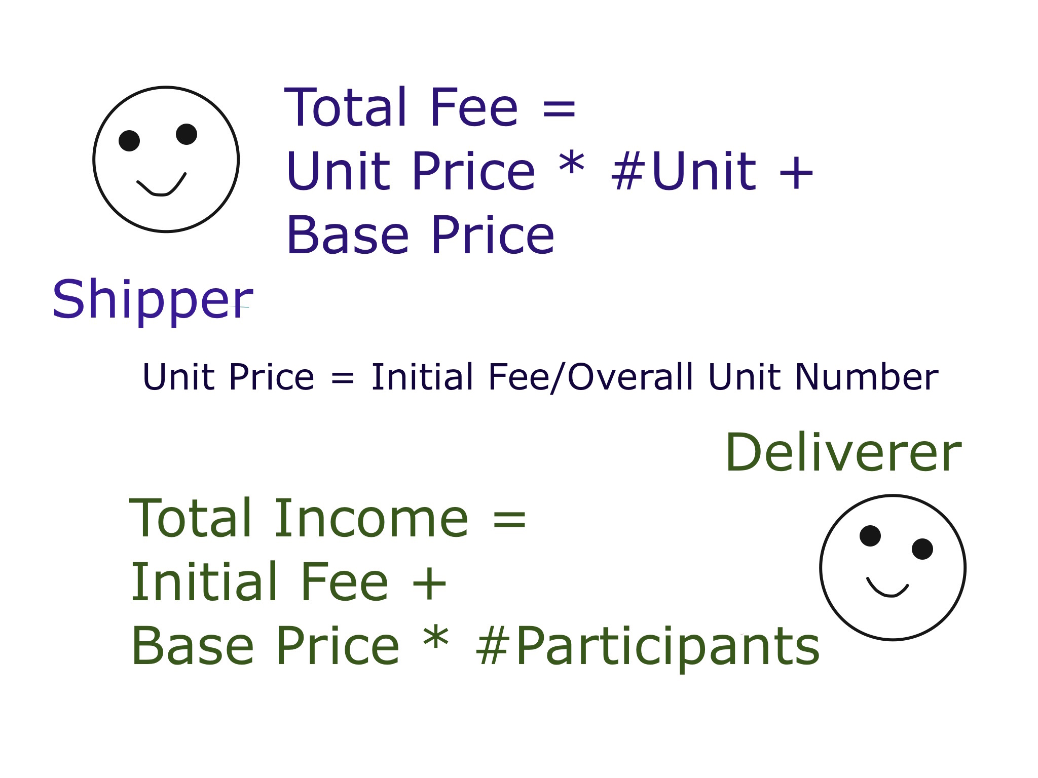
Notes:
As for pricing strategy, we want to maximize benefits of both roles.
Initial fee is the fee that a deliverer charges over an order.
Unit fee is calculated by dividing initial fee by overall unit number.
As more shippers join the order, total fee paid by one shipper goes down and total price collected by deliverer goes up.
It’s a win-win situation.
So, why not use WeDeliver ?

Slide 12

Notes:
Let’s start the demo part!

Slide 13
Promotion
Each shipper inherently is a good promoter
Share on Facebook & Get bonus
Student associations

Slide 14
Shining Points
Money save
Simple manipulation
Reliable service
Rating scale

Slide 15
Future Work
Wide query match
Legal issue
Burst demands

