Slide 1

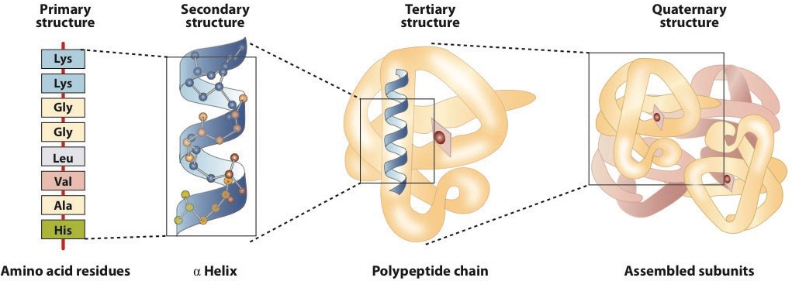
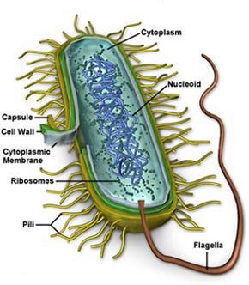
Predict protein subcellular localization
protein
Prokaryotic Structure
http://2012books.lardbucket.org/books/introduction-to-chemistry-general-organic-and-biological/s21-04-proteins.html
MPLDLYNTLTRRKERF…
Chang, J.-M. M. et al. Efficient and interpretable prediction of protein functional classes by correspondence analysis and compact set relations. PLoS ONE 8, e75542 (2013). Chang J-M, Su EC-Y, Lo A, Chiu H-S, Sung T-Y, & Hsu W-L (2008) PSLDoc: Protein subcellular localization prediction based on gapped-dipeptides and probabilistic latent semantic analysis. Proteins: Structure, Function, and Bioinformatics 72(2):693-710.

Slide 2


Document Classification
Categories
Classifier
Documents
Salton’s Vector Space Model

Slide 3
Homework 5
Inputs : Archaeal_tfpssm.csv
V2 : labels of proteins
CP : Cytoplasmic
CW : Cell Wall
EC : Extracellular
IM : Inner membrane
V3~V5602 : the gapped-dipeptide features of each protein
Code to read data
d <- read.csv(“Archaeal_tfpssm.csv",header=F)
levels(d[,2])
head(d[,5600:5603])

Slide 4
Homework 5
hw5_studentID_yourname.R -fold n –out performance.csv
Perform n-fold cross-validation
% of training, % of calibration, % of testing= 80, 10, 10

Slide 5
Homework 5
Model
Any model you want
Predict V2 value for each protein

Slide 6
Homework 5
Output : performance.csv
set,accuracy
trainning,0.91
calibration,0.85
test,0.77
accuracy = P/N

