Slide 1
homework 3
Rscript hw3_yourID.R --target male/female --files meth1 meth2 … methx --out result.csv
Read in multiple files
Positive case defined by “--target” option
Find out which method contains the max
Inputs : method1.csv
where the last column, pred.score, is the predicted probability of "Male".
persons,prediction,reference,pred.score
person1,male,male,0.807018548483029
person2,male,male,0.740809247596189
person3,female,male,0.0944965328089893
person4,female,female,0.148418645840138
Output : result.csv
method,sensitivity,specificity,F1,AUC
method1,0.91,0.96,0.85,0.79
method2,0.99,0.98,0.86,0.70
highest,method2,method2,method2*,method1
*if the highest method is significantly better than the second best (p<0.05).

Slide 2
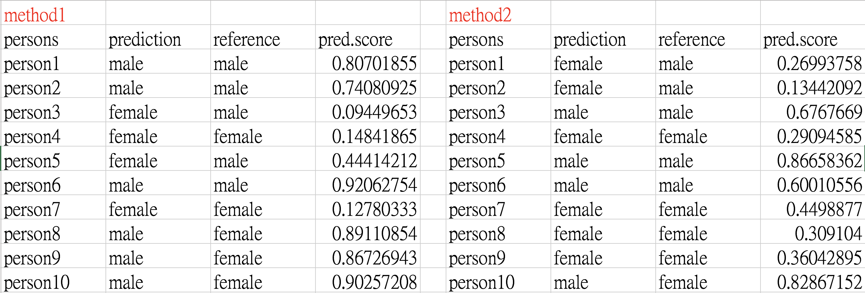
How to test significance?

Slide 3
How to test significance?
http://stats.stackexchange.com/questions/45851/how-to-statistically-compare-the-performance-of-machine-learning-classifiers

Slide 4
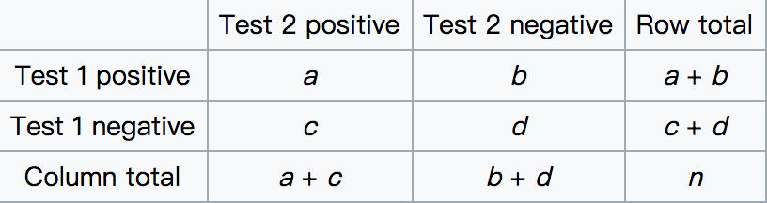
2 × 2 contingency table
The test is applied to a 2 × 2 contingency table, which tabulates the outcomes of two tests on a sample of n subjects, as follows.
The null hypothesis of marginal homogeneity states that the two marginal probabilities for each outcome are the same, i.e. p_{a} + p_{b} = p_{a} + p_{c} and p_{c} + p_{d} = p_{b} + p_{d}.

Slide 5
How to test significance?
Fisher's exact test
McNemar's test
Reference
http://stats.stackexchange.com/questions/26271/comparing-two-classifier-accuracy-results-for-statistical-significance-with-t-te

Slide 6
Fisher’s test for independence (week5, page 64~68)
A (control) / B(treatment) testing:
Building simulated A/B test data
Summarizing the A/B test into a contingency table
the null hypothesis : conversion is independent of group
A=B
fisher.test(tab)

Slide 7
McNemar's test
Under the null hypothesis, with a sufficiently large number of discordants (cells b and c), χ² has a chi-squared distribution with 1 degree of freedom.
Credit by https://en.wikipedia.org/wiki/McNemar%27s_test

Slide 8
chi-squared distribution
The chi-squared distribution with k degrees of freedom = the distribution of a sum of the squares of k independent standard normal random variables
Credit by https://en.wikipedia.org/wiki/Chi-squared_distribution

