Slide 1
DS Final project
利用NBA球員數據預測該年MVP
105753035 藍逵原

Slide 2
Outline
INPUT
MODELING
OUTPUT

Slide 3
INPUT
Data source Basketball-reference.com http://www.basketball-reference.com/awards/ 2016-2006 for training 2005-2001 for testing 2017 unknown
NBA Awards Voting -Most Valuable Player
Input format .csv
Rank | Player | Age | Tm | First | Pts Won | Pts Max | Share | G | MP | PTS | TRB | AST | STL | BLK | FG% | 3P% | FT% | WS | WS/48
1 | Stephen Curry | 27 | GSW | 131 | 1310 | 1310 | 1 | 79 | 34.2 | 30.1 | 5.4 | 6.7 | 2.1 | 0.2 | 0.504 | 0.454 | 0.908 | 17.9 | 0.318
2 | Kawhi Leonard | 24 | SAS | 0 | 634 | 1310 | 0.484 | 72 | 33.1 | 21.2 | 6.8 | 2.6 | 1.8 | 1 | 0.506 | 0.443 | 0.874 | 13.7 | 0.277

Slide 4
INPUT
Preprocessing
3p% 如果球員整季都沒出手三分球為空白，調整為零
Pts.Won
根據記者投票決定最有價值前五名球員獲得選票依序得10分,7分,5分,3分,1分

Slide 5
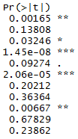
MODELING
Linear Regression
10-Fold Cross Validation
Feature select by backward selection (p-value < 0.05)
Null model 假設每個球員得到的投票皆相等則每人皆得340分 131*26/10

Slide 6
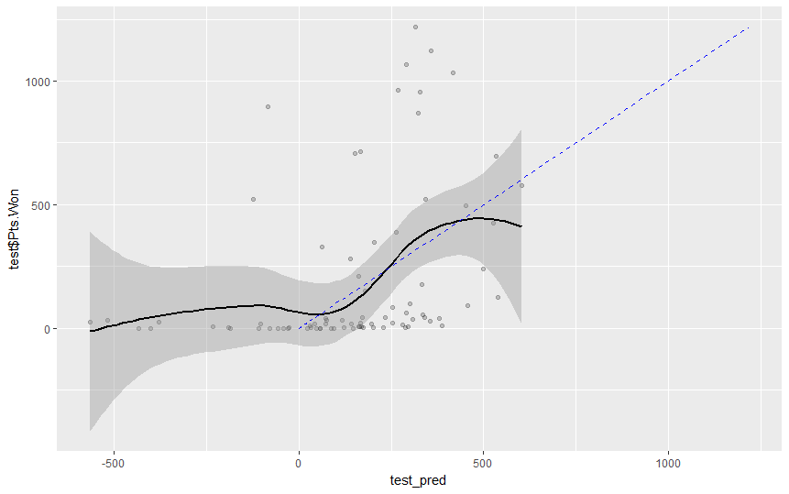
OUTPUT
Performance
R-square train 0.6607751 test 1.033837
root mean square error train 287.3877 test 333.2196

Slide 7
OUTPUT
Challenge
由於是由記者投票決定分數所以實際分數難以數據完全預測
真實情況不會有負分，然而預測時會有負分
2017 result
LeBron James 681.3537
Russell Westbrook 645.6592
James Harden 625.7240
Github https://github.com/Lan105753035/1052DataScience/Final/Final_project.R

