Slide 1
Syracuse Crime Analysis
Yunteng Gu

Slide 2
Problems and Objectives
Crimes take place in the society all over the world and have strong impact on the community. Syracuse, the place we are living in, has high rate of crimes but low chance of arrest. In this project, I’ll try to explore from Syracuse crime data to figure out the key crime factors.
The results would help Syracuse police department to assign police resources more efficiently and help citizens to identify the crimes factors away from dangers.
The project would be a typical classification problem to predict type of crimes with given other crime information.

Slide 3
Data Description
Crime Dataset (from Syracuse OpenData)
Data Duration: January 1st, 2017 – June 3rd, 2018
Colunms: Address, Date, TimeStart, TimeEnd, Code_Defined
Diminsion: 15,266rows * 8colunms
Independent variables: Code_Defined (17 classes)
Census Dataset(from US Census Bureau)
Data Range: Great Syracuse Area
Colunms: ages distribution, income distribution, education, commuting, etc.
Diminsion: 70rows * about 20000colunms (selected only 579colunms for this task)

Slide 4
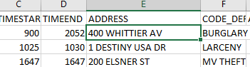

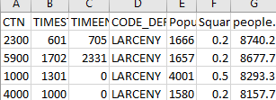
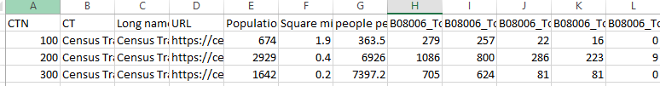
Data Preparation
Clean data:
Remove indentifiers: crime ID
Combine types: 17 types -> 4 major types(Assault, Drug, Property, Theft)
Merge data:
Use census API to map “address” to “census tract”
Merge data by “census tract number”
API

Slide 5
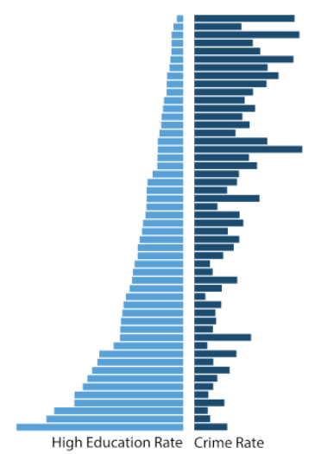
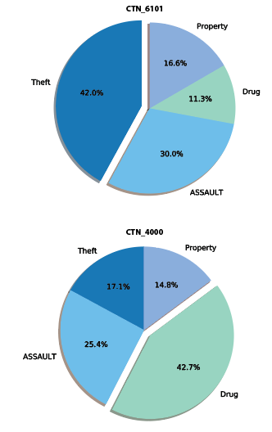
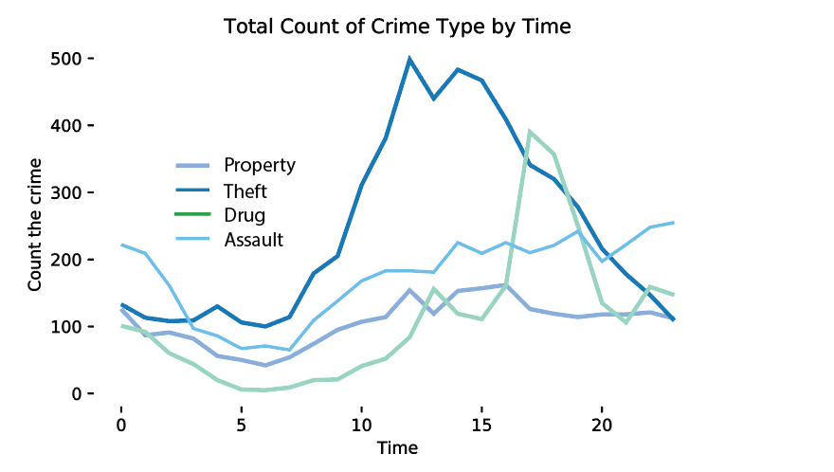
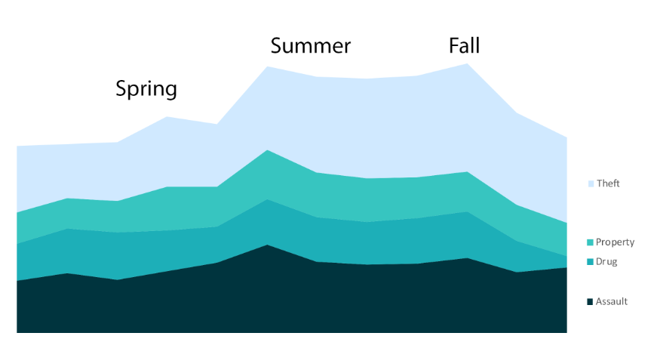
Data Exploration

Slide 6
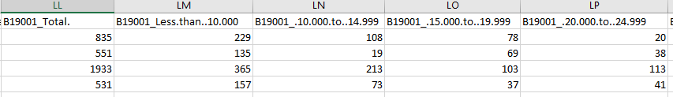

Feature Engineering
Date -> Weekday, Season
TimeStart & TimeEnd -> morning/daytime/evening/midnight
Calculate ratios of Census Data: high Education Rate, high Income rate

Slide 7
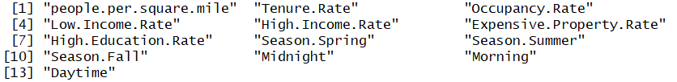
Model Analysis —— SVM
Split dataset: 60% training, 30% validation, 10% testing
Variables:
Tuning: Cost from 2^1 to 2^10
Best cost: 34 for validation
Accuracy for testing: 42.40% (compare to baseline 33.91%)

Slide 8
Model Analysis —— Random Forest
Split dataset: 60% training, 30% validation, 10% testing
Init Variables:
Tuning: number of trees from 200 to 600
Best ntrees: 600 for validation
Accuracy for testing: 41.71% (compare to baseline 33.91%)

Slide 9
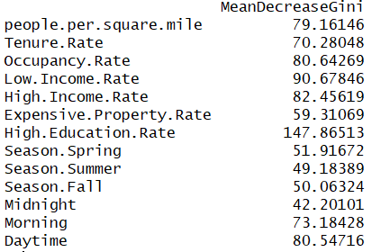
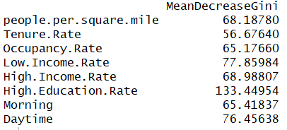
Random Forest —— feature selection
Stepwise
After
5 times filter
Accuracy: 49.58%
Accuracy: 41.71%

Slide 10
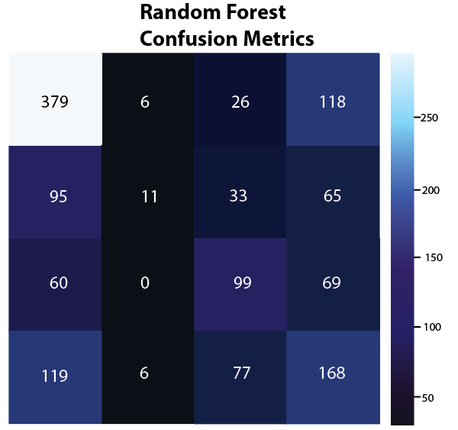
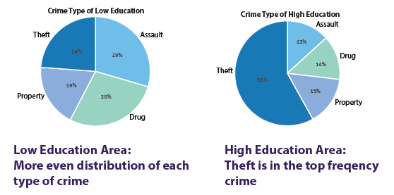
Results and Conclusion
We recommend the police to take into account of different factors for different kind of crimes to better assign their resources.
For areas with more educated residences, polices may need to strengthen night patrols.
For area with less educated residences, polices may need to sustain or increase police force all day long
Theft Property Drug Assault
Property crimes are much more difficult to figure out patterns
Most geographic data should be considered

Slide 11
References
Syracuse Open Data http://data.syrgov.net/
US Census Bureau https://www.census.gov/
Census Reporter https://www.census.gov/
DATA USA, facts of Syracuse https://datausa.io/profile/geo/syracuse-ny/#

Slide 12
Thanks!

