Slide 1

Small area estimation of cancer rates: A case study of lung cancer in Florida, 2000-2010
Lan Hu, Yongwan Chun, Daniel A. Griffith
Geospatial Information Sciences program
University of Texas at Dallas
Email: lan.hu@utdallas.edu

Slide 2
Introduction
Small area estimation (SAE) furnishes a cost-effective method for obtaining reliable small area data
SAE has been widely applied in many research areas (e.g., economics, demography, epidemiology)
One major problem of SAE is how to generate reliable estimates of interest for small areas with data only available at a coarser geographic resolution
Lung cancer, the leading cause of death for both man and woman, has received substantial research attention
The literature notes that spatial autocorrelation frequently is detected in lung cancer incidence rate
Spatial SAE models have been proposed to address spatial autocorrelation [e.g., Spatial Empirical Best Linear Unbiased Predictor (Spatial EBLUP)]

Slide 3
Research Objectives
Estimate lung cancer incidence rates at the census tract resolution in Florida
A synthetic method, a Poisson regression method, and a Poisson eigenvector spatial filtering method
Estimates are compared with actual observed cancer rates
Compare the estimated results of these methods
Examine whether or not accounting for spatial autocorrelation can lead to a better estimation

Slide 4
Literature Review
Small areas can be defined as geographic areas (e.g., census units such tracts, communities), or socio-demographic groups
SAE is an important endeavor in global health, epidemiology
Reveal disparities of disease at local small areas (e.g., Krieger et al., 2002; Mobely et al., 2012)
Provide a fundamental basis for understanding the complex interaction between human and environmental systems (e.g., Langford et al., 2008)
Allow investigation into the factors responsible for geographic disparities in health (Ruther et al., 2017)
Identify priority areas for action, and optimize the use of limited resources (Zhang et al., 2013)

Slide 5
Literature Review (cont’d)
SAE indirect estimator
Synthetic estimator
Compute a designed unbiased estimator across all the areas, and then apply it for every small area (Pfeffermann 2013)
Assume homogeneity that may yield a large bias (e.g., Jia et al., 2004)
Regression model (e.g., logistic or Poisson regression)
Incorporate areal level covariates to consider disparities at different geographic resolutions
Further extended to a mixed model, including random effects to improve model fits (e.g., Li et al., 2009; Zhang et al., 2014 )
SAE spatial model (e.g., spatial EBLUP)
Consider to incorporate spatial autocorrelation in an estimation model specification (e.g., Pratesi and Salvati 2008)
Notes:
Indirect estimation borrows strength from sample units outside the domain and/or time period of interest.

Slide 6
Our Dataset
Lung cancer incident points in the State of Florida
Florida Cancer Registry
An 11-year period from 2000 to 2010
A total of 172,460 cases after data cleaning
Age, sex, race/ethnicity
Variables | Categories
Age | < 20, 20-24, 25-29, 30-34, 35-39, 40-44, 45-49, 50-54, 55-59, 60-64, 65-69, 70-74, 75-79, 80-84, >85
Sex | Male, Female
Race/ethnicity | White, Black, Asian, Hispanic, Other
County | 67 counties

Slide 7
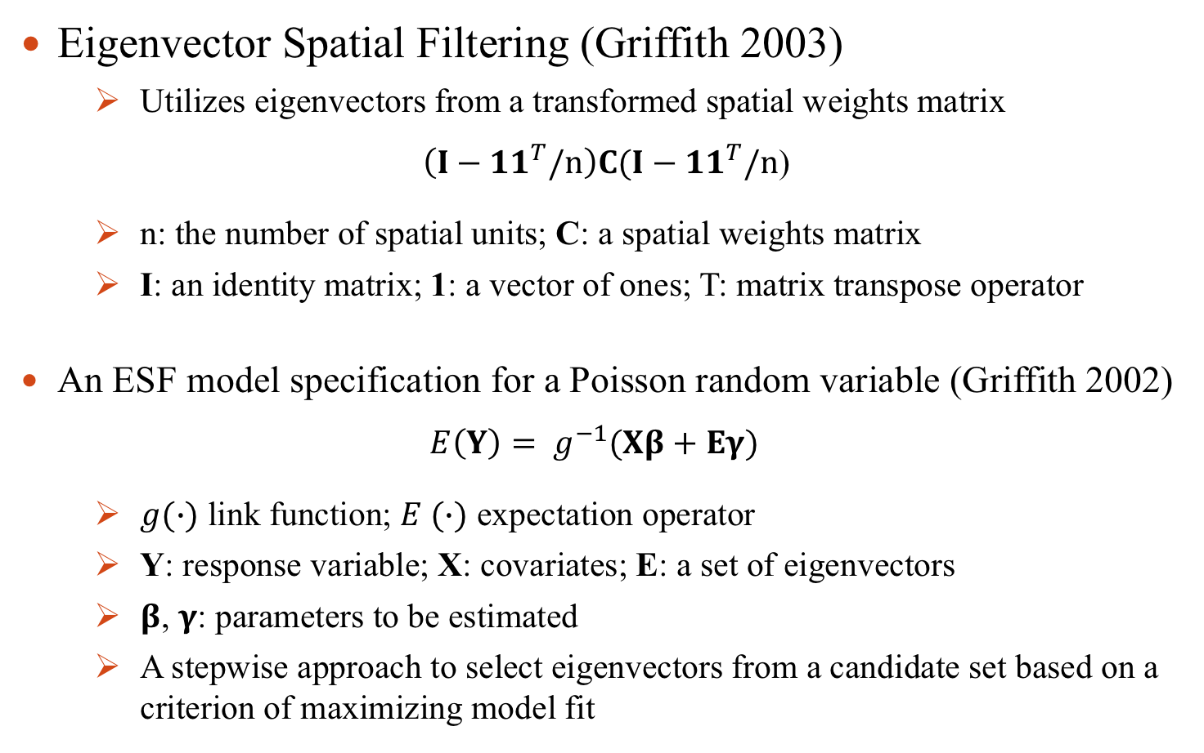
Methodology
Eigenvector Spatial Filtering (Griffith 2003)
Utilizes eigenvectors from a transformed spatial weights matrix
$\left(I−{11}^{T}/n\right)C(I−{11}^{T}/n$)
n: the number of spatial units; C: a spatial weights matrix
I: an identity matrix; 1: a vector of ones; T: matrix transpose operator
An ESF model specification for a Poisson random variable (Griffith 2002)
$E\left(Y\right)= g^{−1}(Xβ+Eγ)$
$g(∙)$ link function; $E (∙)$ expectation operator
Y: response variable; X: covariates; E: a set of eigenvectors
$β$, $γ$: parameters to be estimated
A stepwise approach to select eigenvectors from a candidate set based on a criterion of maximizing model fit

Slide 8
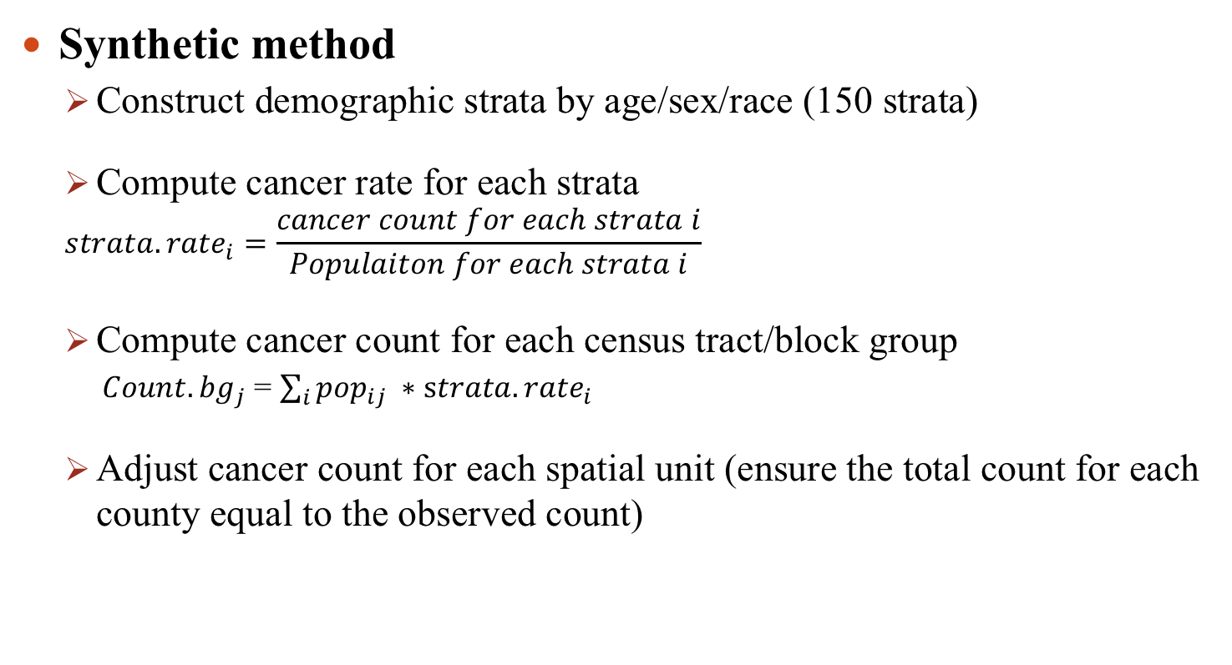
Methodology (cont’d)
Synthetic method
Construct demographic strata by age/sex/race (150 strata)
Compute cancer rate for each strata
$${strata.rate}_{i}=\frac{cancer count for each strata i}{Populaiton for each strata i}$$
Compute cancer count for each census tract/block group
${Count.bg}_{j}$ = $\sum_{i}{{pop}_{ij} ∗{strata.rate}_{i}}$
Adjust cancer count for each spatial unit (ensure the total count for each county equal to the observed count)

Slide 9
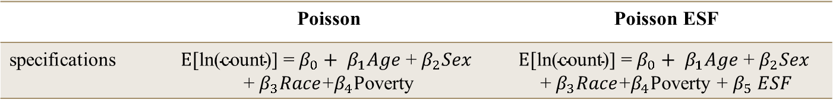
Methodology (cont’d)
Poisson and Poisson ESF methods
Construct demographic-geographic strata age/sex/race/county (10,050 strata)
Model cancer counts for the strata with Poisson and Poisson ESF models (population per stratum as an offset variable)
Calculate a cancer rate for each stratum
Compute a cancer count for each census tract/block group
Adjust a cancer count for each spatial unit (ensure the total count for each county equal to the observed count)
 | Poisson | Poisson ESF
specifications

Slide 10
 | Poisson |  |  | Poisson ESF
(Intercept) | -13.123 | 0.310 | *** | -13.073 | 0.308 | ***
raceblack | 0.791 | 0.060 | *** | 0.775 | 0.059 | ***
racehispanic | 0.355 | 0.060 | *** | 0.348 | 0.059 | ***
raceother | -1.160 | 0.098 | *** | -1.186 | 0.098 | ***
racewhite | 1.213 | 0.058 | *** | 1.201 | 0.057 | ***
agea2024 | 1.271 | 0.430 | *** | 1.300 | 0.427 | **
agea2529 | 2.282 | 0.357 | *** | 2.290 | 0.355 | ***
agea3034 | 2.956 | 0.334 | *** | 2.936 | 0.332 | ***
agea3540 | 4.253 | 0.312 | *** | 4.194 | 0.310 | ***
agea4045 | 5.353 | 0.306 | *** | 5.268 | 0.304 | ***
agea4550 | 6.168 | 0.305 | *** | 6.052 | 0.303 | ***
agea5055 | 6.742 | 0.304 | *** | 6.641 | 0.303 | ***
agea5560 | 7.289 | 0.304 | *** | 7.236 | 0.302 | ***
agea6065 | 7.669 | 0.304 | *** | 7.621 | 0.302 | ***
agea6570 | 8.126 | 0.304 | *** | 8.083 | 0.302 | ***
agea7075 | 8.451 | 0.304 | *** | 8.421 | 0.302 | ***
agea7580 | 8.650 | 0.304 | *** | 8.583 | 0.302 | ***
agea8085 | 8.575 | 0.304 | *** | 8.467 | 0.302 | ***
agea85 | 8.286 | 0.304 | *** | 8.242 | 0.302 | ***
sexmale | 0.340 | 0.008 | *** | 0.362 | 0.011 | ***
poverty | 1.280 | 0.154 | *** | 1.280 | 0.153 | ***
AIC | 38,014 |  |  | 37,681
Moran’s I (areal effects) |  |  |  | -0.04 (-0.61)
selected eigenvector |  |  |  | 5/48

Slide 11
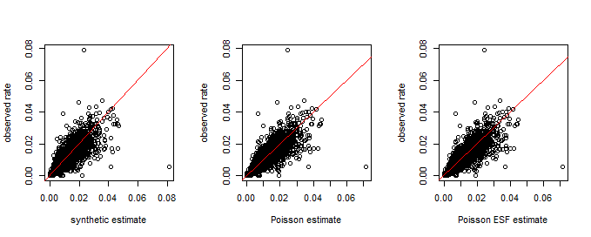
Results
Cor : 0.78 Cor : 0.81 Cor : 0.81

Slide 12
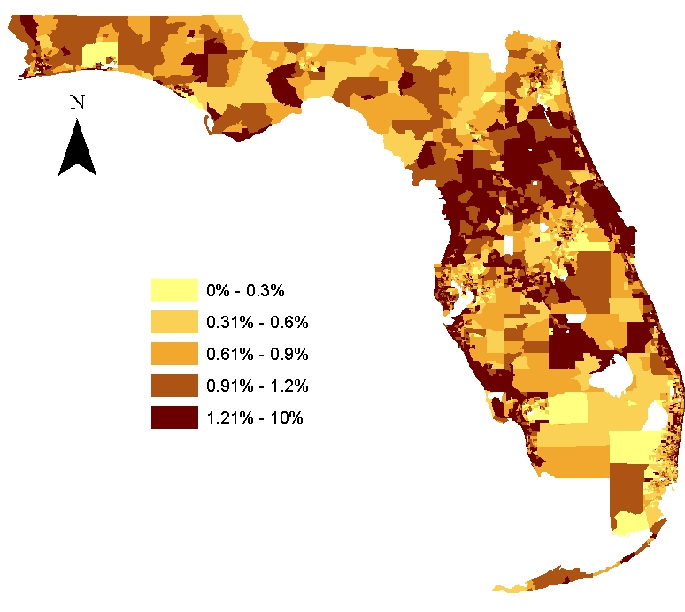
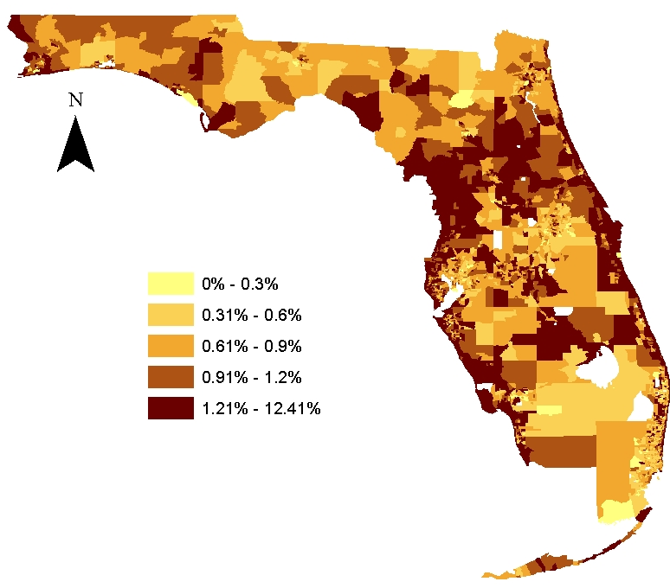


Observed rates
Synthetic estimates
Poisson estimates
Poisson ESF estimates

Slide 13
Summary and Discussions
The estimation results are reasonably good
The correlations between estimates and observed cancer rates are high
age, race and sex are important factors to describe lung cancer rate
Poisson models generate better estimates than synthetic method
The synthetic method assumes homogeneity while Poisson models consider local variations
However, the spatial model improves estimation marginally
Estimates generated with the three methods capture the major spatial pattern of lung cancer rate (e.g., high/low cancer rate areas)
Over/under-estimations exist on all three maps
Estimations need to be further improved to reveal local disparities

Slide 14
Future work
A better spatial model specification is desired
The current method that accounts for spatial autocorrelation only marginally improved estimates
Similar estimates will be extended for the census block group resolution
to evaluate if these SAE methods produce comparable results at different geographic resolutions
to examine how good estimates are for finer level of spatial units

