Slide 1
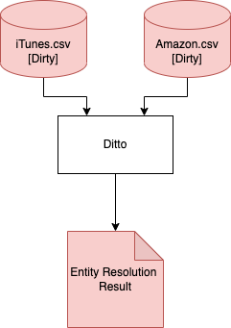
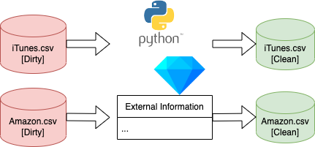
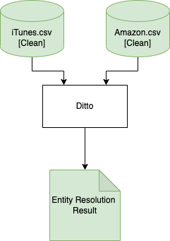
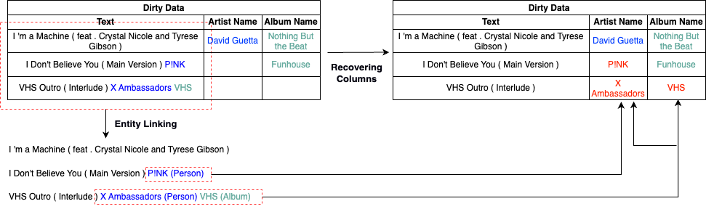
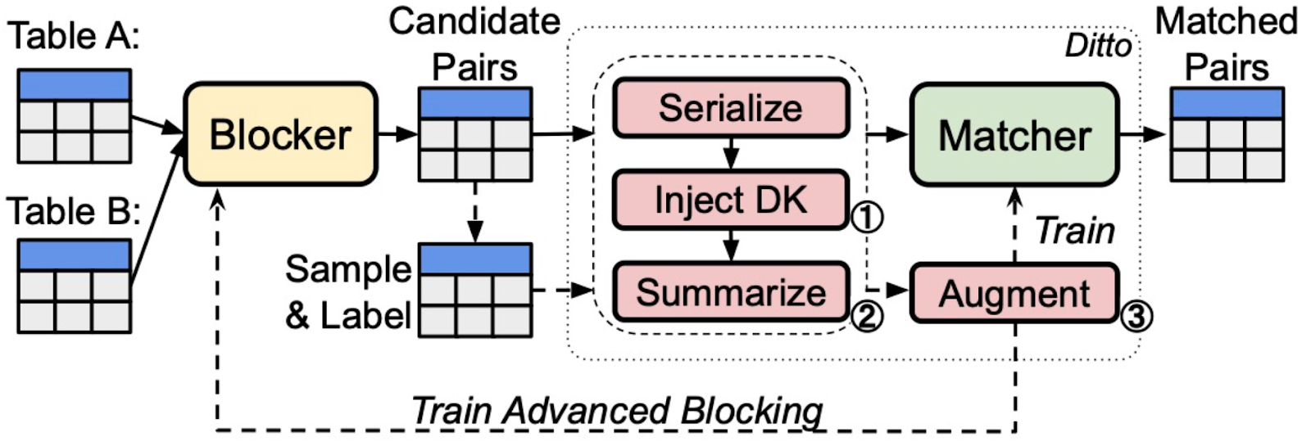
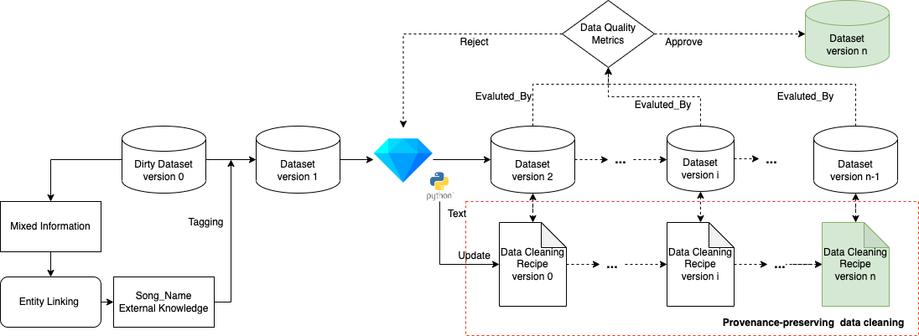

Knowledge-Augmentation Based Data Preparator For Entity Matching Problem
Lan Li¹, Liri Fang¹, Yiren Liu², Bertram Ludäscher¹ ¹School of Information Sciences, ²Informatics, University of Illinois at Urbana-Champaign
INTRODUCTION
We use one specific data quality issue, the mixture of information, as a use case to study how a knowledge-augmentation preparator can be introduced to the entity matching problem. We assume that
1). This preparator can be reused as a module for similar datasets with data quality issue of the mixture of information.
2). By extracting correct information from mixed information, we could improve the data quality and entity matching performance.
MOTIVATION
Information extraction from the mixture of information requires a deeper understanding of the textual data. It is challenging and uneasy to use a basic data transformation to extract the correct domain/position of the information.
Knowledge augmentation method, such as entity linking, which can acquire more semantic information and provide evidence for data preparation.
A reusable data cleaning recipe can be generated on the dataset with this data quality issue of mixture information, which can save a lot of effort.
Varied Data quality of all training, testing, and valid data might affect model performance².
USE CASE: Example of Dirty Records and Analysis
Data Quality Issues and Challenges of Data Preparation:
Data values in column Song_Name contain mixture information, i.e., the data values are inconsistent with the schema information.
Challenges: We can not extract the information for Song_Name simply by applying basic data transformation like “Split Attribute” with some separator.
Hard-coding method like using the range to set up the domain of the information extraction is not reliable (proposed from [3]), because the mixed information are randomly selected from other columns.
Missing values across the column Artist_Name, Album_Name, Genre, Price, CopyRight, Time, and Released
Challenges: Values of these column are important and contribute to the entity matching results. Too many missing values will result in model inaccuracy and hurt the robustness of the entity matching system.
Experiment Results
Note:
iTunes.Amazon.structured dataset is provided by Ditto, and we call it “Ground” version;
iTunes.Amazon.dirty dataset is generated by this dataset. In particular, “the dirty version of dataset is generated from the clean version by randomly emptying attributes and appending their values to another randomly selected attribute. ”^{[1]}
iTunes.Amazon.clean dataset is the prepared result with the proposed methods.
To ensure the quality consistency, we reuse the generated data cleaning recipe generated by OpenRefine to clean all the dataset: training, testing, and valid.
According to the experiment results, we can see a huge improvement of the F1 score for entity matching tasks after we prepare and clean the dataset.
Clean Status | Dataset Name | Batch Size | Max length | Language Model | Best-F1
FALSE | iTunes.Amazon.dirty | 64 | 512 | roberta | 0.667
TRUE | iTunes.Amazon.clean | 64 | 512 | roberta | 0.862
Ground | iTunes.Amazon.structured | 64 | 512 | roberta | 0.852
ARCHITECTURE
DISCUSSIONS
Entity linking based on a pre-trained language model can be used as evidence for data cleaning processes; data cleaning processes can contribute to entity resolution tasks based on a pre-trained language model.
This can be seen as a real-world use case representing the symbiotic relationship between ML and data cleaning⁴:
In other words, from machine learning to data cleaning, and from data cleaning to machine learning.
Data cleaning is still required even under the pre-trained language model.
How exactly and to what extent the decision-making during the data cleaning process affects the final model still requires further study.
BACKGROUND
Entity Matching with Ditto¹
Entity matching problem refers to determining whether two data entries refer to the same real-world entity.
Pretrained language models are typically deep neural networks with multiple transformer layers, and pre-trained on large text corpora such as Wikipedia articles in an unsupervised manner.
Ditto¹ (see Figure 1), a state-of-the-art entity matching system, which fine-tunes a pre-trained language model for the EM task with a labeled training dataset consisting of positive and negative pairs of matching and non-matching entries
Figure 1. Architecture of Ditto
Knowledge Augmentation with Entity Linking
Entity Linking (EL) refers to the task of identifying entity mentions with in a text sentence from a given set of entities from a knowledge base (KB)
We use, ReFinED, a state-of-the-art EL method to identify mentions of entities from Wikidata, and annotate the initial text with semantic type information of the linked entities
Entity Resolution Task
with Dirty Inputs
Data Preparation
Entity Resolution Task
with Clean Inputs
METHODS
Method 1/2 Evidence-Based Data cleaning: Entity Linking
Method 2/2 Data Cleaning with OpenRefine: Pattern-based transformations
REFERENCES
[1] Li, Y., Li, J., Suhara, Y., Doan, A., & Tan, W. C. (2020). Deep entity matching with pre-trained language models. arXiv preprint arXiv:2004.00584.
[2] Budach, L., Feuerpfeil, M., Ihde, N., Nathansen, A., Noack, N., Patzlaff, H., ... & Naumann, F. (2022). The Effects of Data Quality on Machine Learning Performance. arXiv preprint arXiv:2207.14529.
[3] Koumarelas, I., Jiang, L., & Naumann, F. (2020). Data Preparation for Duplicate Detection. Journal of Data and Information Quality (JDIQ), 12(3), 1-24.
[4] Ilyas, I. F., & Rekatsinas, T. (2022). Machine Learning and Data Cleaning: Which Serves the Other?. ACM Journal of Data and Information Quality (JDIQ), 14(3), 1-11.
[5] Ayoola, Tom, et al. "ReFinED: An Efficient Zero-shot-capable Approach to End-to-End Entity Linking." arXiv preprint arXiv:2207.04108 (2022).

