Slide 1
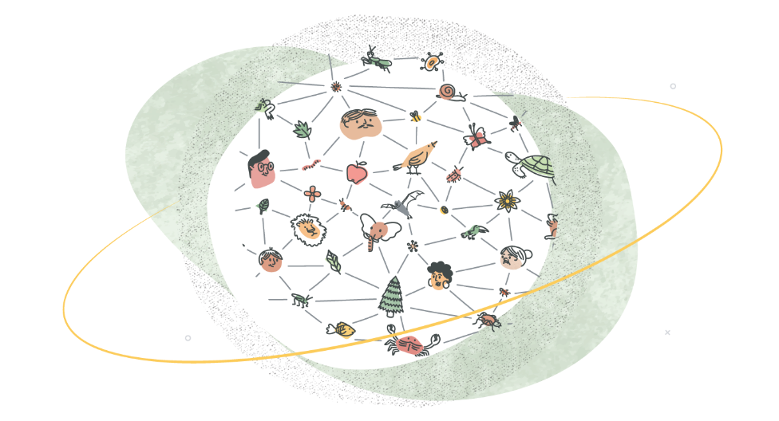

Knowledge Augmentation
(1) Column Semantic type augmentation
Prompting for
Knowledge Injection
BERT
(1) Prompt type I: space
Visible Matrix + Soft-Position
COL1
COL2
COL3
COL4
[SEP]
Y/N
(2) Entity Semantic type augmentation
ROW1
(2) Prompt type II: slash
ROW2
ROW3
(3) Prompt type III: tag

