Slide 1
Reproducible Data wrangling with openrefine
Lan Li, ischool, University of Illinois, urbana-champaign
Primary Mentor: Bertram Ludäscher, iSchool&NCSA, University of Illinois, Urbana-Champaign
Secondary mentor: Kacper Kowalik, NCSA, University of Illinois, Urbana-Champaign

Slide 2
introduction
The goal is to make data cleaning workflows more easy to use (via Jupyter-based Python notebooks, RStudio notebooks, and OpenRefine workflows), transparent (using provenance tools and standards), and reproducible (using the WholeTale execution environment).
A new WholeTale frontend for OpenRefine will be employed, based on existing docker recipes
Different standards (e.g., W3C PROV and ProvONE) and tools (e.g., YesWorkflow and recordR) will be employed that can help in modeling and capturing data lineage and provenance information.

Slide 3
methodology
User Story1:
Using Openrefine Web GUI to do data wrangling, and generate operation history json file. Verify the reproducibility of the json file.
step 1: Use Openrefine web UI to work on a data cleaning project;
step 2: Get input csv D1(raw dataset) and output (cleaned dataset) csv D2, as well as the output json (operation history) file;
step 3: Use the input csv D1 and output json file to run them in the Openrefine-client Library(interactively) step by step (based on apply operation with output json file) and see if it’s able to obtain exactly the same output csv D2’. Compare D2 and D2’.
Notes:
userStory1: @:
userStory2:
update d1: ---->

Slide 4
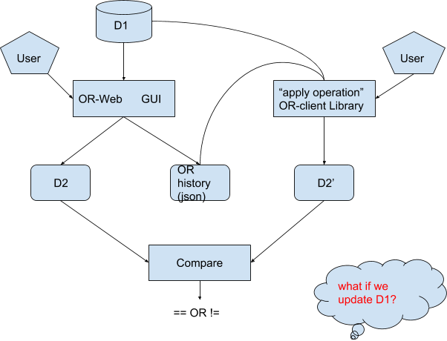
Userstory1:

Slide 5
methodology
User story2:
Use Openrefine-client library to construct User-script system, which can generate the reproducible json file.
Step 1: Openrefinerecipe.py includes all of the operations in Openrefine, where the functions of operations are through Openrefine-client Library.
Step 2: X-OR-X.py (Extended-Openrefine-Execute) is the human-Openrefine interaction script, where let users choose data-wrangling operations on columns. After running system, it will generate ”original Openrefine json file”, “user-guided json file”, and the cleaned data D2. “user-guided” json file catches “clustering type”, ”clustering function” and ”clustering parameters”.
Step 3:Parse&reproduce.py using this system to parse the step 2 “user-guided” json file, reproduce data wrangling procedure, and output cleaned data D2’.
Step 4:Compare D2 and D2’.

Slide 6
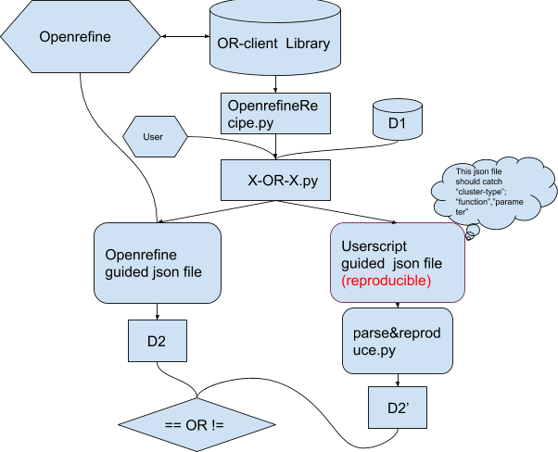
Userstory2:

Slide 7
Predefined data and workflow
Dataset is from this website: http://menus.nypl.org/data.
Split the whole Menu.csv , a half for testing and the other half for training.
There are two parts: Openrefine GUI workflow, and Openrefine-client Library workflow.

Slide 8
Openrefine Gui workflow outputs

Slide 9
create project with Openrefine, do the data cleaning:
columnName | Operation 1 | Operation 2
City&Country | Rename
sponsor | lowercase | Cluster and edit
date | To date
place | lowercase | cluster and edit
page_count | To number
call_number | Split into several columns

Slide 10
Openrefine Gui workflow outputs
1. export the Openrefine cleaned csv: Openrefine_cleanedcsvfile
2. extract the Openrefine json file: Openrefine_cleanedjsonfile
3. apply step2 json file with openrefine-client library in bash mode: Openrefine-client_bash
4. generate the Openrefine cleaned csv: Openrefine-client_cleanedcsvfile
5. compare step1 and step4 output cleaned csv file, they are the same.

Slide 11
Openrefine-client library Outputs

Slide 12
Openrefine-client library Outputs
1. Openrefinerecipe.py : Openrefinerecipe, this python script is to list all of the operations of Openrefine, which return the functions in Openrefine-client Library (higher-order Function).
2. X-OR-X.py: X-OR-X, this system is to construct interaction between human and the Openrefine with python command. with all data wrangling commands done, it can generate a user-guided json file after running the system. At the same time, the Openrefine GUI will generate the corresponding cleaned csv file and original-OR json file.
3. parseandreproduce.py: ParseandReproduce system is used to parse the user-guided json file, and by running it, Openrefine GUI will generate the cleaned data D2’, and the original json file.

Slide 13
Further work
1. generate the Yesworkflow model and ProvONE model with the data cleaning script.
2. work with The WholeTale frontend

