Slide 1
Things on Research
Liu Nianbo

Slide 2

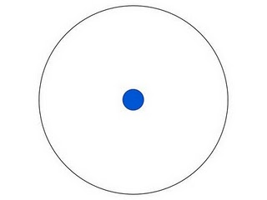
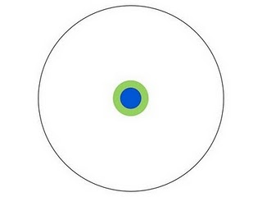
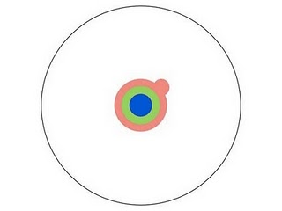
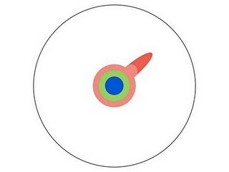
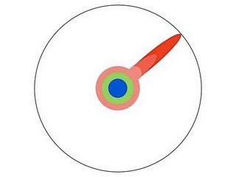



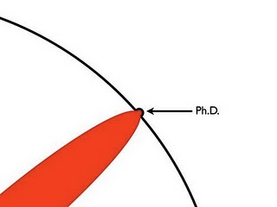

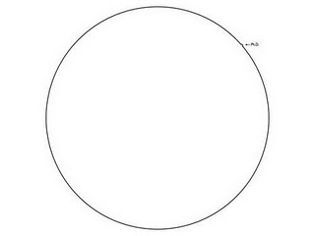
What is research
http://gizmodo.com/5613794/what-is-exactly-a-doctorate

Slide 3
What is keypoint
Master -> Incremental work on existing work
PhD -> Original work to fill research gap
Asking the right question is critical to doing good research
The question is the focus of research
Solving a problem -> solving a “right” problem
Cost
Know a little about a lot or a lot about a little?
Keep your research narrow
Bring something “new”
Skill Tree

Slide 4
Knowledge types
Explicit knowledge -> Implicit knowledge
Explicit knowledge
Know what: facts
Know why: natural laws, principles
Reading and understanding are useful
Implicit knowledge
Know how: tips, skills, capabilities
Know who: who has such knowledge
Coding and cooperating are useful
Feynman’s learning method
Teaching others

Slide 5
Research types
New approach + New problem
Automatic Computing
Von Neumann Model -> Computer (information age)
Old approach + New problem
Deep Learning
Vision Imaging -> Deep Neutral Network (universal function fitter)
New approach + Known problem
T-share
Driving Knowledge -> Navigation System (choose a right question)
Known approach + Known problem
Watering
Scene i + Item j + Method k = New ? (change i/j/k)

Slide 6
How to start
Choose a direction
Interest + Skill Tree, Lab focus
Job-oriented, Company/Team focus
Build your background FAST
Survey/Review Paper (www.deepl.com/translator)
CNKI -> Phd Dissertation -> Related Work
Mindmap, Book Index, Online Open Class (MOOCs, MeTel, etc.)
Learn recent progress IN DETAIL
Good Papers (3 years, top conference /journal, most cited, source code)
Conference/Journal Ranking in your area (CCF A, JCR 1/2, etc.)
(http://www.letpub.com.cn/)
How to read a research paper (www.zhihu.com/)

Slide 7
A simple objective
Research = Re-search
Write a survey paper (to be a researcher)
Copying -> Writing -> New Idea(Scene + Item + Method)
Tex/Visio…
English -> Chinese Survey Paper
Replicate a model/algorithm/system…(to be a algorithm/data engineer)
Coding -> Tuning -> Incremental Work(Veracity/Universality/Replaceability/ Portability/…)
PyTorch/TensorFlow…
Open Game(dataset, application, model…)
Keep your week meeting and brainstorm
Paper Reading -> Teaching others -> Rating -> Learning what
Game of A + B (…or you can be a software engineer)

Slide 8
Check an idea
You sell, others check
Make a presentation
Area->Direction->Background
4-5 related papers (paper 1, abstract 1, …, depth first, problem changes, know why)
Problem, Idea(Scene + Item + Method), Framework (know how)
Discussions
Is it a proper academic problem (value)
Is it feasible/practical/effective (standpoint)
What’s the key challenge/main contribution
How to improve (more values)
How to implement (cost)
Reviewers’ response (enough contributions/how to reject)
SWOT(Strengths Weakness Opportunity Threats) (sell again)

Slide 9
Writing and Submitting
New Idea/Incremental Work + Problem + Data + Result
Introduction
6 Steps: Background and Principles, Previous Approaches, Problem, Abstract(idea, framework, method, performance), Contributions(first, key, state-of-art), Structure
Good Story(scene+concern/challenge) + Good Logic(scientific problem+solution)
Grammar Check/Plagiarism Check
Gingersoftware, 1Checker, Tutor…/Turnitin, Duplichecker, ithenticate, …
Submitting
Top Conference/Journal (fast response) -> Revise as Comments
Related Work -> Cite Potential Reviewers’ Papers

Slide 10
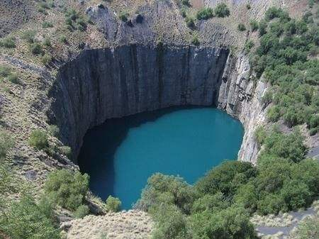
Problems
Improper Direction
Huge Sate Space/Undisclosed Dataset/ Resource-needed…
A direction is too new or too old
No Global View/Focus/Time Limits
Slow start on background/method
Above some research assumptions
Unclear target -> target-oriented
A timetable is necessary
Poor Writing
No area’s terms and fixed expression
No one can understand/modify
Write from 3-5 similar papers

