Slide 1
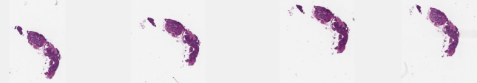
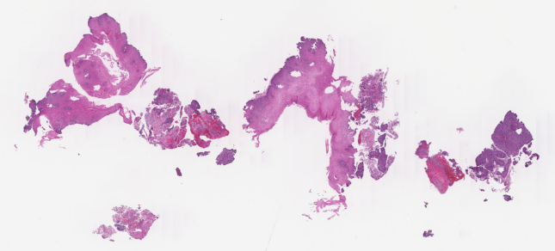
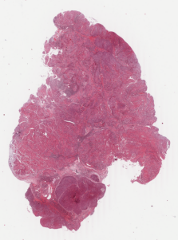
Figure 4 | Public TCGA demonstration of the manuscript spatial layout
H&E, standalone regional map and area percentages. Clinical case categories are unavailable for these public slides.
TCGA-V5-AASV | Public TCGA ESCC
2,577 all segmented tissue patches; illustrative coefficients; no clinical B/NB assignment
Covered area (%)
H&E
Regional map
Positive association
35.9%
Negative association
37.7%
1 mm
1 mm
Not significant
26.5%
0
50
100
TCGA-V5-A7RC | Public TCGA ESCC
4,127 all segmented tissue patches; illustrative coefficients; no clinical B/NB assignment
H&E
Regional map
Covered area (%)
Positive association
36.0%
Negative association
31.0%
Not significant
33.0%
1 mm
1 mm
0
50
100
TCGA-LN-A49S | Public TCGA ESCC
9,556 all segmented tissue patches; illustrative coefficients; no clinical B/NB assignment
H&E
Regional map
Covered area (%)
Positive association
37.5%
Negative association
33.4%
Not significant
29.1%
1 mm
1 mm
0
50
100
Area denominator: unique patch-covered area; overlap counted once. White: uncovered. Gray: not significant / not estimable.
Directions are relative to C15. These are regional interaction associations, not local B/NB labels or verified treatment effects.
Coefficients and uncertainty are artificially specified for visualization only. TCGA cluster identities do not match the paper model.
Notes:
Public TCGA ESCC diagnostic images from NCI GDC. File-specific source links are in data/tcga_wsi/manifest.csv. Interaction coefficients and intervals are illustrative, not estimates of TCGA clinical benefit. Tissue images are raster photographs; labels and overlays are editable native objects.

