Slide 1
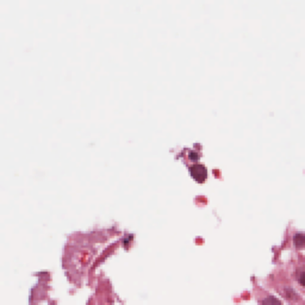
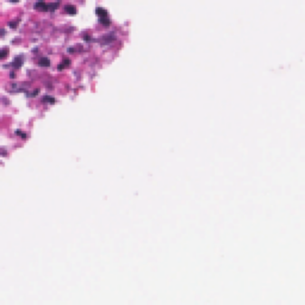
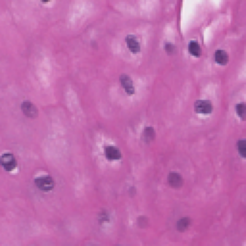
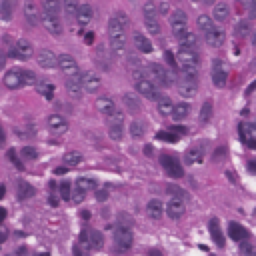
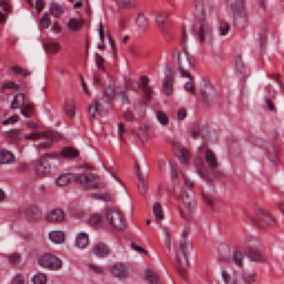
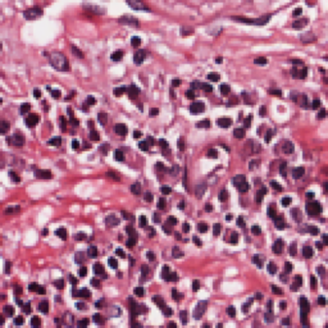
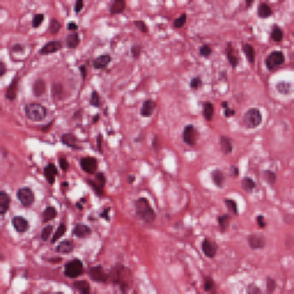
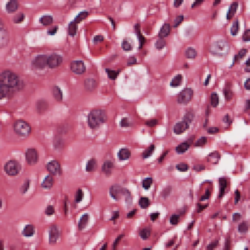
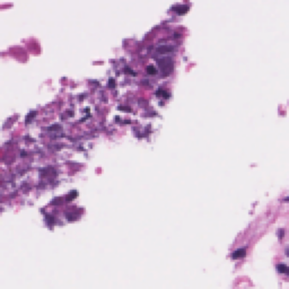
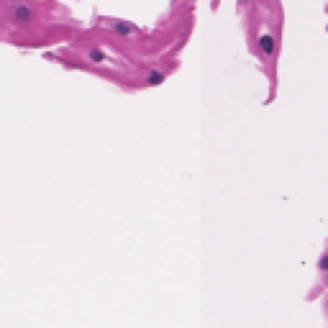
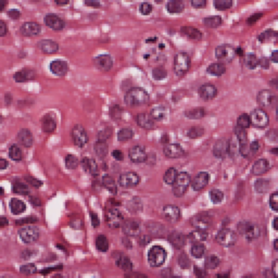
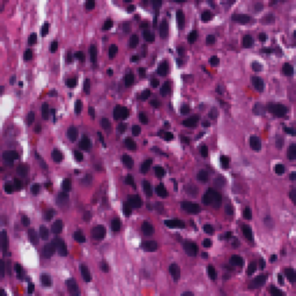
Figure S4 | Cluster atlas demonstration
Negative association: interval below 0
Positive association: interval above 0
Not significant / reference
C09
C10
C08
C34
C80
C83
C74
C71
C43
C46
C06
C09
C25
C22
C62
C59
C55
C58
C18
C21
C13
C10
C50
C47
C67
C11
C07
C00
C70
C87
C84
C30
C33
C01
C35
C38
C82
C79
C72
C75
C45
C42
C08
C05
C23
C26
C60
C63
C57
C54
C20
C17
C06
C01
C05
C11
C14
C48
C51
C69
C66
C85
C88
C32
C29
C36
C02
C81
C39
C73
C78
C44
C76
C07
C41
C24
C04
C61
C27
C02
C04
C03
C56
C64
C19
C53
C12
C16
C49
C52
C68
C65
C86
C89
C31
C28
C00
C03
C15
C40
C37
C77
−0.50
−0.25
0.00
0.25
0.50
−0.50
−0.25
0.00
0.25
0.50
Illustrative γ (interval)
Illustrative γ (interval)
Illustrative coefficients and intervals; no TCGA clinical inference. Cluster identities differ from the paper-trained model.
Forest order: increasing gamma down the left column, then the right. Representative patches also follow increasing gamma.
Notes:
Public TCGA ESCC diagnostic images from NCI GDC. File-specific source links are in data/tcga_wsi/manifest.csv. Interaction coefficients and intervals are illustrative, not estimates of TCGA clinical benefit. Tissue images are raster photographs; labels and overlays are editable native objects.

