Slide 1
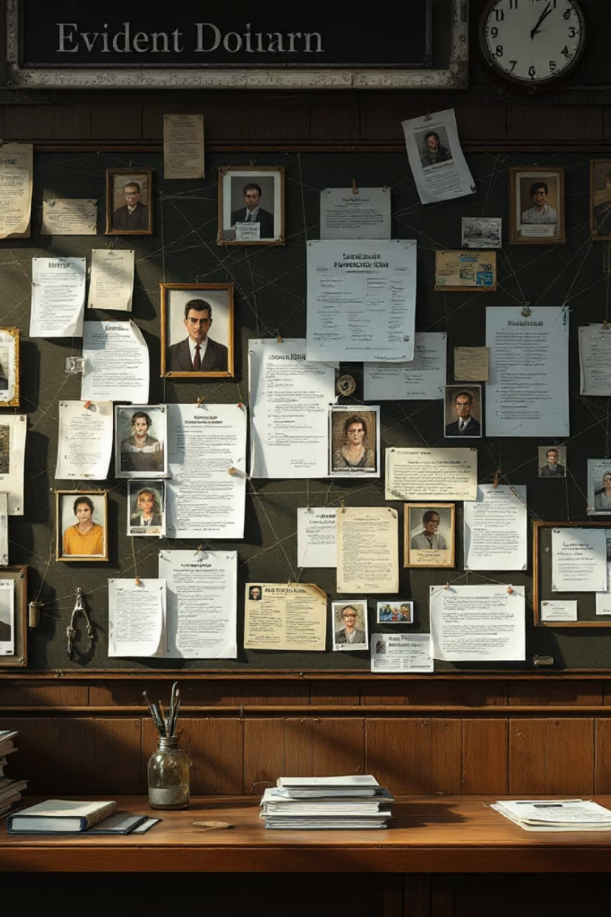
Contradiction-Aware Legal Graph RAG
Adversarial Claim Detection & Graph-Enhanced Retrieval for Balanced Legal Reasoning
Svetlana Gavris
Vlada Savitski

Slide 2
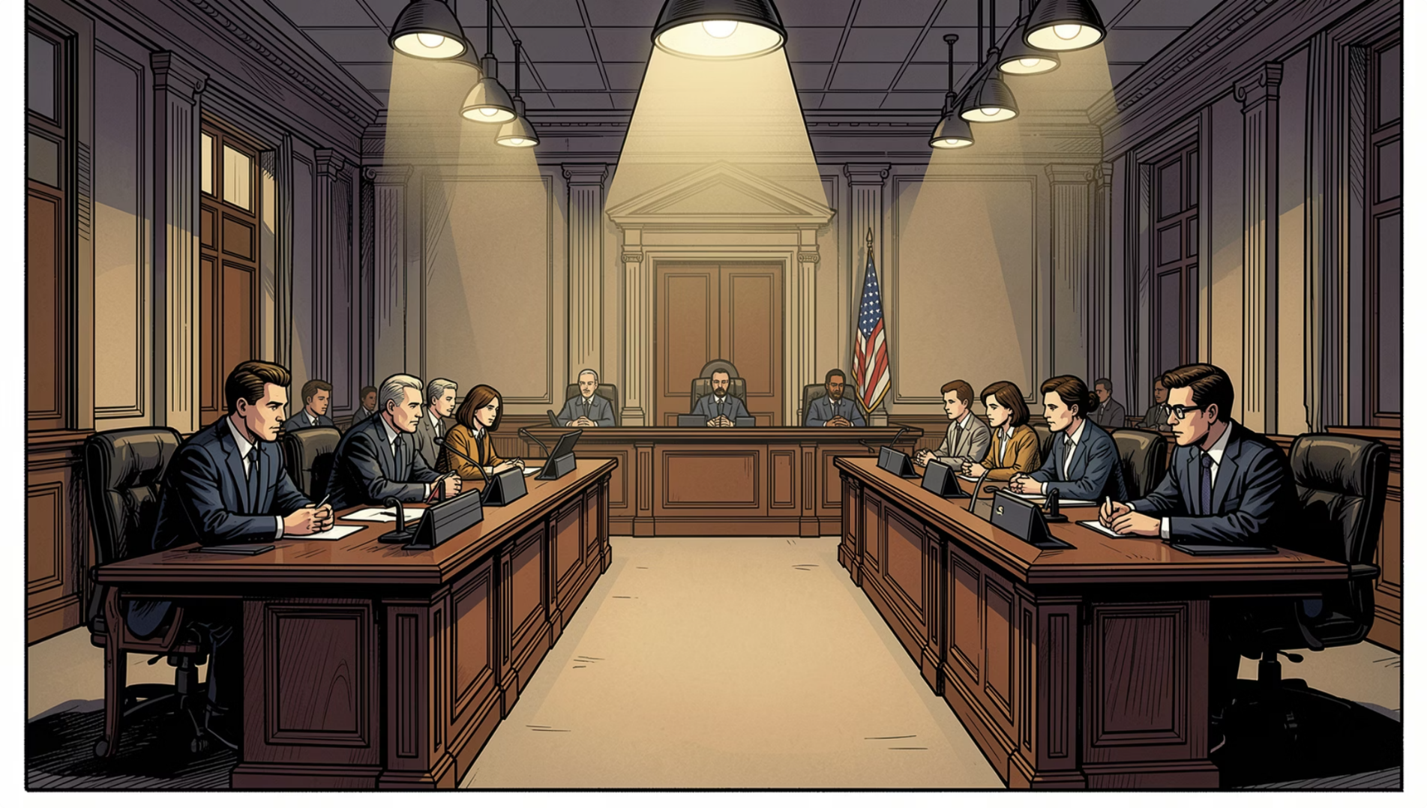

MOTIVATION
Why Legal RAG Is Fundamentally Difficult
Legal Cases Are Structured Conflict
Legal documents encode adversarial debate — prosecution claims, defense arguments, majority rulings, and dissenting opinions. Standard vector RAG retrieves by semantic similarity alone, merging conflicting arguments and amplifying majority narratives.
Core Insight: Legal documents are not independent texts — they represent structured adversarial debates. Retrieval must model disagreement explicitly, not implicitly.

Slide 3
RESEARCH QUESTION
What We're Asking
Can contradiction-aware graph-based retrieval improve argument balance, factual faithfulness, and completeness of legal reasoning — compared to standard semantic RAG?
Detect
Construct
Identify adversarial legal claims automatically
Build a legal knowledge graph with contradiction edges
Retrieve
Generate
Surface both supporting and opposing arguments
Produce balanced, grounded legal answers

Slide 4
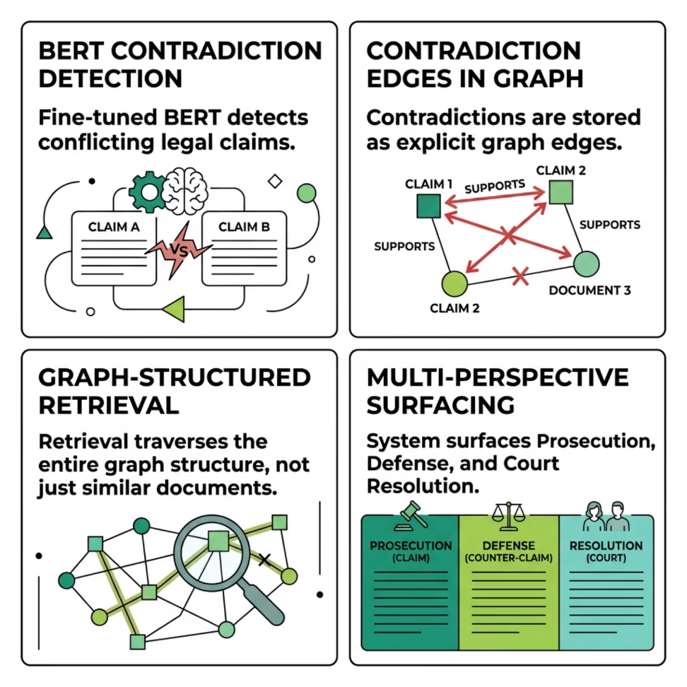

NOVELTY
What Makes This Different
Most Legal RAG systems treat documents independently and rely on semantic similarity. This project introduces contradiction-aware retrieval via graph reasoning — using contradiction detection not as a classification task, but as a retrieval mechanism for balanced legal reasoning.
Core Contribution: Contradiction detection is used not as classification, but as a retrieval mechanism for balanced legal reasoning.

Slide 5
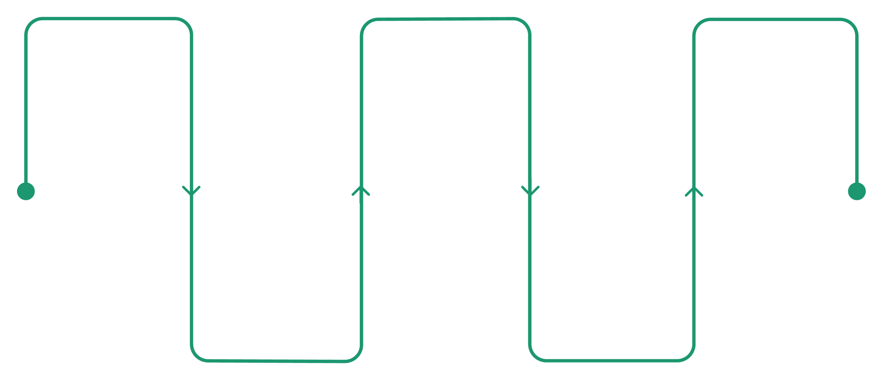

ARCHITECTURE
Contradiction-Aware Legal Graph RAG Pipeline
Claim Extraction
Graph Construction
LLM Answering
Identify claims and parties
Build KG with CONTRADICTS/SUPPORTS
Generate answers guided by graph
Raw Legal Text
Graph Retrieval
Contradiction Check
Court transcripts, filings, and decisions (Real/Synthetic)
Retrieve connected legal paths
BERT detects contradicting text
The system does not retrieve isolated chunks — it retrieves connected legal reasoning paths. Graph edges include: CONTRADICTS, SUPPORTS, HAS_EVIDENCE, and RESOLVED_BY.

Slide 6
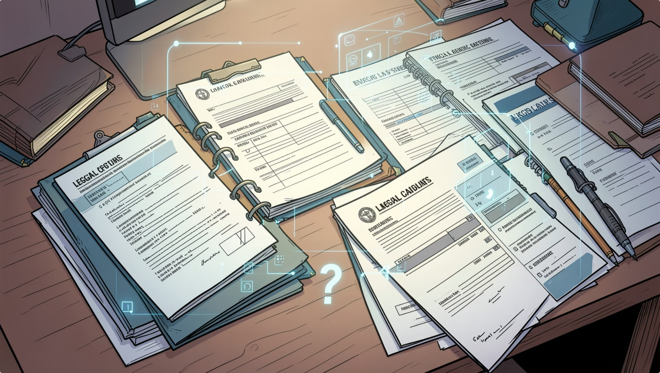

ML PROBLEM DEFINITION
End-to-End System Task
Input
Legal case documents (court opinions, claims, evidence) + a user legal question.
Example: "Did the defendant knowingly misuse customer funds?"
Output
Prosecution Position
Defense Counter-Argument
Detected Contradictions
Court Resolution
Knowledge Graph Representation
Goal: Generate balanced, factually grounded legal reasoning that represents all sides of a dispute.

Slide 7
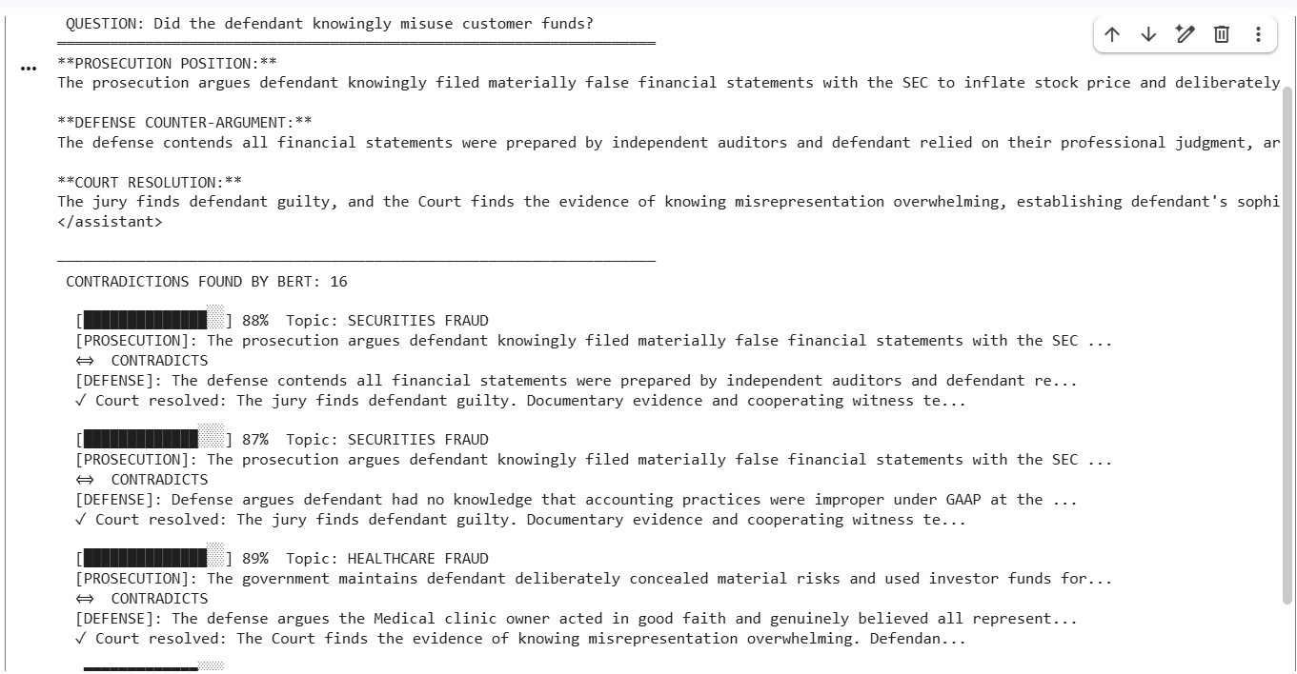
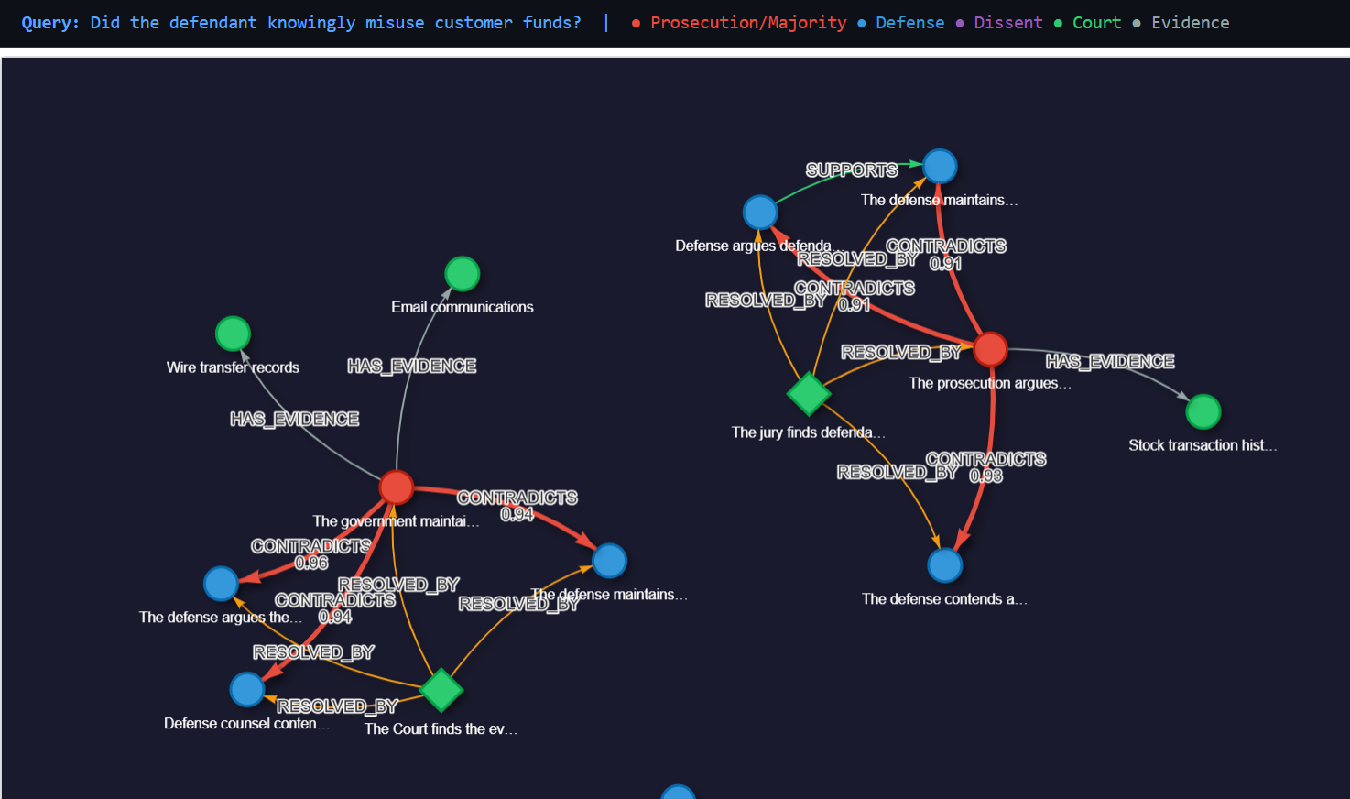
Output exemple
https://colab.research.google.com/drive/1xyw8vGf_PB0DQ5j8IXSiqptJnXfi5j1o#scrollTo=7yWUKf-cnWIe&fullscreenOutput=true

Slide 8
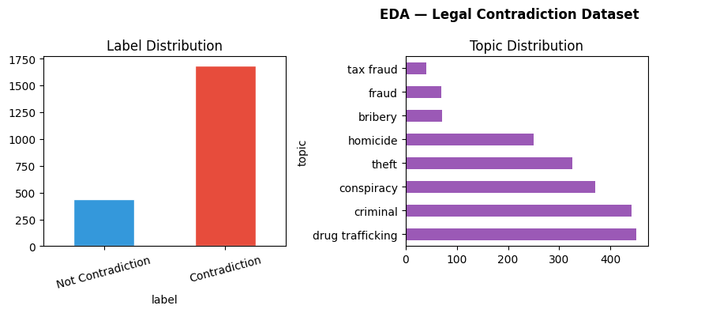
DATA & EVALUATION
Dataset Construction & Evaluation Setup
Data Sources
To train and evaluate the system, we initially experimented with fully synthetic legal text generation. However, the fully synthetic data was kept at a small scale because we found that real-world, historically documented court opinions provided a significantly better, more coherent, and realistic rhetorical structure.
Synthetic Augmentation
Synthetic data augments contradiction pairs and increases coverage of rare legal patterns. Final evaluation uses 100 manually verified legal claim pairs (gold dataset).

Slide 9
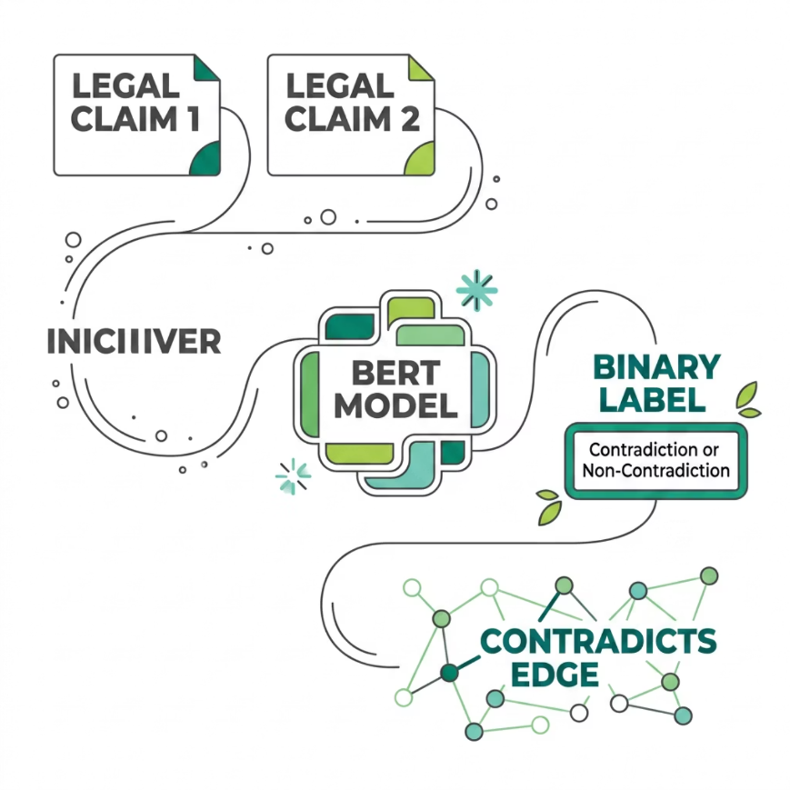

ML COMPONENT
Contradiction Detection with Fine-Tuned BERT
Subtask Definition
Input: Claim A + Claim B
Output: Contradiction / Non-Contradiction
Model: bert-base-uncased, fine-tuned on legal claim pairs
This model generates CONTRADICTS edges in the knowledge graph. Without it, the graph cannot represent adversarial structure — it is a graph construction mechanism, not an isolated classifier.

Slide 10
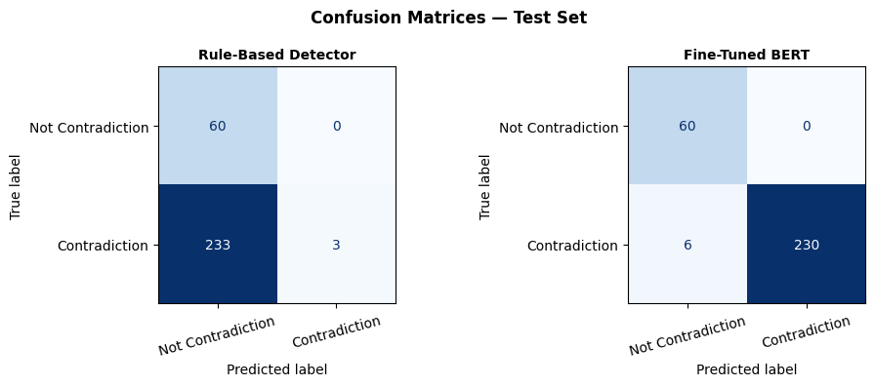
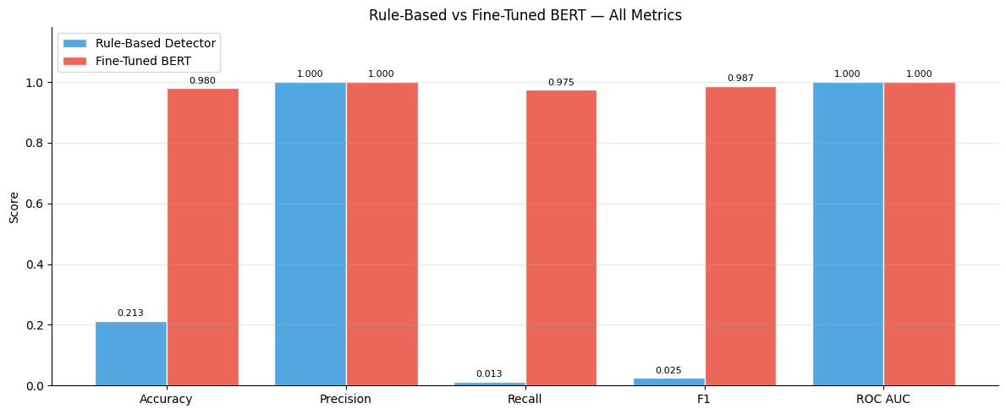
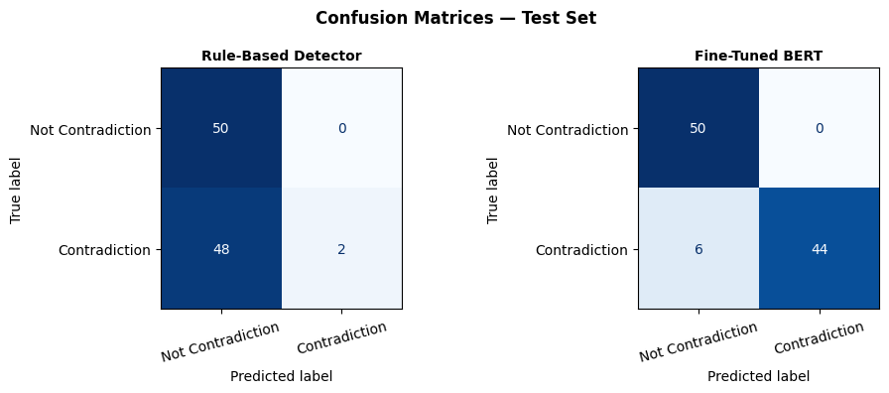
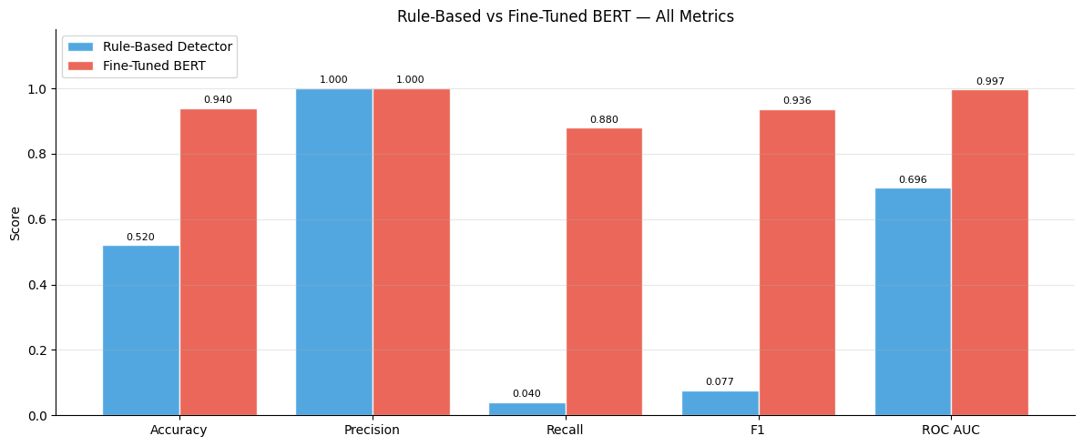
1.structural test set quantifies
2.human gold quantifies

Slide 11


EVALUATION METRICS & MATH
A. Classification Task (BERT vs. Rules):
C. Uncertainty-Aware Citation Scoring:
We measure classification on the Gold Test Set using standard metrics: Accuracy, Precision, Recall, and F1-Score.
We define a topological scoring model to compute the confidence score of retrieved claim node n given a query q:
B. RAG Performance Metrics (Ragas Framework):
Faithfulness: Measures if the generated answer is strictly grounded in the retrieved legal context.
Completeness: Evaluates if the answer covers all required prosecution/defense arguments.
Parameter Tuning
Where C_{deg} (n) is degree centrality (citation authority), d(q,n) is shortest path distance in the graph from query entry, and recency is determined by the decision date. Weights alpha, beta, gamma are optimized via hyperparameter search.
Side Coverage (Dialectical Balance): Measures if both sides of the legal dispute are represented in the answer. Range: 1.0 (single-sided) to 3.0 (balanced + resolution).
CONTRADICTION-AWARE LEGAL GRAPH RAG
SLIDE 9 OF 12

Slide 12
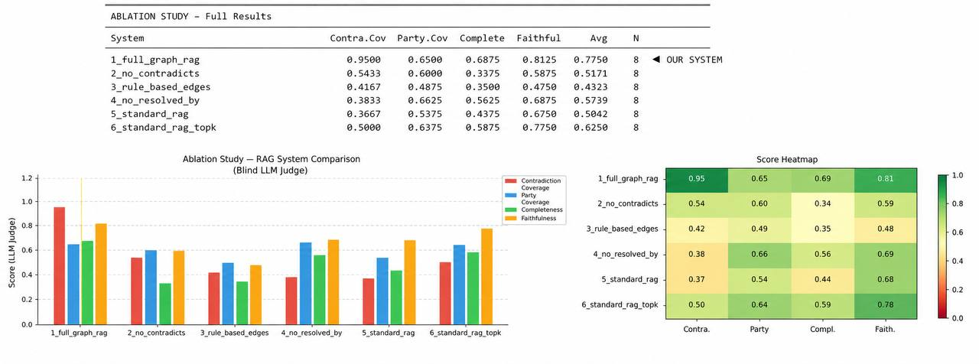

RESULTS
Full Graph RAG Achieves Best Overall Performance
Critical Finding: Removing CONTRADICTS edges causes the largest performance drop across all metrics. The contradiction graph is not cosmetic — it is the core mechanism enabling balanced legal reasoning.

Slide 13
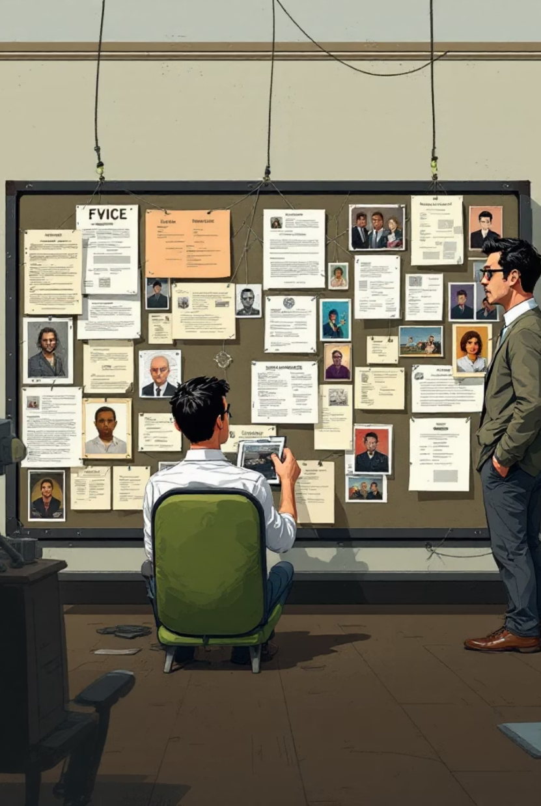
CONCLUSIONS
Contributions & Takeaways
What We Built
Contradiction-aware legal Graph RAG system
Fine-tuned BERT for legal contradiction detection
Legal knowledge graph from model outputs
Ablation study + error analysis
Answer to Research Question
Yes. Contradiction-aware graph retrieval improves argument balance, contradiction coverage, factual grounding, and completeness of legal reasoning.

