Slide 1

QA TESTING PROJECT – SAUCEDEMO & DUMMYJSON
What does “ready for production” actually mean?
Supervised By
Eng.Ashraf Smadi
Prepared By
Lana Al-Khateeb

Slide 2

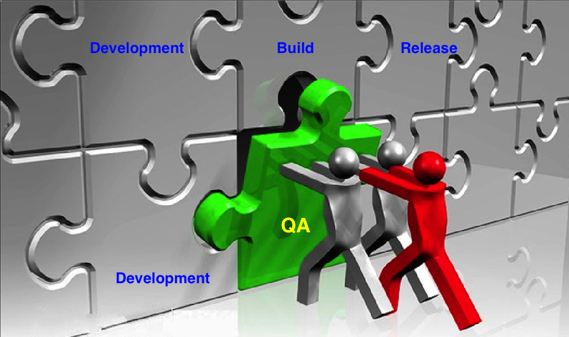
THE ROLE OF QA IN REAL PROJECTS
Software can look correct
Real users behave differently
Bugs reach production without QA
QA protects users and business
In real projects, software is often released because it looks fine.
But QA exists because looking fine is not enough.
QA’s role is to simulate real user behavior, uncover hidden risks, and decide whether the system is safe to release.”

Slide 3
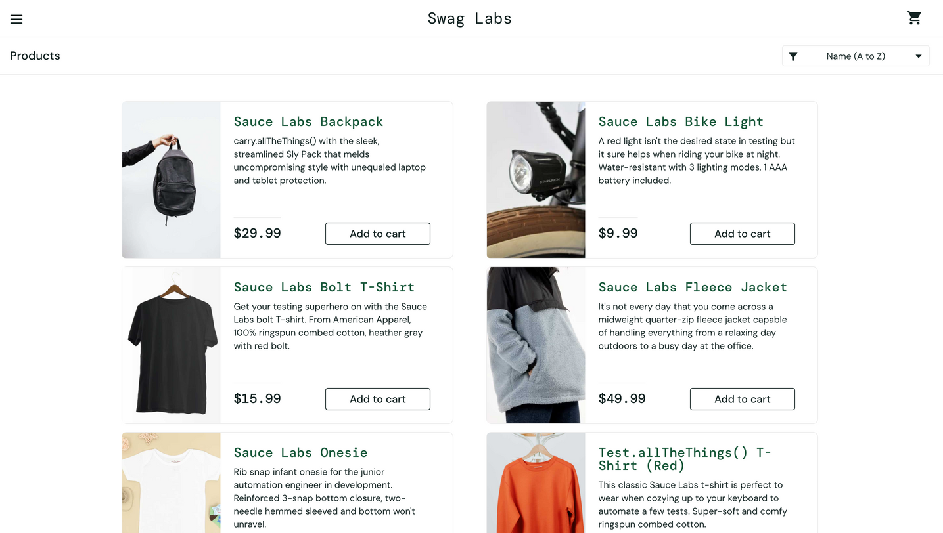
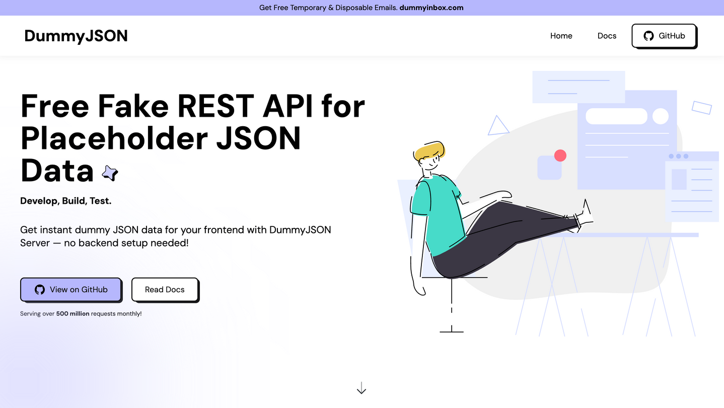
SYSTEMS UNDER TEST
SauceDemo – Web Application
DummyJSON – REST API

Slide 4

QA APPROACH USED
1
Manual testing (user behavior)
2
UI automation testing (critical flows)
3
API testing (backend validation)
4
Performance testing (system stability)

Slide 5

MANUAL TESTING
Focus Areas
Login & authentication
Product listing & sorting
Cart management
Checkout & validation
Logout & session handling
Testing Type
Positive scenarios
Negative scenarios
Tools
Microsoft Excel

Slide 6
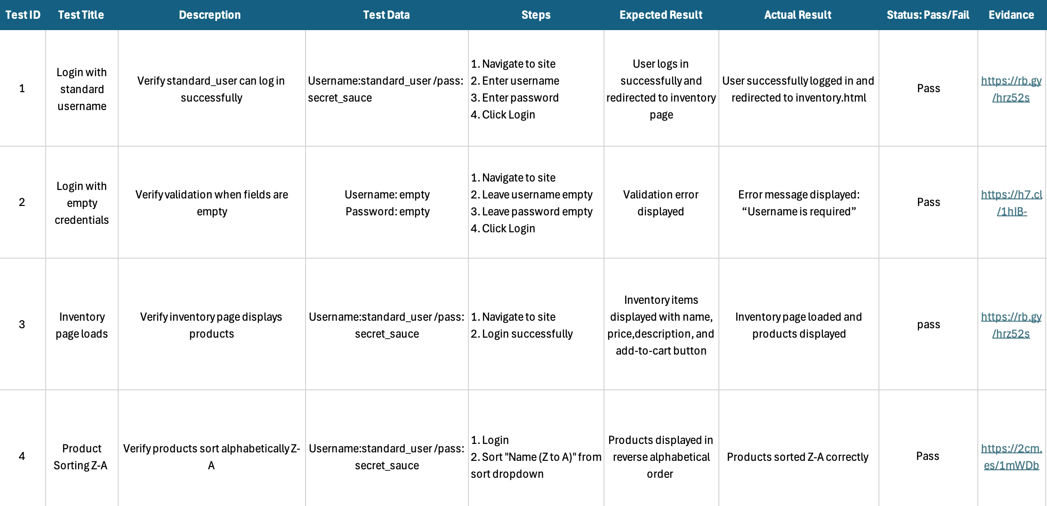
Test Cases Excel sheet

Slide 7
CRITICAL DEFECT IDENTIFIED
Defect Summary
Checkout form malfunction
Last Name field affects First Name field
Severity
Critical
Business Impact
User cannot complete checkout
Order completion is blocked

Slide 8
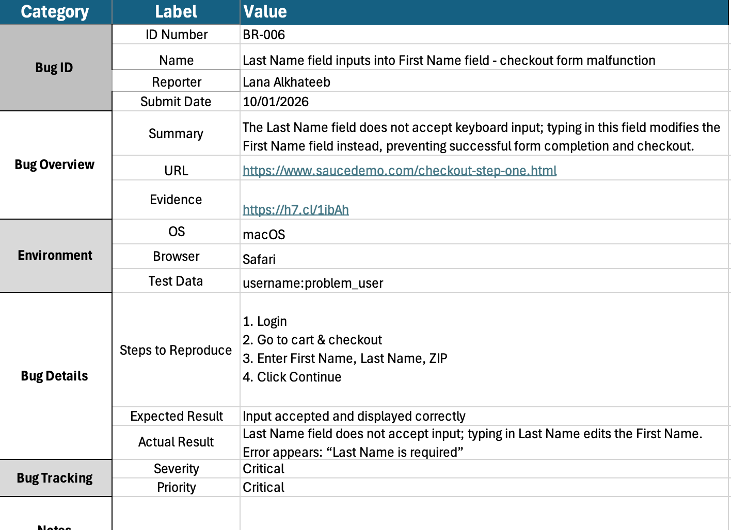
DEFECT REPORT:

Slide 9
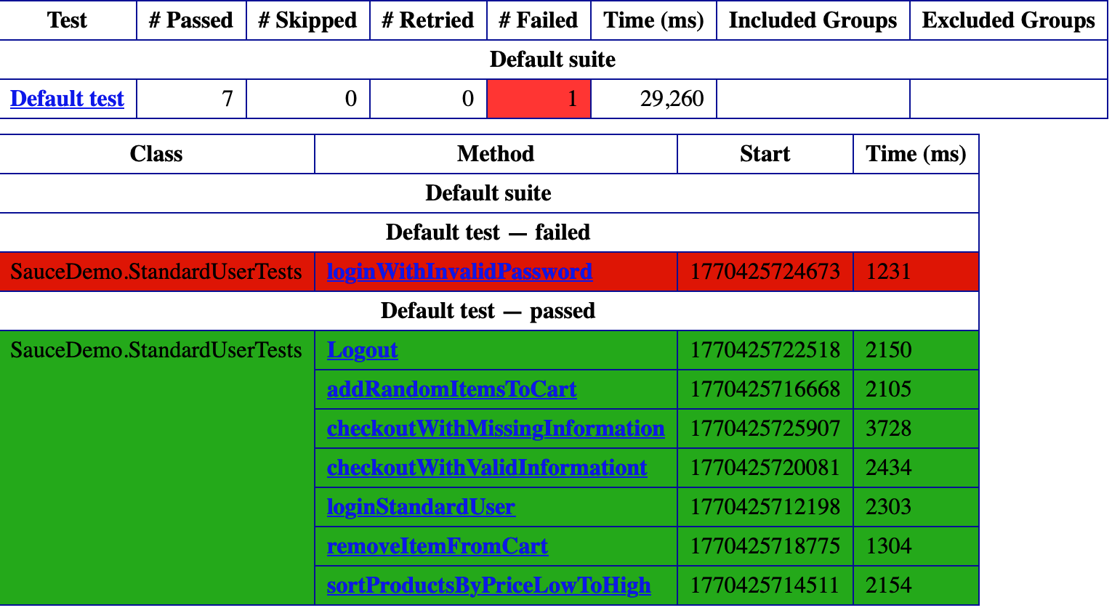
UI AUTOMATION TESTING
Purpose
Re-validate critical user flows automatically
Detect regressions early
Coverage
Login (valid & invalid)
Product sorting
Cart operations
Checkout validation
Logout
Tools
Selenium WebDriver
Java
TestNG

Slide 10
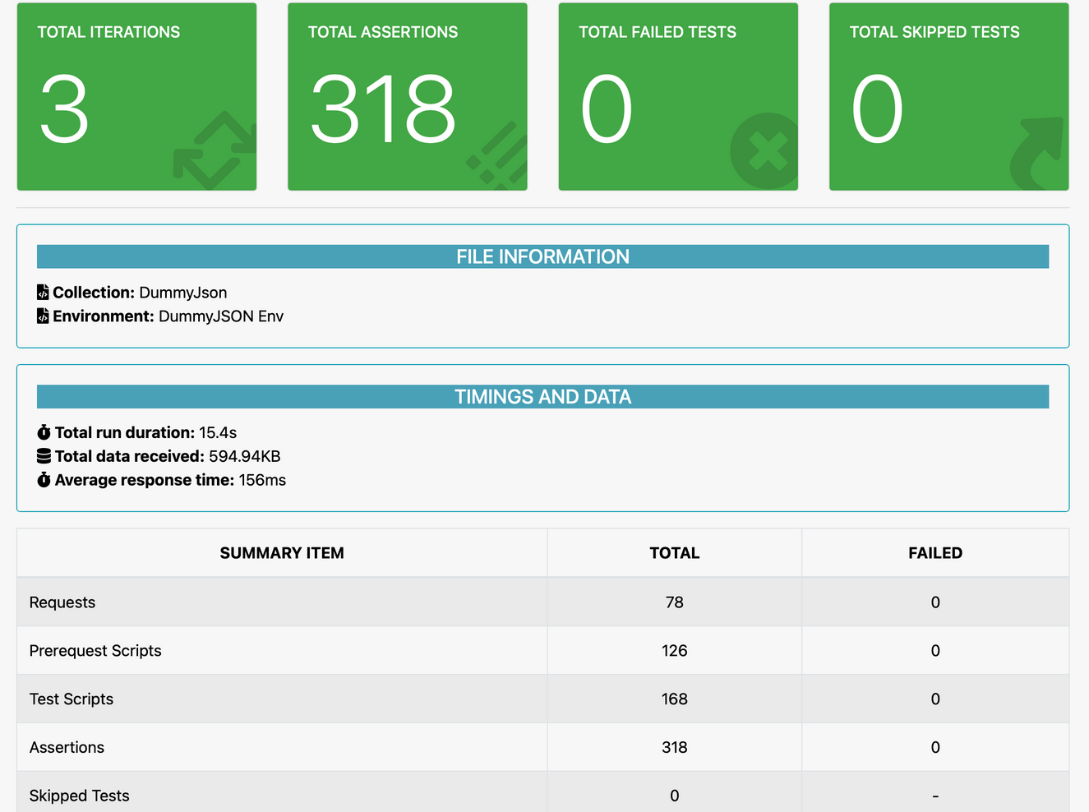
API TESTING
Objective
Validate backend behavior independently of the UI
Ensure correct responses and data structure
Scope
Product-related endpoints
Positive response validation
Schema and data checks
Execution
Automated API collection execution
Assertions for response correctness
Tools
Postman
Newman

Slide 11
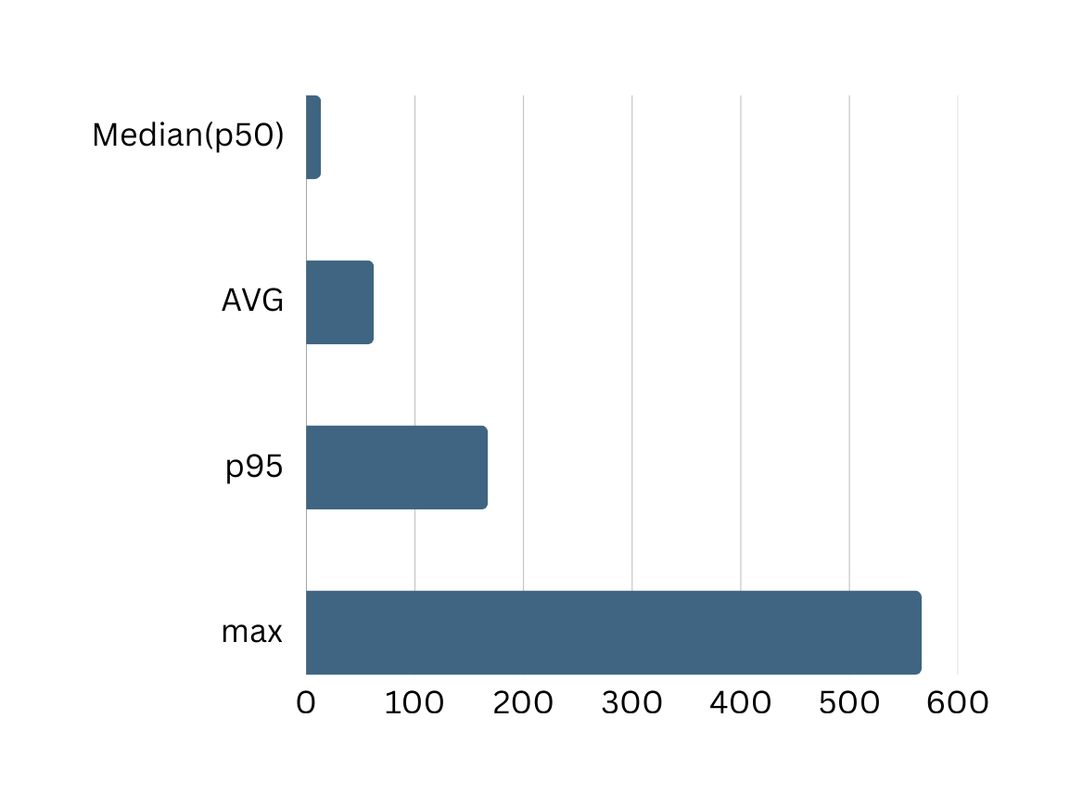
PERFORMANCE TESTING
Objective
Validate system stability under
concurrent load
Ensure performance does not introduce
production risk
Test Scenarios
Smoke test to verify baseline system behavior
Load test simulating up to 50 concurrent users
QA Assessment
System performance is stable within the tested scope
Performance is not a release-blocking risk

Slide 12
THANK YOU
Any Questions?

