Slide 1
Analysis of Statewise Consumer Price Index (CPI) in India Using R
Lana Anvar
Ashfaq Hussain
Benson
Salman Faris N

Slide 2
Abstract
The Consumer Price Index (CPI) measures changes in the general price level of household goods and services over time, making it a macroeconomic indicator of inflation. This project examines CPI trends across Indian states before and during the COVID-19 pandemic, providing insights into the economic impacts and recovery patterns following the crisis. Using a dataset from data.gov.in, our analysis highlights variations in financial resilience and inflationary pressure across different states. Essential analysis techniques include data cleaning, time series forecasting with ARIMA modeling, and various data visualizations to understand past trends and forecast future CPI levels, providing a broader picture of economic conditions and inflationary trends at the state level.

Slide 3
Introduction
The Consumer Price Index (CPI) tracks changes in the general price level of goods and services that households consume. Widely used by governments and central banks, for inflation targeting, monitoring price stability, and adjusting national accounts. As one of the most significant economic indicators, CPI relies on two primary components: weighting diagrams, which reflect consumption patterns, and regularly collected price data.
This project uses a dataset that provides CPI data for urban and rural populations across Indian states, enabling an analysis of price variations and economic resilience within these groups. Understanding urban-rural price differences highlights which sectors and regions may require targeted economic support and growth initiatives.

Slide 4
Data Description
Data Source: data.gov.in
Published Under: National Data Sharing and Accessibility Policy
Compiled by: Ministry of Statistics and Programme Implementation
This dataset provides monthly Consumer Price Index (CPI) values from January 2011 to February 2024 for each Indian state and union territory, covering rural, urban, and combined categories.

Slide 5
Challenges Encountered
A significant challenge encountered was the presence of null values, with some states and specific months needing more data.
These data gaps impact the ability to comprehensively analyze CPI trends across all regions, potentially limiting insights into nationwide inflation patterns.

Slide 6
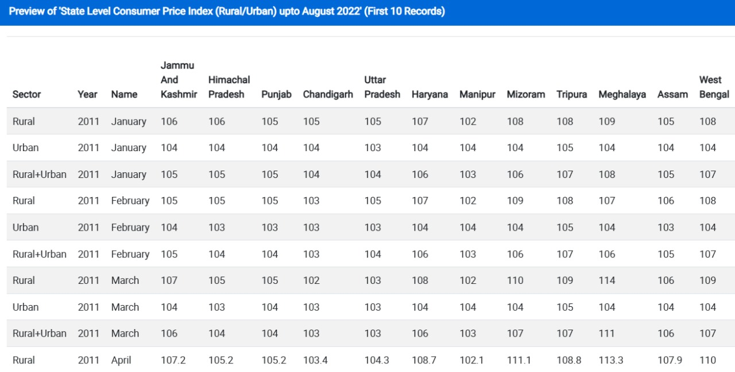

Slide 7
Time Series Analysis
The time series plot visualizes CPI data points over time, helping to identify underlying patterns and trends in inflation. By plotting CPI values across the dataset’s timeline, we can observe clear seasonal patterns and an overall upward trend, indicating persistent price increases over the years.

Slide 8
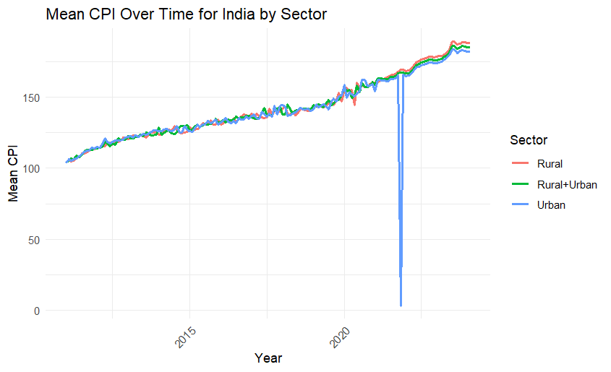

Slide 9
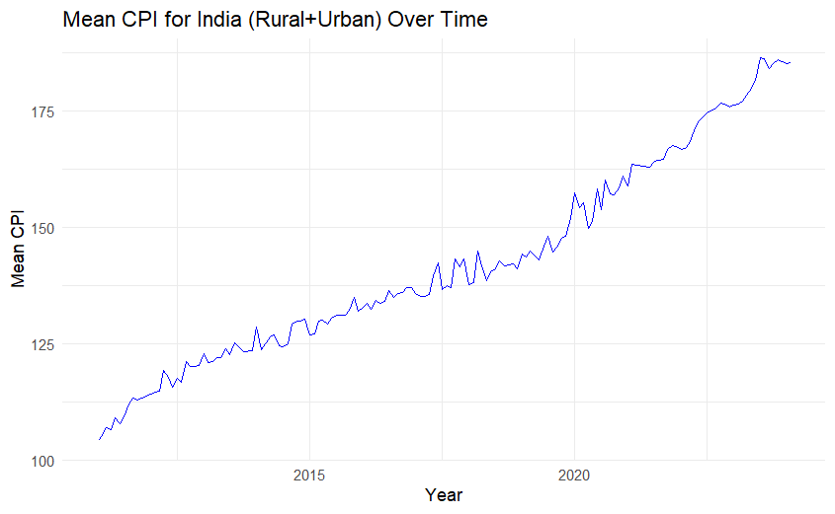

Slide 10
ARIMA Model
To further analyze these trends, we decomposed the time series into its seasonal, trend, and residual components, confirming the presence of both seasonality and an upward trend. Given this complexity, we applied the ARIMA model, specifically using auto.arima, to select optimal parameters. This model captures the seasonal and trend components, allowing us to generate a forecast that provides insights into expected future CPI values.

Slide 11
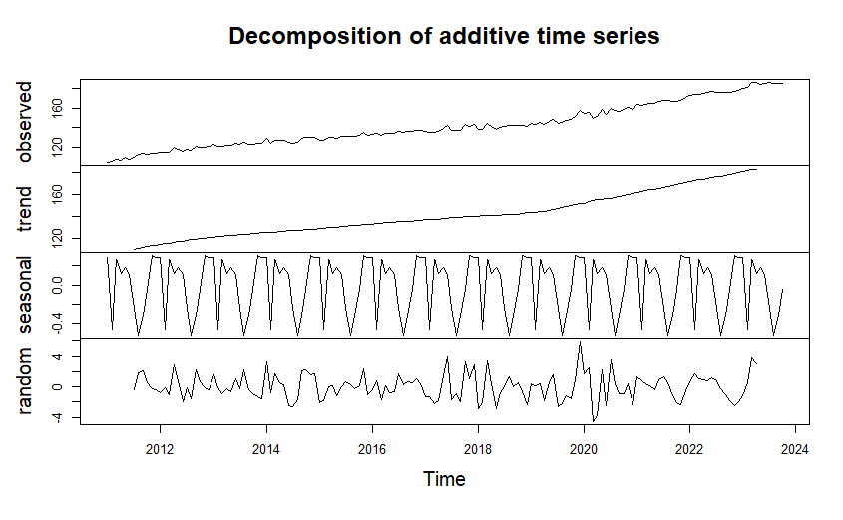

Slide 12
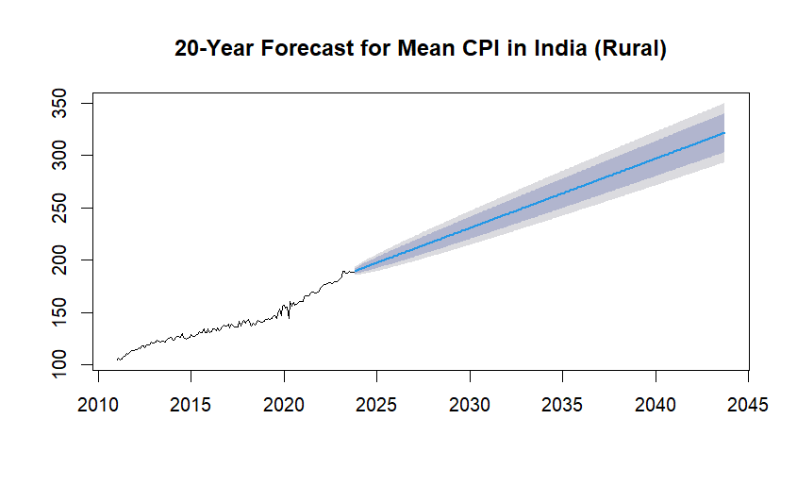

Slide 13
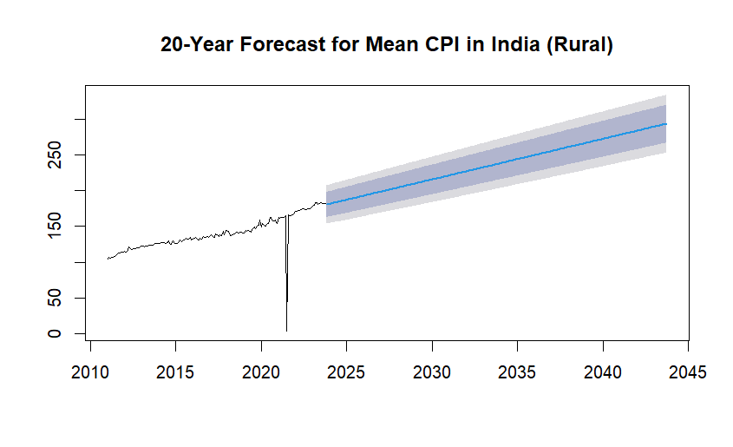


Slide 14
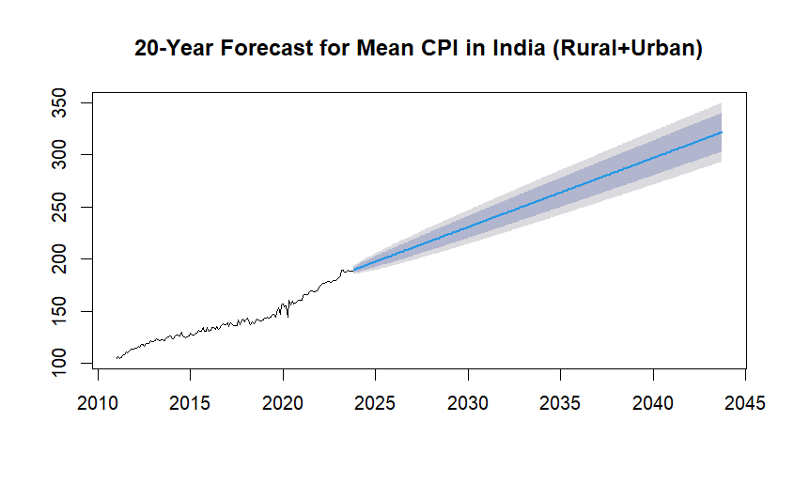

Slide 15
Line Plot
The urban sector’s higher volatility with sharp spikes in CPI suggests that urban areas are more sensitive to rapid price changes.
The spikes could also indicate periods of economic strain or policy changes affecting urban prices more intensely than in rural areas.
A majority of states show a gradual and steady increase in CPI, which reflects a consistent inflationary trend over the years. This steady upward trend is common in inflationary economies where the general price level increases annually.

Slide 16
Evaluation of line plots
North-Eastern states showing greater volatility could reflect the unique economic and logistical challenges these states face. Being geographically remote, they may experience price changes more acutely due to transportation costs, infrastructure challenges, or localized economic factors.
The noticeable increase in CPI around 2020 aligns with the onset of the COVID-19 pandemic, which triggered inflationary pressures across the globe. In India, supply chain disruptions, lockdowns, and increased demand for certain goods (like essentials) likely pushed prices upward.

Slide 17
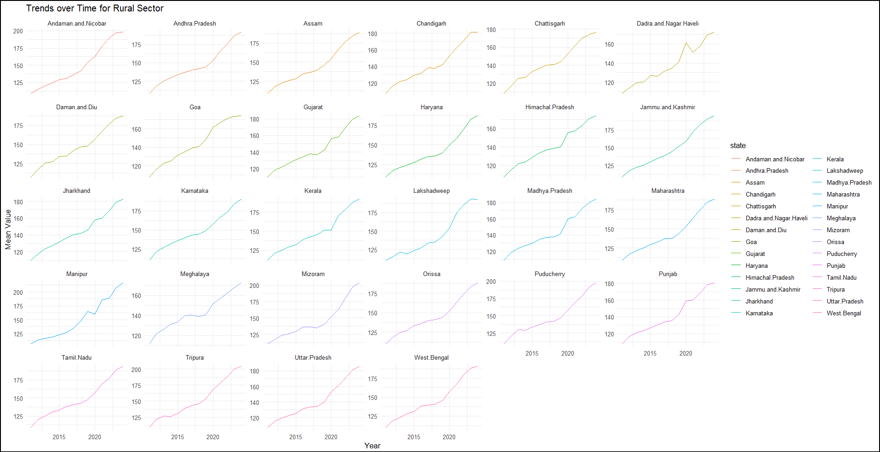
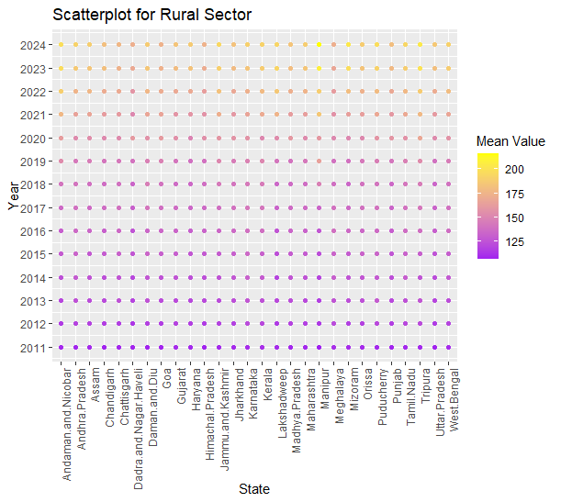

Slide 18
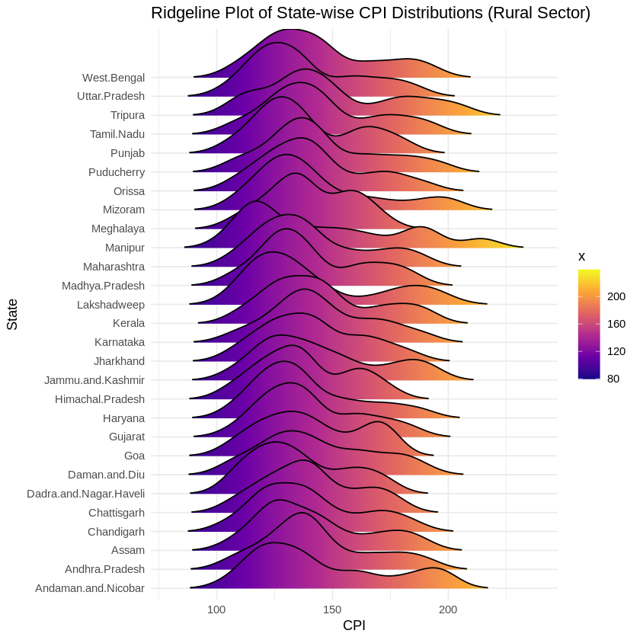

Slide 19
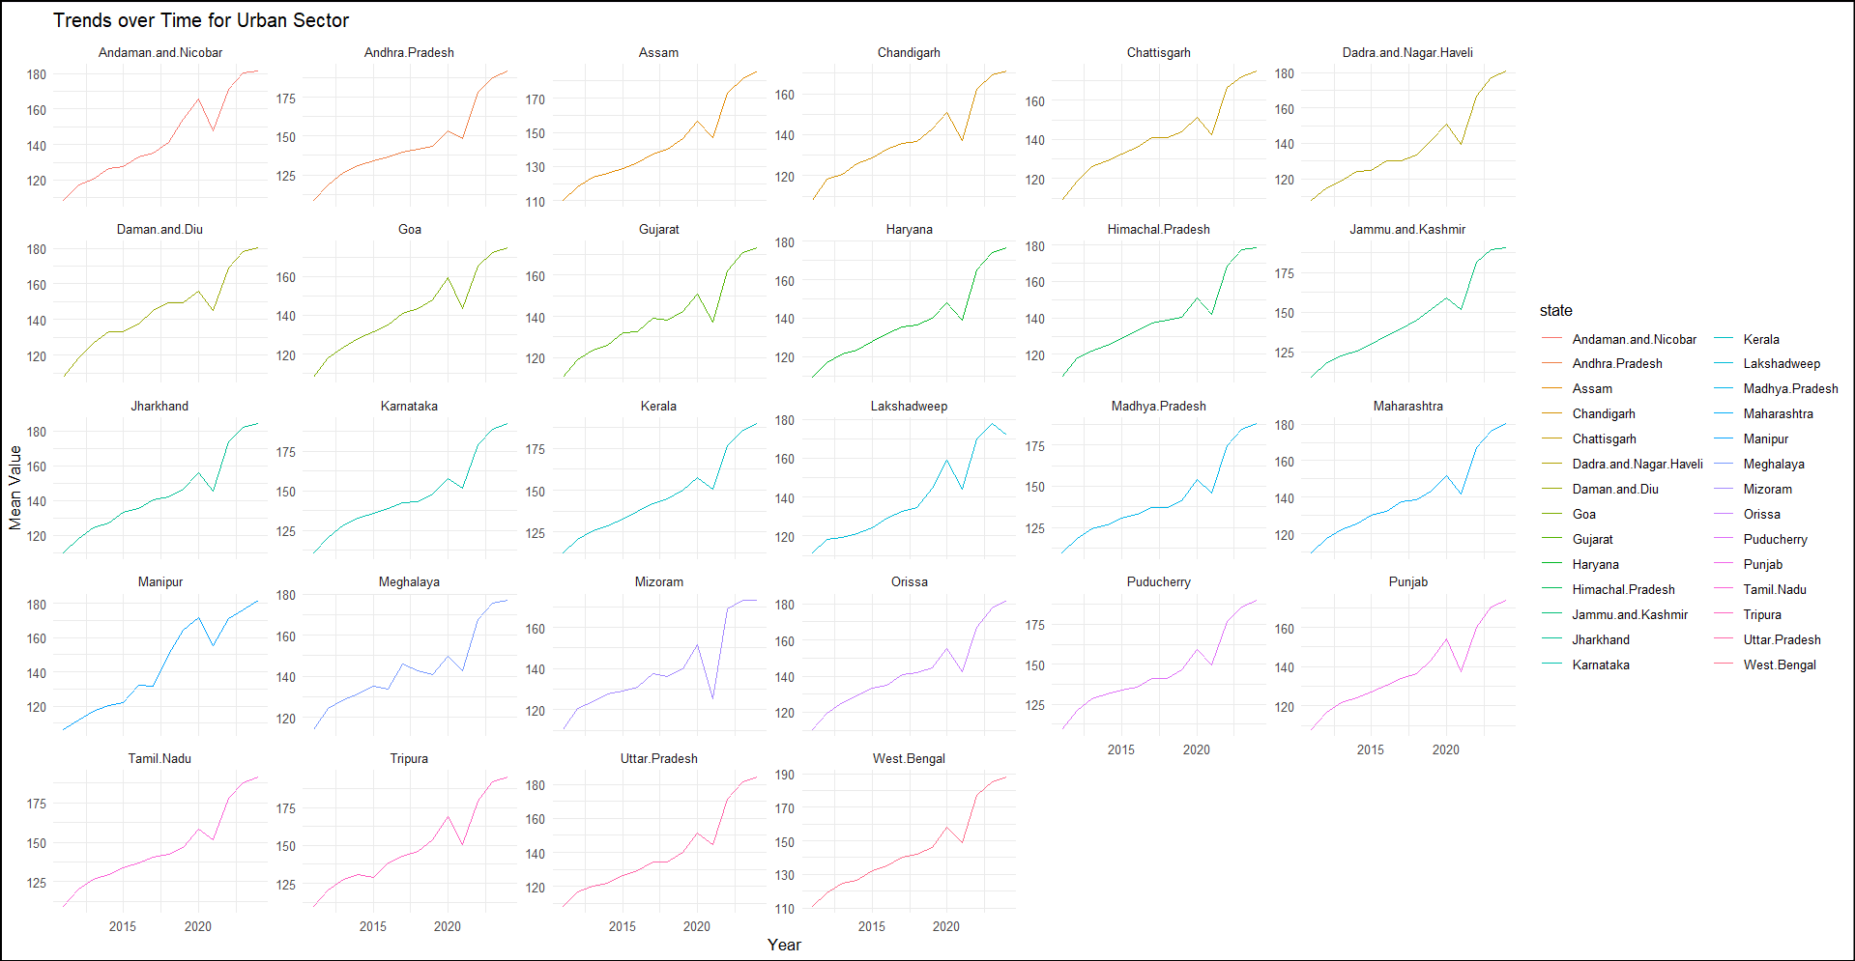
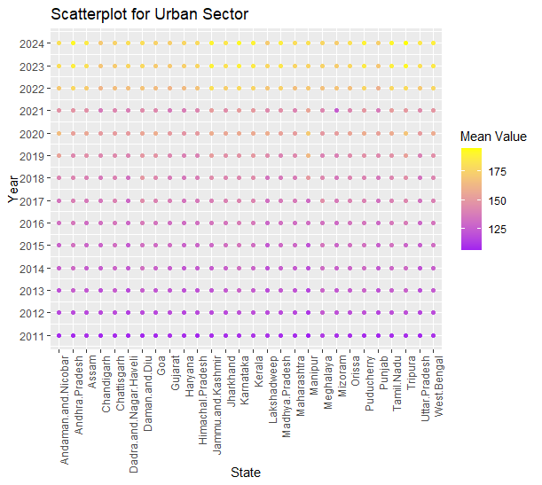

Slide 20
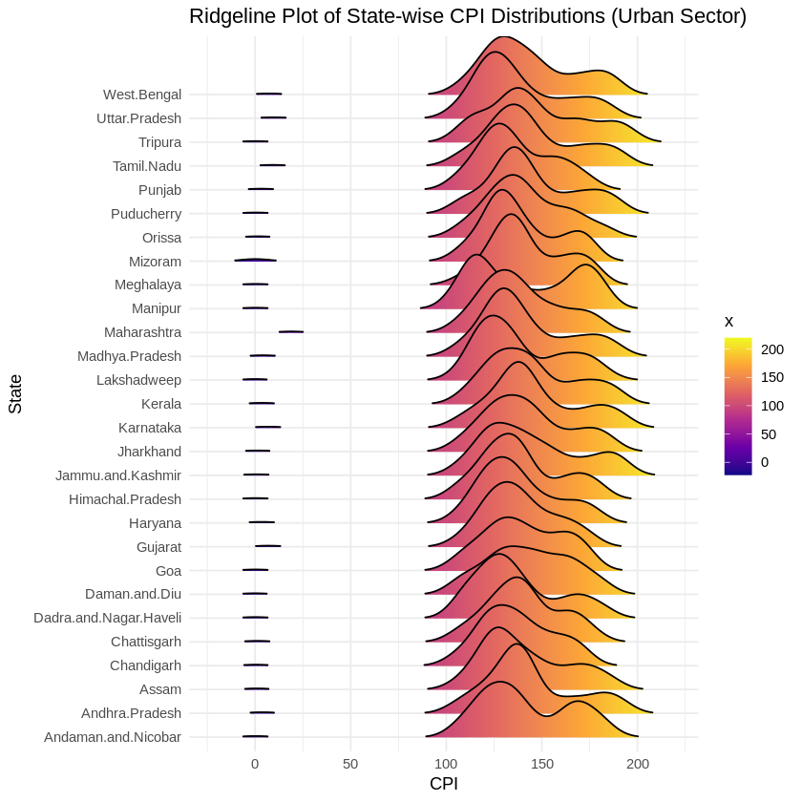

Slide 21
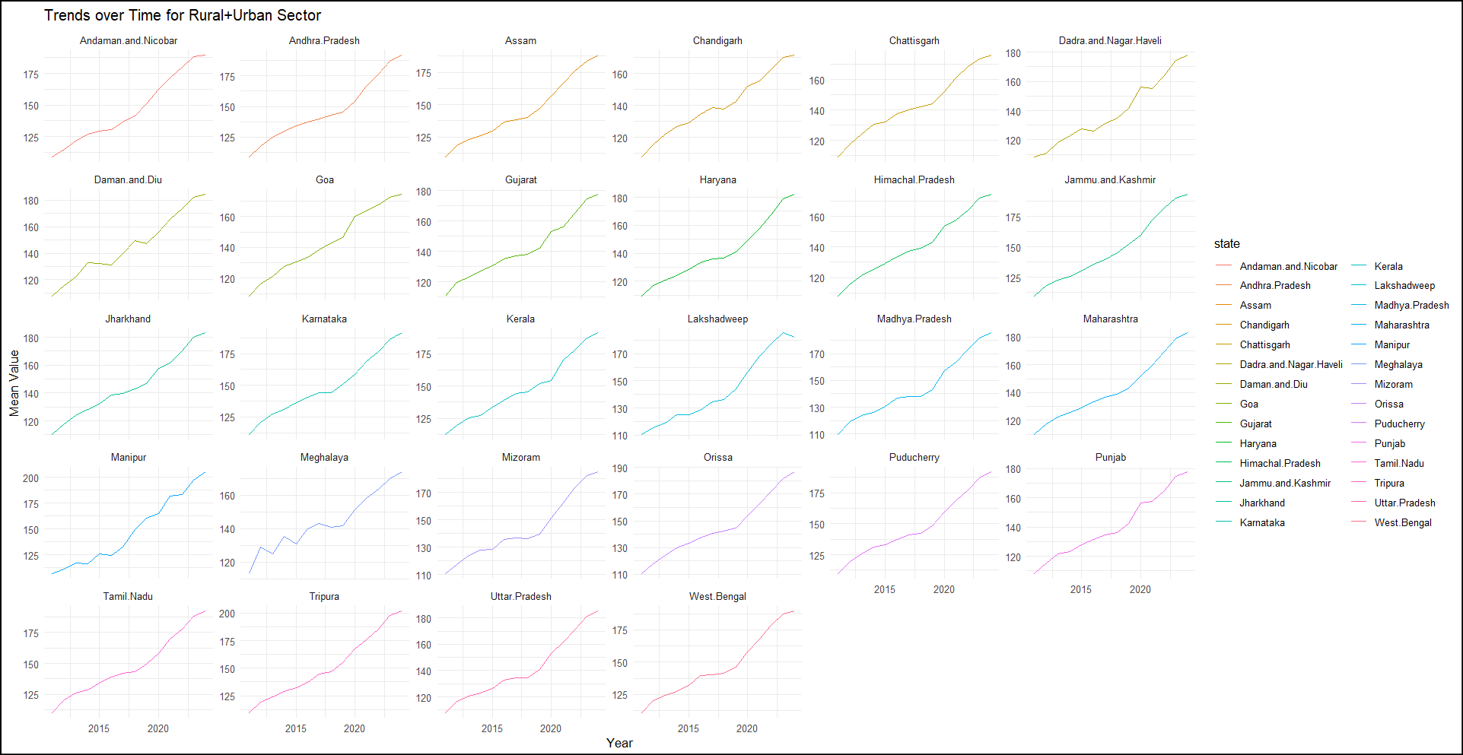
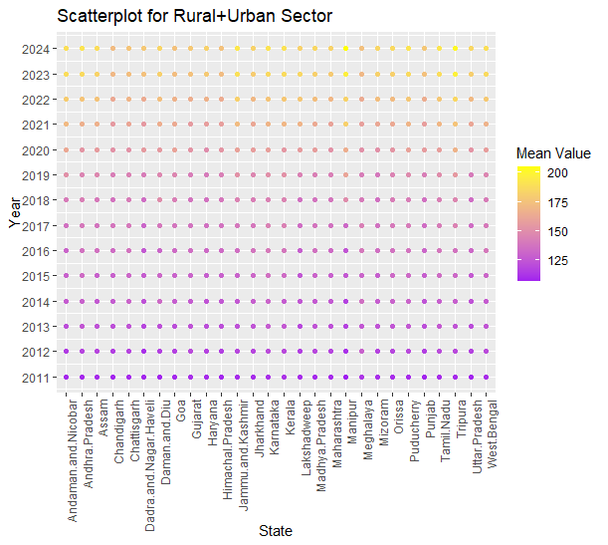

Slide 22
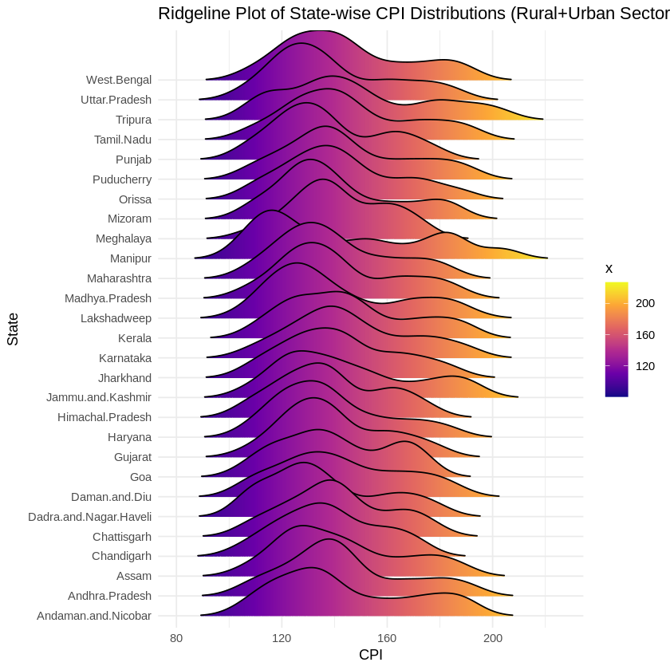

Slide 23
Heatmap
The color scale ranges from blue (representing lower CPI values, around ~125) to red (representing higher CPI values, around ~200).
The heatmap for the urban sector shows the most intense red patches, indicating consistently higher CPI values compared to rural areas.
The rural sector heatmap displays a more uniform color transition from blue to red over time, signifying a steady, linear increase in CPI without sudden spikes.
The combined sector heatmap, representing both rural and urban CPI values, lies somewhere between the other two in terms of color intensity and variation.
Across all sectors, the heatmaps show a clear upward trend in CPI values from 2010 to 2024, marked by a shift from blue to red.

Slide 24
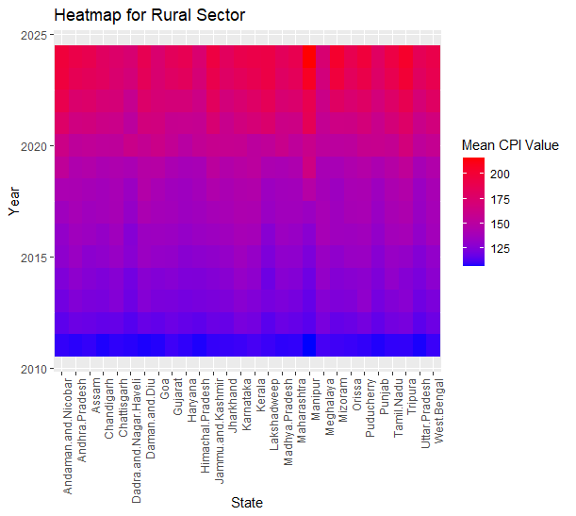

Slide 25
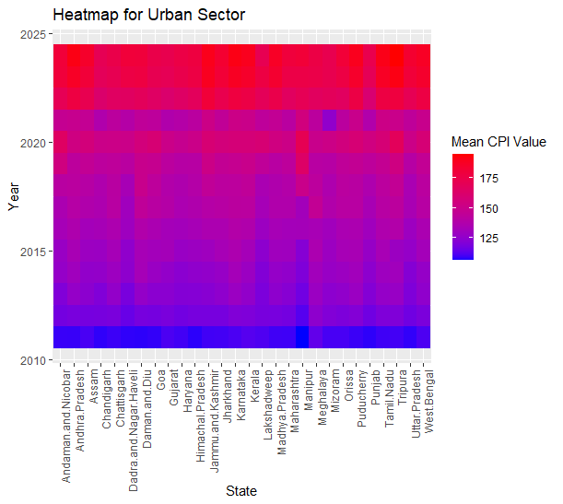

Slide 26
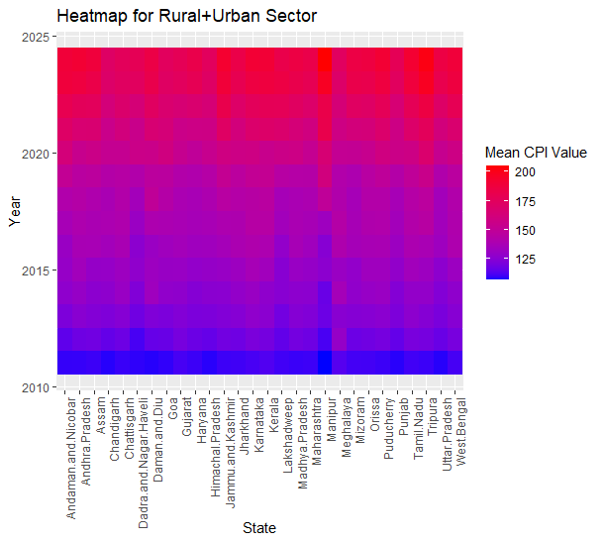

Slide 27
Indian Map
From these maps, we can interpret the impact of the Consumer Price Index (CPI) on the population’s cost of living across different states in India. Here’s a breakdown of how CPI affects lives based on the data:
Regional Price Variation: The maps reveal that some states have higher CPI values (darker shades), indicating a higher cost of goods and services. This variation implies that people in high-CPI states need to spend more to maintain the same standard of living compared to those in low-CPI states. Regions with a darker shade, like southern India, indicate higher price levels for essential commodities, which could increase the financial burden on households.

Slide 28
Impact on Rural Populations
The Rural CPI map highlights the cost of living specifically in rural areas. A high rural CPI can affect the affordability of goods for people in rural areas, who may have lower income levels. This can lead to reduced purchasing power, pushing households to limit consumption or switch to cheaper alternatives.

Slide 29
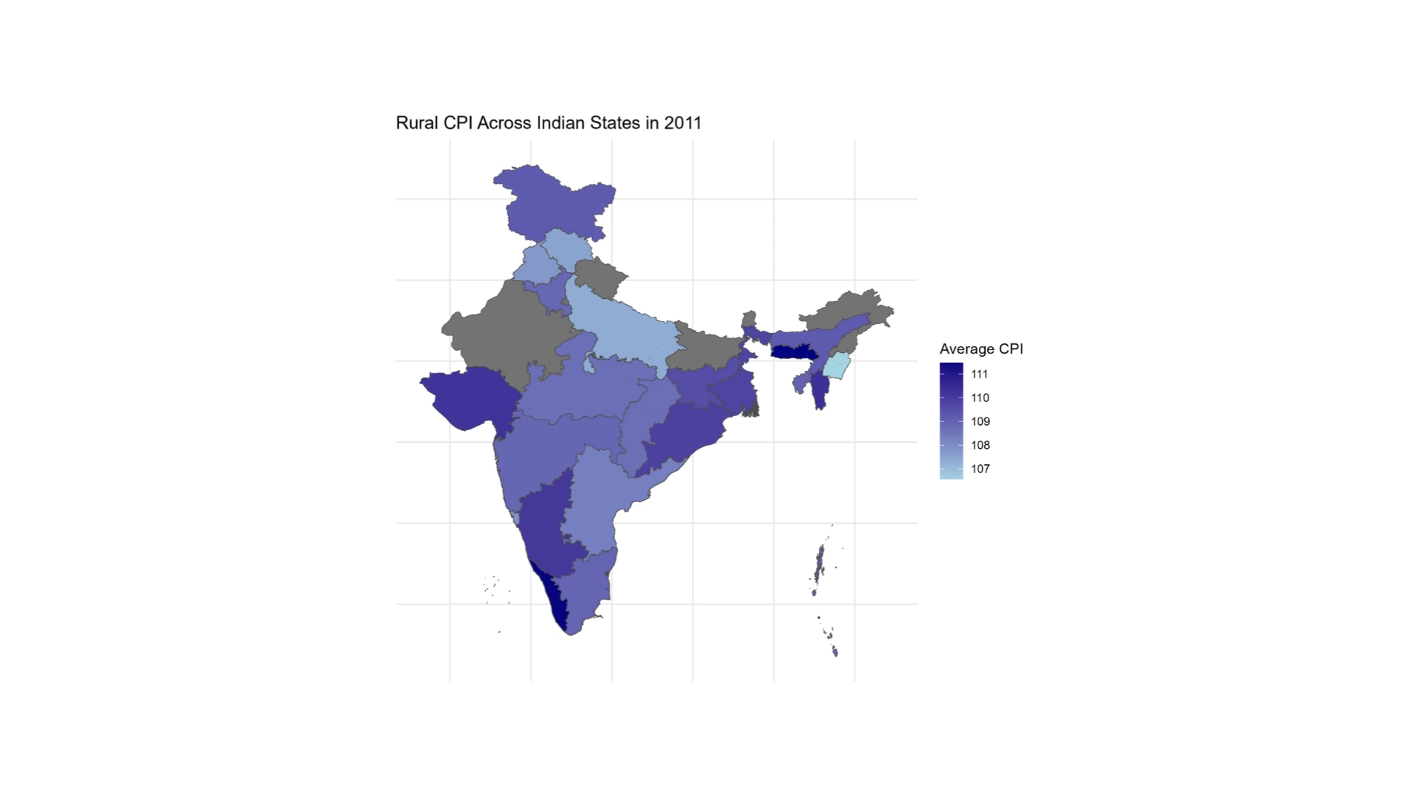

Slide 30
Impact on Urban Populations
The Urban CPI map shows price levels in urban areas. Urban areas typically have higher living costs due to factors like higher demand for housing, transportation, and other services. This affects urban dwellers, especially lower-income groups, as they need to allocate a larger portion of their income to cover essentials.

Slide 31
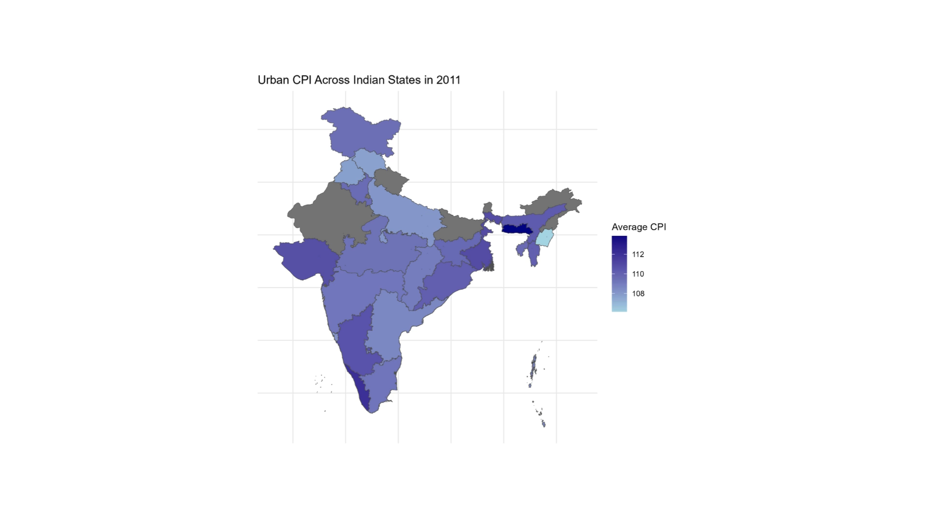

Slide 32
Impact on Combined Populations
The combined CPI map provides an overall picture of the state-wide CPI. It reflects the general cost of living for all demographics in each state, giving an idea of where goods and services are generally more expensive or affordable. High CPI here means people across the state, regardless of urban or rural setting, are experiencing a higher cost of living.

Slide 33
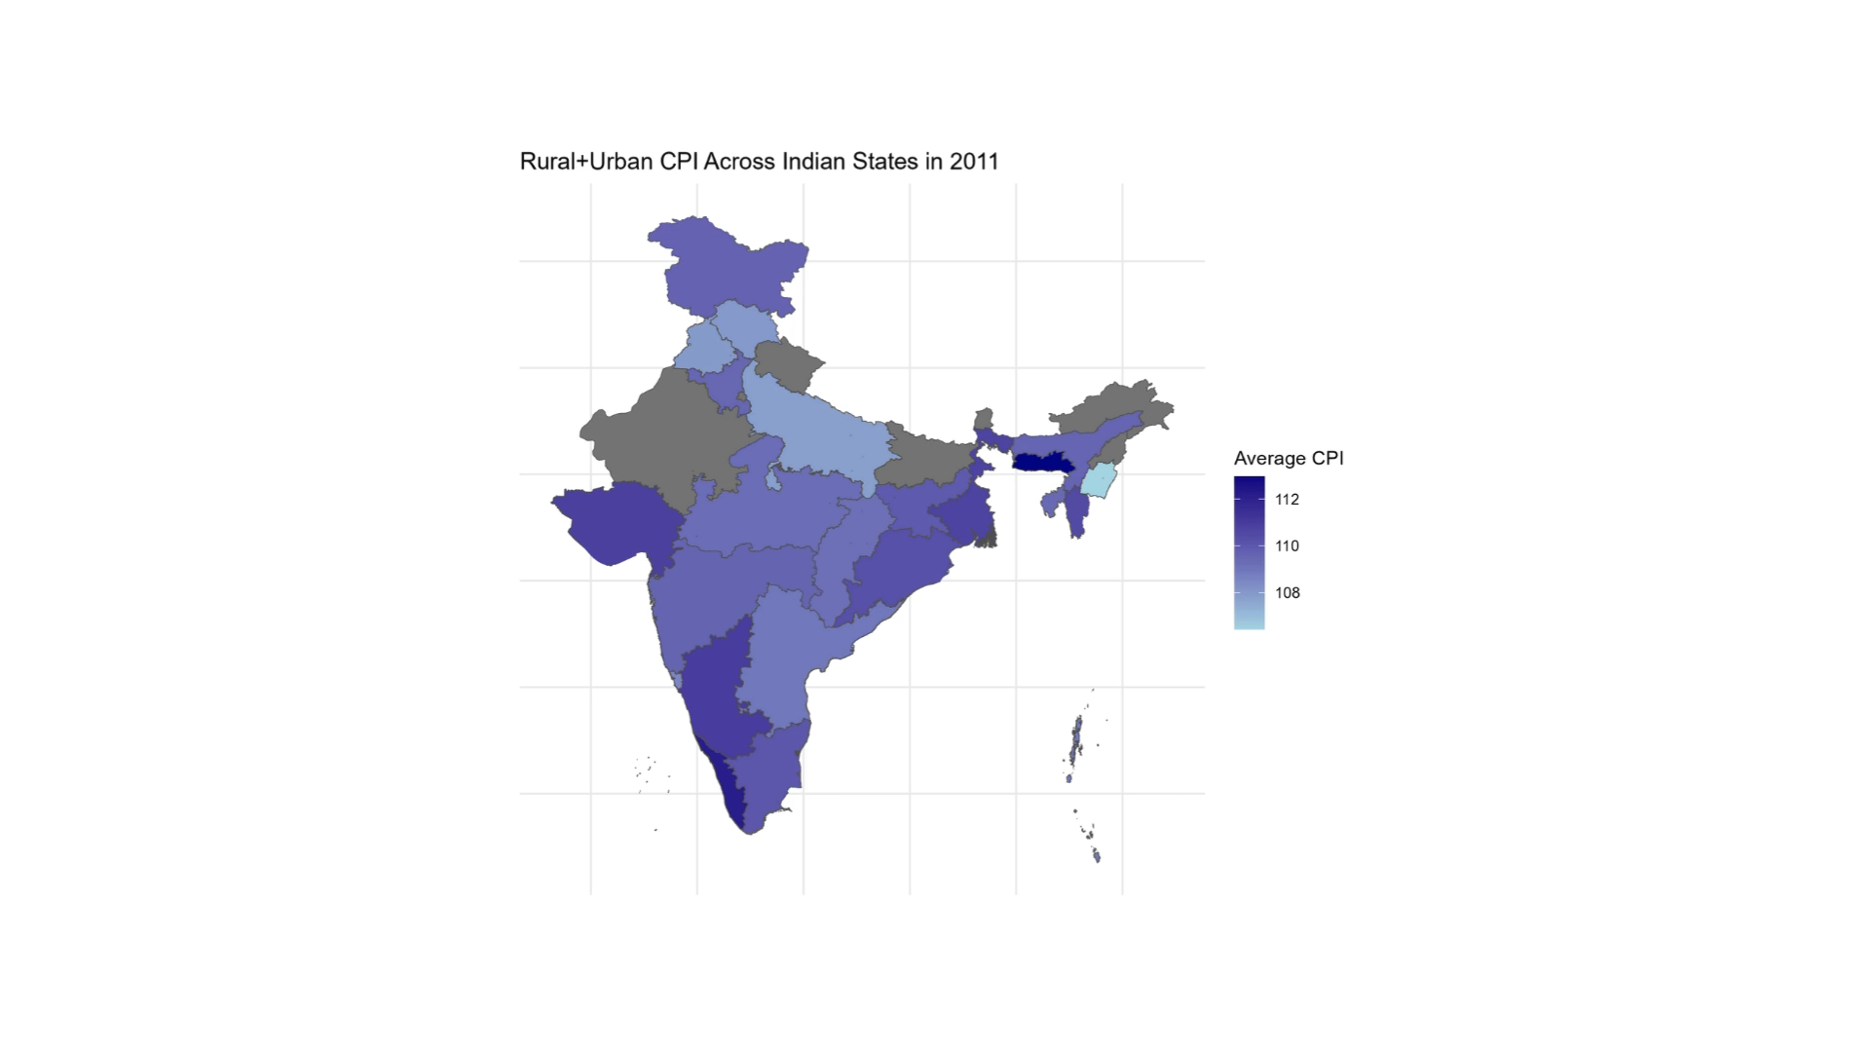

Slide 34
Effect on Inflation and Purchasing Power
High CPI values indicate inflationary pressure in those areas. When prices rise, people’s purchasing power decreases, meaning they can buy less with the same income. This can affect the quality of life, as people might cut down on non-essential spending, impacting lifestyle and mental well-being.

Slide 35
Economic and social impact
Persistent high CPI in some regions could drive inequality, as only wealthier households might be able to keep up with the higher cost of living. In rural areas, where incomes are often lower and less stable, high CPI can contribute to poverty. For urban areas, it could lead to increased demand for higher wages, possibly driving wage inflation and affecting business profitability.
These maps serve as a tool for policymakers to identify regions with high living costs and consider interventions, like subsidies, to help residents afford essential items, or to implement measures that can stabilize prices in high-cost regions.

Slide 36
Interpretation
CPI values are high in Urban Areas than in the Rural Areas.
The sudden spike of inflation is compromised in Rural + Urban Areas.
The prediction done with the ARIMA model showcases that the future-value is lying between a range of values.
High CPI (Inflation) generally results in increased cost of living, reduced purchasing power and economic uncertainty
Low CPI (deflation) can initially increase purchasing power but lead to reduced spending, higher debt burdens and potential economic stagnation.

Slide 37
References
Dataset - https://www.data.gov.in/catalog/state-level-consumer-price-index-ruralurban
Visualisation - https://r-statistics.co/Top50-Ggplot2-Visualizations-MasterList-R-Code.html#Open%20Street%20Map
CPI Informations - https://groww.in/p/consumer-price-index

