Slide 1


SPRINT 4 PRESENTATION
By- Lance Harewood, Jannut Khan, O’Cyrus Bapiste

Slide 2

Challenges We Faced
Making sure the speed of the robot is not too fast or too slow
The robot avoided two objects but hit one, so we had to keep making little adjustments
The robot hit a few pins but not all, so it was difficult for our group to program it to knock over every pin

Slide 3
Roles Of Each Team Member
Lance - (Planner)= Gantt Chart, Testing The Code, Making the Algorithm, meet up and help plan out the roles
O’Cyrus- (Programmer/Flowchart)= Writing the Code, Testing the Code,meet up and help plan out the roles
Jannut- (Designer)= Design Document, Testing the Code, meet up and help plan out the roles

Slide 4
What We Have Learned About Software Engineering
We learned how to receive a set of instructions and follow it exactly with our code
We learned that we have to keep making adjustments while building so that it works perfectly every time
We learned that working in a team requires a lot of time management and self management
Lastly we learned that building something does not happen overnight, it is a long process

Slide 5
What Would You Do Differently
If we could go back in time we would....
Plan ahead for issues
Set aside more time for tasks that we assume will not take long
Not stress when something does not go according to plan the first time

Slide 6
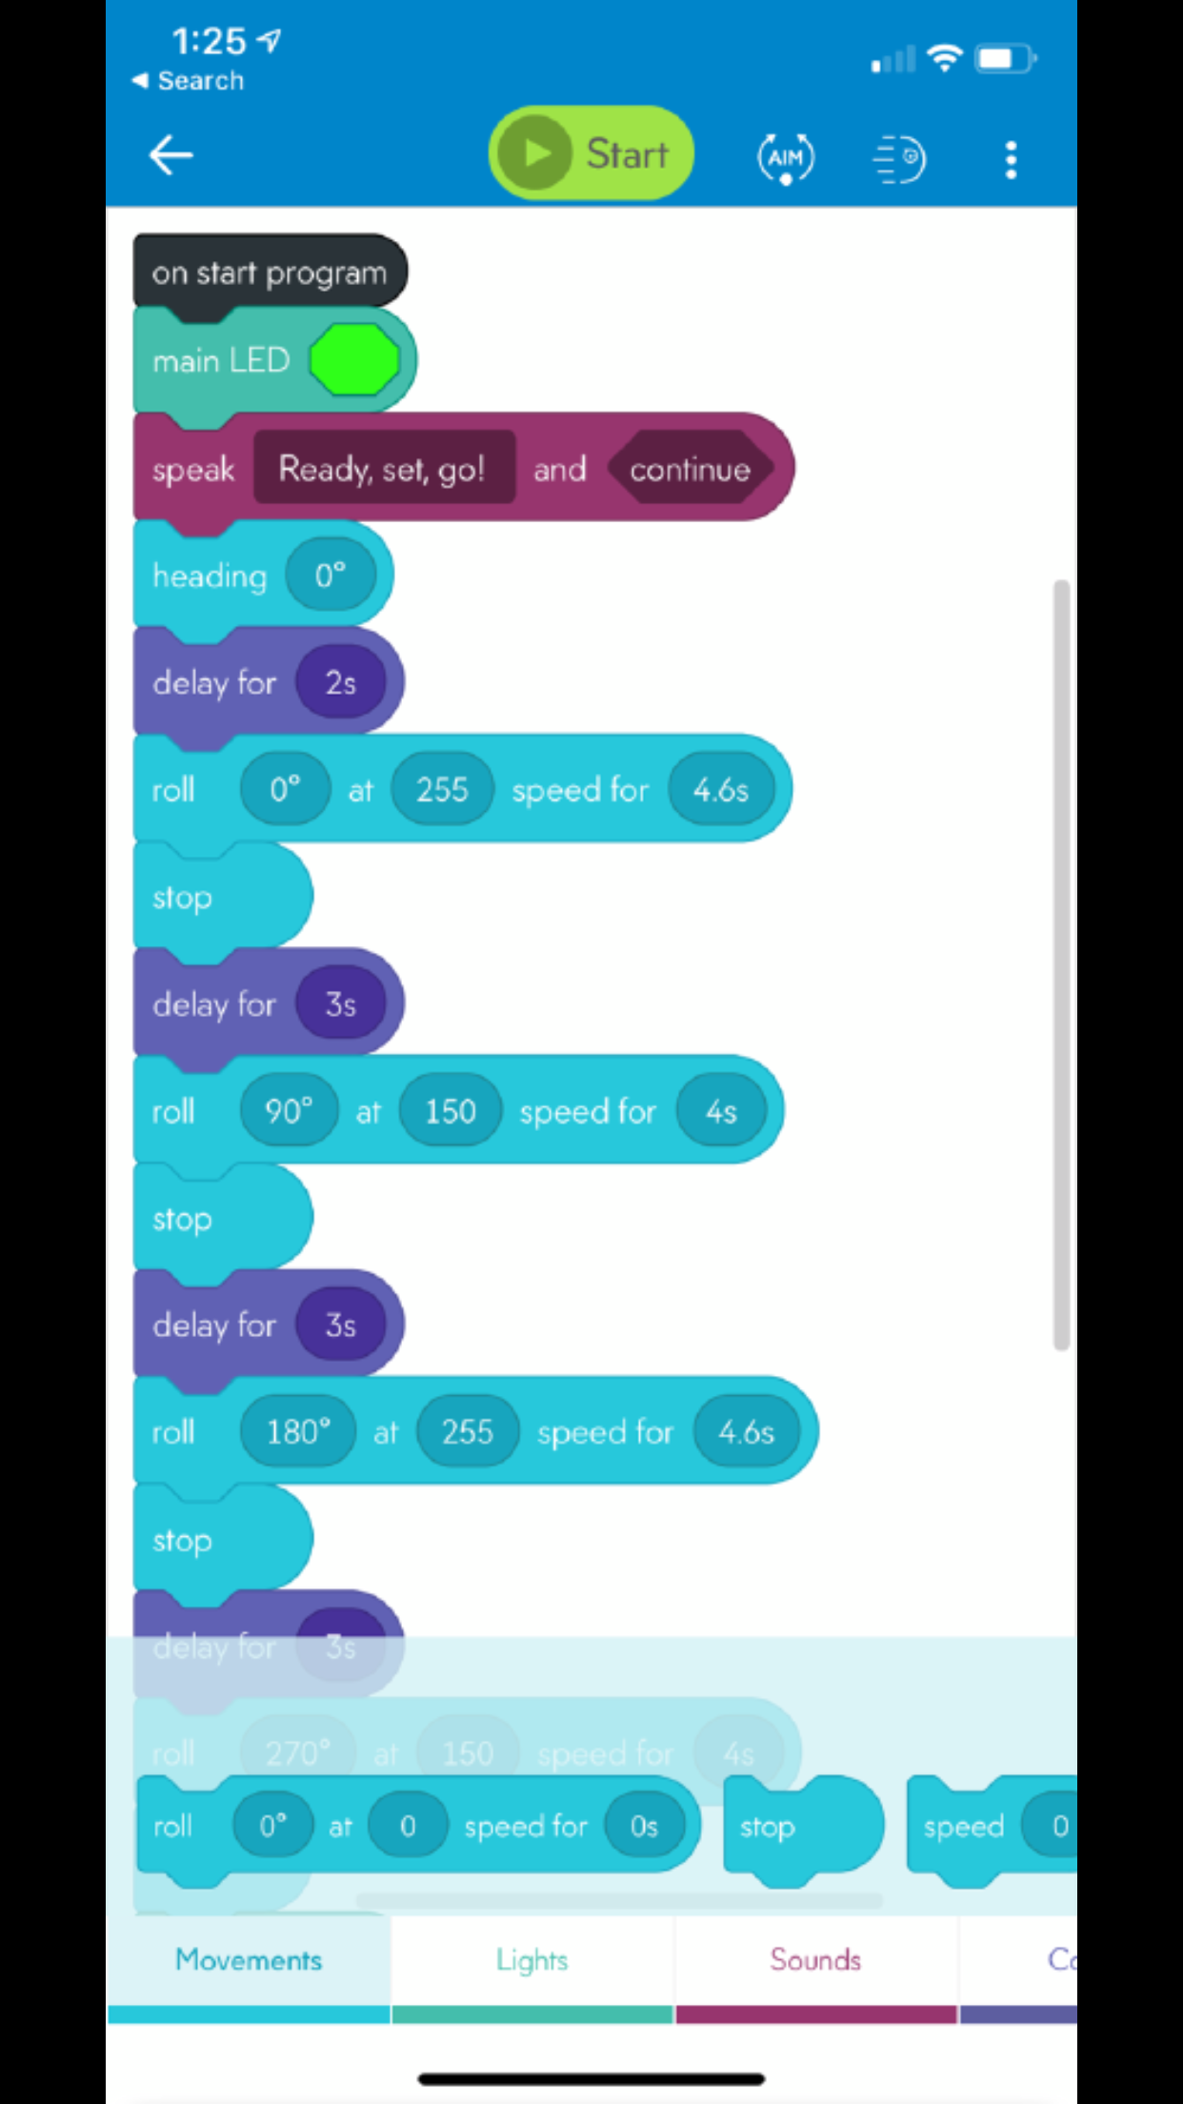
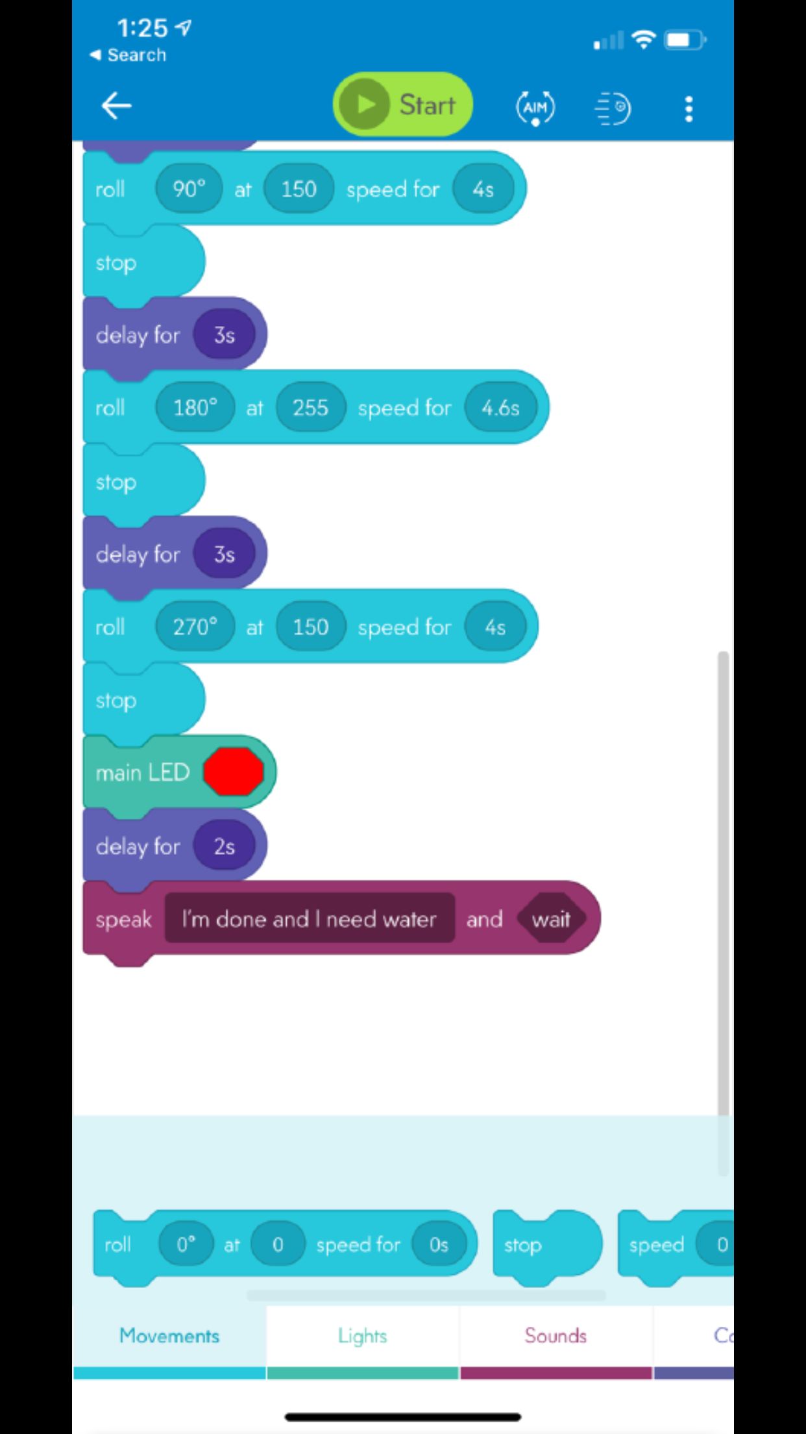
Code For Sprint 3 Agility

