Slide 1
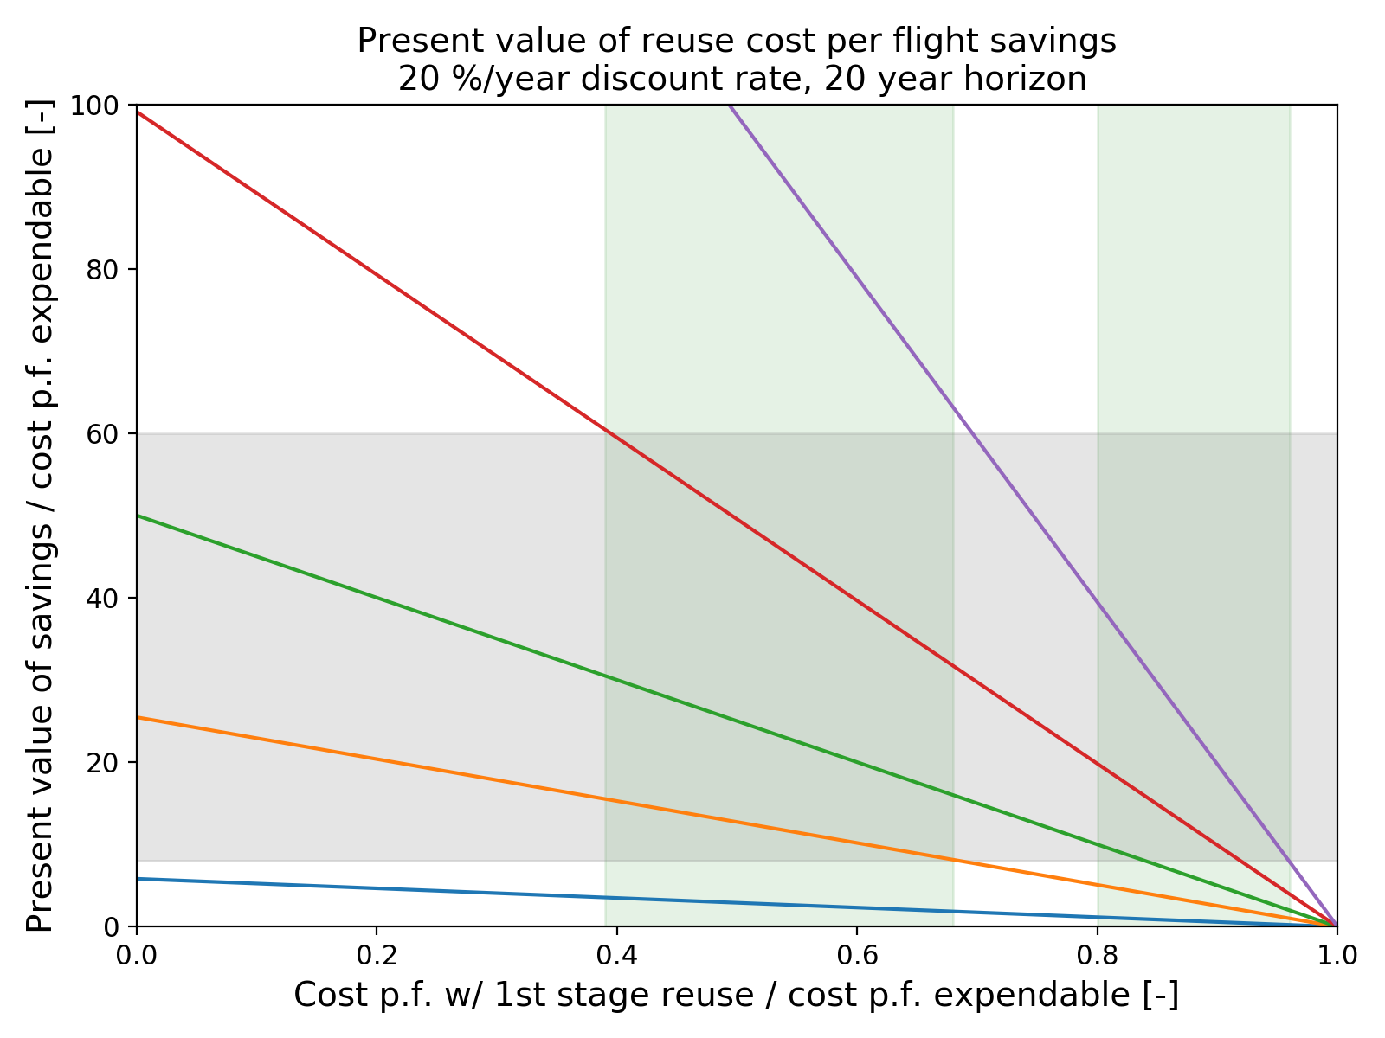
Credible range
of c.p.f. ratio:
Medium-Heavy
Credible range
of c.p.f. ratio:
Small
40 launches / year
20 launches / year
Credible range
of dev costs
10 launches / year
5 launches / year
1 launch / year

